Slide 1

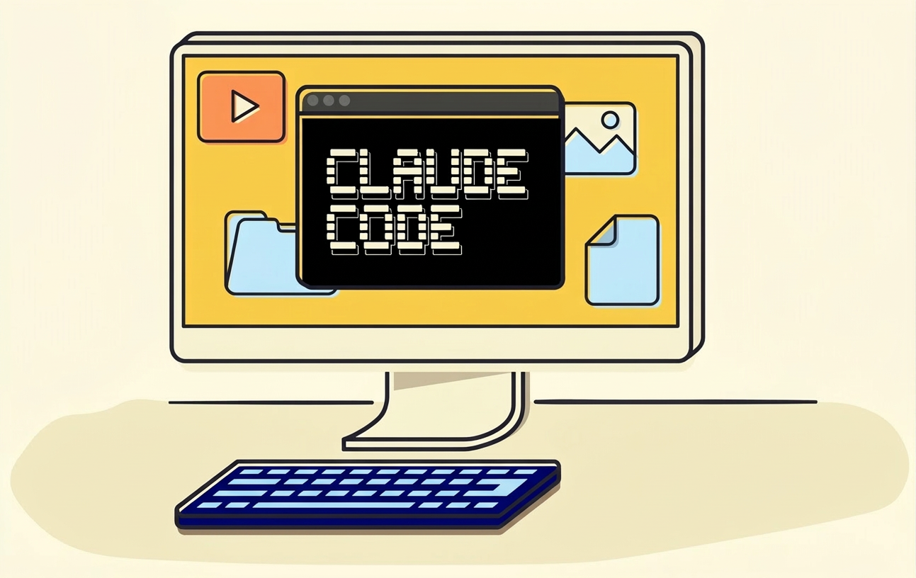
→
Claude Code for Business
Turn AI from chat into a repeatable operating system for marketing teams
Samy Chouaf

Slide 2


Chat apps help. Operating systems compound.
The difference is whether the work survives the session.
Chat app
AI operating system
What usually happens
What the system changes
→
One-off prompts with no durable workflow
Reusable workflows for recurring tasks
Context gets rebuilt every time
Shared context across the whole team
Manual copy/paste between tools
Outputs tied to business jobs to be done

Slide 3



What Claude Code unlocks for business
Three leverage points that matter to a marketing team.
Speed
Consistency
Leverage
Turn repetitive work into a faster, repeatable flow so campaigns move sooner.
Keep the same context, prompts, and quality bars across the whole team.
Reuse one well-built workflow many times instead of starting from scratch.

Slide 4



Practical marketing workflows
Start with work that repeats every week.
1
2
3
Campaign planning
Content repurposing
Reporting loops
Draft launch plans, briefs, and asset outlines from a single team prompt.
Turn one source into posts, emails, hooks, and summaries without re-starting.
Summarize performance, spot patterns, and prepare the next review faster.

Slide 5
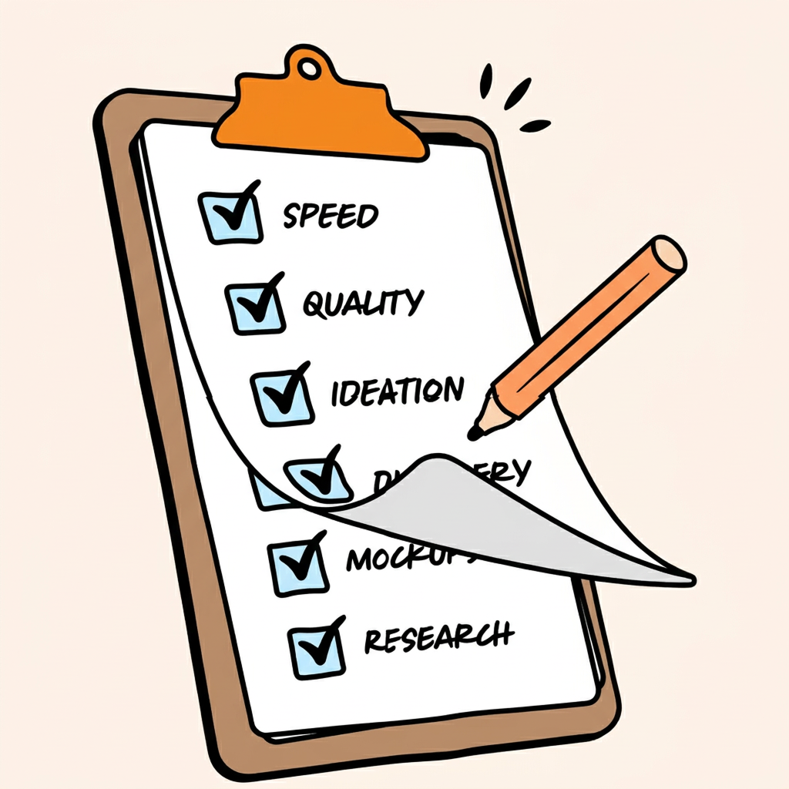
How to roll it out
Start small, then standardize, then measure.
1
1. Pick one repeatable workflow
Measure
Start with a weekly task such as campaign briefs, repurposing, or reporting.
2. Turn it into a team standard
What to watch
2
Package the context, prompts, and checks so anyone can run it the same way.
Cycle time
3
3. Tie it to business metrics
Output volume
Track cycle time, output volume, and rework to prove the system is working.
Reuse rate
Track the system, not the prompts

Slide 6
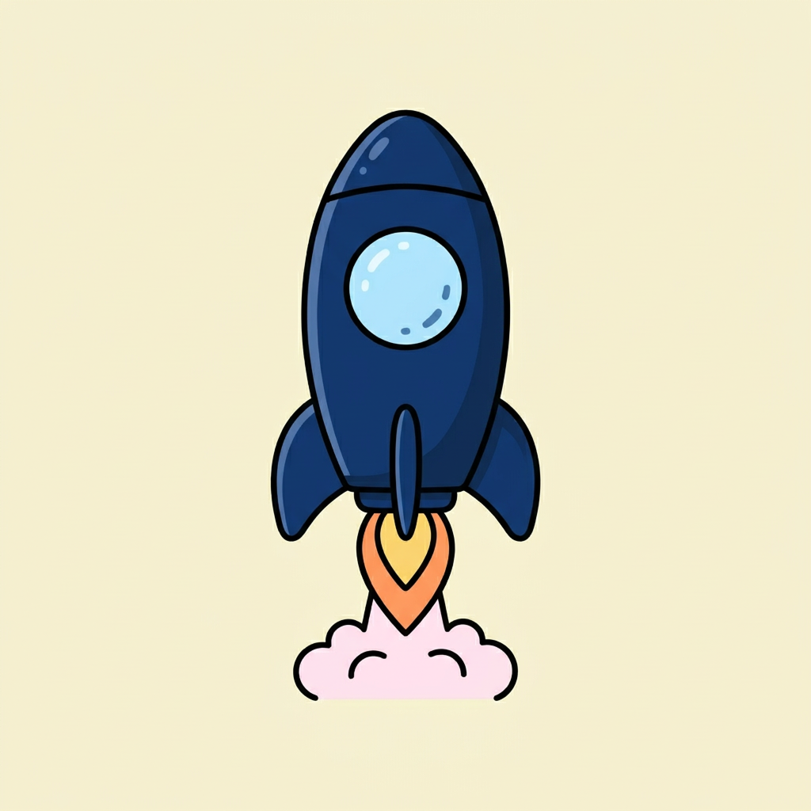
The goal is leverage, not just answers.
If Claude Code is in the workflow, the workflow can be repeated, delegated, and scaled.
Start with one marketing task this week
Samy Chouaf

