Slide 1
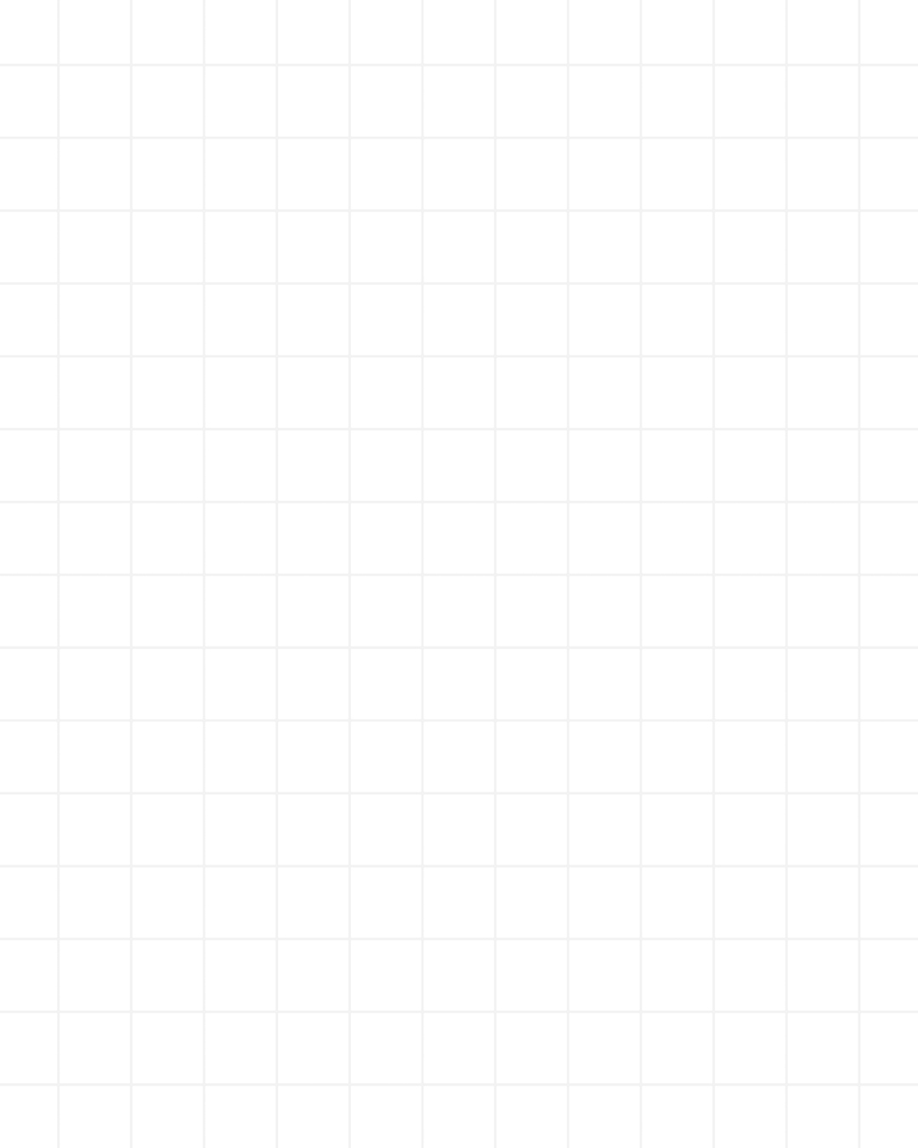
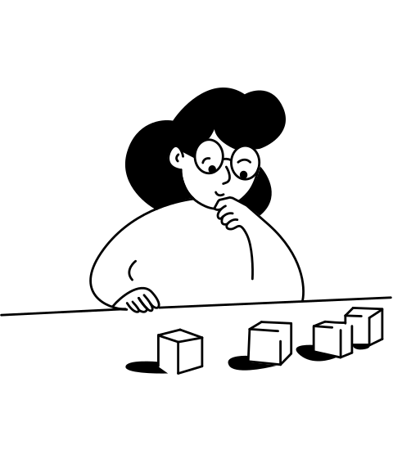
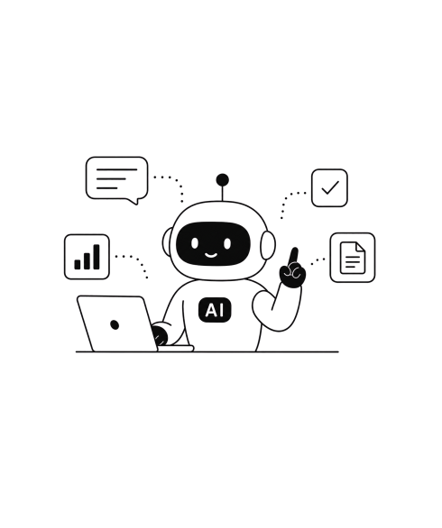
→
Human creator
AI design agent

Slide 2

PART 1
How to build your design system

Slide 3

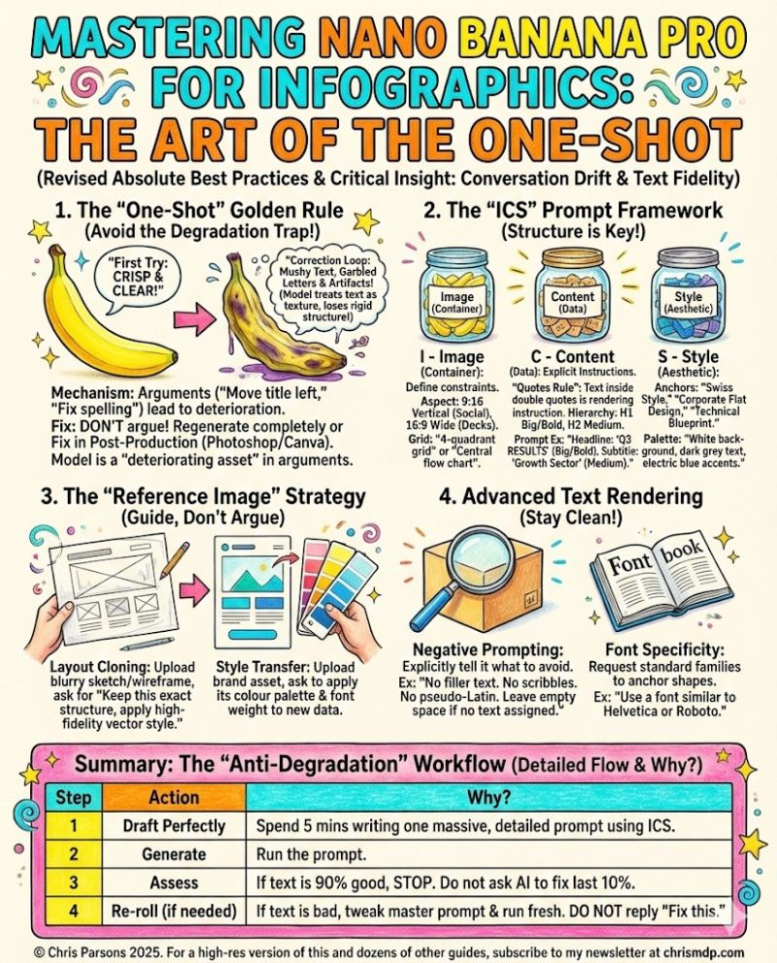
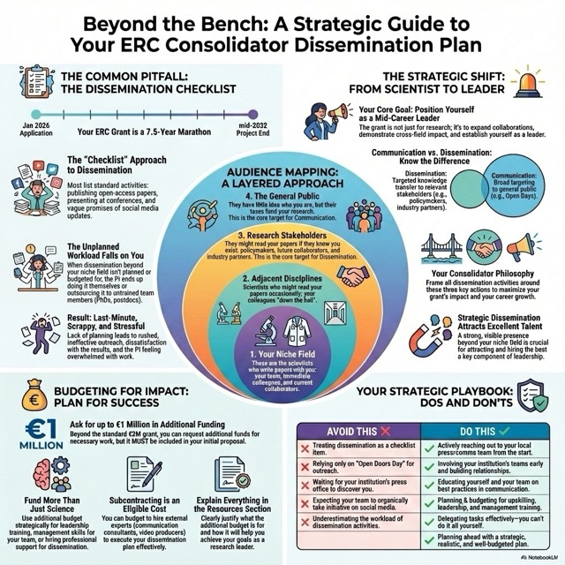
You really don't want that for your brand
AI slop: inconsistent, generic, off-brand
AI slop: inconsistent, generic, off-brand

Slide 4

PART 2
Design your first templates

Slide 5






Social Media Asset Size Guide
Carousel
Infographic
Slides
1080 × 1350
1080 × 1350
1920 × 1080
LinkedIn
PDF carousel pages
Tall feed infographic
16:9 video / webinar
1080 × 1350
1080 × 1350
1920 × 1080
Instagram
Portrait carousel
Feed infographic
Reel cover / story frame
1280 × 720
1080 × 1080
1920 × 1080
YouTube
Thumbnail sequence
Community visual
Presentation / video

