Slide 1

Your School Is One Click Away

Slide 2
ISSUES IN THE FIELD OF EDUCATION
Paperwork
Traceability
Accessibility and Availability
Analysis and monitoring

Slide 3
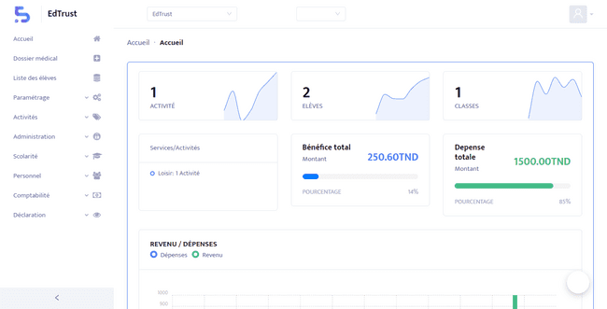
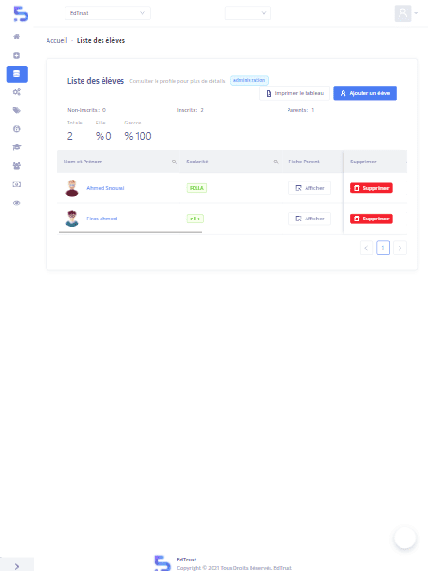

SOLUTIONS
Suite of multi-platform tools, allowing both to manage the school, to educate in hybrid, to follow the evolution of your children

Slide 4

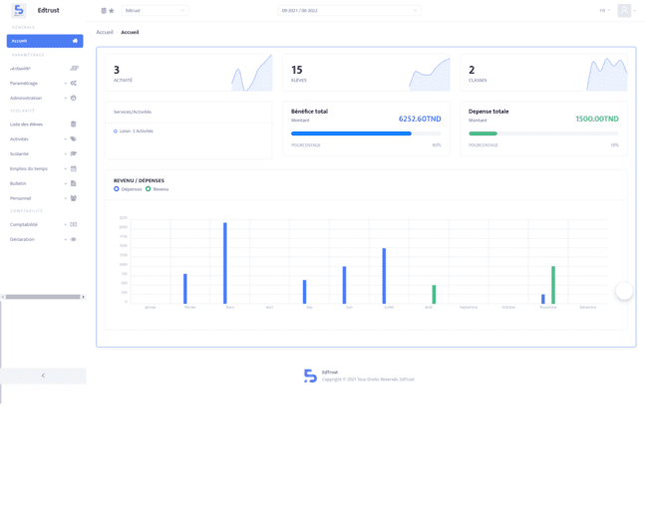
ED-MANAGER
(Web solution dedicated to administration)
SOLUTIONS
Managing the school with ZERO paper
Archiving and traceability of data
Dynamic and intelligent reporting
Decision Support System

Slide 5
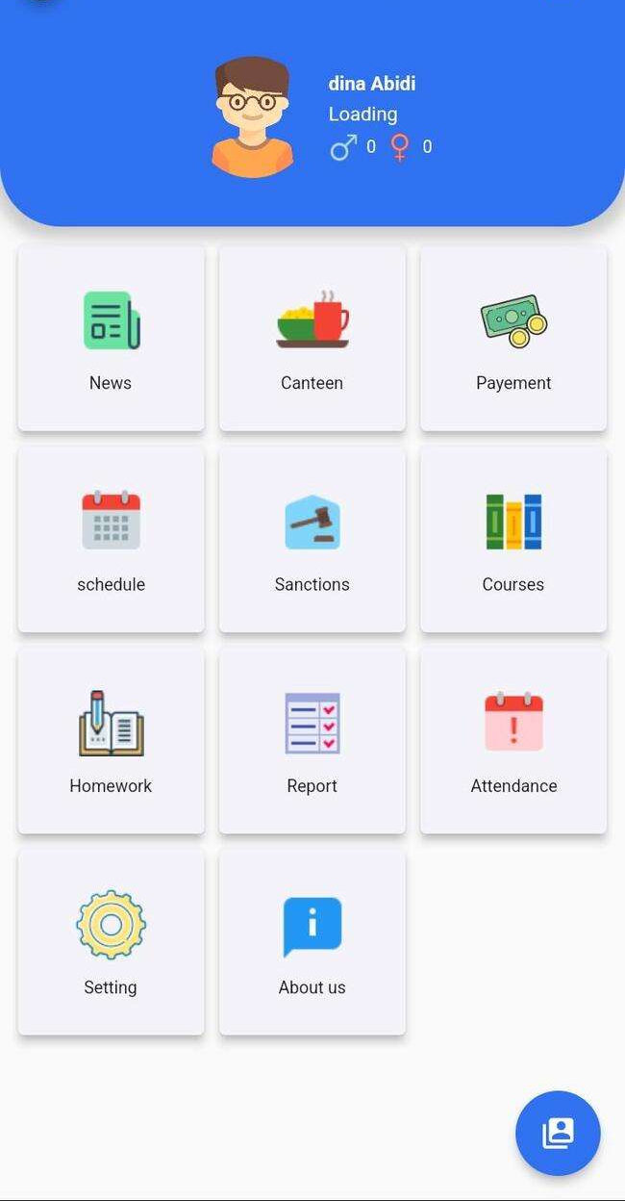

ED-PARENT
(Web & mobile solution dedicated to parents)
SOLUTIONS
Follow-up of the student within the school
Real-time alerts and notifications
Direct communication with the educational staff

Slide 6
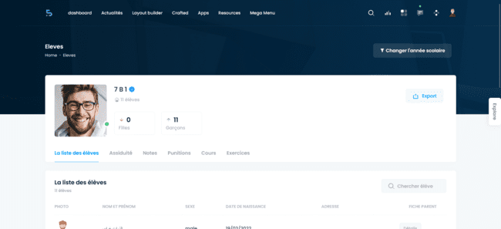
ED-LEARNING
(Web & mobile solution dedicated to teachers and students)
SOLUTIONS
Virtual classes
Exchange of exercises and Quiz
Automatic scheduling of online classes
Communication between students and teachers

Slide 7
BUSINESS MODEL
Ed Go
Ed Plus
Ed Pro
$0.99 / Student / Month
$1.5 / Student / Month
$1.99 / Student / Month
Administrative features
Unlimited admin accounts
All data is exportable
Pedagogical features
Unlimited admin accounts
All data is exportable
All features
Unlimited admin accounts
All data is exportable
1000 SMS for free
All offers include 2 free months
1 free training session
1 hour of additional training: 30 $
5000 SMS: 100 $
File storage limit: 2 GB.
They can purchase additional storage upon request.
In house database hosting: 300 $ / Year
Data implementation: 40 $ P/D

Slide 8
TRACTION
40
10
3
10k
600%
300%
100k $
PRIVATE PRIMARY SCHOOL
PRIVATE HIGH SCHOOL
TRAINING CENTER
STUDENTS ENROLLED
GROWTH IN STUDENT NUMBER
2022 - 2024
TURNOVER GROWTH
Q1 2022 – Q1 2024
FUND RAISED

Slide 9









COMPETITION
Personalization
User Experience

Slide 10
ROADMAP
Q3 2024
Q3 2025
Q4 2025
Increase Market Reach in Tunisia
Expand Market Reach in Africa
Develop and Launch E-School
Strengthen the sales team by recruiting new agents
Targeted marketing campaign
Partnerships with local institutions
Launch of B2C services targeting parents and teachers
Market research in target countries
Strategic partnerships for market entry
Make the necessary adaptations so that our solutions adapt to new markets
Tailored marketing for targeted countries
Raise funds
Beta testing and adjustments
Official launch with marketing blitz
Continuous improvement and metrics tracking
Strengthen the development team
Upgrade our technical infrastructure

Slide 11



Rwanda
GO-TO-MARKET
Literacy rate : 73%
EdTech market size : Growing
GDP : 13B
Number of children > 15 YO : 5.2M
Competition: Fair
Government focus on education development and digital transformation
Literacy rate : 82%
EdTech market size : Growing
GDP : 113B
Number of children > 15 YO : 20.3M
Competition: Fair – Strong
Vibrant education sector with diverse opportunities
Literacy rate : 77%
EdTech market size : Growing
GDP : 131B
Number of children > 15 YO : 9.9M
Competition: Fair
Favorable business environment for startups and technology companies
Kenya
Morocco

Slide 12
FUNDING REQUEST
350K $
R&D
Marketing and sales
150K $
WE ASK FOR
13K $
50K $
137K $
Team expansion
Servers and infrastructure

Slide 13
















TEAM
Ahmed MAALEJ
CEO & CO-FOUNDER
Firas DHAOUADI
CPO & CO-FOUNDER
Ahmed SNOUSSI
CTO & CO-FOUNDER
Iheb MEFTAH
Mobile Developer
Thamer AYACHI
Full-Stack Web Developer
Haithem TURKI
Full-Stack Web Developer
Ilyes HRISSI
QA Engineer
Mayssa MAY
QA Engineer
Ela ZELFANI
UI-UX Designer
Meriem ZHIOUA
Graphic Designer
Habib Mansour
Marketing Manager
Aymen JABALLAH
Sales And Support Representative
Nessrine CHOURA
Customer Support Associate
Lamia JOUINI
Advisor
Mohamed ATTIAOUI
Investor
Former Sales Manager At Zen Home
Co-Founder OnePack
Bachelor In Computer Sciences
+33 Years Experience
In Digital Pedagogy At CNTE
+11 Years As Director Of Private Schools
Former Math Teacher
Former CEO At OnePack
Co-Founder OnePack
+7 Years As Web Developer
+2 Years As Technical Support
Cybersecurity Expert
Bachelor In Cybersecurity
Former CTO At OnePack
+5 Years As Web Developer
Bachelor In Computer Sciences
Engineer In Business Intelligence
Douja GHARBI
Investor
Awatef ADLET
Investor
CEO RedStart Tunisie
Lamia SASSI
Investor
Imen BEN JMIAA
Investor

Slide 14




THANK YOU FOR YOUR ATTENTION !
ANY QUESTIONS ?
Site : www.edtrust.tn
Email : contact@edtrust.tn
Tel : +216 52 588 822

