Slide 1
Air Fla r
10127
- Ahmed Helmy
- Islam Essam
- Khalid Yasser
- Samy Mohamed

Slide 2
Table of contents
01
02
03
04
05
06
Problem
Solution
Location
The challenge to be solved.
The best determined solution for the problem.
The determined location for the project.
Design
Materials
Mechanism
The dimensions and estimated results.
The materials for building the parts.
The system of generating the electricity.

Slide 3
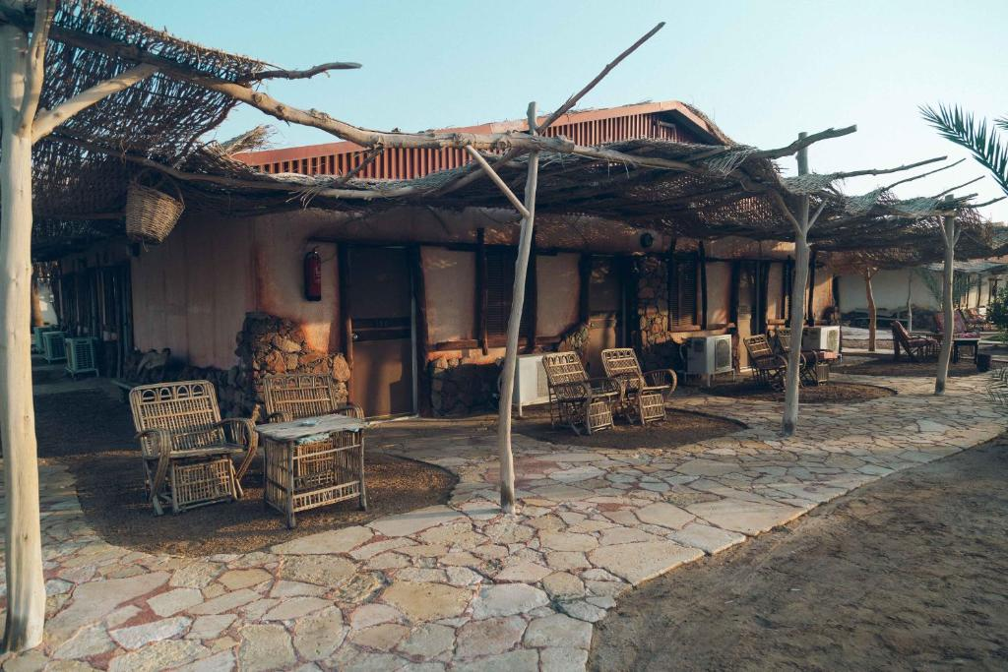
Problem
01

Slide 4
Reducing power shortage at Al-Sayadeen
Power shortages
Environmental problems

Slide 5
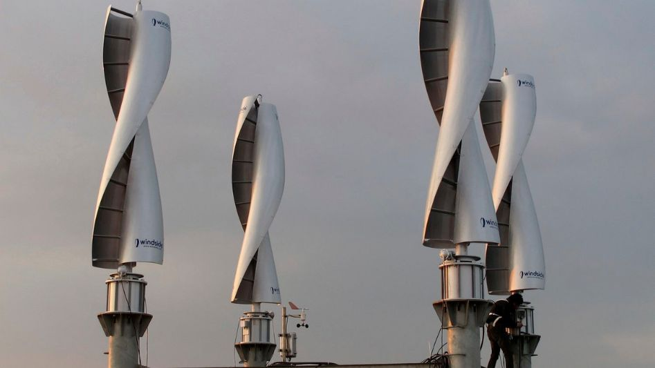
Solution
02

Slide 6
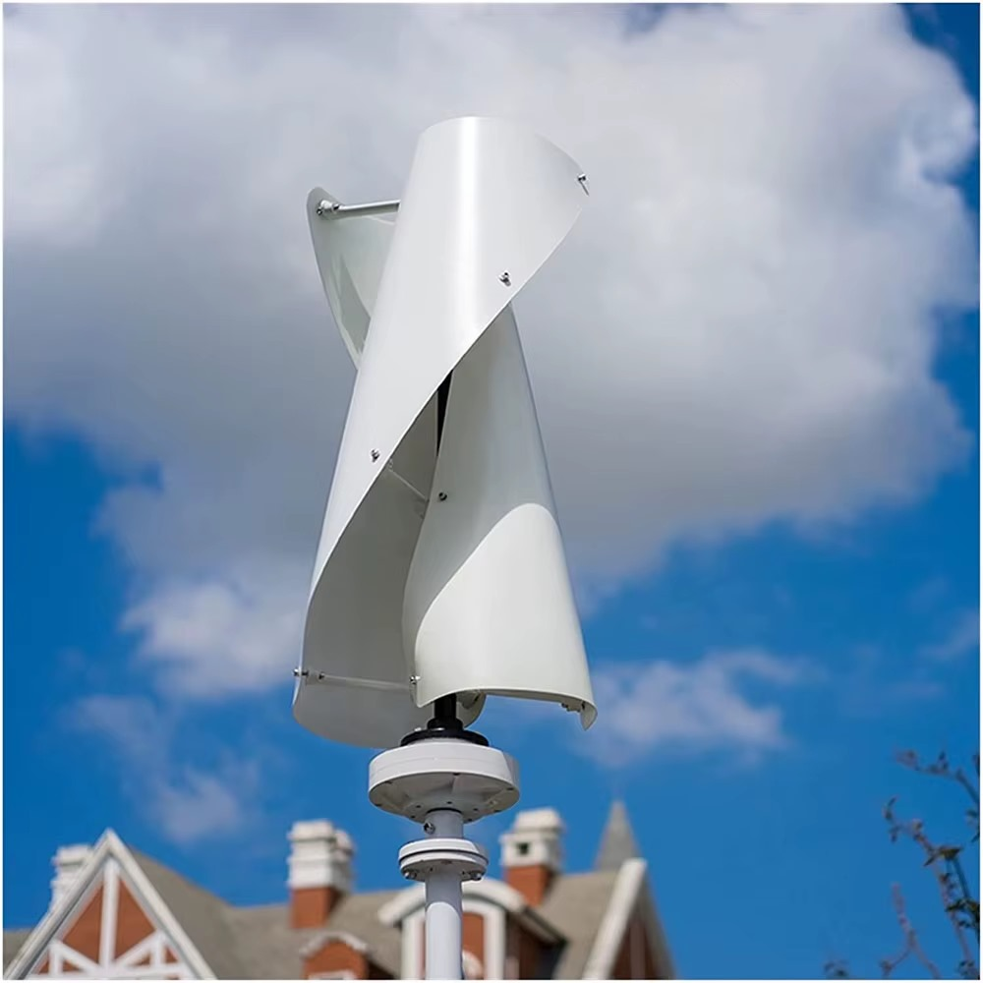
Double-helix VAWT
01
02
03
Omni-directional
Self starting
durabillity

Slide 7
03
Location

Slide 8
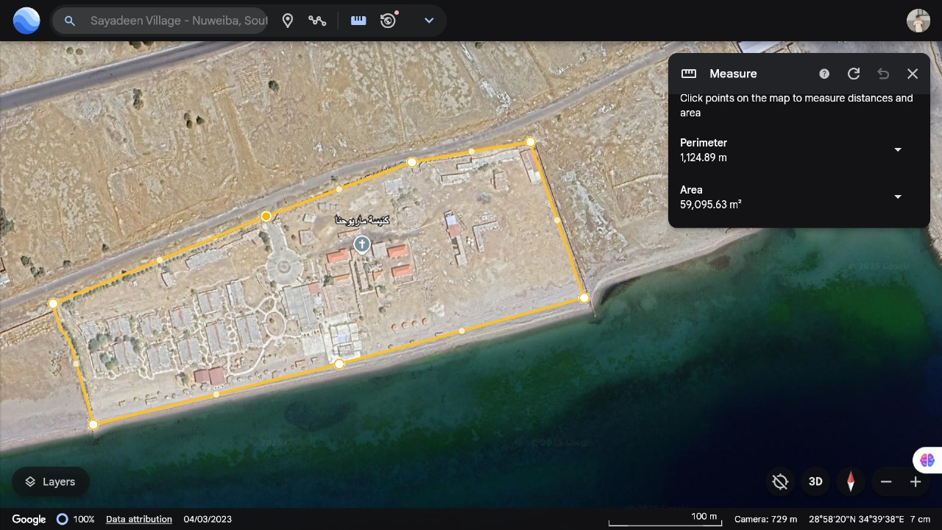
Red sea coast, Nuwibaa, Al-Sayadeen village.

Slide 9
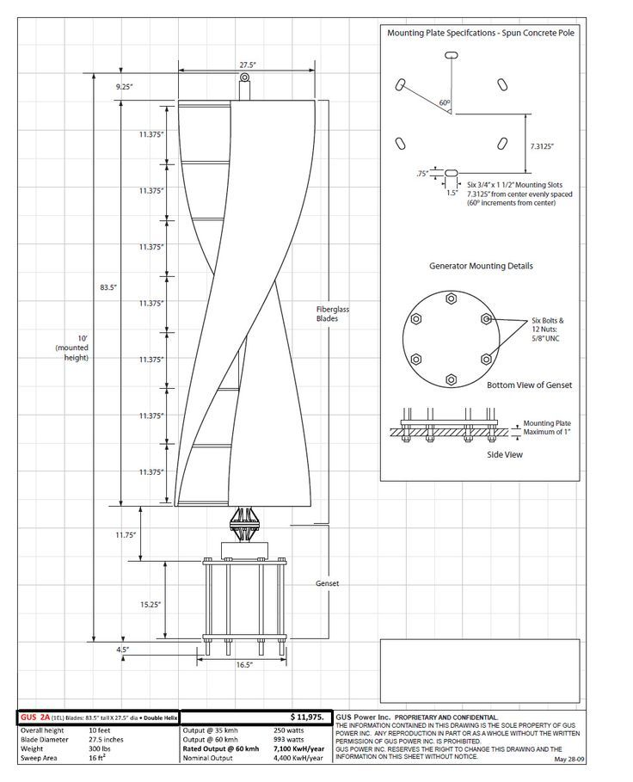
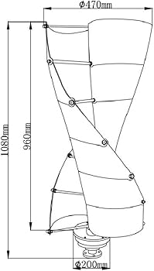
Design & estimated results
04

Slide 10
Dimensions | Estimated results
Height : 0.8 M | Power : 1.44 W/S
Blade width : 0.2 M | Rotational speed : 6 R/S
Total width : 0.45 M | RPM : 57,2
Aspect ration : 4 | TSR : 1.5
Swept area : 0.45 M^2
Twist angle : 180*

Slide 11
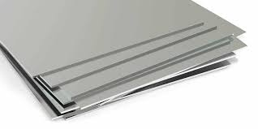
Materials
05

Slide 12
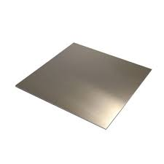
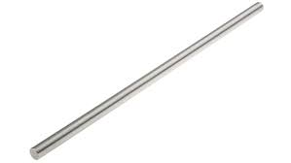
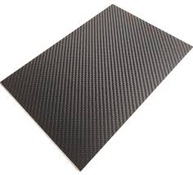
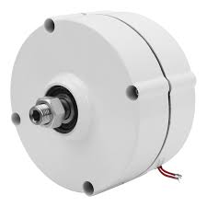
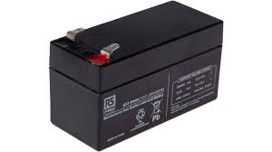
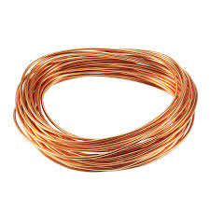
Materials

Slide 13
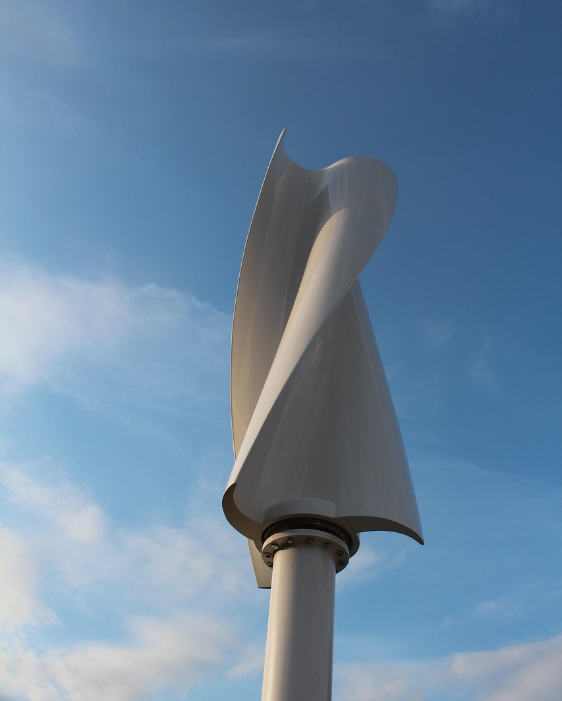
Mechanism
06

Slide 14
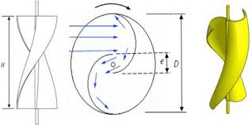
Drag-based wind turbines
Drag force
Air flow

Slide 15
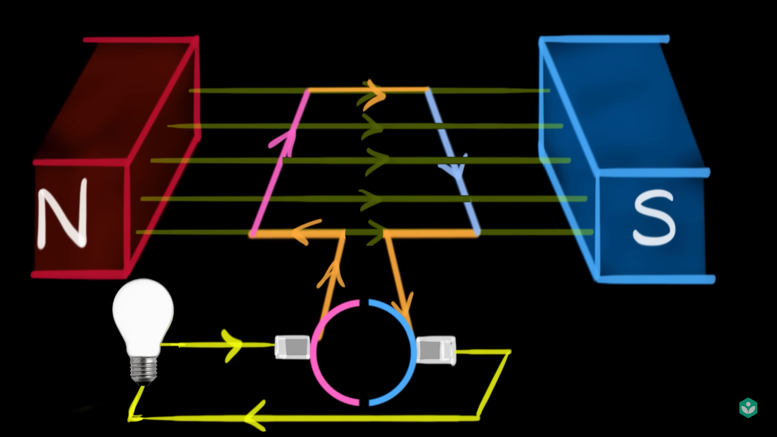
Dynamo
Details
Right-hand rule
Current direction

Slide 16
Circuit
Main shaft
Dynamo
Consumer
Rotor
Rechargeable battery

Slide 17
Thanks!

