Slide 1

Pharmacist
Graduation project
Sci asu 2025

Slide 2
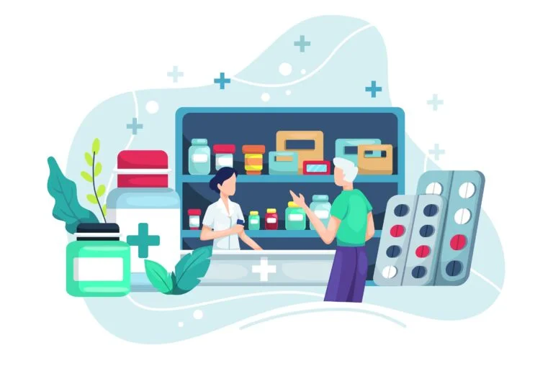
project members:
1- Abdelrhman Taha Saad Taha (CS/PHYS).
2- Yehya Fadl Ali Fadl (CS/PHYS).
3- Samy Mohamed Samy Shoukry (CS/PHYS).
4- Ahmed Anter Sayed Awad (CS/STAT).

Slide 3

Project Name
pharmacist

Slide 4
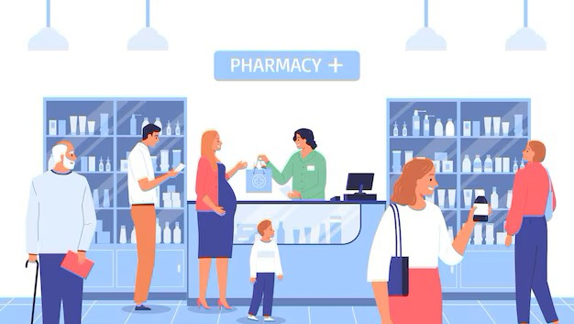
introduction
From project name it’s going for medical usage like getting medicine online know information about medical products, thermos, hair care, skin care, medicines etc..., the new idea we added here is the exchange products whatever they are between users the idea is easing finding the non-major products like the imported products and that ones are very expensive
Also ease the way for people who want to donate for their products, there is the ability to buy online by adding your online card, as there is a feature to buy more than one product at a time by adding products in your shopping card

Slide 5

Problem & Solution
Problem: The main problem that the project gets solution is to ease the way of finding rare medicines and products.
Solution: the feature of exchanging the products between the users.

Slide 6
Objectives
Ease the way of finding products.
Buying online products.
Increase the donations for helping people.
Exchange products.
Khow more information about medicine and help users to take care of their health.
The website has acceptable information about skin care and it’s products, hair care and baby’s Shambu.

Slide 7
Project Scope
This project responsible for medical products , information and knowing more about medicine, it’s price and how to use it, donate it and sell if someone wanted that.

