Slide 1

Pharmacist
Graduation project
Sci asu 2025

Slide 2

Project Name
pharmacist

Slide 3
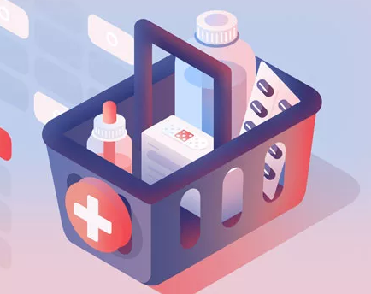
Supervisor
Dr: Ghada
Supervisor for project pharmacist SCI ASU 2025.

Slide 4
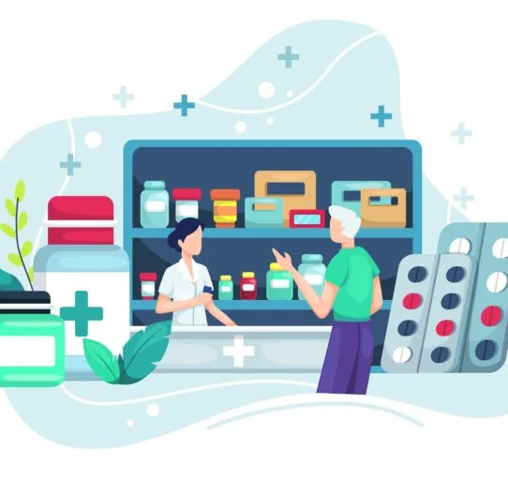
project members:
1- Abdelrhman Taha Saad Taha (CS/PHYS).
2- Yehya Fadl Ali Fadl (CS/PHYS).
3- Samy Mohamed Samy Shoukry (CS/PHYS).
4- Ahmed Anter Sayed Awad (CS/STAT).

Slide 5

introduction
From project name it’s going for medical usage like getting medicine online know information about medical products, thermos, hair care, skin care, medicines etc..., the new idea we added here is the exchange products whatever they are between users the idea is easing finding the non-major products like the imported products and that ones are very expensive
Also ease the way for people who want to donate for their products, there is the ability to buy online by adding your online card, as there is a feature to buy more than one product at a time by adding products in your shopping card

Slide 6

Problem & Solution
Problem: The main problem that the project gets solution is to ease the way of finding rare medicines and products.
Solution: the feature of exchanging the products between the users.

Slide 7

Project Scope
This project responsible for medical products , information and knowing more about medicine, it’s price and how to use it, donate it and sell if someone wanted that.

Slide 8

Objectives
Ease the way of finding products.
Buying online products.
Increase the donations for helping people.
Exchange products.
Khow more information about medicine and help users to take care of their health.
The website has acceptable information about skin care and it’s products, hair care and baby’s Shambu.

Slide 9
High-Level Use Cases
1-Sign up/Sign in.
2-Searching for products.
3- Online shopping ” getting the medicines and all other products online ”
4- The ability of adding products for donation or exchanging them.
5-reviewing all requests.

Slide 10

Task Management
1- Figma usage for designing the UI/UX of the project
2- Html , CSS , Java Script , React for project front end .
3- Node.js , next ,firebase,

Slide 11

Pitfalls & Lessons Learned
1- it’s not so easy for finding a suitable appointment for members to discus about project details.
2-knowing about medical products and skin care products we need as a data for our project.
3- imagination of how to make our project suitable and look so awesome which make us changing the front-end of the project which took long time from us .

Slide 12

We want to thank our supervisor who helped us all the semester also the evaluation committee for hearing us , we appreciate your time and attention and we look forward to your feedback and suggestions.

