Slide 1

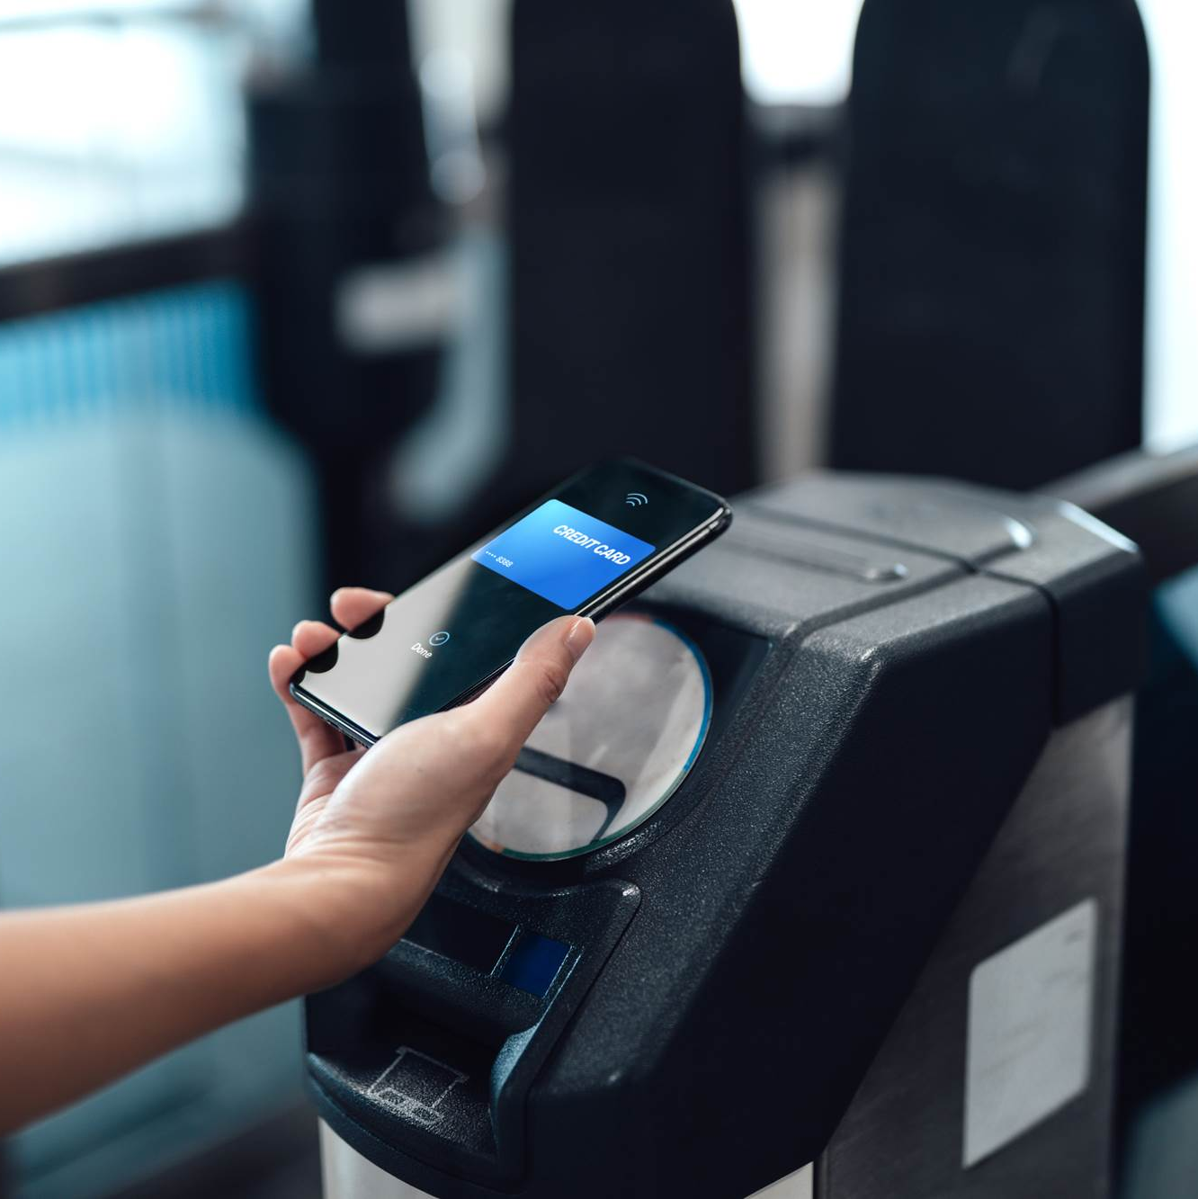

Project Cospace Blueprint.

Slide 2
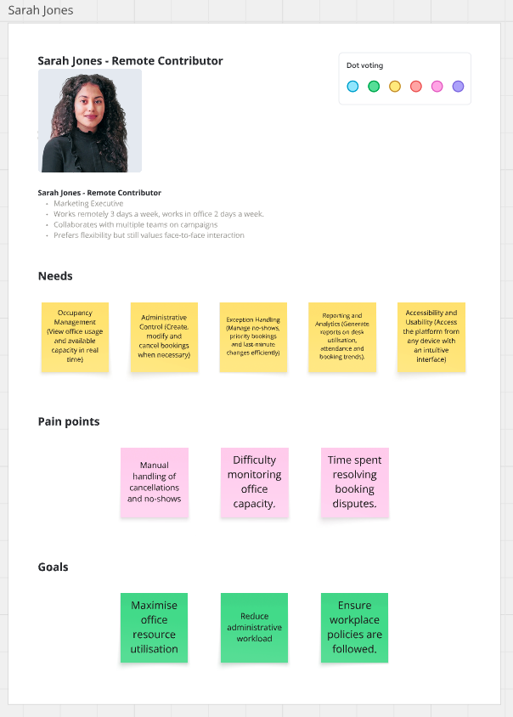
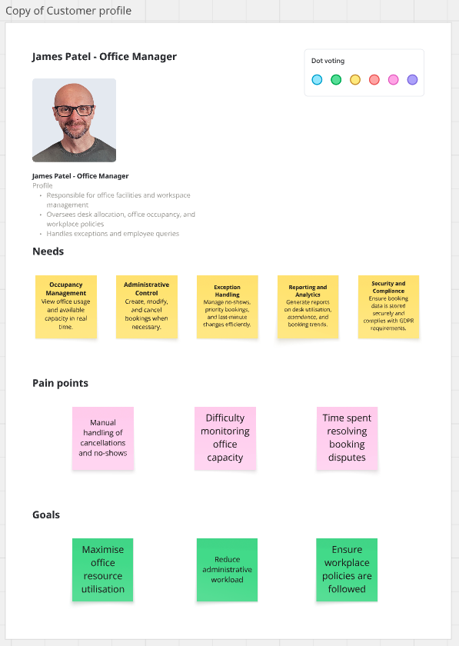
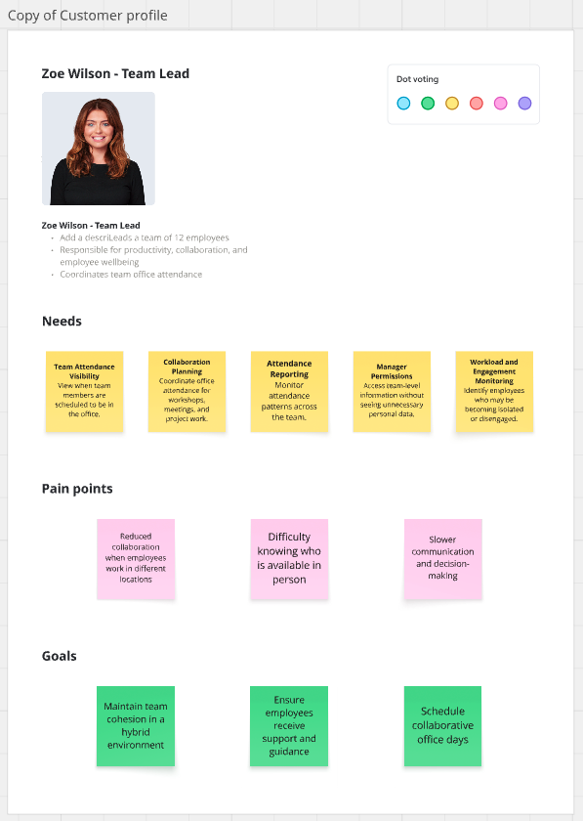
User Profiles

Slide 3
Business goals
Business Goal | UK Legal Constraints | Financial Constraints | Technical Constraints
Reduce double-bookings and manual spreadsheet admin | Booking data linked to named employees is personal data, so handling must comply with UK GDPR and the Data Protection Act 2018. Access to booking details should be role-based. | Admin time is already being wasted resolving clashes manually, so the solution should reduce the workload rather than create more admin work. | Must fit the agreed stack: Express + TypeScript API, Next.js frontend, MySQL + Prisma, Zod, JWT auth.
Make office attendance more predictable and worthwhile for colleagues | BrightMedia should avoid exposing more employee attendance information than necessary. Visibility of who the booking belongs to should be limited appropriately. | BrightMedia has 200 employees but only 80 desks, so the system must help people plan ahead without increasing physical office costs. | Availability data must be accurate and up to date; the API and UI need to support reliable desk availability checks and booking creation/cancellation.
Improve use of reduced office space after moving to hybrid working | Any reporting on attendance or desk usage must still respect privacy principles such as data minimisation and appropriate access control. | The company has already reduced office space, so the business goal is to make better use of existing desks rather than pay for more space. | The system must support the existing domain model and conventions already agreed for the Booking, User, and Desk tables.
Support fairness, accessibility, and trust in the booking process | The system should support accessibility expectations and avoid disadvantaging users with additional needs; this aligns with UK accessibility and equality expectations in workplace systems. | A poor booking experience could reduce office attendance value and harm collaboration, which creates hidden productivity costs even if no new spend is required. | Frontend must follow the agreed accessibility conventions: labelled inputs, proper buttons, table headers, dialog behaviour, keyboard support, and announced validation errors.
Deliver a secure, maintainable internal product that can be reviewed and extended | Authentication, personal data handling, and auditability need to be designed carefully to reduce security and compliance risk. Passwords must never be stored in plain text. | Budget and delivery capacity are limited, so the team should prioritise the desk booking MVP before expanding further. | The whole academy builds into the same two repositories, so changes must follow branch, commit, PR, testing, environment, logging, and pagination conventions already defined.

Slide 4
Core User Stories
Acceptance Criteria
Given I am signed in, when I select a valid date, then I see a list of desks for that date.
Given a desk has no active booking for the selected date, when the list is shown, then that desk is marked as available.
Given a desk already has an active booking for the selected date, when the list is shown, then that desk is marked as unavailable.
Given I change the selected date, when the list refreshes, then I see availability for the newly selected date.
Scenario 1 – View Available Desks
As an employee, I want to see which desks are available on a selected date so that I can decide whether to come into the office.
Edge Cases
All desks have been booked for the selected date. - Should display a message saying "No desks are available".
The desk becomes unavailable while booking. - The booking should fail and availability should update.
The employee selects a date in the past. - The system should prevent the booking or display an appropriate message.

Slide 5
Core User Stories
Acceptance Criteria
Given I am signed in and view desk availability for a date, when I choose an available desk and submit the booking, then a new booking is created for that desk and date
Given my booking is created successfully, when the system responds, then I receive the confirmation that the booking has been made.
Given I have successfully booked a desk, when I view my bookings, then the new booking appears in my list.
Given I have successfully booked a desk, when another colleague views availability for that same date, then the desk is shown as unavailable.
Scenario 2- Booking a desk
As an employee, I want to book an available desk for a specific date so that I have a guaranteed place to work in the office.
Edge Cases
Employee tries to book a date in the past- the date is rejected
Employee tries to put date in the wrong format- there will be a date-time picker.
The user sees a desk as available, but another user books it before they submit- the create request should fail cleanly rather than relying only on the UI state.
User tries to book 2 desks on the same day- the create request should fail

Slide 6
Core User Stories
Acceptance Criteria
Given a desk already has an active booking for a selected date, when I try to book that same desk for that same date, then the booking is rejected.
Given the booking is rejected because the desk is already taken, when the system responds, then I see a clear error message explaining that the desk is unavailable.
Given a failed booking attempt for an already booked desk, when I return to the availability view, then the desk still appears as unavailable.
Given a desk is booked on one date, when I book that same desk on a different date, then the booking is allowed.
Scenario 3 – Preventing Double-Booking
As an employee, I want to be prevented from booking a desk that is already taken for the selected date, so that I can trust the booking system is accurate.
Edge Cases
Two employees attempt to book a desk at exactly the same time. - Only one booking succeeds.
An employee changes their existing booking to a desk that has just been booked by someone else. - The update is rejected and the original booking remains the same
An employee enters or selects a date incorrectly. - The date should be rejected.

Slide 7
Core User Stories
Acceptance Criteria
Given I am signed in, when I open my bookings page, then I see a list of my bookings only.
Given I have active bookings, when the list is displayed, then each booking shows the desk, floor, date, and active status.
Given I have no bookings, when I open my bookings page, then I see an empty state message instead of a blank page or error.
Given I have cancelled a booking, when I view my bookings, then that booking is not shown as active.
Scenario 4 – View My Bookings
As an employee, I want to see my current and upcoming desk bookings so that I can keep track of when I am expected in the office.
Edge Cases
The employee has a booking is for the current day. - It should still appear in upcoming bookings until the day is over.
A booked desk is removed from the system. - The employee should be notified.
The employee has bookings in the past but none in the future. - Past bookings should not appear and they should be informed that they have no upcoming bookings.

Slide 8
Core User Stories
Acceptance Criteria
Given I am signed in and have an active booking, when I choose to cancel that booking, then the booking is marked as inactive.
Given my booking has been cancelled, when the system responds, then I receive confirmation that the cancellation succeeded.
Given a booking has been cancelled, when desk availability is viewed for that date, then the desk is shown as available again.
Given I try to cancel a booking that does not belong to me, when the request is made, then the action is rejected.
Scenario 5 – Cancel a Booking
As an employee, I want to cancel a desk booking I no longer need so that the desk becomes available for someone else.
Edge Cases
The booking does not exist. - The system should display an error message and make no changes.
The booking is in the past. - The cancellation should be prevented.
An employee tries to cancel someone else's booking. - The cancellation should be prevented and access denied.

Slide 9
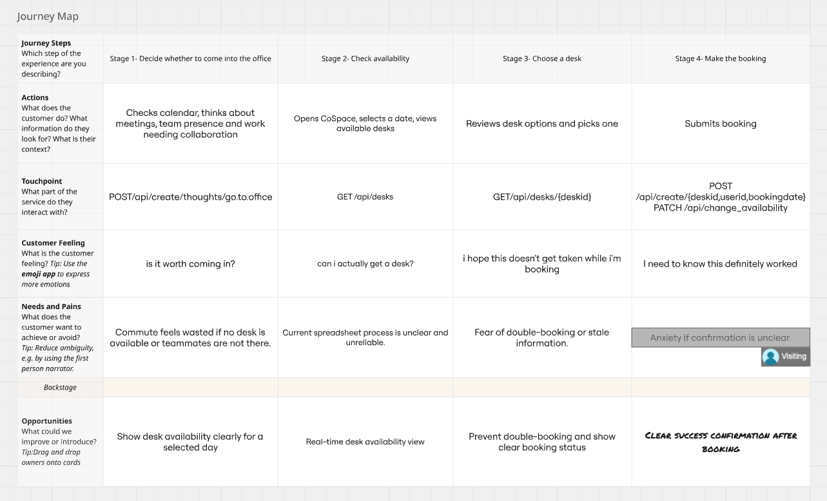

Slide 10
