Slide 1
CUTE 3: CSE 7305c METHODs & ALGORITHMS IN MACHINE LEARNING
BANKRUPTCY PREDICTION MODEL
BATCH 56
SAMYA MAITI
DIVYA M S
MIDHUN RAJAGOPAL

Slide 2
OVERVIEW
The given data contains details of various markers and financial ratios of entities. Target variable is whether the company got bankrupt in the subsequent years or not..
OBJECTIVE
Using the data build appropriate model to ascertain the bankruptcy of entity
APPROACH
DATA ANALYSIS
DATA
PRE-PROCESSING
PIPELINE BUILDING
MODEL BUILDING & EVALUATION

Slide 3
DATA ANALYSIS
Understanding the Data
65 Independent Attributes
ID | Attr1 | Attr2 | Attr3 | Attr4 | Attr5 | Attr6 | Attr7 | Attr8 | . | . | . | . | . | . | . | . | . | . | . | . | . | Attr63 | Attr64 | Target
int | float | float | float | float | float | float | float | float | float | float | float | float | float | float | float | float | float | float | float | float | float | float | float | int
. | . | . | . | . | . | . | . | . | . | . | . | . | . | . | . | . | . | . | . | . | . | . | . | 0
 | . | . | . | . | . | . | . | . | . | . | . | . | . | . | . | . | . | . | . | . | . | . | . | 0
. | . | . | . | . | . | . | . | . | . | . | . | . | . | . | . | . | . | . | . | . | . | . | . | .
 | . | . | . | . | . | . | . | . | . | . | . | . | . | . | . | . | . | . | . | . | . | . | . | .
. | . | . | . | . | . | . | . | . | . | . | . | . | . | . | . | . | . | . | . | . | . | . | . | 1
31283 Records
DATA ANALYSIS
DATA
PRE-PROCESSING
PIPELINE BUILDING
MODEL BUILDING & EVALUATION

Slide 4
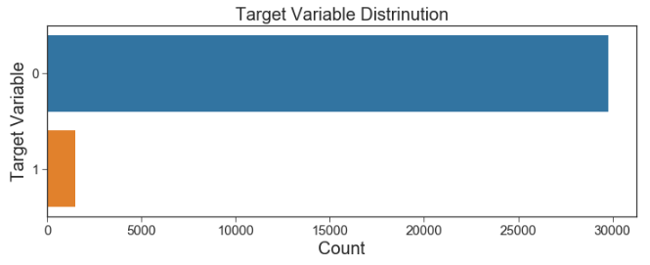
DATA ANALYSIS
Understanding the Data
Target Variable Distribution
Class Imbalance Observed
DATA ANALYSIS
DATA
PRE-PROCESSING
PIPELINE BUILDING
MODEL BUILDING & EVALUATION

Slide 5
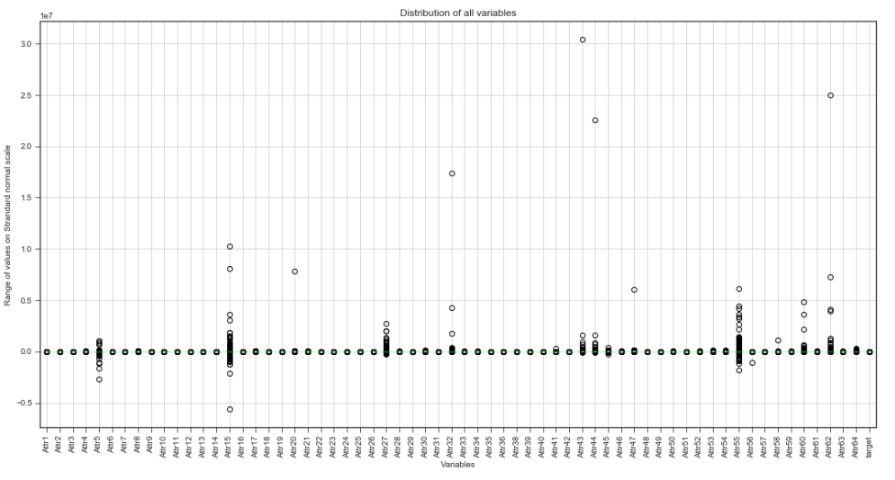
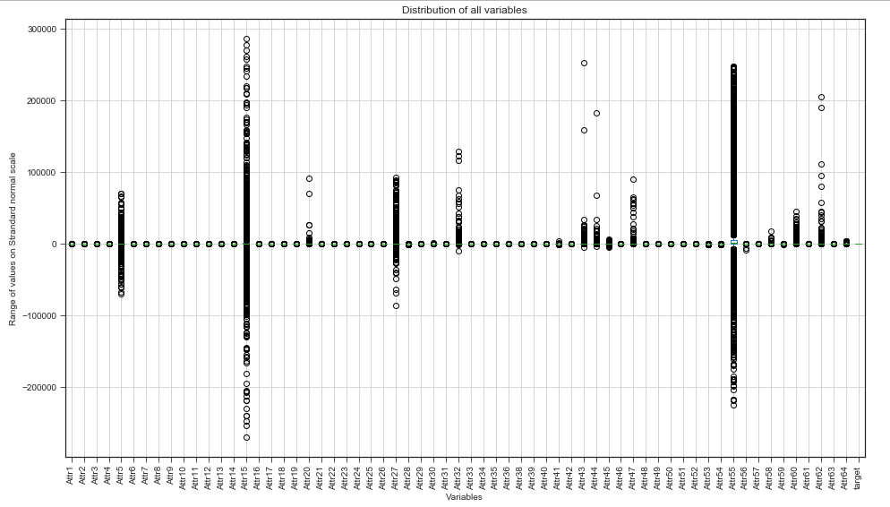
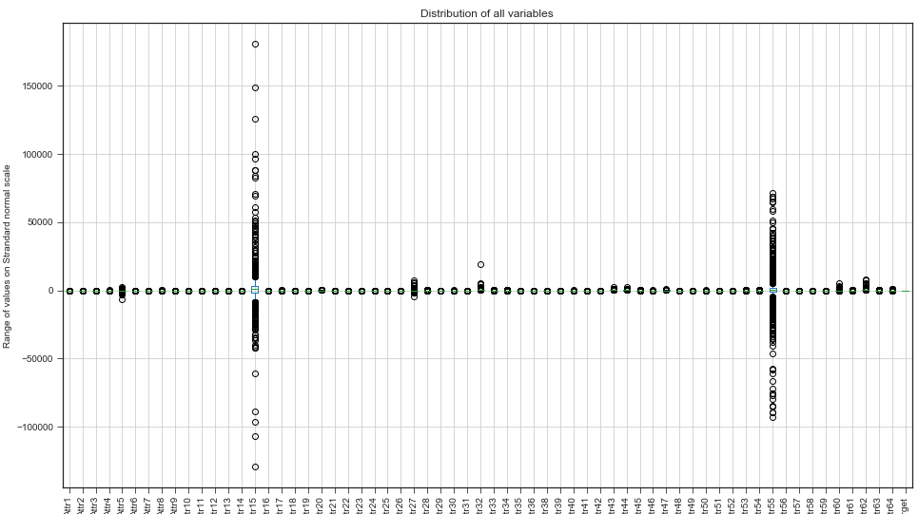
DATA ANALYSIS
Univariate Outlier Detection & Removal
Removal of data 3 S.D. away from mean (Based on Target)
Initial Variable Distribution
DATA ANALYSIS
DATA
PRE-PROCESSING
PIPELINE BUILDING
MODEL BUILDING & EVALUATION

Slide 6
DATA ANALYSIS
Multivariate Outlier Detection & Removal
Multivariate Outlier Detection
K-Means Clustering, Silhoutte Score for evaluation
Records with Target = 1
2 Clusters
4 Records Dropped
Records with Target = 0
No Clusters Formed
No Action Taken
DATA ANALYSIS
DATA
PRE-PROCESSING
PIPELINE BUILDING
MODEL BUILDING & EVALUATION

Slide 7
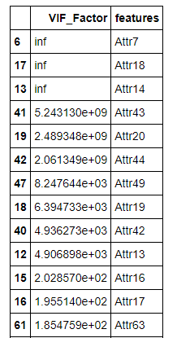
DATA ANALYSIS
VIF, Missing Values Analysis
Missing Values – Column wise
Missing Values – Row wise
Column | # NA | % NA
Attr37 | 13768 | 44%
Attr21 | 4251 | 13%
Attr27 | 2004 | 6%
Attr60 | 1570 | 5%
Attr45 | 1566 | 5%
Row | # NA | % NA
18126 | 27 | 67%
28366 | 21 | 49%
12074 | 20 | 46%
4126 | 19 | 44%
25377 | 19 | 44%
Rows & Columns having missing values above threshold can be removed
VIF Analysis & Removal
DATA ANALYSIS
DATA
PRE-PROCESSING
PIPELINE BUILDING
MODEL BUILDING & EVALUATION

Slide 8
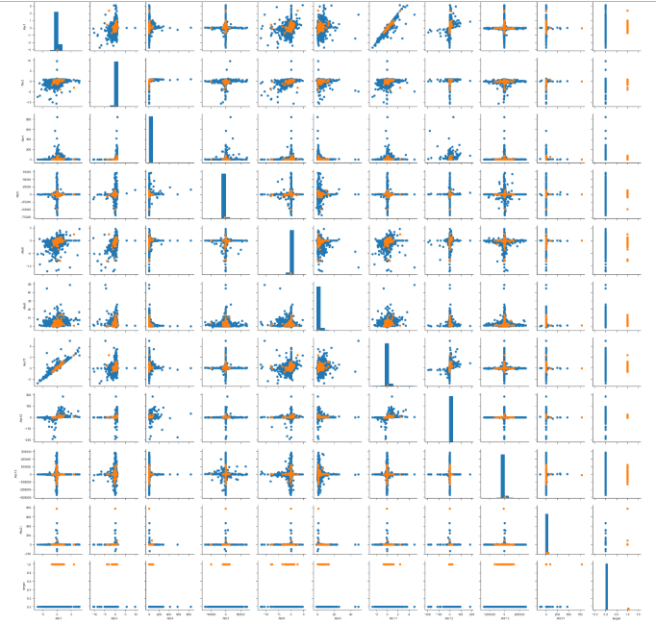
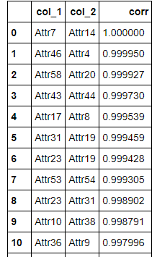
DATA ANALYSIS
Correlation Analysis
Pair-wise Distribution Analysis
DATA ANALYSIS
DATA
PRE-PROCESSING
PIPELINE BUILDING
MODEL BUILDING & EVALUATION

Slide 9
DATA PRE-PROCESSING
Columns & Rows with missing values exceeding threshold removed
ID Column dropped as the values as monotonically increasing
Univariate & Multivariate outliers identified and removed
Columns exceeding VIF threshold removed
TEST / TRAIN SPLIT >> 80 : 20
DATA ANALYSIS
DATA
PRE-PROCESSING
PIPELINE BUILDING
MODEL BUILDING & EVALUATION

Slide 10
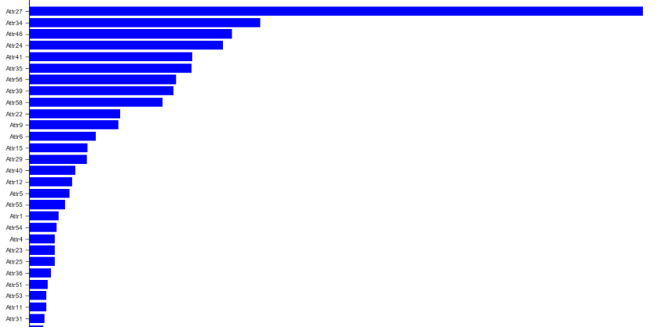
DATA PRE-PROCESSING
Feature Selection
Random Forest
RFE Ranking
DATA ANALYSIS
DATA
PRE-PROCESSING
PIPELINE BUILDING
MODEL BUILDING & EVALUATION

Slide 11
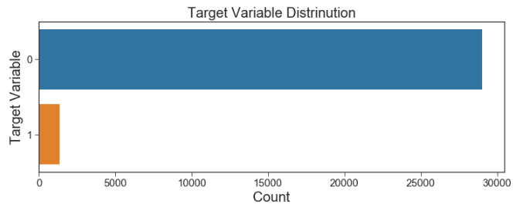
DATA PRE-PROCESSING
Target variable distribution in the dataset is maintained after pre-processing
Target Variable Distribution
DATA ANALYSIS
DATA
PRE-PROCESSING
PIPELINE BUILDING
MODEL BUILDING & EVALUATION

Slide 12
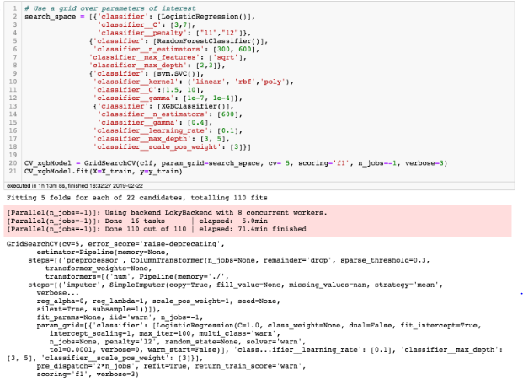
PIPELINE BUILDING
Grid Search
DATA ANALYSIS
DATA
PRE-PROCESSING
PIPELINE BUILDING
MODEL BUILDING & EVALUATION

Slide 13
PIPELINE BUILDING
Imputation
Mean Imputation
Interaction Variables
Polynomial Features
Standardization
Standard Scaler
Sampling
Classifier
SMOTE
XGB Classifier
DATA ANALYSIS
DATA
PRE-PROCESSING
PIPELINE BUILDING
MODEL BUILDING & EVALUATION

Slide 14
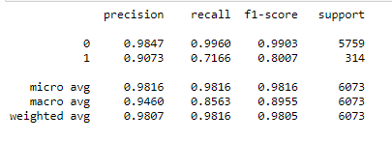
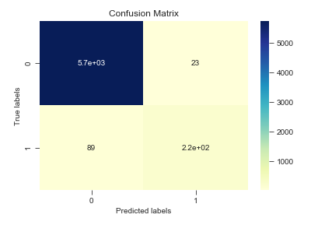
MODEL BUILDING & EVALUATION
XGBOOST Classifier
Test Data Evaluation
XG BOOST
F1 Score: 0.80
Best Parameter
Accuracy: 98%
Estimators: 600
Gamma: 0.4
Learning Rate: 0.1
Max Depth: 5
Positive Class Weight: 3
DATA ANALYSIS
DATA
PRE-PROCESSING
PIPELINE BUILDING
MODEL BUILDING & EVALUATION

Slide 15
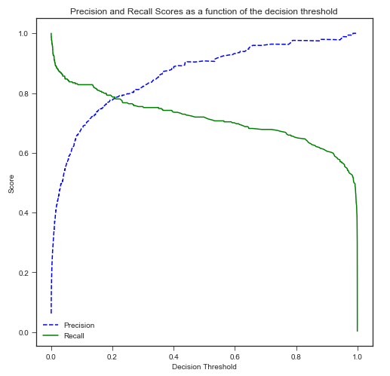
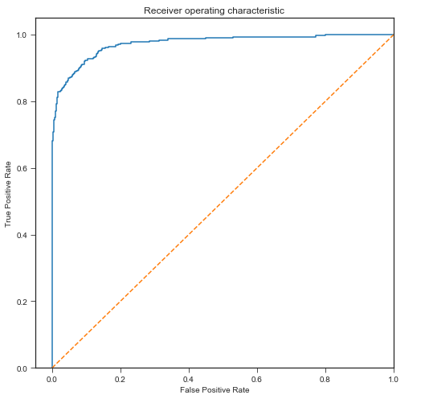
MODEL BUILDING & EVALUATION
AUC Score: 0.97
DATA ANALYSIS
DATA
PRE-PROCESSING
PIPELINE BUILDING
MODEL BUILDING & EVALUATION

Slide 16
BUSINESS INSIGHT
The final model predicts the propensity of an entity to report bankruptcy with F1 score of 0.80, based on financial ratios.
The model attempts to predict high number of bankrupt entities without compromising precision in prediction
DATA ANALYSIS
DATA
PRE-PROCESSING
PIPELINE BUILDING
MODEL BUILDING & EVALUATION

Slide 17
THANK YOU

