Slide 1
Heart Disease Predictor
Samya Maiti, Justin Robin M, Rohit Singh Jadon

Slide 2
Business Case/Statement
Identification of disease ahead of time and make medical intervention if necessary.
Improving the economical condition also, as it has been identified that health performance and economic performance are interlinked.

Slide 3
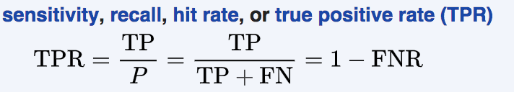
Evaluation Matrix
“Human life is more important than repeat consultation cost.”
Its acceptable to have more FP and fewer FN’s, Hence recall is the evaluation matrix we are looking at.

Slide 4
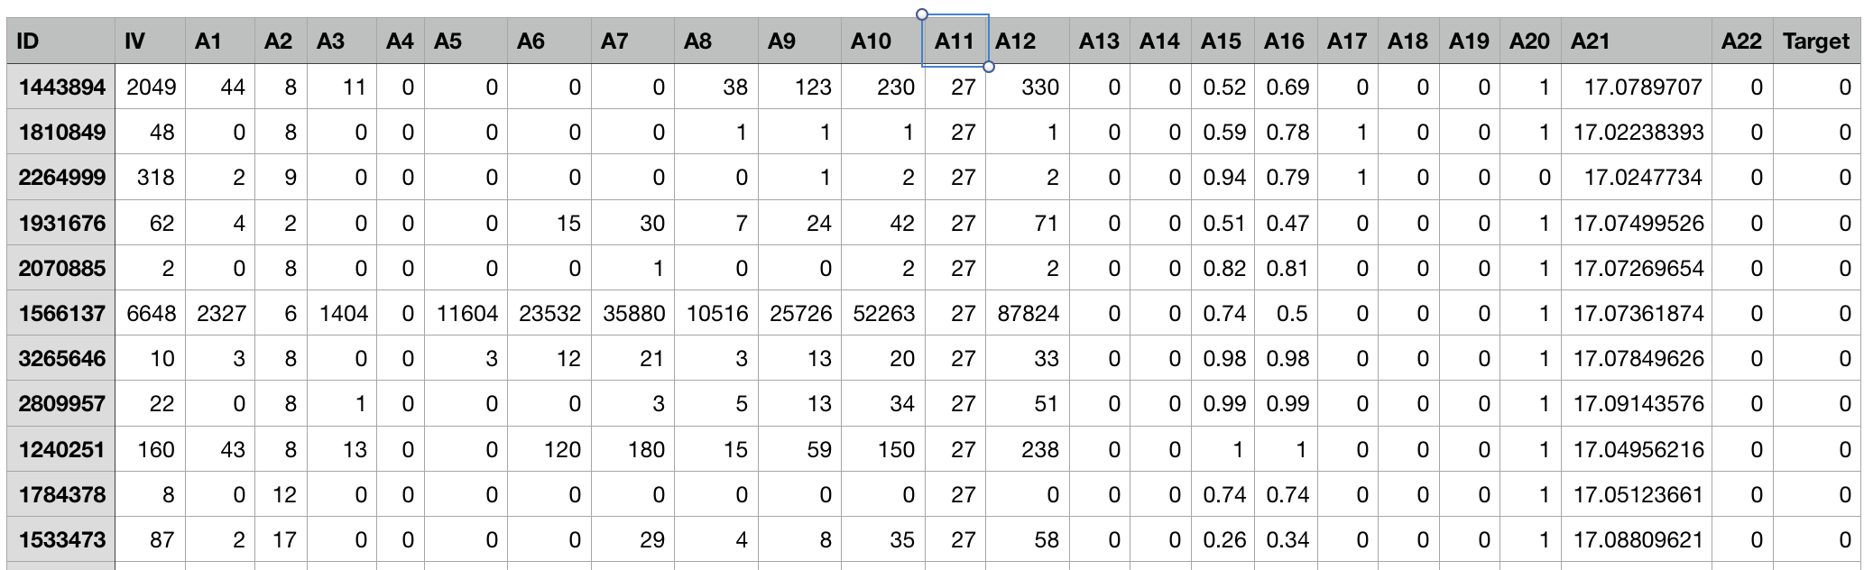
Data Analysis
The total number of records is 34281 with 24 independent attributes and the 25th column is the target which needs to be predicted.

Slide 5
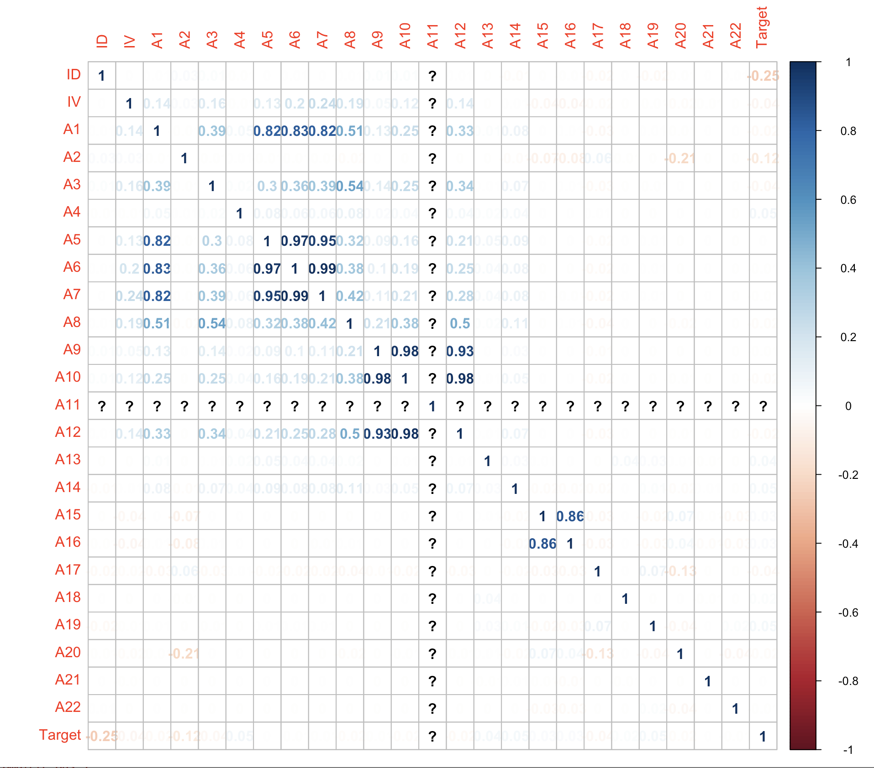
Data Analysis (cont.)
A11 is a column with no variance. Will be removed from analysis.
A5, A6, A7 are highly corelated.
A9, A10 are highly corelated.
A9, A12 are highly corelated.
A10, A12 are highly corelated.
None of the features are having significant correlation with Target variable.

Slide 6
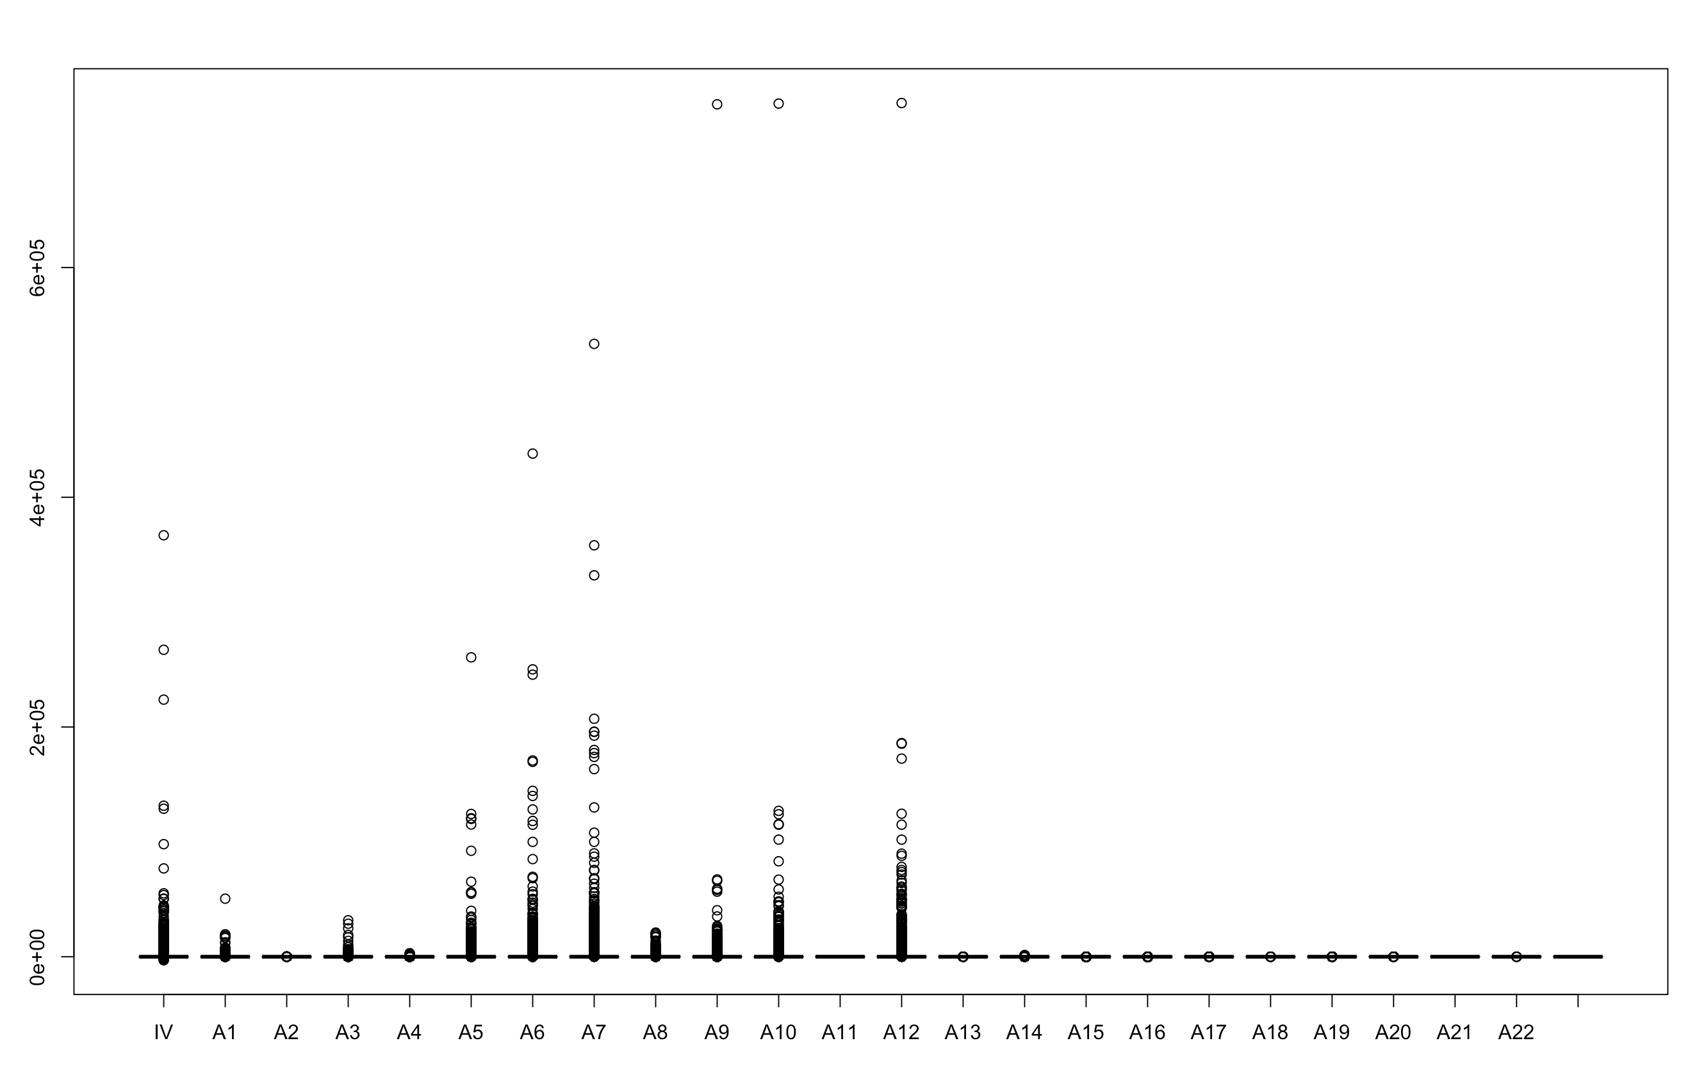
Data Analysis (cont.)
Data highly Right Screwed
Significant outliers

Slide 7
Data Preprocessing
Outliers removal
Imputation
Standardization

Slide 8
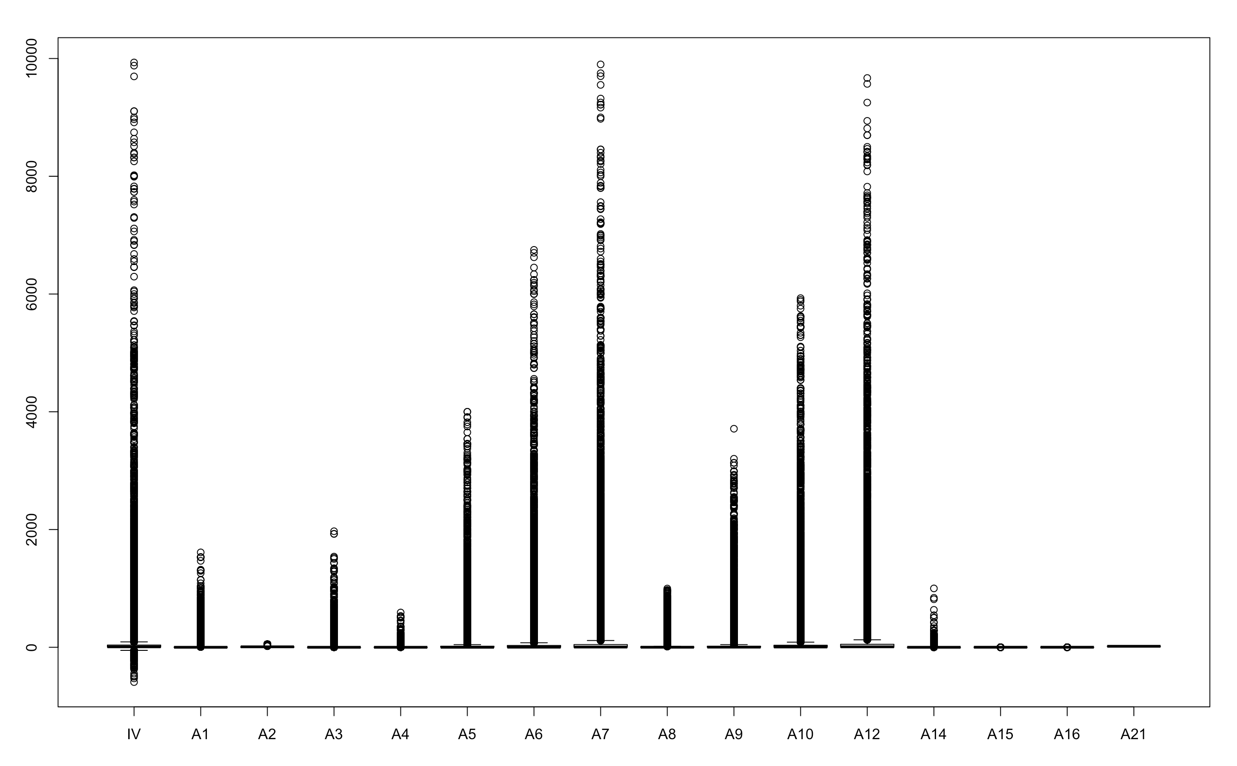
Data Preprocessing (Cont.)

Slide 9
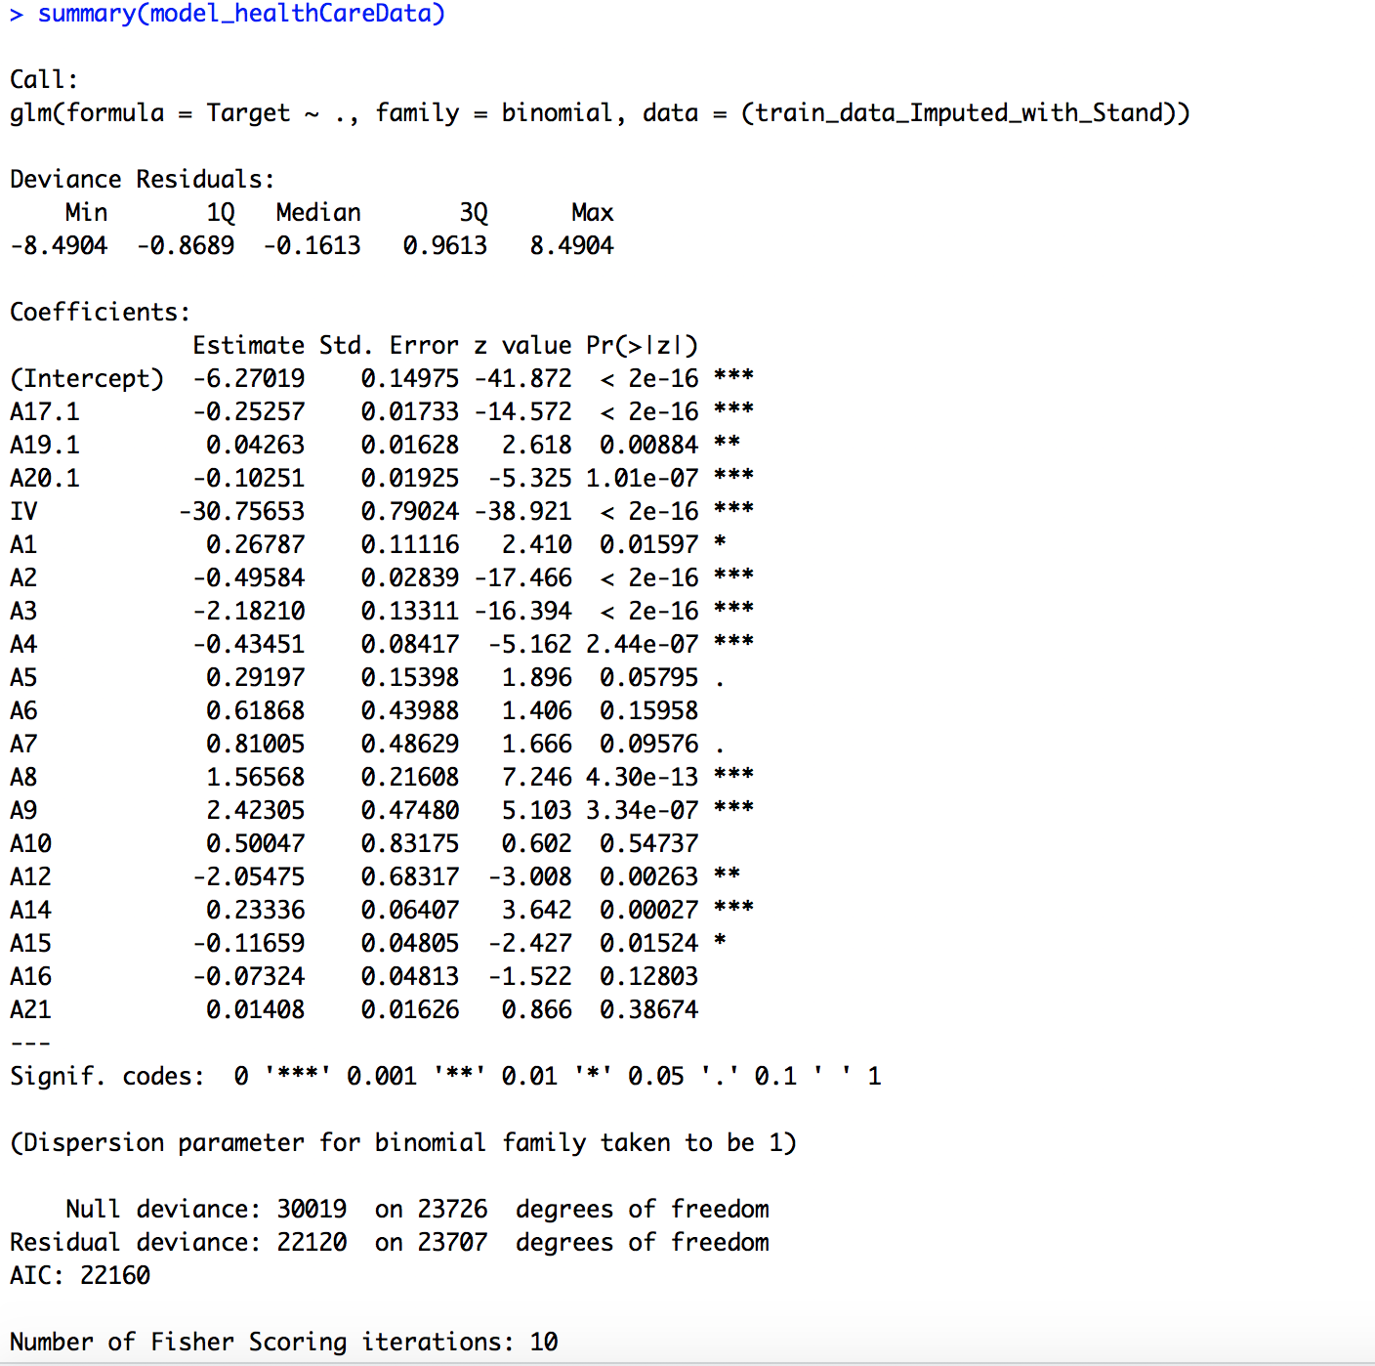
Model Building

Slide 10
Model Building (Cont.)
Remove attributes with high VIF

Slide 11
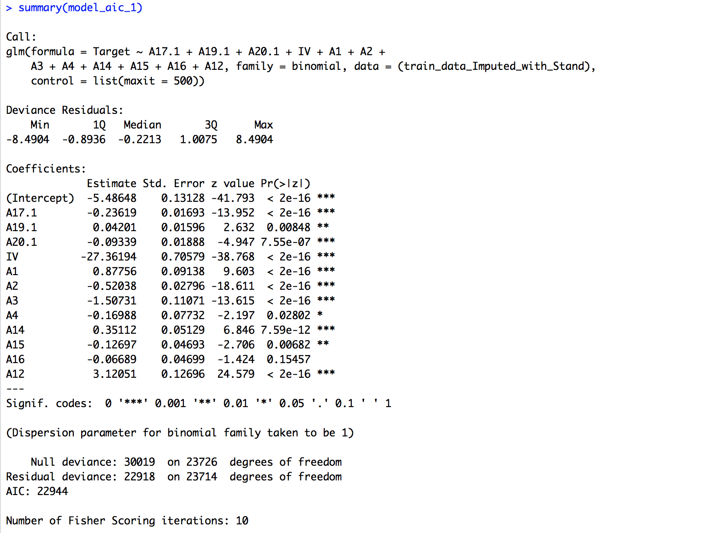
Model Building (cont.)
StepAIC

Slide 12
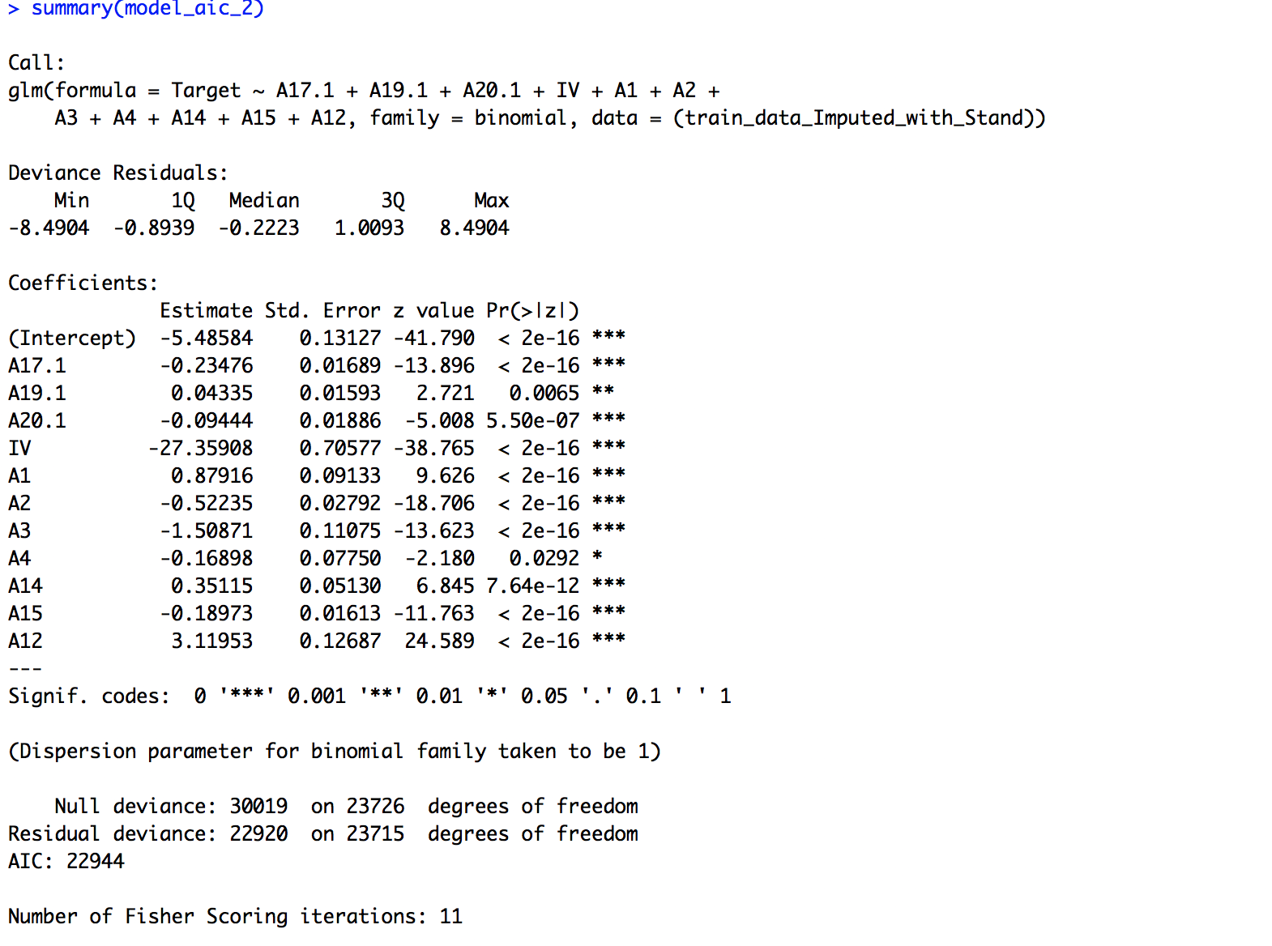
Model Building (cont.)

Slide 13
Model Building (cont.)
Y = -5.48584 -0.23476*A17.1 + 0.04335*A19.1 - 0.09444*A20.1 - 27.35908*IV + 0.87916*A1 - 0.52235*A2 - 1.50871*A3 - 0.16898*A4 + 0.35115*A14 - 0.18973*A15 + 3.11953*A12
Y = Log of odds (of disease)

Slide 14
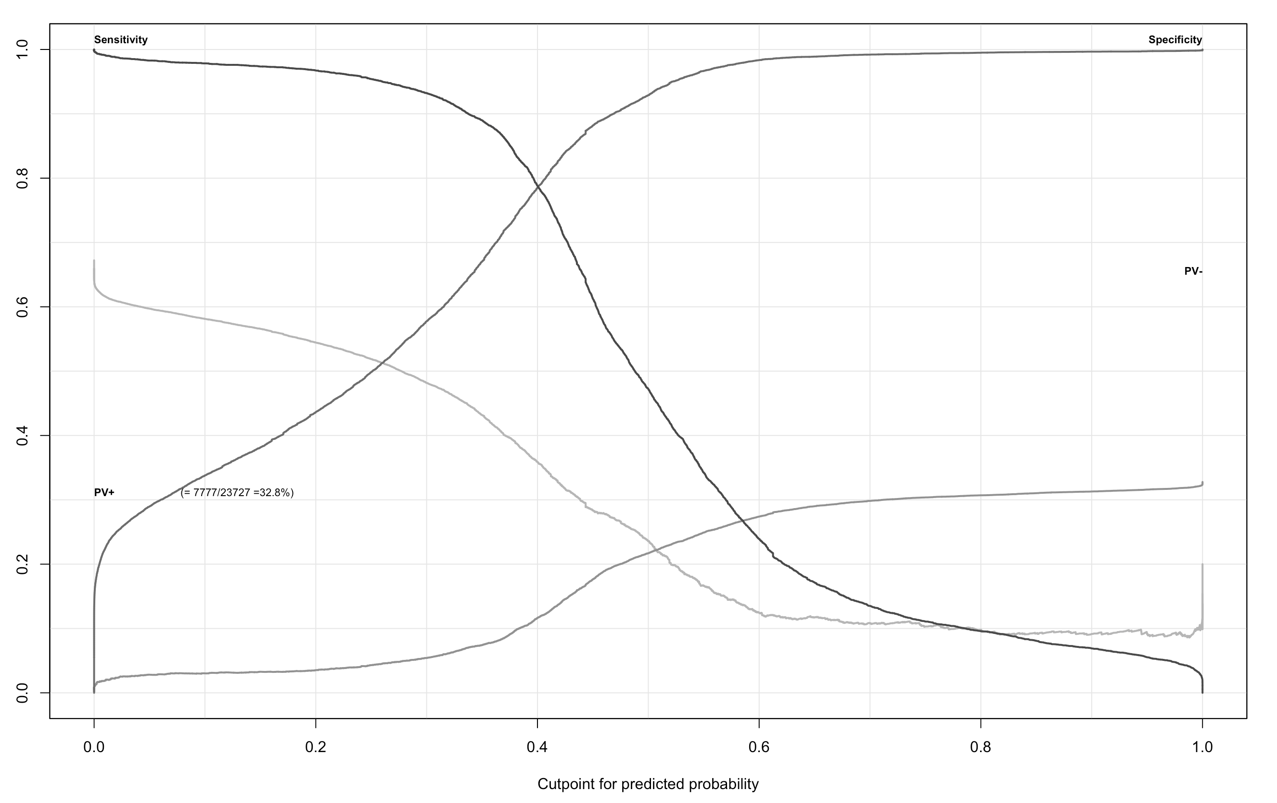
Evaluation & Post analysis

Slide 15
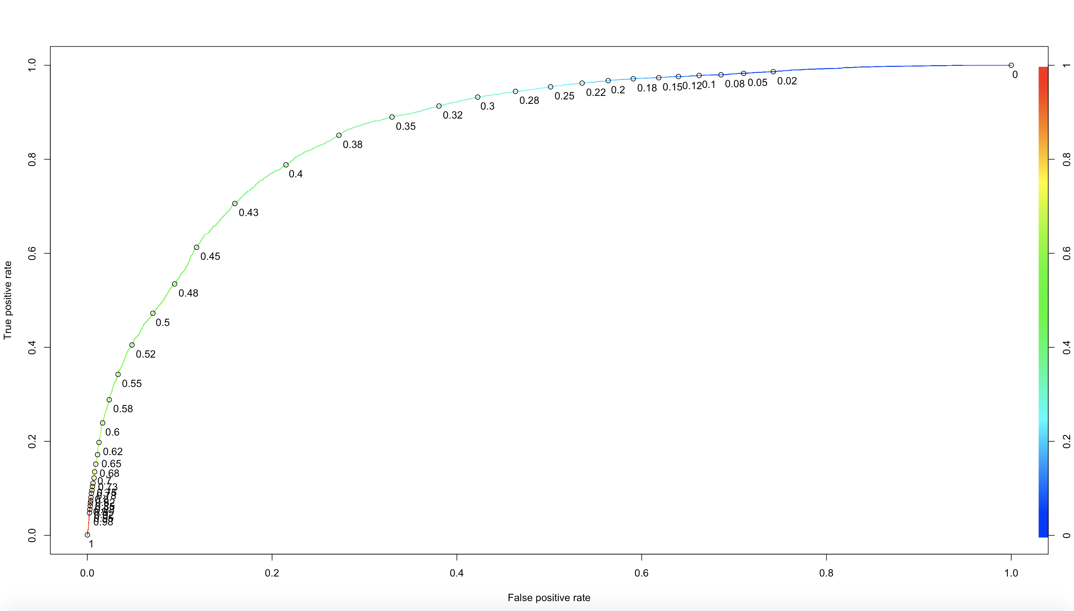
Evaluation & Post analysis(Cont.)
AUC : 0.8644543

Slide 16
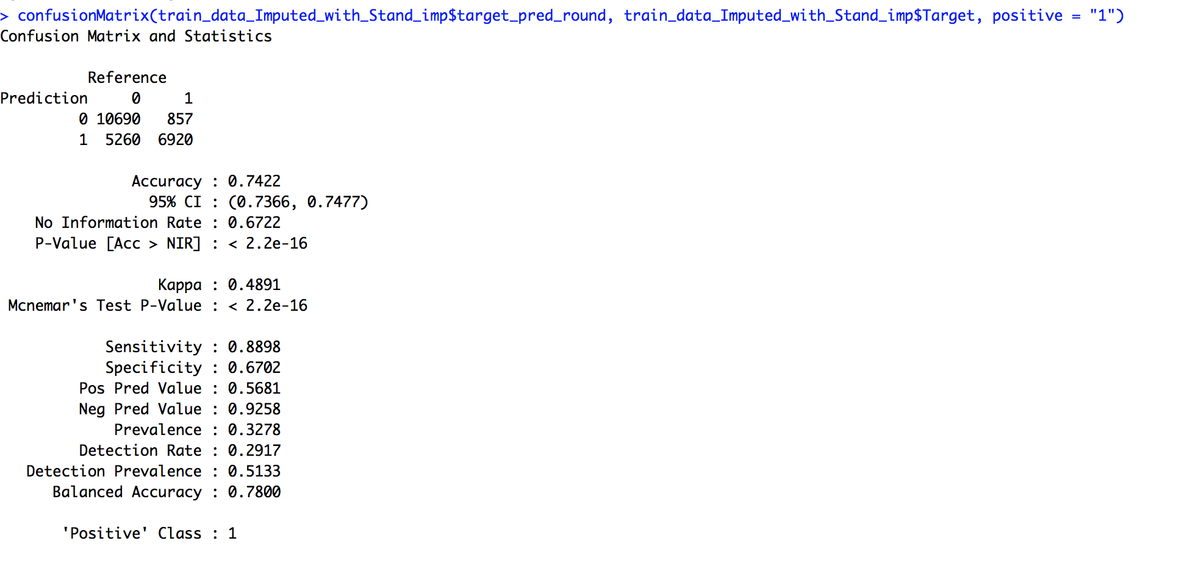
Evaluation & Post analysis(Cont.)

Slide 17
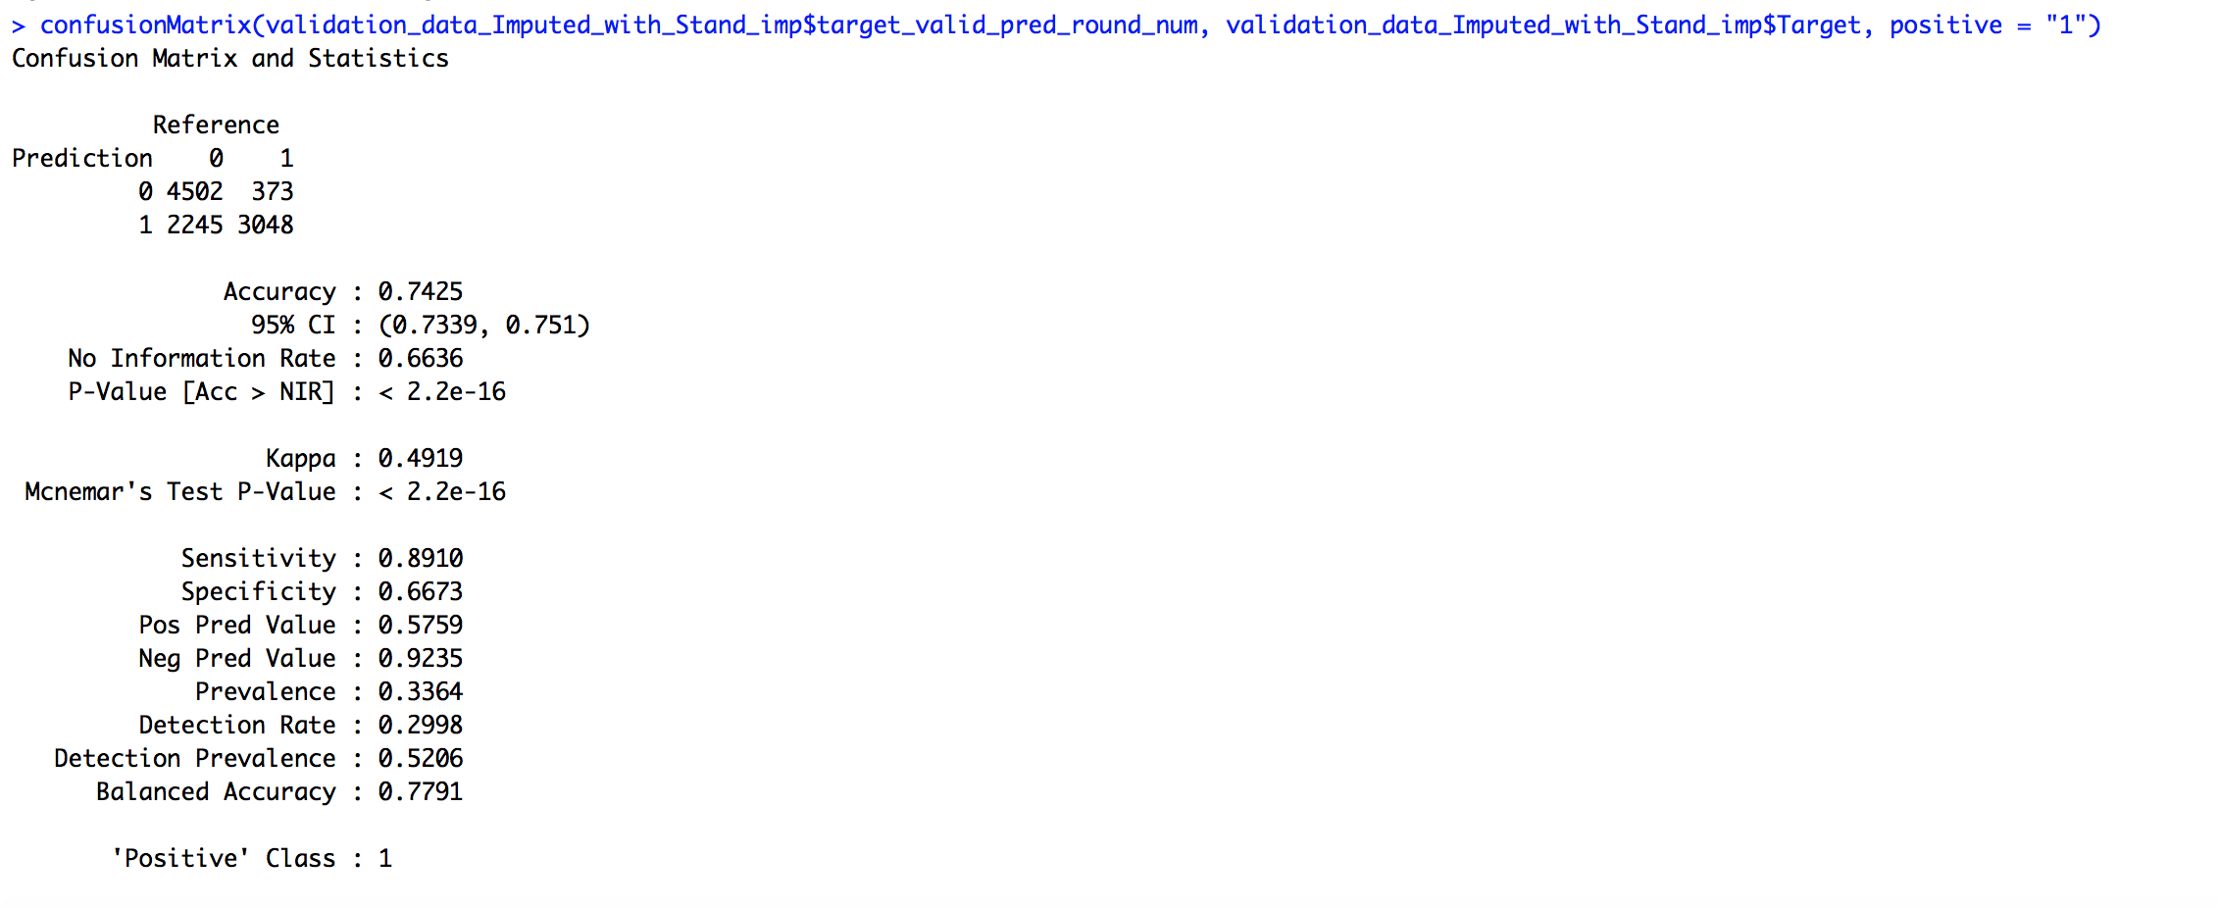
Evaluation & Post analysis(Cont.)

Slide 18
Conclusion
Recall of ~90% at .35 threshold, signifies a local with good coverage.
We can improve the Recall at the cost of Precession (FP), based on discussion with hospital authorities.

Slide 19
Next step (Evaluation in progress)
Transform parameters to remove skewness.

