Slide 1
Augmented Reality
-Dr. Panchali Datta Choudhury
Assistant Professor
UEMK

Slide 2
What is Augmented Reality?
Augmented reality is a technology that superimposes Computer generated images on the users view of the real world thus providing a composite view

Slide 3
In simple terms…..
Augmented
Augment
To add something

Slide 4
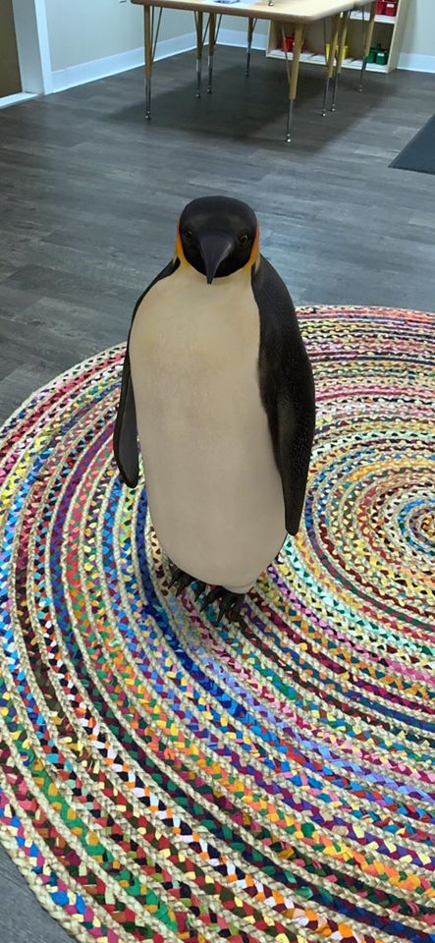
Computer Generated 2D graphics or 3D object in real world

Slide 5
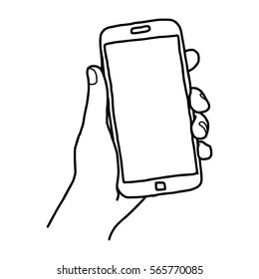
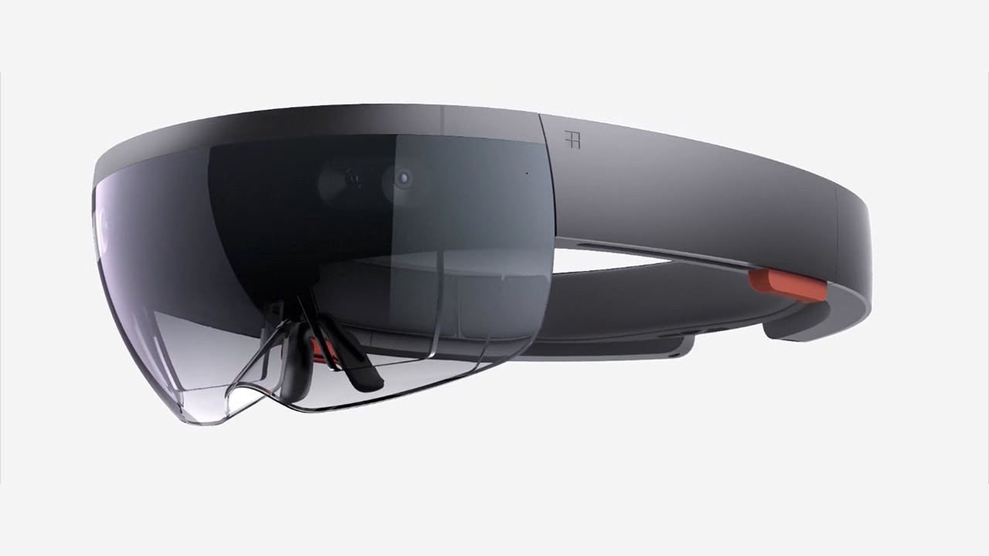
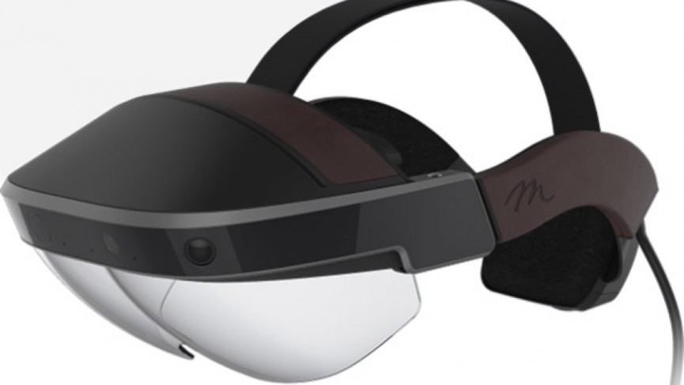
Requirements
Handheld devices- for e.x. a smartphone
Head’s up display- for e.x. a Microsoft Hololens or Meta 2

Slide 6
Requirements contd…
Devices like Hololens put augmented reality objects straight in front of your face
The Hololens and Meta 2 head’s up display are way too costly when compared to smart phone devices
Hololens is currently priced as $3000 and Meta 2 is priced as $1500

Slide 7
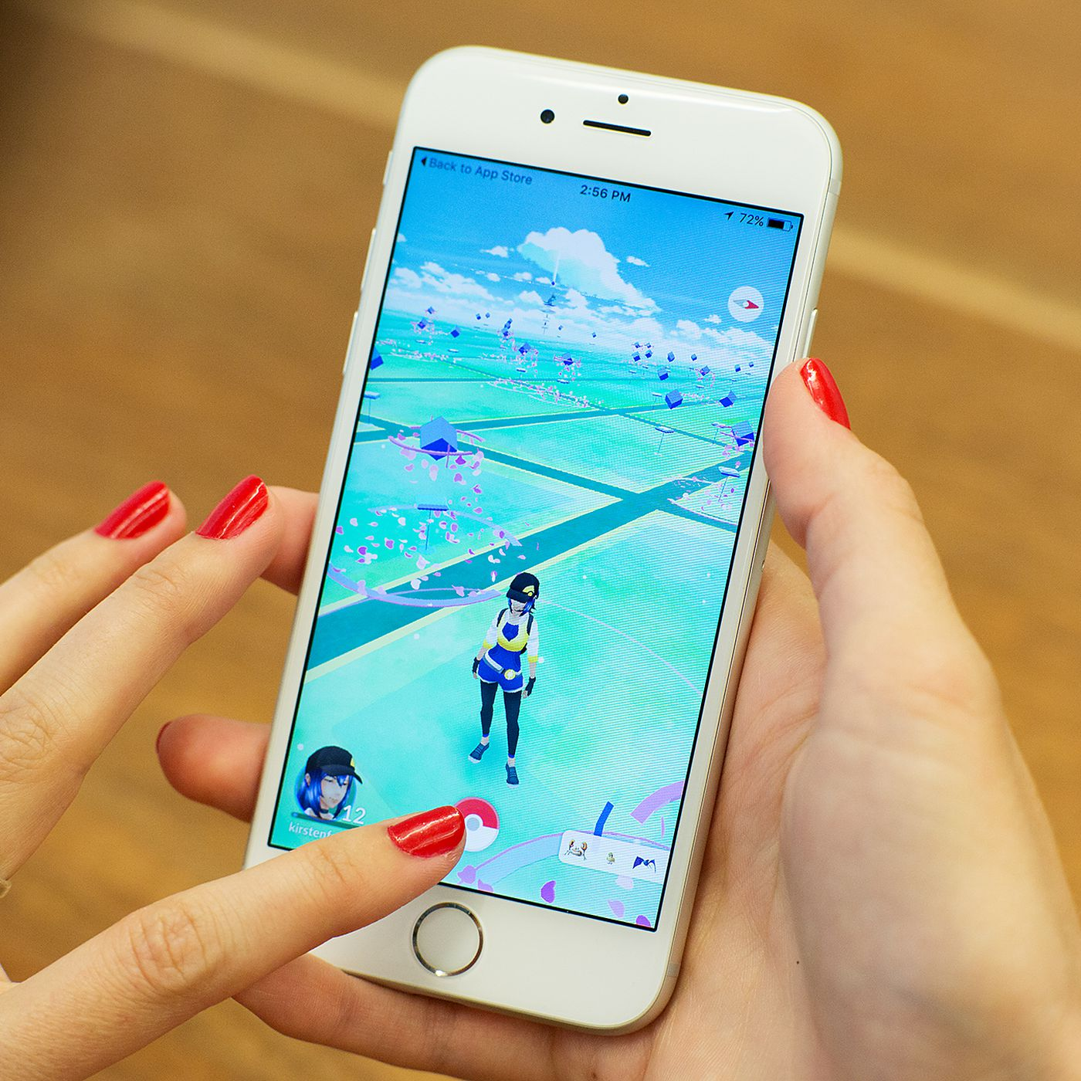
Example
The best example of augmented reality is the POKEMON GO game

Slide 8
Example contd..
In this game, you first have to move to the location where the Pokemon is located and upon reaching that location, you can see a Pokemon image inside your smart phone through the smart phone’s camera.

Slide 9
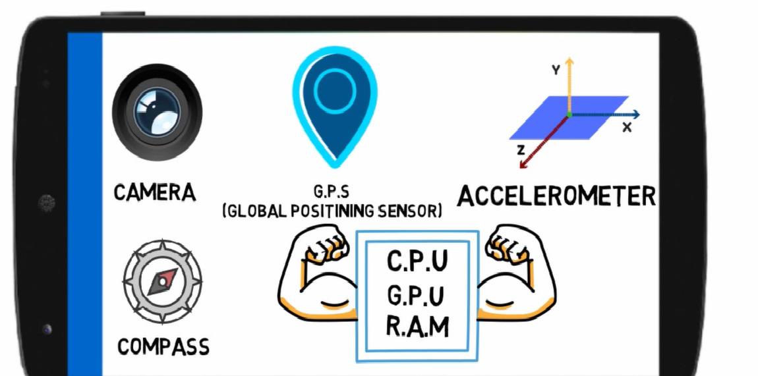
For experiencing augmented reality inside your smart phone, your smart phone must contain
Camera sensor
GPS sensor
Accelerometer sensor
Compass sensor
On top of this your smart phone should also have significant processing power i.e.
Must have good CPU
Graphics Processing Unit (GPU)
RAM

Slide 10
The head’s up devices like Hololens also consists of all these sensors
$3000

Slide 11
Different Types of Augmented Reality
Marker-based Augmented Reality
Marker-less Augmented Reality
Projection-based Augmented Reality
Superimposition-based Augmented Reality

Slide 12
Marker-based Augmented Reality System
You have to keep a marker in front of the smartphone’s camera
The marker can be in form of a QR code or a 2D image
When this marker is recognized by the camera we can see a 3D object or virtual object on top of this marker
Marker-based AR system is also referred to as Image Recognition AR, as we are basically recognizing an image over here

Slide 13
Marker-less Augmented Reality
As the name suggests, it do not require any marker or image for its working
Instead it detects surface plane i.e. the floor and on top of the surface plane we can place augmented objects
Marker-less augmented reality in location based AR applications
Pokemon Go is the best example of Marker-less AR as the Pokemon go takes input from the GPS sensor of your smart phone and when you reach at the place where the Pokemon is showed in the map , you can see the digital Pokemon image

Slide 14
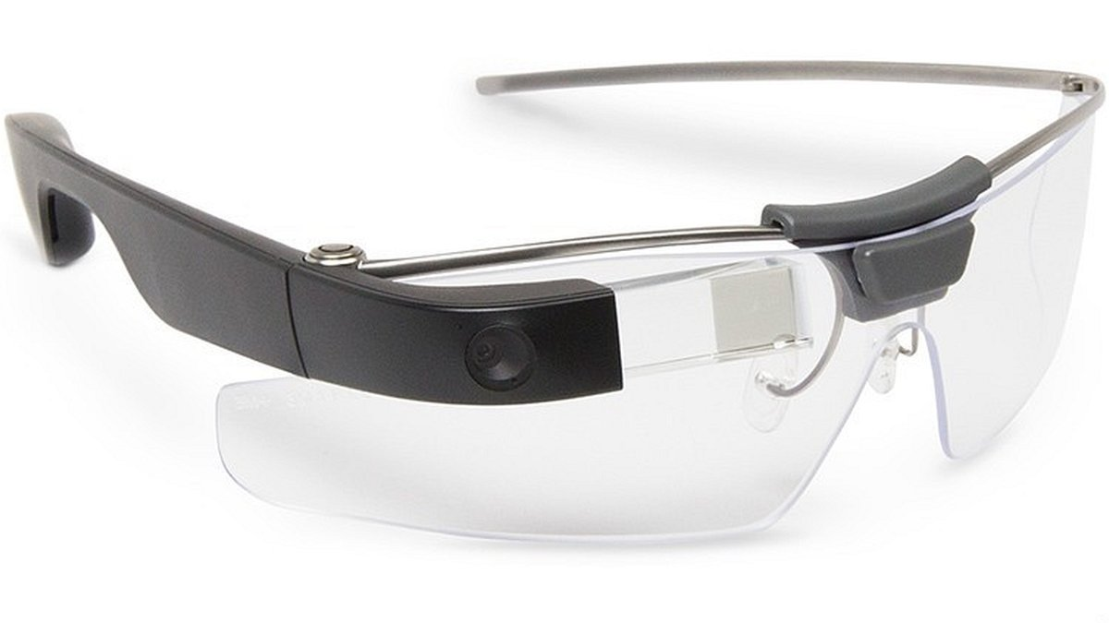
Projection-based Augmented Reality
Projection based AR requires a small projector for working and this projector projects light on any surface
Google glass is an example of projection based AR
Google glass consisted of a mini projector which project light on a small prism and because of this we were able to see augmented data like time, weather information and even location data in front of our eyesGoogle-Glass

Slide 15
Superimposition-based Augmented Reality
Superimposition based AR is also called as Object Tracking AR
In Superimposition-based AR, we replace the original view of the object with a new augmented view
For example projecting a car 3D model on top of actual car object

Slide 16
THANK YOU

