Slide 1
Python Programming language and tools

Slide 2
How a Program Works
A computer’s CPU can only understand instructions that are written in machine language.
Because people find it very difficult to write entire programs in machine language, other programming languages have been invented.
Each instruction in a program is a command that tells the CPU to perform a specific operation. Here’s an example of an instruction that might appear in a program:
10110000

Slide 3
How a Program Works
A machine language instruction exists for each operation that a CPU is capable of performing.
For example, there is an instruction for adding numbers, there is an instruction for subtracting one number from another, and so forth.
The entire set of instructions that a CPU can execute is known as the CPU’s instruction set.

Slide 4
Fetch , Decode and Execute
When a CPU executes the instructions in a program, it is engaged in a process that is known as the fetch-decode-execute cycle. This cycle, which consists of three steps, is repeated for each instruction in the program. The steps are:
1. Fetch A program is a long sequence of machine language instructions. The first step of the cycle is to fetch, or read, the next instruction from memory into the CPU.

Slide 5
Fetch, Decode and Execute
2. Decode A machine language instruction is a binary number that represents a command that tells the CPU to perform an operation. In this step the CPU decodes the instruction that was just fetched from memory, to determine which operation it should perform.
3. Execute The last step in the cycle is to execute, or perform, the operation.

Slide 6
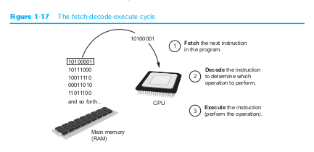
Fetch, Decode and Execute

Slide 7
From Machine Language to Assembly Language
Computers can only execute programs that are written in machine language.
As previously mentioned, a program can have thousands or even millions of binary instructions, and writing such a program would be very tedious and time consuming.
Programming in machine language would also be very difficult because putting a 0 or a 1 in the wrong place will cause an error.

Slide 8
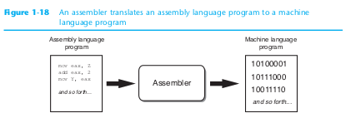
From Machine Language to Assembly Language

Slide 9
High-Level Languages
Although assembly language makes it unnecessary to write binary machine language instructions, it is not without difficulties.
Assembly language is primarily a direct substitute for machine language, and like machine language, it requires that you know a lot about the CPU.
Assembly language also requires that you write a large number of instructions for even the simplest program. Because assembly language is so close in nature to machine language, it is referred to as a low-level language.

Slide 10
High-Level Languages
Python is a modern, high-level programming language that we will use in this course.
In Python you would display the message Hello world with the following instruction:
print('Hello world')

Slide 11
High-Level Languages
Doing the same thing in assembly language would require several instructions, and an intimate knowledge of how the CPU interacts with the computer’s output device.
mov dl,'A' ;
mov ah,2
int 21h
As you can see from this example, high-level languages allow programmers to concentrate on the tasks they want to perform with their programs rather than the details of how the CPU will execute those programs.

Slide 12
Compilers and Interpreters
Because the CPU understands only machine language instructions, programs that are written in a high-level language must be translated into machine language. Depending on the language that a program has been written in, the programmer will use either a compiler or an interpreter to make the translation.
A compiler is a program that translates a high-level language program into a separate machine language program. The machine language program can then be executed any time it is needed.

Slide 13
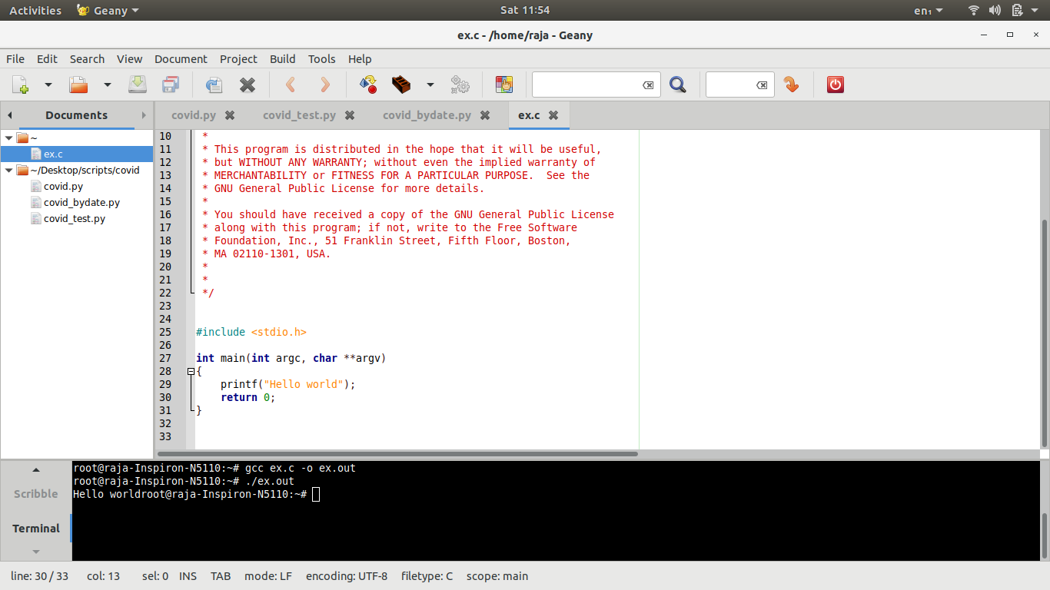
Compilers and Interpreters
Ex:gcc filename.c -o outputfile.out
#include <stdio.h>
int main(int argc, char **argv)
{
printf("Hello world");
return 0;
}

Slide 14
Compilers and Interpreters
The Python language uses an interpreter, which is a program that both translates and executes the instructions in a high-level language program.
As the interpreter reads each individual instruction in the program, it converts it to machine language instructions and then immediately executes them.
This process repeats for every instruction in the program.

Slide 15
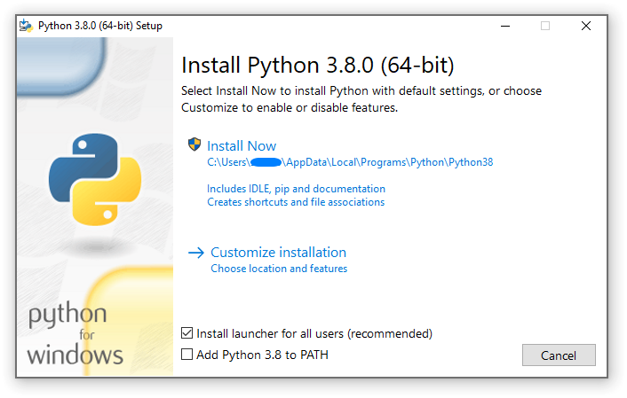
Download and install python - IDLE
https://www.python.org/downloads/

Slide 16
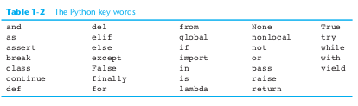
Key Words, Operators, and Syntax: an Overview
Each high-level language has its own set of predefined words that the programmer must use to write a program.
The words that make up a high-level programming language are known as key words or reserved words. Each key word has a specific meaning, and cannot be used for any other purpose.

Slide 17
Key Words, Operators, and Syntax: an Overview
In addition to key words, programming languages have operators that perform various
operations on data. For example, all programming languages have math operators that per-
form arithmetic. In Python, as well as most other languages, the sign is an operator that
adds two numbers. The following adds 12 and 75:
12 + 75
There are numerous other operators in the Python language, many of which you will learn
about as you progress through this text.

Slide 18

The Program Development Cycle
Pseudocode
Flowcharts
Algorithms

Slide 19
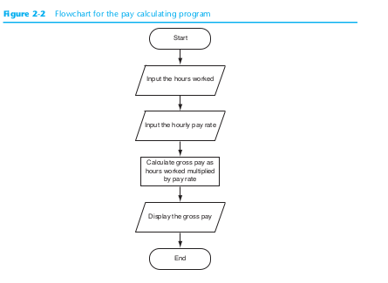
Flowchart
Pseudocode
Flowcharts
Algorithms

Slide 20


