Slide 1
Python -
Special output and functions

Slide 2
Overview
So far we have discussed only basic ways to display data. Eventually, you will want to exercise more control over the way data appear on the screen. Here, you will learn more details about the Python print function, and you’ll see techniques for formatting output in specific ways.

Slide 3
Suppressing the print Function’s Ending Newline
print('One', end=' ')
print('Two', end=' ')
print('Three')
print('One', end='')
print('Two', end='')
print('Three')

Slide 4
Specifying an Item Separator
>>> print('One', 'Two', 'Three') e
One Two Three
>>> print('One', 'Two', 'Three', sep='') e
OneTwoThree
>>> print('One', 'Two', 'Three', sep='*') e
One*Two*Three
>>>

Slide 5
Escape Characters
An escape character is a special character that is preceded with a backslash ( \ ), appearing inside a string literal. When a string literal that contains escape characters is printed, the escape characters are treated as special commands that are embedded in the string.
For example, \n is the newline escape character. When the \n escape character is printed, it isn’t displayed on the screen. Instead, it causes output to advance to the next line.
For example, look at the following statement:
print('One\nTwo\nThree')
When this statement executes, it displays
One
Two
Three . Python recognizes several escape characters

Slide 6
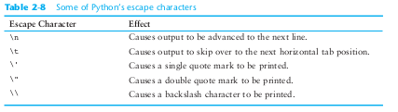
Escape Characters

Slide 7
Displaying Multiple Items with the + Operator
Earlier , you saw that the + operator is used to add two numbers. When the + operator is used with two strings, however, it performs string concatenation. This means that it appends one string to another. For example, look at the following statement:
print('This is ' + 'one string.')
This statement will print “This is one string.”
String concatenation can be useful for breaking up a string literal so a lengthy call to the
print function can span multiple lines. Here is an example:
print('Enter the amount of ' + \
'sales for each day and ' + \
'press Enter.')
This statement will display the following:
Enter the amount of sales for each day and press Enter.

Slide 8
Formatting Numbers
>>> amount_due = 5000.0
>>> monthly_payment = amount_due / 12.0
>>> print('The monthly payment is', monthly_payment)
>>>print(format(monthly_payment, '.2f'))

Slide 9
Displaying Multiple Items with the + Operator
# This program displays the following
# floating-point numbers in a column
# with their decimal points aligned.
num1 = 127.899
num2 = 3465.148
num3 = 3.776
num4 = 264.821
num5 = 88.081
num6 = 799.999
# Display each number in a field of 7 spaces
# with 2 decimal places. print(format(num1, '7.2f'))
print(format(num2, '7.2f'))

Slide 10
Formatting Integers
You use d as the type designator.
You cannot specify precision.
>>> print(format(123456, 'd')) e >>> print(format(123456, ',d')) e >>> print(format(123456, '10d')) e >>> print(format(123456, '10,d')) e

Slide 11
Introduction to Functions
A function is a group of statements that exist within a program for the purpose of performing a specific task.

Slide 12
Benefits
Simpler Code
Code Reuse
Better Testing
Faster Development
Easier Facilitation of Teamwork

Slide 13
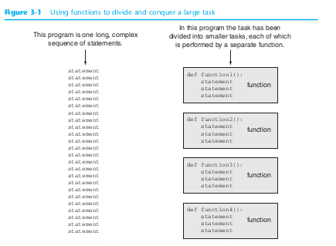

Slide 14
Defining and Calling a Function
The code for a function is known as a function definition. To execute the function, you write a statement that calls it. Python requires that you follow the same rules that you follow when naming variables, which we recap here:
• You cannot use one of Python’s key words as a function name. (See Table for a list of the key words.)
• A function name cannot contain spaces.
• The first character must be one of the letters a through z, A through Z, or an underscore character (_).
• After the first character you may use the letters a through z or A through Z, the digits 0 through 9, or underscores.
• Uppercase and lowercase characters are distinct.

Slide 15
Defining and Calling a Function
# This program demonstrates a function.
# First, we define a function named message.
def message():
print('I am Arthur,') # Follow the indentation
print('King of the Britons.')
# Call the message function.
message()

Slide 16
Defining and Calling a Function
# This program has two functions. First we
# define the main function.
def main():
print('I have a message for you.')
message()
print('Goodbye!')
# Next we define the message function.
def message():
print('I am Arthur,')
print('King of the Britons.')
# Call the main function.
main()

Slide 17
Practice Problems
Q1) A car’s miles-per-gallon (MPG) can be calculated with the following formula: MPG = Miles driven / Gallons of gas used. Write a program that asks the user for the number of miles driven and the gallons of gas used. It should calculate the car’s MPG and display the result in integers after 20 spaces.
Q2)Write a program that converts Celsius temperatures to Fahrenheit temperatures. The formula is as follows:
The program should ask the user to enter a temperature in Celsius, and then display the temperature converted to Fahrenheit with a precision of 3

Slide 18
Thank you!

