Slide 1
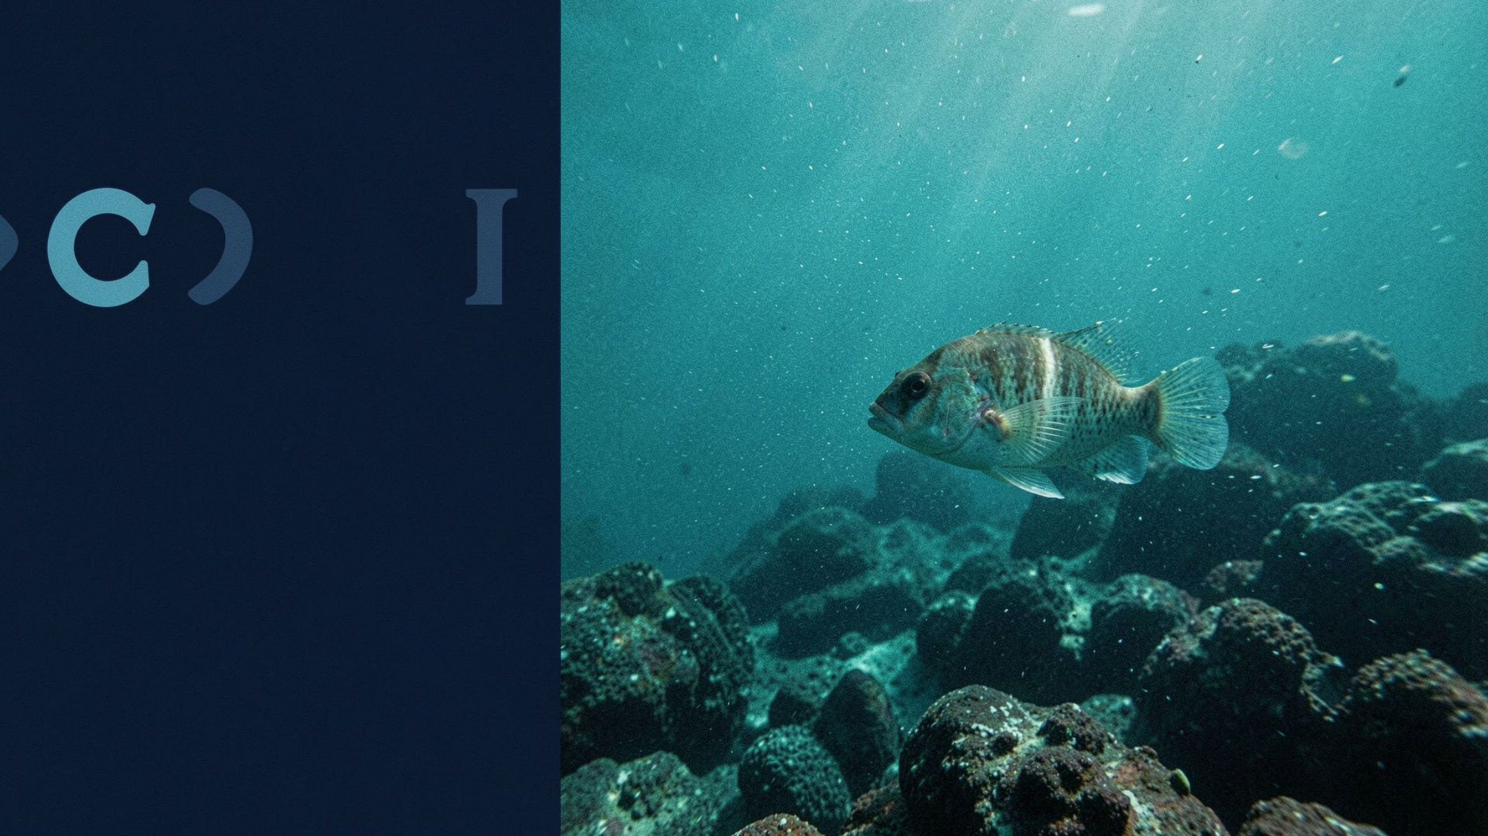
PROJECT REVIEW 1
Unsupervised Underwater Object Segmentation Using Pretrained Vision Transformer Features
Notes:
1

Slide 2
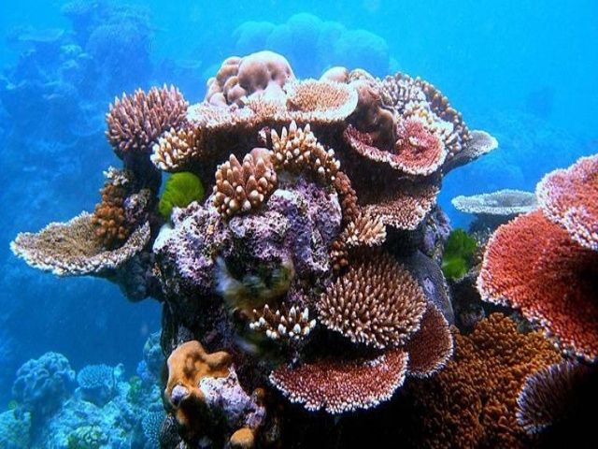
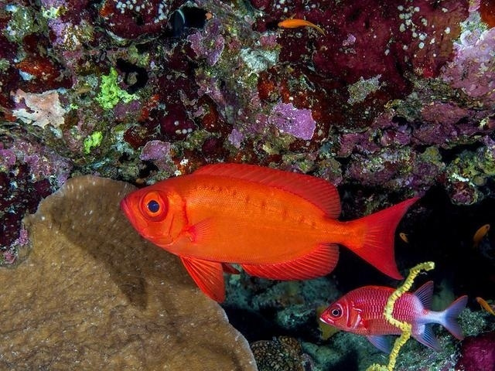
BACKGROUND AND PROBLEM STATEMENT
Background and Problem Statement
  Objective: Identify foreground objects and distinguish them from the surrounding background in underwater images.
  Challenges: Underwater images suffer from light absorption and scattering, reduced visibility, colour distortion, haze, uneven illumination, and complex backgrounds.
  Proposed Approach: Explore pretrained DINOv2 visual features to capture object appearance, texture, and spatial structure without task-specific fine-tuning.
  Research question: Can DINOv2 features combined with unsupervised clustering and label-free foreground selection produce useful binary segmentation masks for underwater images?
  Scope: Focus on binary salient object segmentation (foreground vs. background), rather than assigning semantic categories to individual pixels.
Notes:
2

Slide 3




RESEARCH OBJECTIVES AND SCOPE
Research Objectives and Scope
Primary objective: Investigate the feasibility of training-free underwater salient object segmentation using frozen features extracted from a pretrained DINOv2 vision transformer.
  Feature Extraction: Extract patch-level visual features from underwater images using pretrained DINOv2.
  Frozen Backbone: Preserve the pretrained model weights without fine-tuning or modification.
  Feature Clustering: Group image patches based on similarities in their DINOv2 feature representations.
  Cluster Analysis: Investigate how different clustering configurations affect foreground-background separation.
  Foreground Identification: Identify clusters corresponding to salient objects without ground-truth labels.
  Background Separation: Distinguish foreground clusters from background regions using label-free selection strategies.
  Segmentation Metrics: Evaluate mask quality using IoU, F-measure, and MAE.
  Failure Analysis: Identify challenging scenes and analyse segmentation errors.
  Computational Efficiency: Examine the trade-off between segmentation accuracy and processing time.
Notes:
4

Slide 4
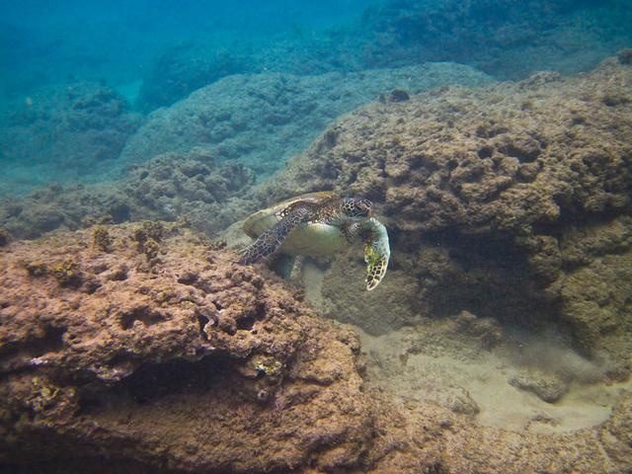


DATASET SELECTION AND UNDERSTANDING
Dataset Selection and Understanding
The SUIM dataset will serve as the primary dataset, providing underwater images and corresponding segmentation annotations. The USOD dataset will be incorporated to expand the dataset and increase visual diversity.
Each sample consists of an underwater RGB image and an associated ground-truth mask that identifies the annotated foreground region. The RGB image is the input to the segmentation pipeline, while the ground-truth mask serves as the reference for quantitative evaluation.
The RGB image is the input to the segmentation pipeline
The ground-truth mask serves as the reference for quantitative evaluation
The first three principal components of DINOv2 patch features are mapped to RGB channels
Predicted masks will be compared with ground-truth annotations to evaluate segmentation accuracy across variations in object size, background complexity, image quality, and foreground location. Initial evaluation will use USOD, with SUIM considered for future generalisation testing.
Notes:
5

Slide 5
PROPOSED METHODOLOGY
Proposed Methodology
01
02
03
Input preprocessing:
Feature extraction:
Feature analysis:
  Image Resizing: Resize underwater RGB images to the required input resolution.
  Normalisation: Normalise pixel values according to DINOv2's input requirements.
  Pretrained Backbone: Use DINOv2 ViT-B/14 without fine-tuning.
  Patch-Level Features: Extract a 768-dimensional feature vector for each image patch.
  Dimensionality Reduction: Apply PCA to project high-dimensional features into 3D for visualisation.
  Feature Preservation: Retain original features for clustering to avoid losing potentially useful information.
04
05
06
Unsupervised clustering:
Foreground selection:
Mask generation and evaluation:
  Feature Clustering: Apply K-means to group image patches based on feature similarity.
  Cluster Analysis: Investigate the effect of varying the number of clusters on segmentation quality.
  Baseline Strategy: Use image-border heuristics to identify potential foreground clusters.
  Improved Selection: Explore spatial coherence, feature similarity, and multi-scale consistency for more reliable foreground identification.
  Mask Generation: Combine selected clusters into a binary mask and resize it to the original image resolution.
  Performance Evaluation: Compare predicted masks against ground-truth annotations using IoU, F-measure, and MAE.
The pipeline consists of image preprocessing, frozen DINOv2 ViT-B/14 feature extraction, unsupervised K-means clustering, label-free foreground selection, binary mask generation, and evaluation. For a 588 × 448 input, the model produces 1,344 patch tokens, each with a 768-dimensional feature vector. Ground-truth masks are used only for evaluation, not during inference.
Notes:
7

Slide 6
EVALUATION STRATEGY AND PERFORMANCE METRICS
Evaluation Strategy and Performance Metrics
The proposed method will be evaluated using established binary-segmentation metrics.
Intersection over Union:
F-measure:
Mean Absolute Error:
  IoU = |P ∩ G| / |P ∪ G|, where P denotes the predicted foreground pixels and G denotes the ground-truth foreground pixels. Higher IoU indicates greater overlap.
  Precision and Recall: Combines both metrics into a single score.
  Weighted F-Measure: Uses β² = 0.3, giving greater importance to precision than recall.
  Pixel-Level Error: Measures the average absolute difference between predicted and ground-truth masks.
  Interpretation: Lower MAE indicates fewer pixel-level disagreements.
Qualitative analysis will use original images, ground-truth masks, and predicted masks, including difficult cases such as small objects, complex reef backgrounds, haze, foreground objects touching image boundaries, and similar foreground and background characteristics.
Assess processing time per image and, where appropriate, throughput in frames per second. The initial evaluation uses USOD; an independent dataset may be added if feasible. Comparisons against appropriate baselines and sensitivity analysis are needed. Do not invent numerical results or claim superiority before experiments are performed.
Evaluation will include qualitative mask comparisons, processing time, and FPS where appropriate. Experiments will initially use USOD, with additional datasets and baseline comparisons considered if feasible. Sensitivity analysis will examine clustering configurations, and all conclusions will be based on measured results without assuming superiority.
Notes:
8

Slide 7

EXPECTED OUTCOMES AND DELIVERABLES
Expected Outcomes and Deliverables
01
A reproducible implementation for extracting frozen DINOv2 features from underwater images.
02
A segmentation pipeline using feature clustering and a label-free foreground-selection strategy to generate binary masks.
03
A quantitative evaluation using IoU, F-measure, and MAE, supported by visual comparisons between predicted masks and ground-truth annotations.
04
A systematic investigation of the factors affecting performance, including the number of clusters, the feature representation used for clustering, object size, background complexity, and foreground-selection strategy.
05
An assessment of computational requirements and the practical limitations of the method.
Notes:
9

Slide 8
THANK YOU!!
Notes:
10

