Slide 1
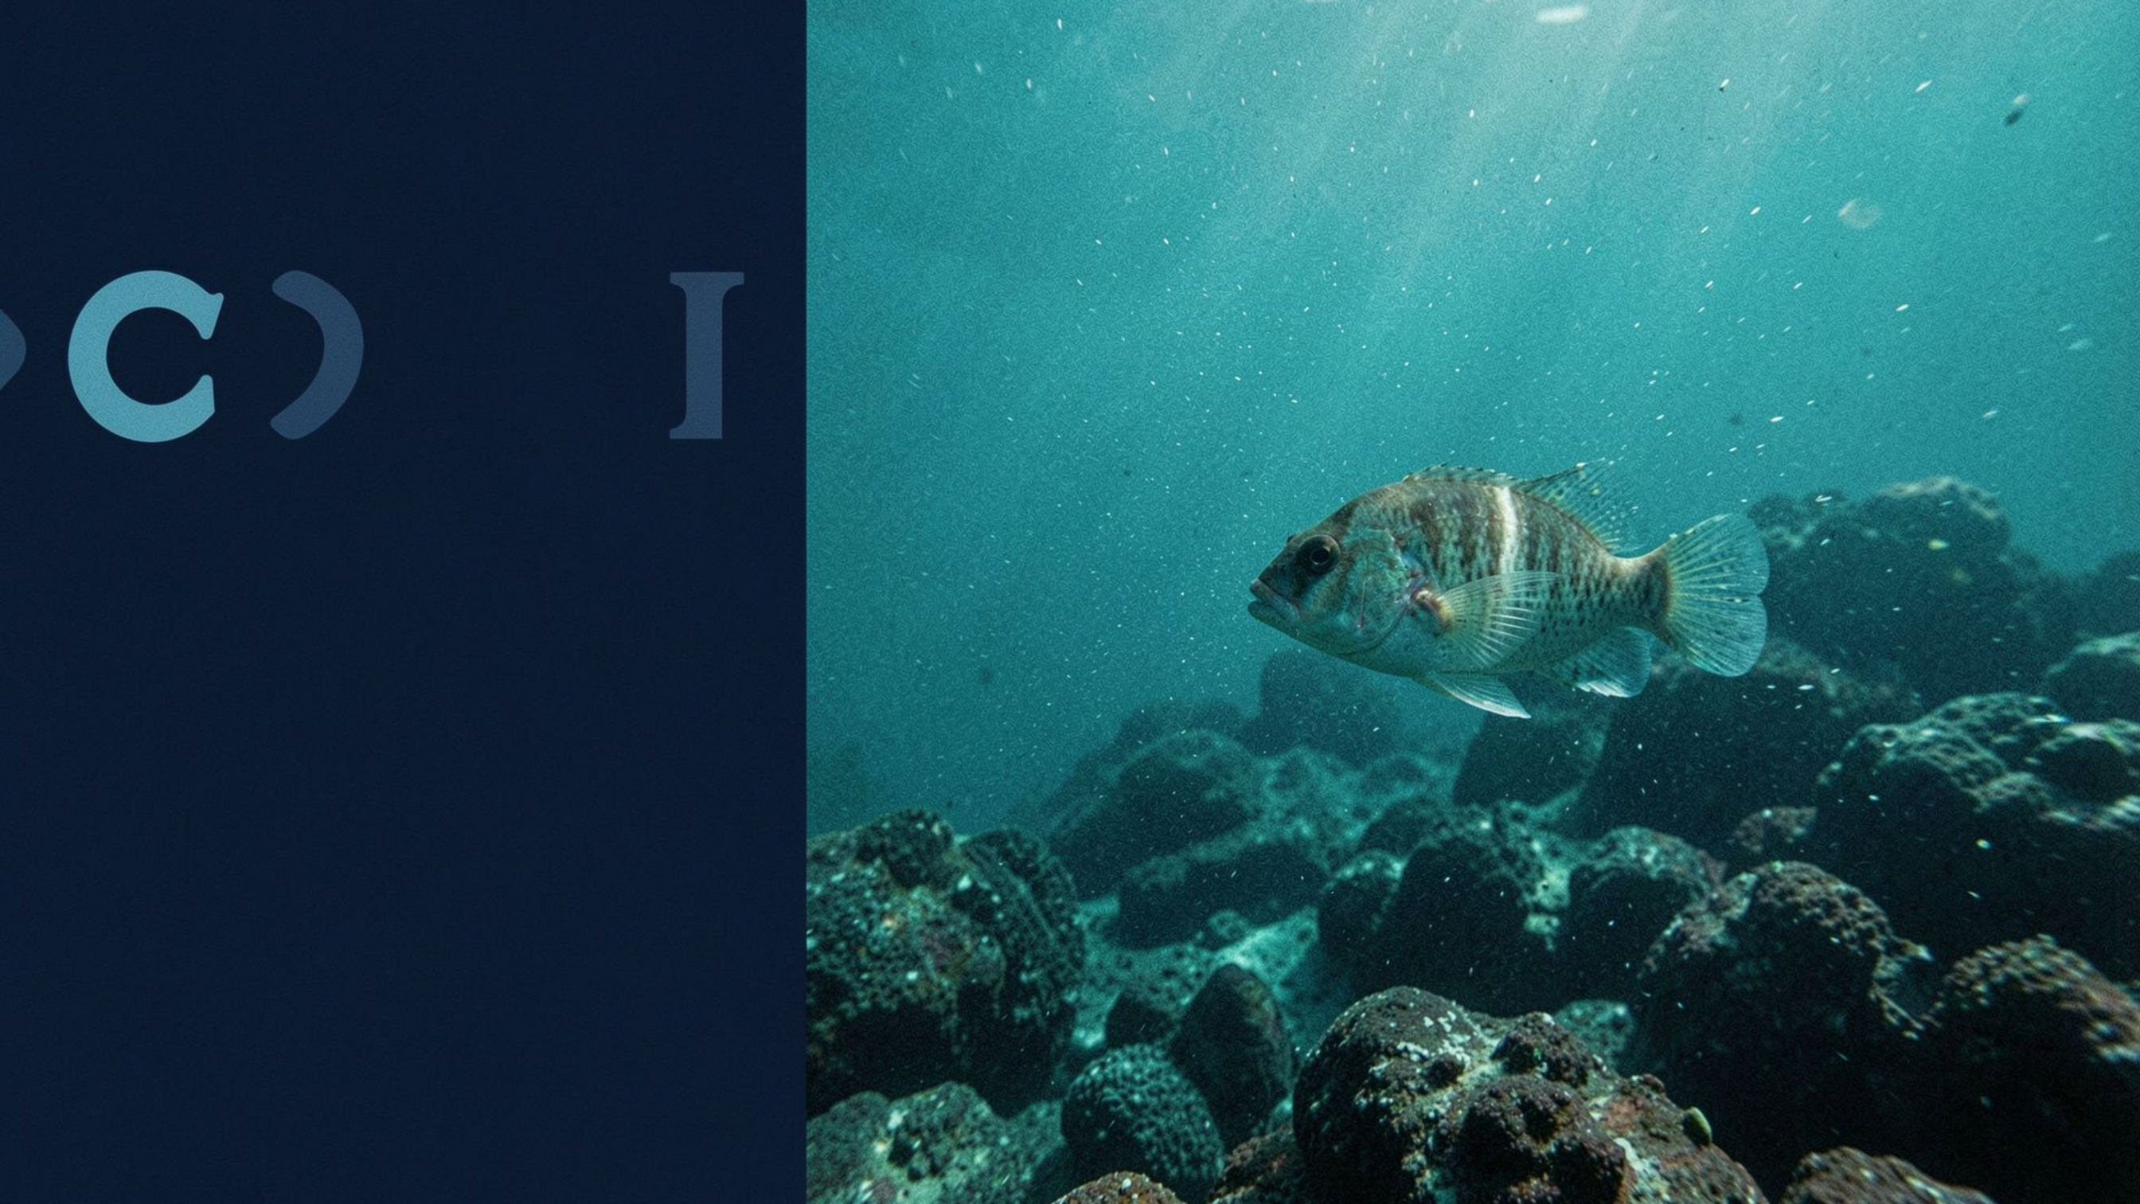
PROJECT REVIEW 2
Unsupervised Underwater Object Segmentation Using Pretrained Vision Transformer Features
[Student name 1] · [Roll number 1]
[Student name 2] · [Roll number 2]
[Student name 3] · [Roll number 3]
[Student name 4] · [Roll number 4]
Department of Naval Architecture and Ocean Engineering, IIT Madras · Machine Learning for Ocean Engineers · [Project guide, if applicable]
Notes:
1

Slide 2
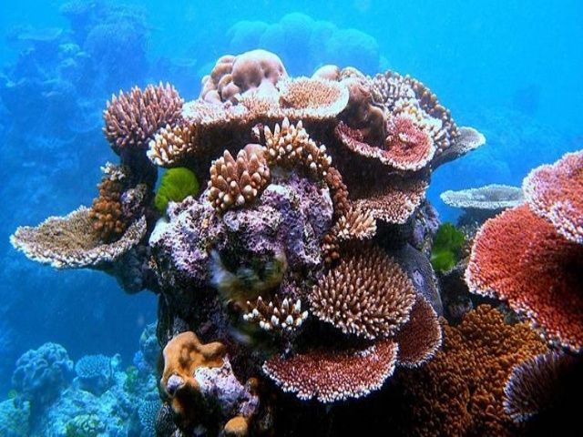
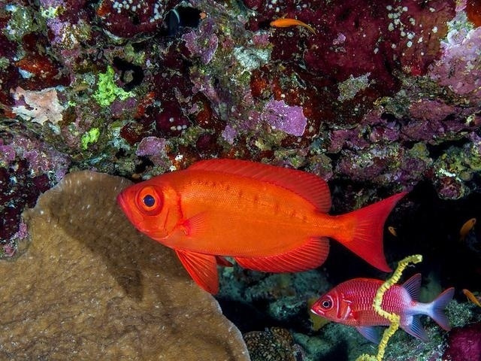
BACKGROUND AND PROBLEM STATEMENT
Background and Problem Statement
  Objective: Identify foreground objects and distinguish them from the surrounding background in underwater images.
  Challenges: Underwater images suffer from light absorption and scattering, reduced visibility, colour distortion, haze, uneven illumination, and complex backgrounds.
  Proposed Approach: Explore pretrained DINOv2 visual features to capture object appearance, texture, and spatial structure without task-specific fine-tuning.
  Research question: Can DINOv2 features combined with unsupervised clustering and label-free foreground selection produce useful binary segmentation masks for underwater images?
  Scope: Focus on binary salient object segmentation (foreground vs. background), rather than assigning semantic categories to individual pixels.
Notes:
2

Slide 3

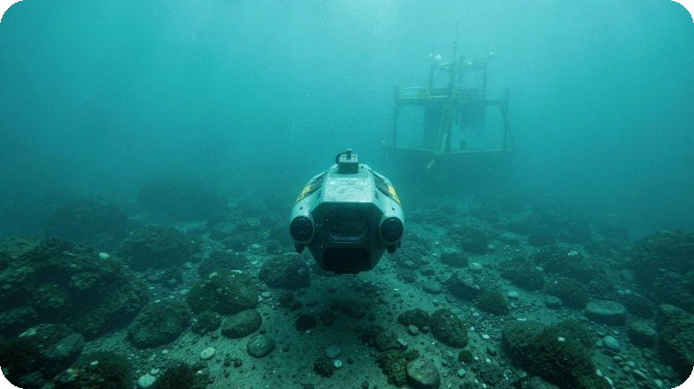

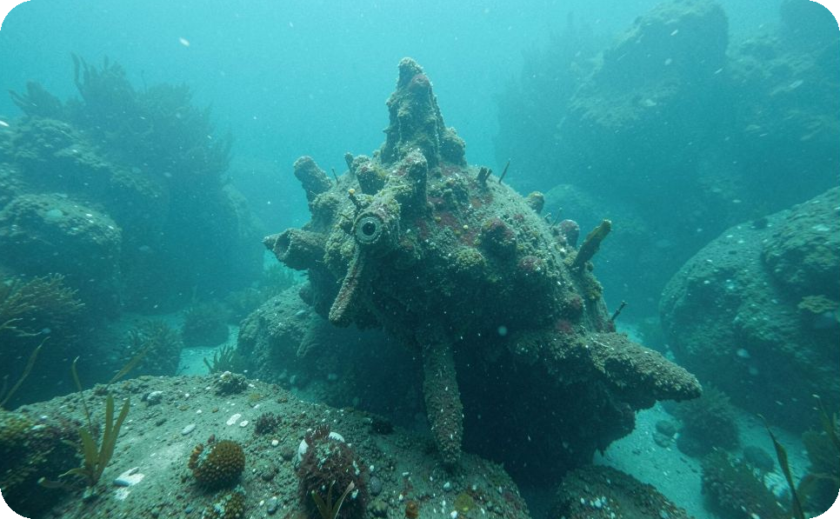

WHY IT MATTERS
Why it matters, and the cost of ignoring it
Labels are scarce
Marking every pixel of underwater photos by hand is slow and expensive. USOD has only 300 images.
Water hides the object
Light absorption, haze and colour cast defeat hand-made colour thresholds.
Vehicles need a cue
An AUV that cannot tell something is ahead cannot avoid it, inspect it or follow it.
If we do not solve it: every new site or camera needs fresh labelled data, or the vehicle stays blind to what is in front of it.
AUV use is the motivation here, not yet a demonstrated result.

Slide 4
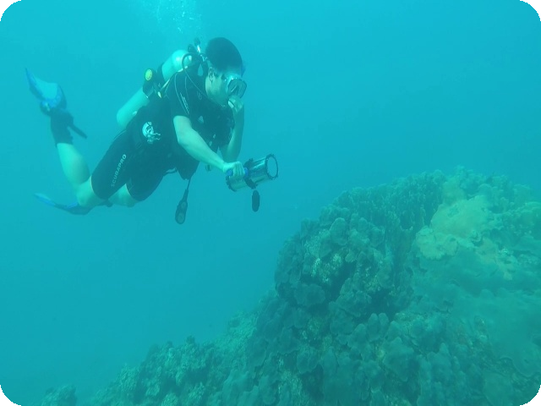
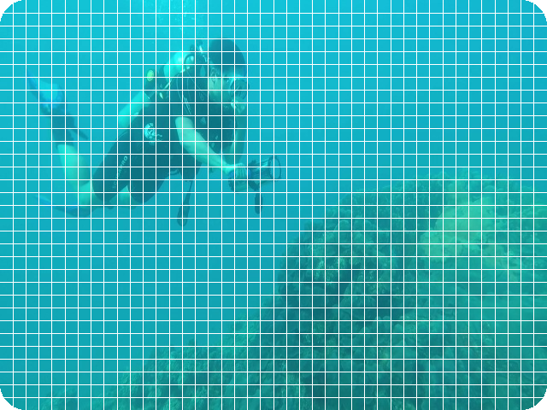
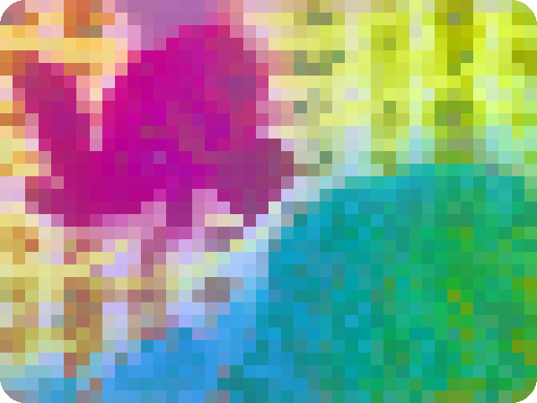


THE METHOD IN PLAIN WORDS
How the method works, step by step
1 · Photo
2 · Patches
3 · Fingerprints
4 · Groups
5 · Object
›
›
›
›
An underwater image goes in.
Cut into 14 × 14 pixel squares: 42 × 32 = 1,344 patches.
DINOv2 gives each patch 768 numbers. Shown here squeezed into 3 colours.
Patches that look alike are put in the same group.
Pick the groups that are the object. That is the mask.
Think of sorting jigsaw pieces by how they look, then deciding which piles are the fish and which are the water. Nothing is trained: the DINOv2 model is used as it is.

Slide 5
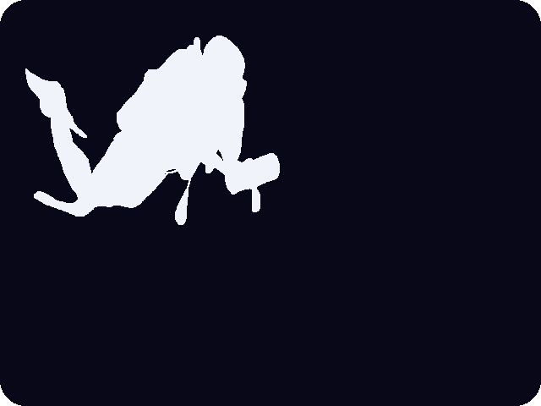
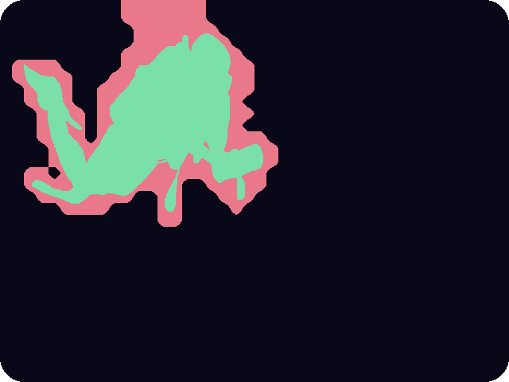
DATA AND METRIC
What we measure: overlap with the true mask
USOD photo
Ground truth (drawn by annotators)
Our mask
hit false alarm missed
IoU = overlap ÷ area covered by either mask
This image: 31,307 ÷ 57,622 = 0.54
1 means a perfect match, 0 means no overlap.
300 USOD underwater images, each with a true object mask
Every number later is a mean IoU over these 300 images.

Slide 6
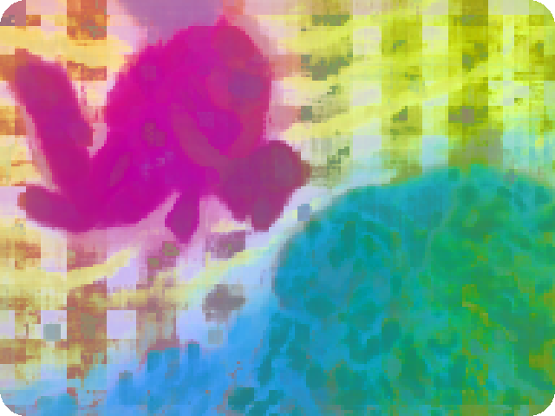
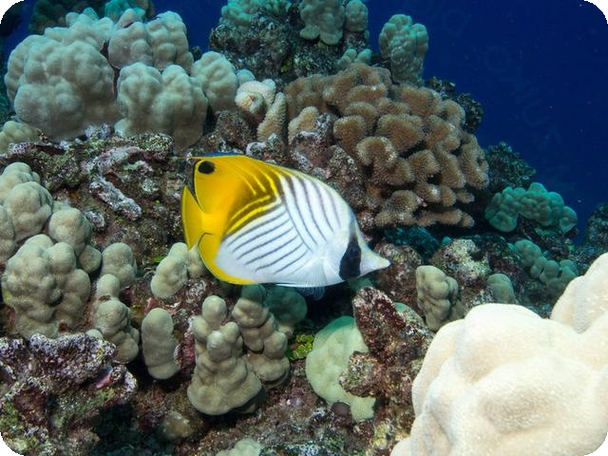
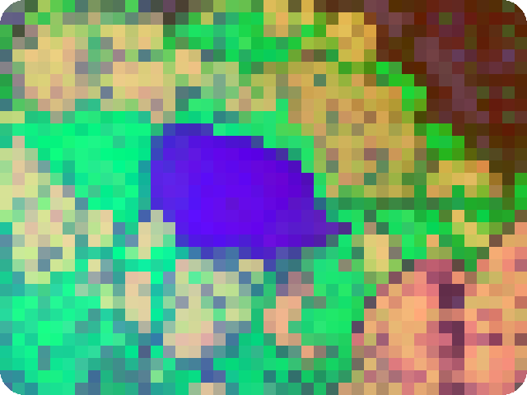
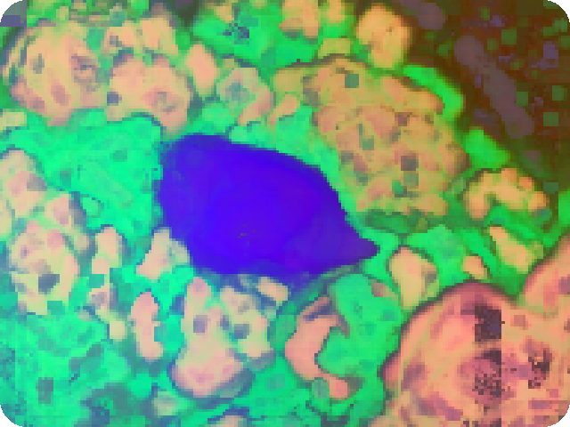
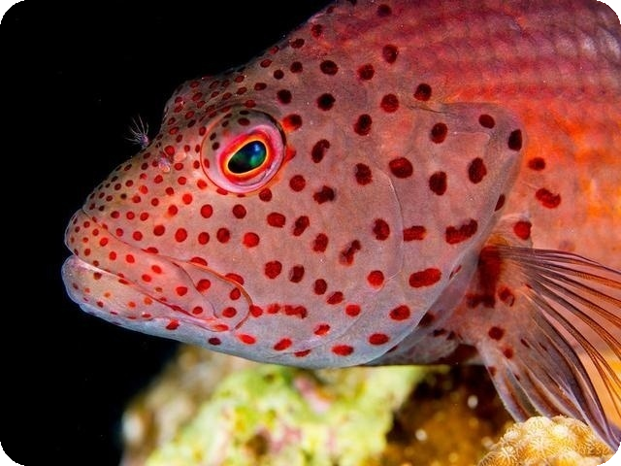
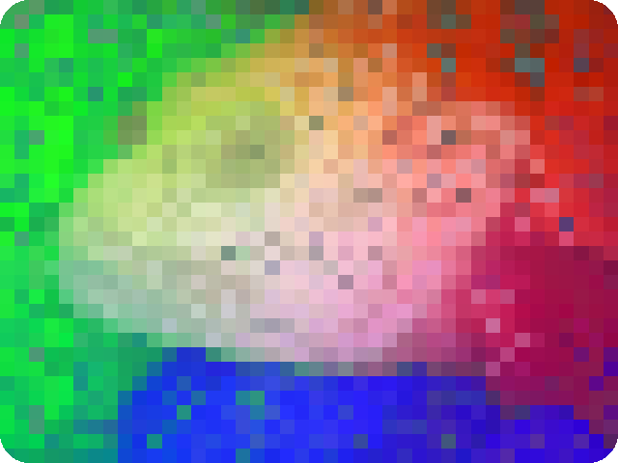
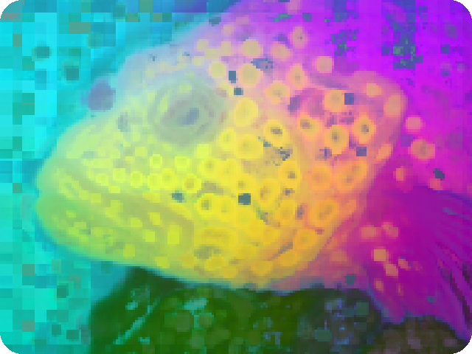
FEATURE MAPS
PCA-RGB maps: stride 14, then stride 3
Photo
Stride 14: blocky
Stride 3: smoother
What you see: three colours made from the 768 numbers of every patch. Same colour means similar patch: diver, water and reef separate without any training.
Stride 3: we slide the patch grid by 3 pixels instead of 14, so the map has finer detail and looks much better.
But the score barely moves: best-case IoU 0.703 → 0.702 (raw 768-D), at about 17× the backbone time.

Slide 7
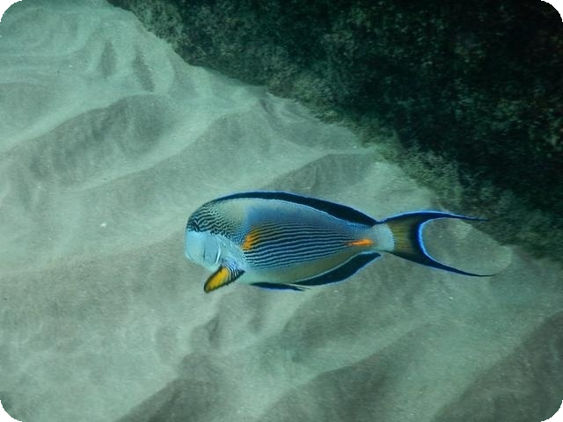
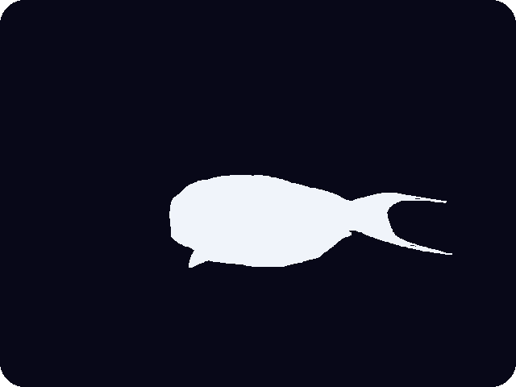
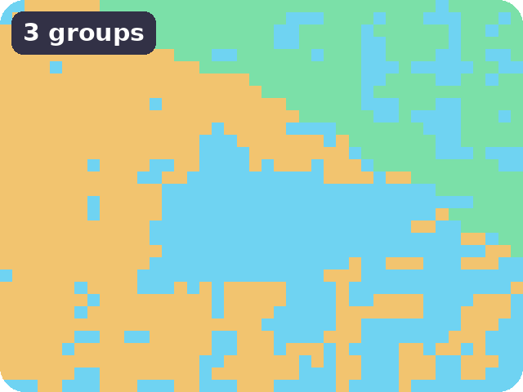
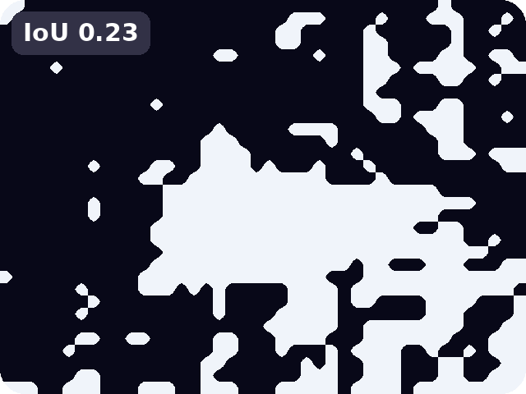
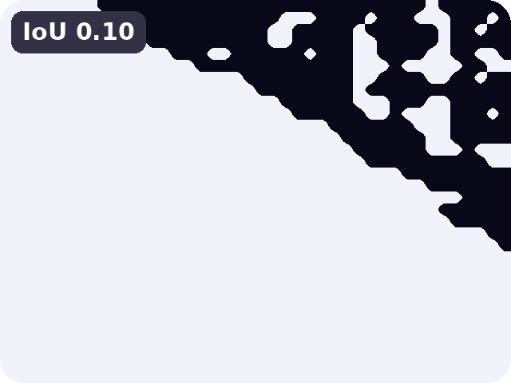
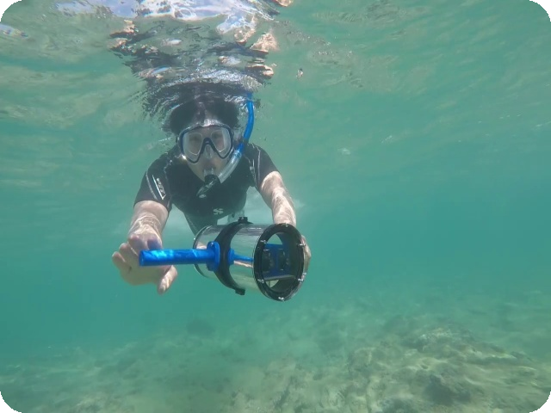

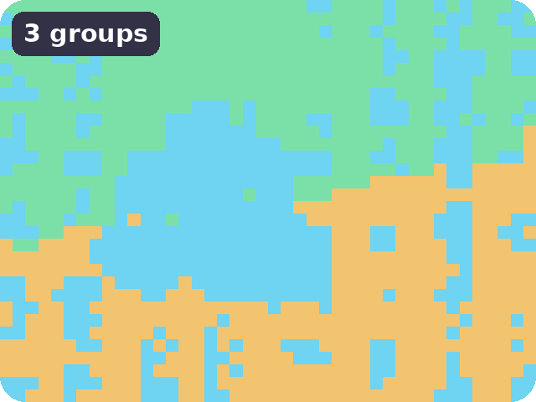
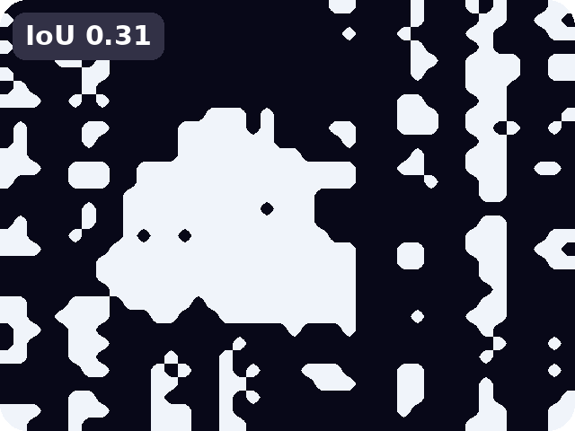
K-MEANS · UP TO 4 CLUSTERS
k-means with up to 4 groups
Photo
True mask
Groups found (k ≤ 4)
Best choice of groups (uses true mask)
Our mask (no labels used)
With 4 groups the fish and the diver are split over several groups, so even the best choice is rough. Mean over 300 images (raw 768-D): best possible 0.676 · without labels 0.560. PCA-RGB: 0.662 · 0.456

Slide 8
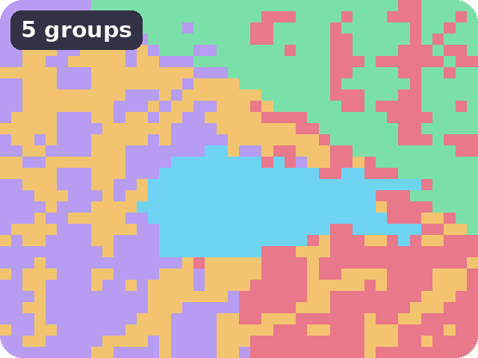
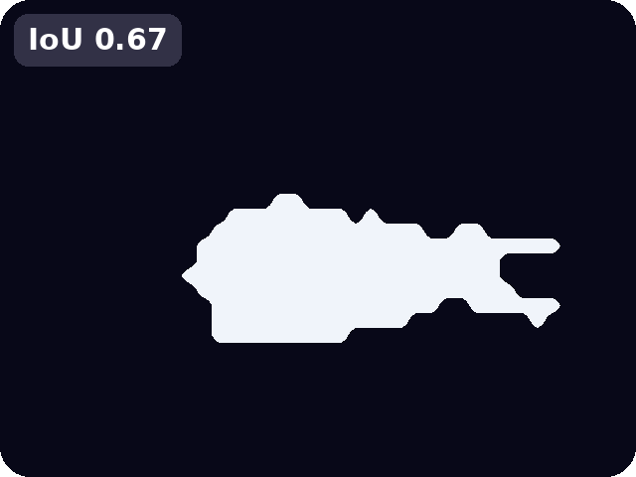
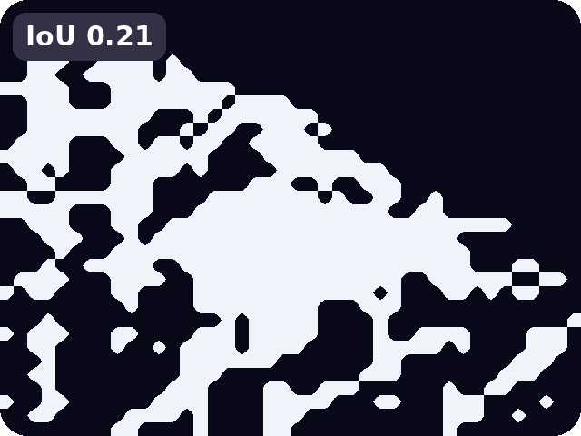
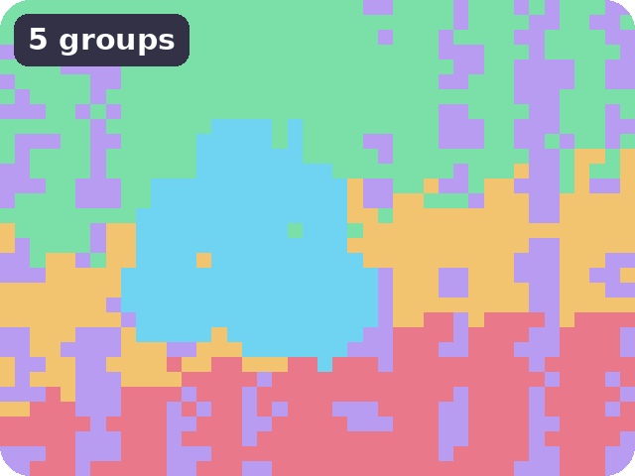
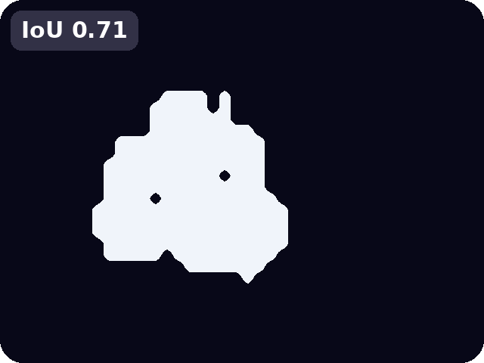
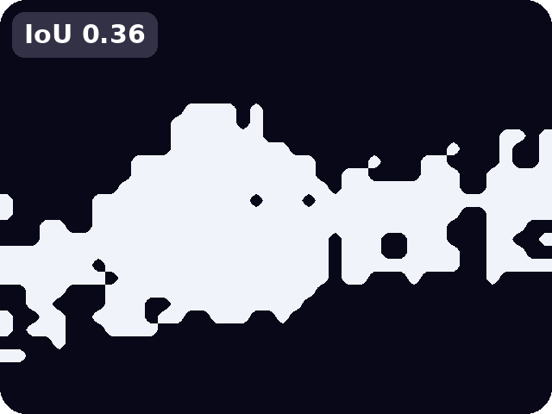
K-MEANS · UP TO 6 CLUSTERS
Same images: 4 groups versus 6 groups
k ≤ 4
k ≤ 6
Photo
Groups
Best choice
Our mask
Groups
Best choice
Our mask
More groups give a much better best choice: 0.23 → 0.67 and 0.31 → 0.71 on these two images (mean 0.676 → 0.703; better by more than 0.10 on 29 of 300 images).
But our mask, with no labels, hardly follows: 0.10 → 0.21 and 0.31 → 0.36 here, and the mean over 300 images falls 0.560 → 0.531.

Slide 9
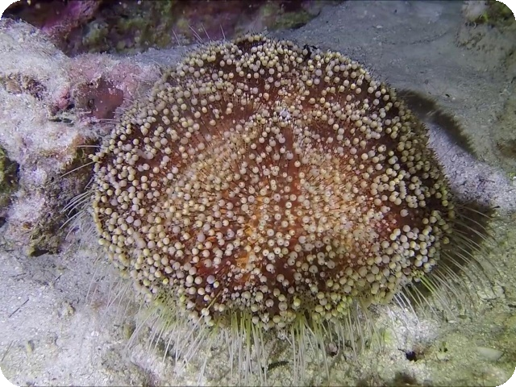
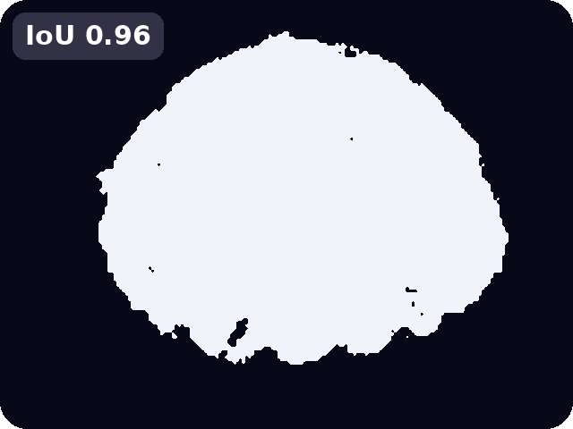
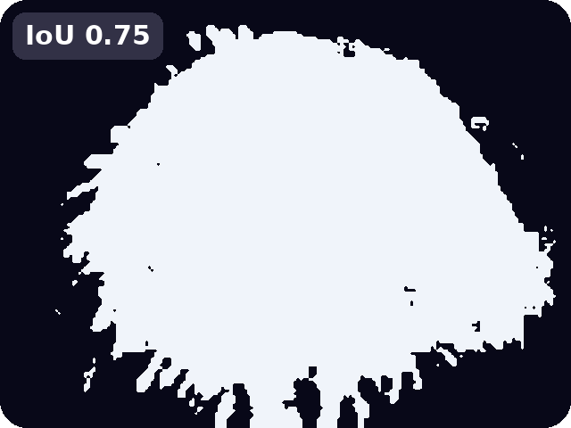
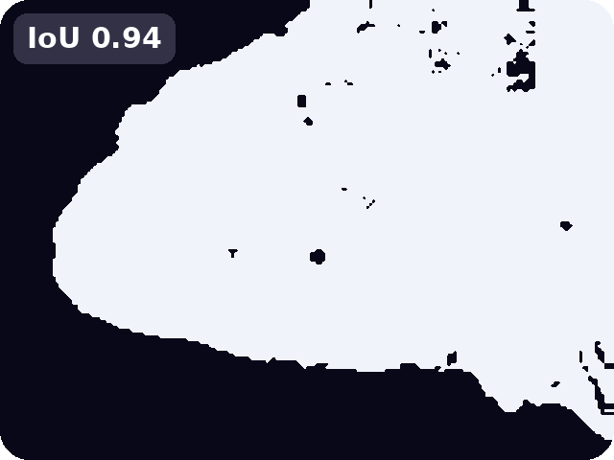
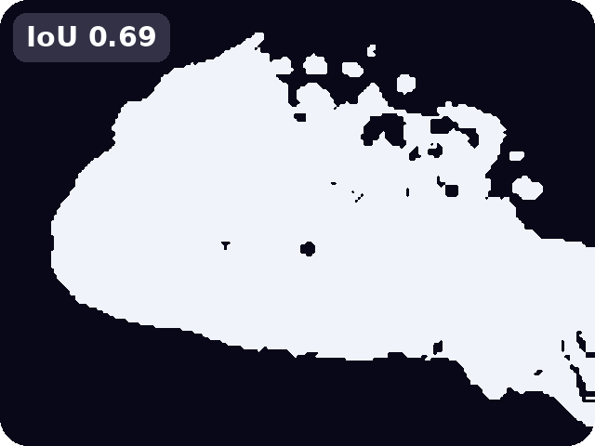
THE REAL PROBLEM
The groups are good; choosing them is hard
Photo
Best choice
Our choice (no labels)
0.70 vs 0.52
Mean over 300 images. The groups already contain a good mask; our rule for picking the object is the weak link, so we try a dendrogram.

Slide 10
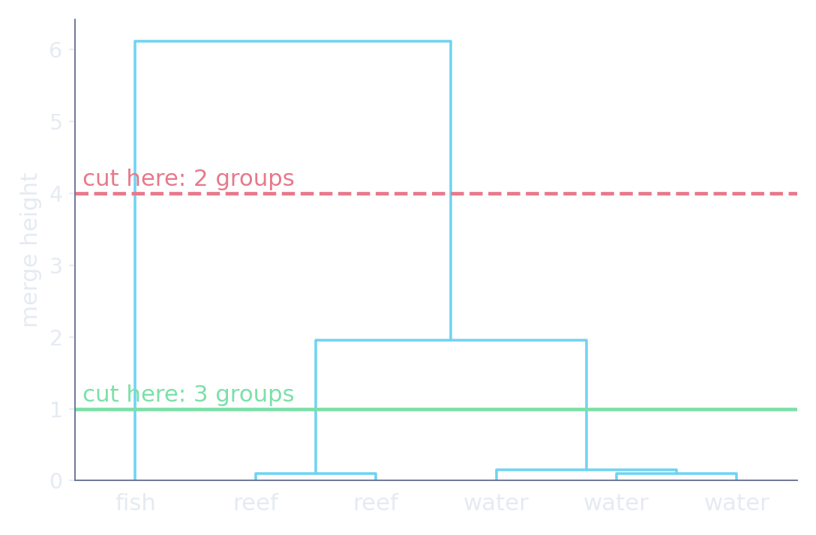
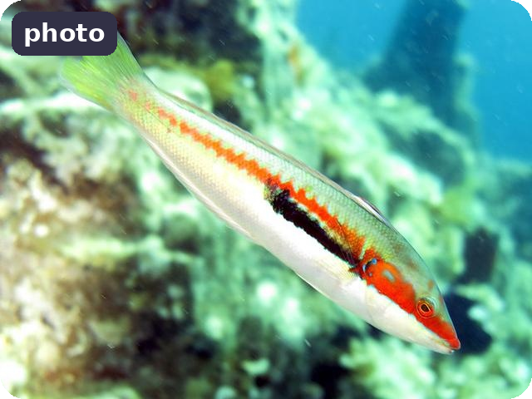
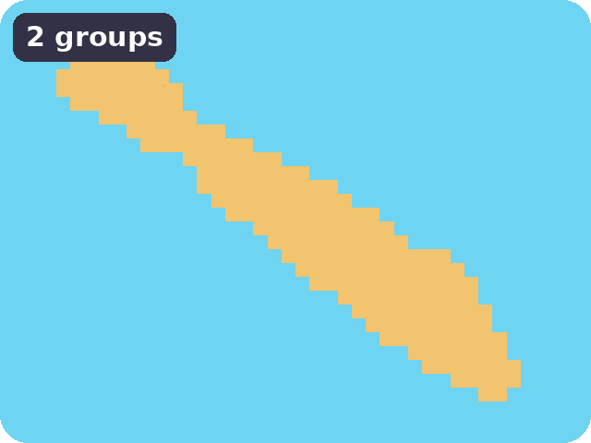
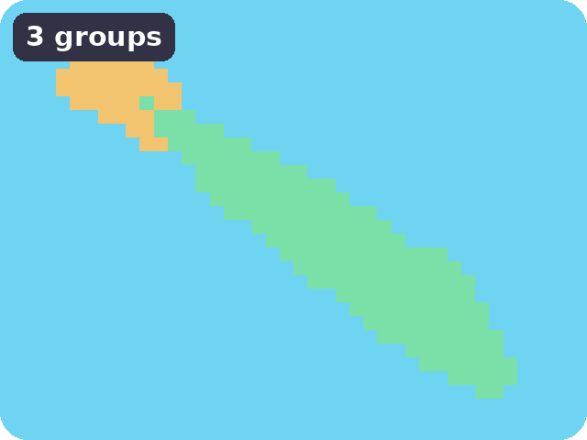
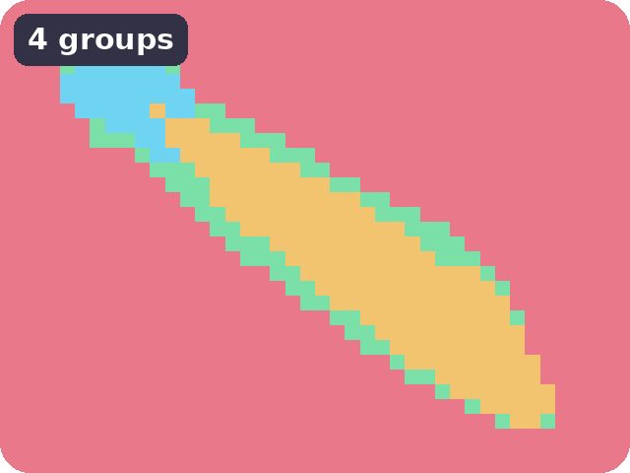
DENDROGRAMS
A dendrogram is a family tree of patches
1 Every patch starts alone; glue the closest groups, again and again.
2 Cutting the tree at a height gives k groups.
3 One tree gives every k: 2 groups, 3, 4 … each one a split of the last.
A real image: one tree, cut at three heights.

Slide 11
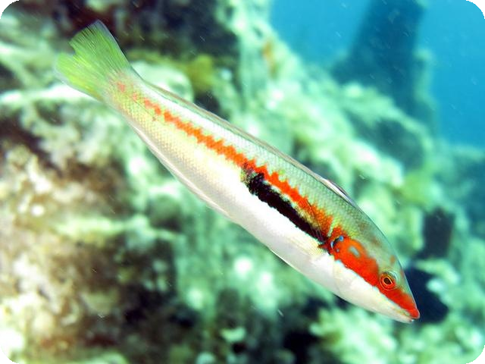

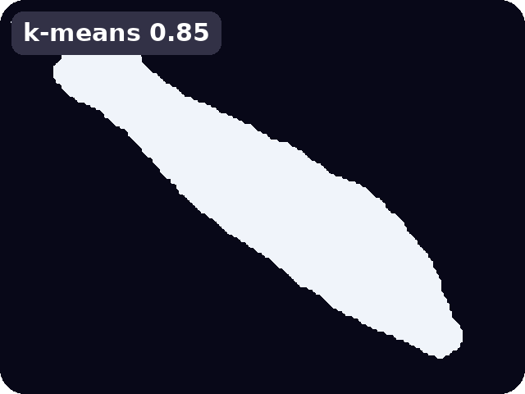
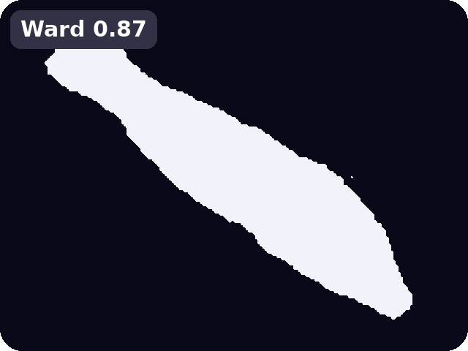
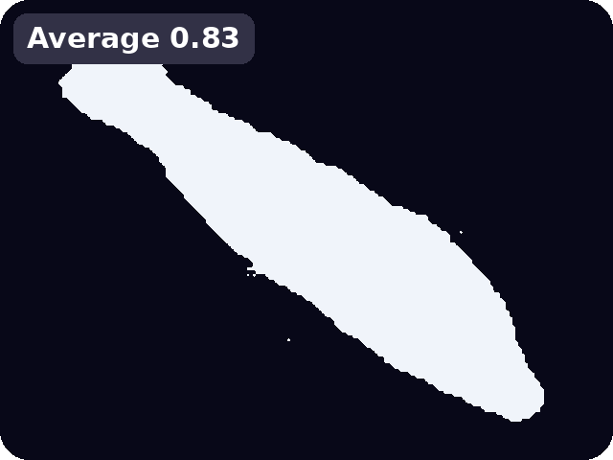
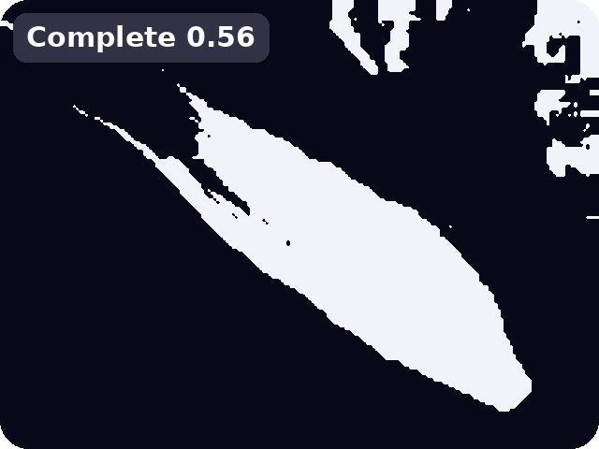
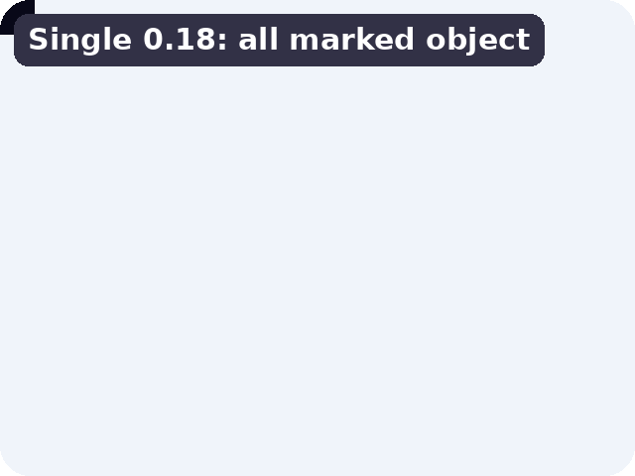
DENDROGRAM VARIANTS
Four ways to measure 'closest' between groups
Same photo, same rule for picking groups. Only the way groups are compared changes.
Why Single is all white: it chains patches into one huge group (99.7% of the patches), and the few left out sit on the border, so everything else is called object. The score is then just the fish's share of the picture, 0.18 (mean over 300 images 0.22). Average works best on USOD (0.65).

Slide 12
RESULTS
Dendrogram versus k-means on USOD
+0.12
mean IoU gain over k-means (95% interval +0.09 to +0.15)
52% / 20%
of images clearly better / clearly worse than with k-means
Same trend on SUIM: +0.12 on 108 images with its salient-object masks.
Mean IoU on 300 USOD images, stride 3, raw 768-D, no labels used (grey: k-means, amber: upper bound).

Slide 13
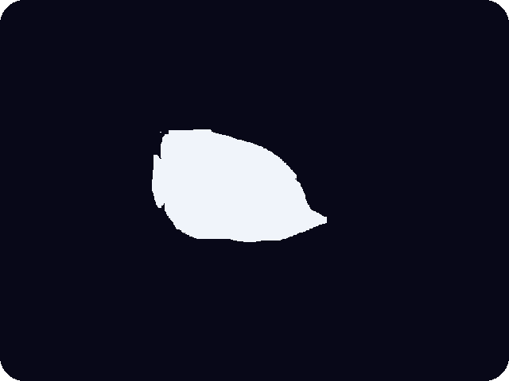
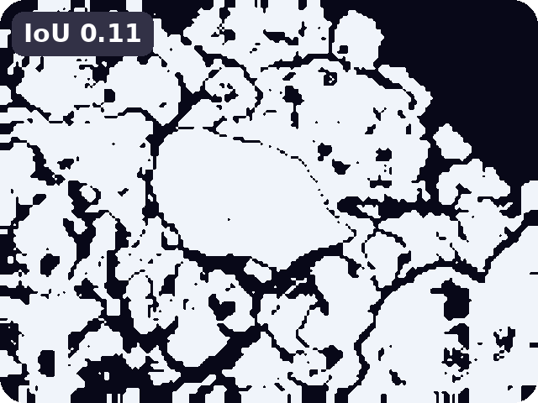
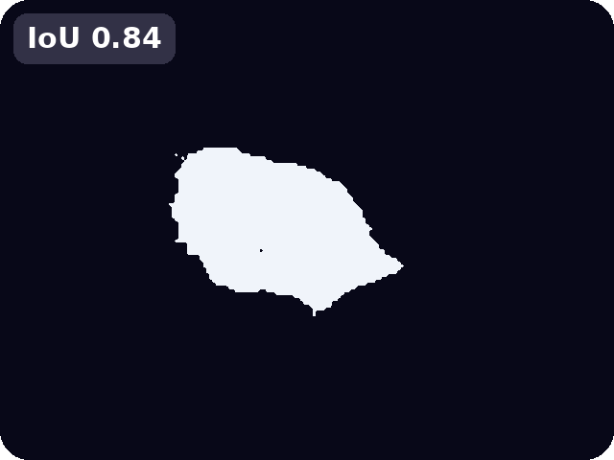








WHERE IT WINS
Where the dendrogram fixes k-means mistakes
Photo
True mask
k-means
Dendrogram
k-means picks the wrong group (IoU 0.07 to 0.11) on these three images.
The dendrogram, with average linkage and the gap cut, finds the object (IoU 0.72 to 0.84).

Slide 14





A FAILURE, AND WHY
When it fails: the same method on usod_test40
Why: the gap rule cuts at 2 groups, but the top split of the tree separates only 6 of 27,840 patches (0.02%), a few odd patches.
The rest is then called the object, so almost the whole picture becomes object (IoU 0.21).
Cutting at 4 groups works (0.83). About 1 image in 5 gets worse than with k-means.

Slide 15
CONCLUSION AND PLAN
Conclusion and plan for Review 3
0.52 → 0.65
mean IoU without labels, k-means → dendrogram (USOD)
0.71
best possible with the same groups, so the gain is in how we choose them
52% / 20%
of images clearly better / clearly worse
Limits
Best variant picked on the same images it is scored on (best of 64).
On SUIM 'everything except water' labels a trivial guess already scores 0.52.
Only 2 to 6 groups tried; rule constants not tuned; no real-time test yet.
Plan for Review 3 · [date]
1 Stop tiny outlier groups from winning the gap rule; test on held-out images.
2 Ablations and a baseline comparison (SVAM-Net).
3 Generalise: SUIM per-class evaluation and more data.
4 Measure speed for onboard use; final report.

Slide 16
THANK YOU!!
Notes:
10

