Slide 1

Bonus Lab 1
Inertial Measurement Units
This lecture is part of the RACECAR-MN introductory robotics course. You can visit the course webpage at mitll-racecar-mn.readthedocs.io.

Slide 2
Objectives
Main Objective: Use the RACECAR’s IMU data to prevent rolling
Learning Objectives
Use the Physics module to retrieve linear acceleration and angular velocity

Slide 3
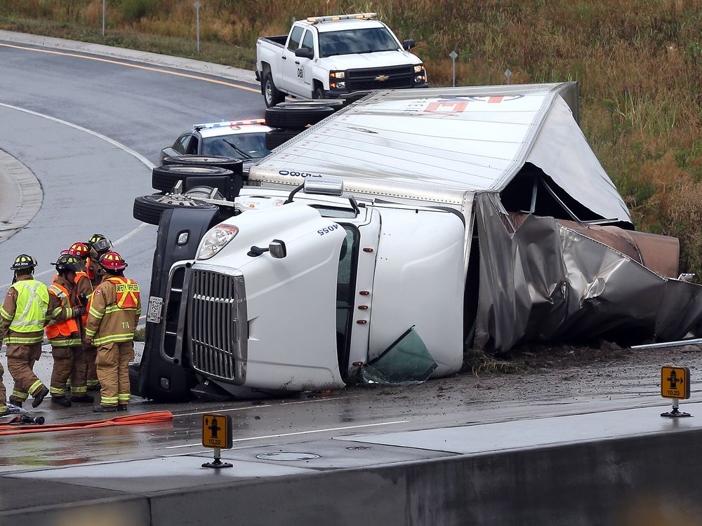
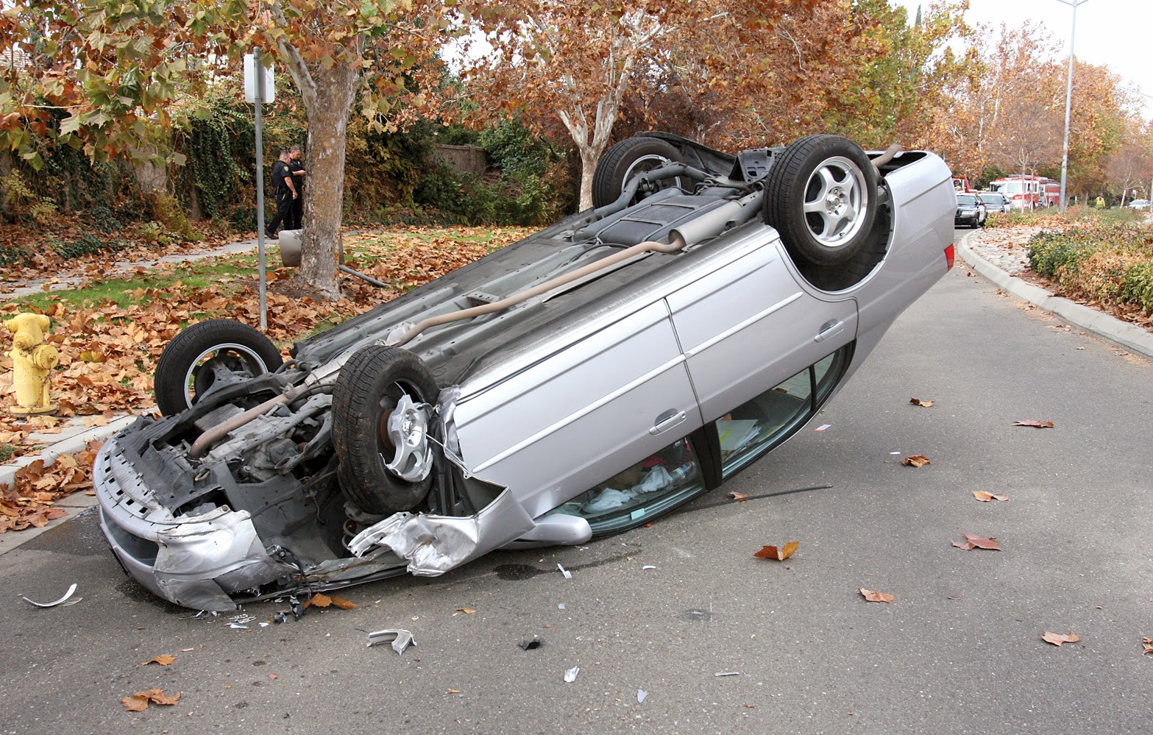
Roll Prevention
Vehicle rollover is a threat for cars and trucks
Turning too quickly can cause a vehicle with a high center of mass to roll

Slide 4
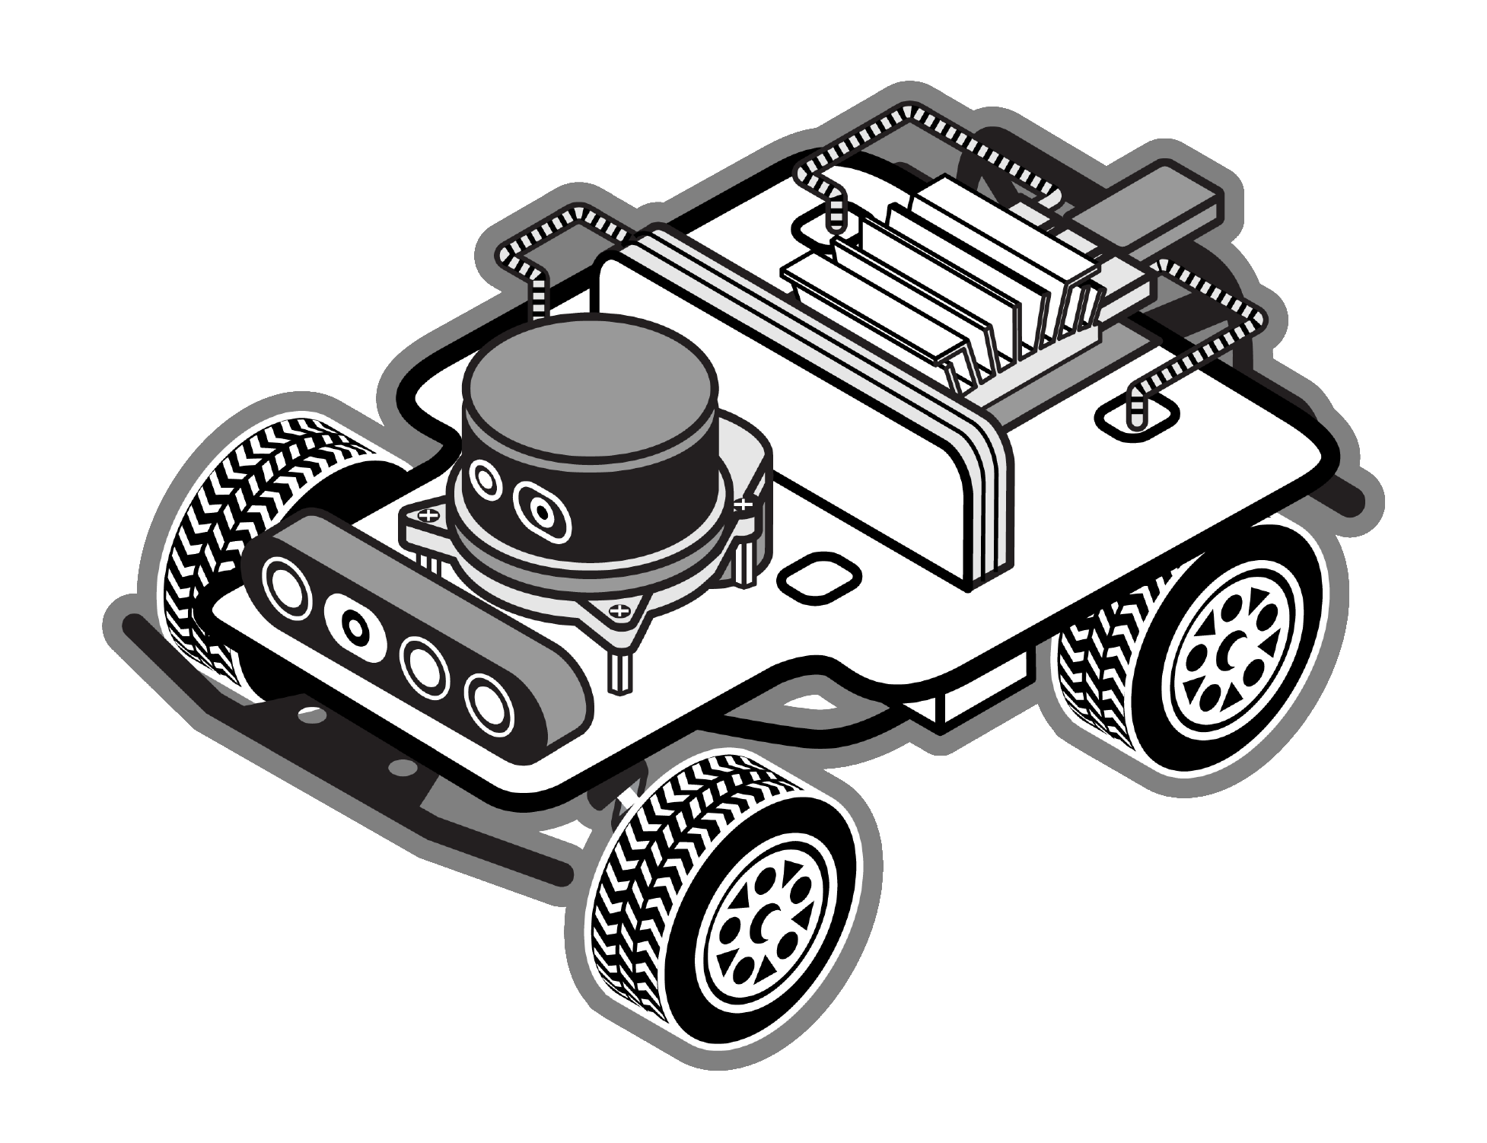
Roll Prevention
It is difficult to roll the RACECAR-MN due to its low center of mass, but we will model this problem by artificially raising the center of mass in RacecarSim

Slide 5
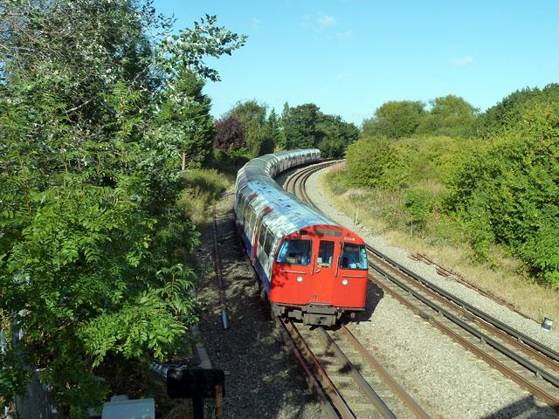
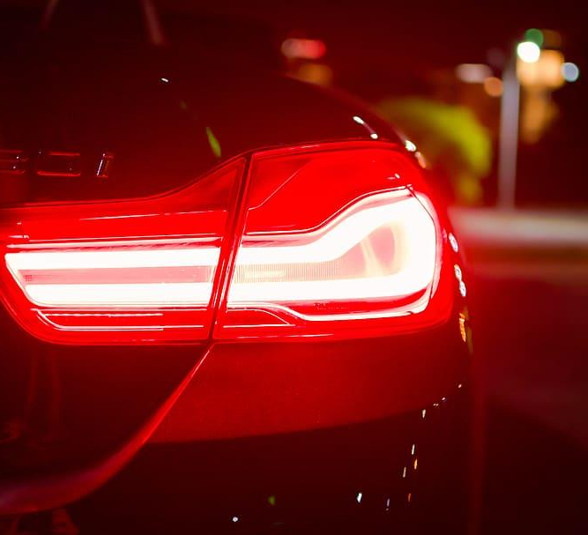
Rolling Prevention
Rolling is caused by inertia
When a car turns the inertial force continues linearly, which creates an outward force
There are various ways to prevent rolling:
Super elevation
Wider turning
Reducing speed

Slide 6
Inertial Measurement Unit (IMU)
Uses accelerometers and gyroscopes to measure:
Linear acceleration (acceleration data)
Angular velocity (gyro data)

Slide 7
Inertial Measurement Unit (IMU)
Accel
Gyro
-
+
-
Yaw
RIGHT
+
+
-
FRONT
+
Pitch
+
DOWN
Roll
+

Slide 8
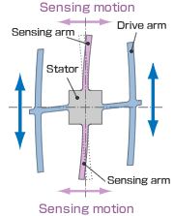
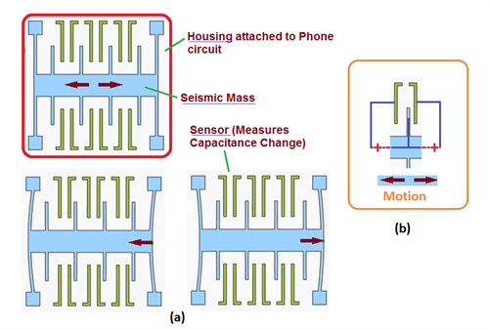
Inertial Measurement Unit (IMU)
Accelerometer
Gyroscope

Slide 9

Group activity
Using IMU Data
What benefits are there to having linear acceleration?
What benefits are there to having angular velocity?
What concerns do you have about using the IMU data?

Slide 10
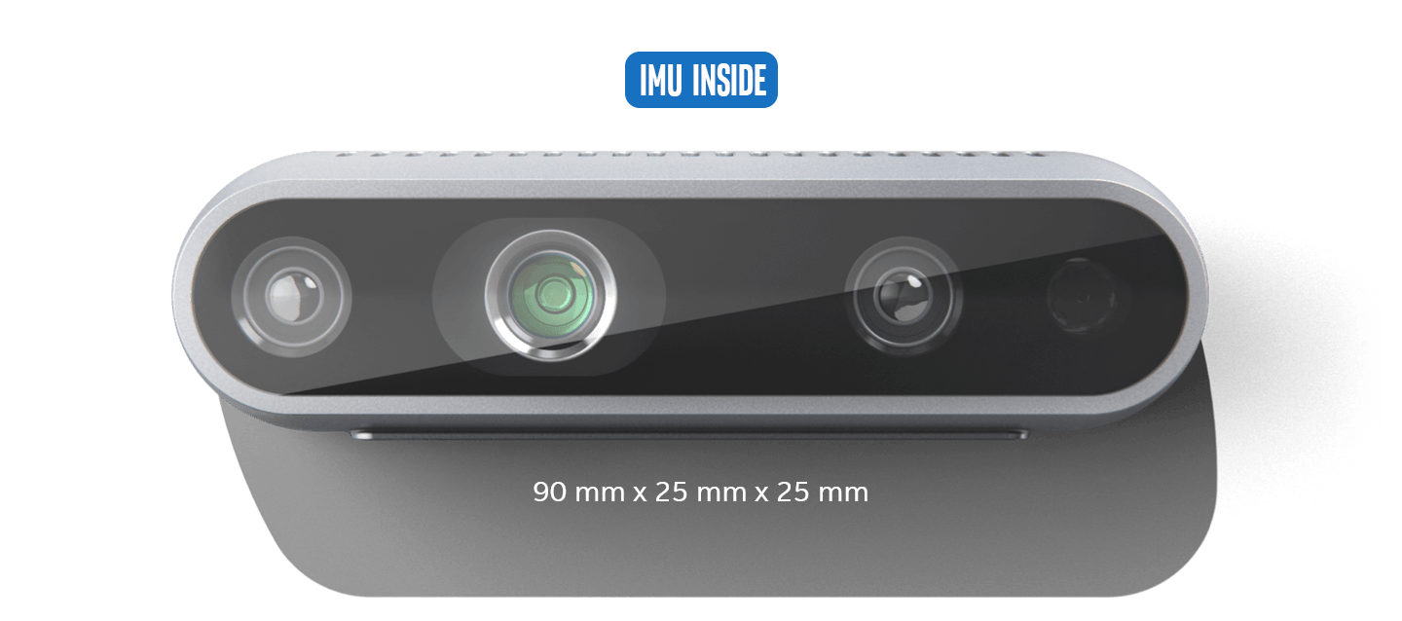
Intel RealSense D435i

Slide 11
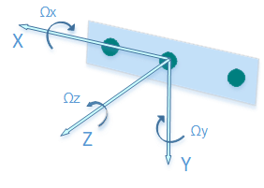
Acceleration
Has three values (in m/s²):
Linear acceleration on X-axis, which points to the right
Linear acceleration on Y-axis, which points down
Linear acceleration on Z-axis, which points forward
FRONT of RACECAR

Slide 12
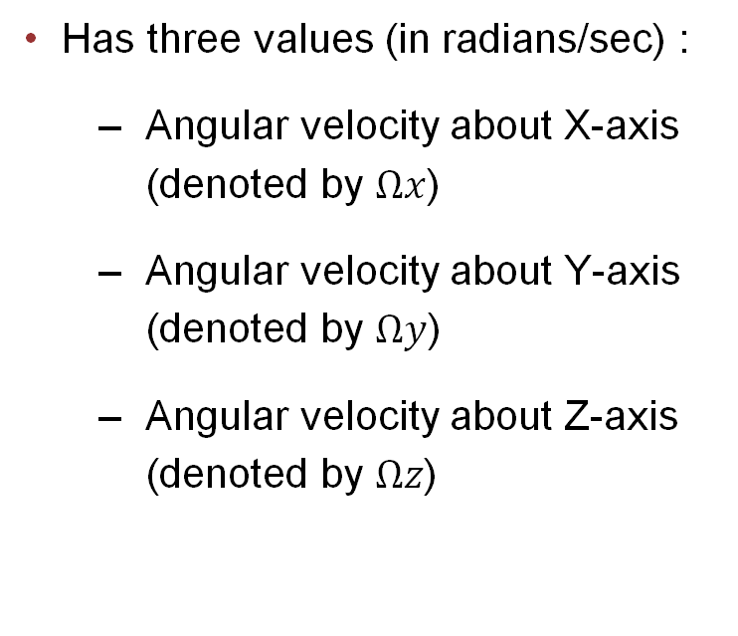
Gyro
Has three values (in radians/sec) :
Angular velocity about X-axis (denoted by $Ωx$)
Angular velocity about Y-axis (denoted by $Ωy$)
Angular velocity about Z-axis (denoted by $Ωz$)
FRONT of RACECAR

Slide 13
Physics Module
Retrieves IMU data
Public Interface
get_linear_acceleration()
get_angular_velocity()
Notes:
https://mitll-racecar.readthedocs.io/en/latest/controller.html

Slide 14
Examples
Group activity
# Example 1
def update():
accel = rc.physics.get_linear_acceleration()
ang_vel = rc.physics.get_angular_velocity()
if accel[2] > 0.10:
print("Kachow!")
if ang_vel[0] > 0.25:
rc.drive.stop()

Slide 15
Examples
Group activity
foo = 0
def update():
global foo
ang_vel = rc.physics.get_angular_velocity()
foo += ang_vel[1] * rc.get_delta_time()
if foo < math.pi / 2:
rc.drive.set_speed_angle(1, 1)
else:
rc.drive.set_speed_angle(1, 0)

