Slide 1

Bonus Lab 2
Sensor Fusion
This lecture is part of the RACECAR-MN introductory robotics course. You can visit the course webpage at mitll-racecar-mn.readthedocs.io.

Slide 2
Objectives
Main Objective: Perform sensor fusion to produce a more accurate velocity estimation
Learning Objectives
Identify several ways to calculate velocity from the sensors onboard the RACECAR-MN
Learn strategies to combine several sources of data into a single, more trustworthy value

Slide 3

Estimating Velocity
Group activity
How can we estimate velocity on the RACECAR-MN?
What are the limitations of each method?

Slide 4
Estimating Velocity
Group activity
How can we estimate velocity on the RACECAR-MN?
Track throttle input
Integrate IMU linear acceleration
Change in distance detected by depth camera
Change in distance detected by LIDAR
Change in object size seen by color camera
What are the limitations of each method?

Slide 5
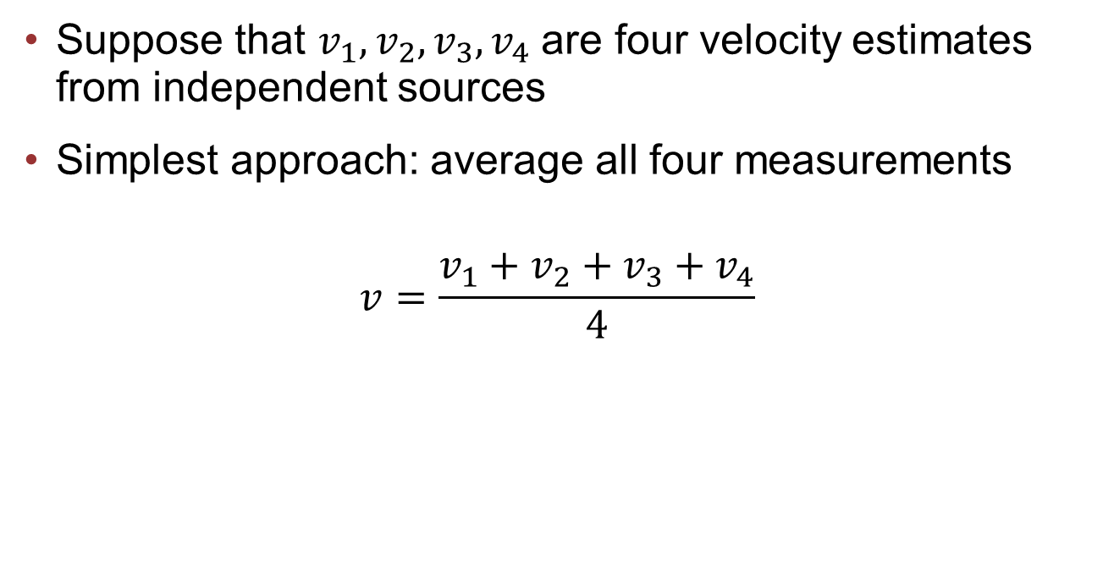
Simple Average
Suppose that $v_{1}, v_{2},v_{3},v_{4}$ are four velocity estimates from independent sources
Simplest approach: average all four measurements
$$v=\frac{v_{1}+v_{2}+v_{3}+v_{4}}{4}$$

Slide 6
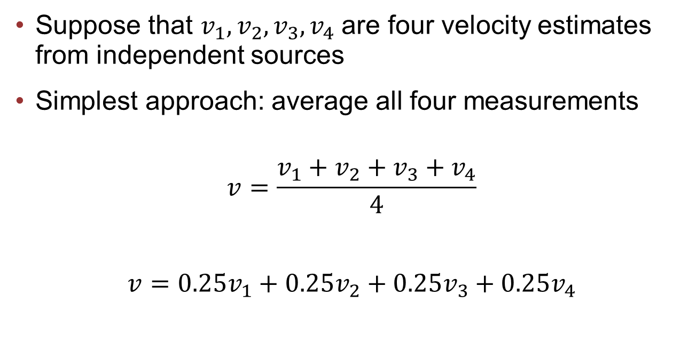
Simple Average
Suppose that $v_{1}, v_{2},v_{3},v_{4}$ are four velocity estimates from independent sources
Simplest approach: average all four measurements
$$v=\frac{v_{1}+v_{2}+v_{3}+v_{4}}{4}$$
$$v=0.25v_{1}+0.25v_{2}+0.25v_{3}+0.25v_{4}$$

Slide 7
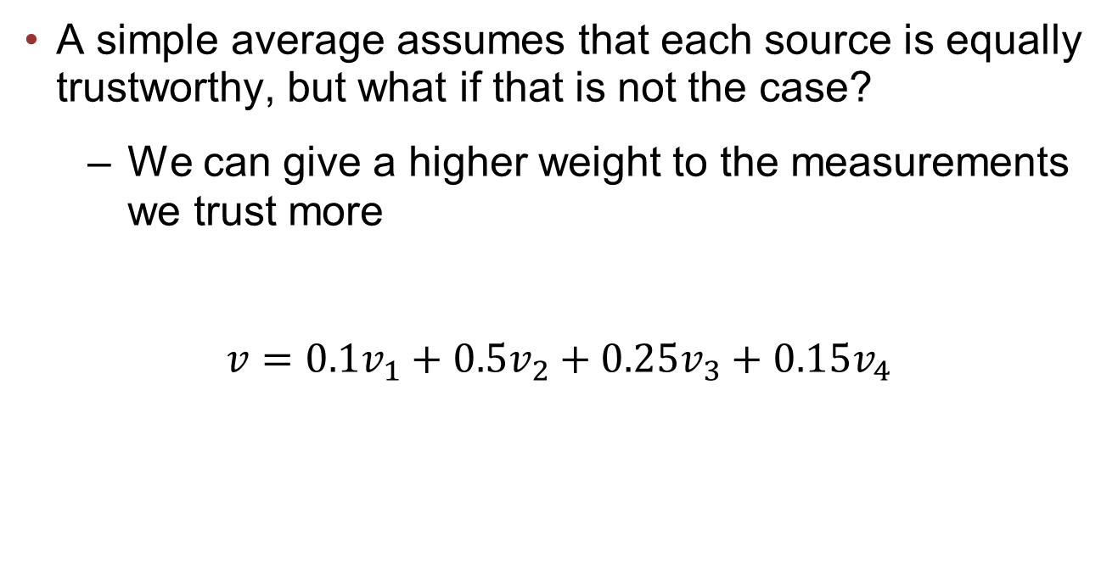
Weighted Average
A simple average assumes that each source is equally trustworthy, but what if that is not the case?
We can give a higher weight to the measurements we trust more
$$v=0.1v_{1}+0.5v_{2}+0.25v_{3}+0.15v_{4}$$

Slide 8
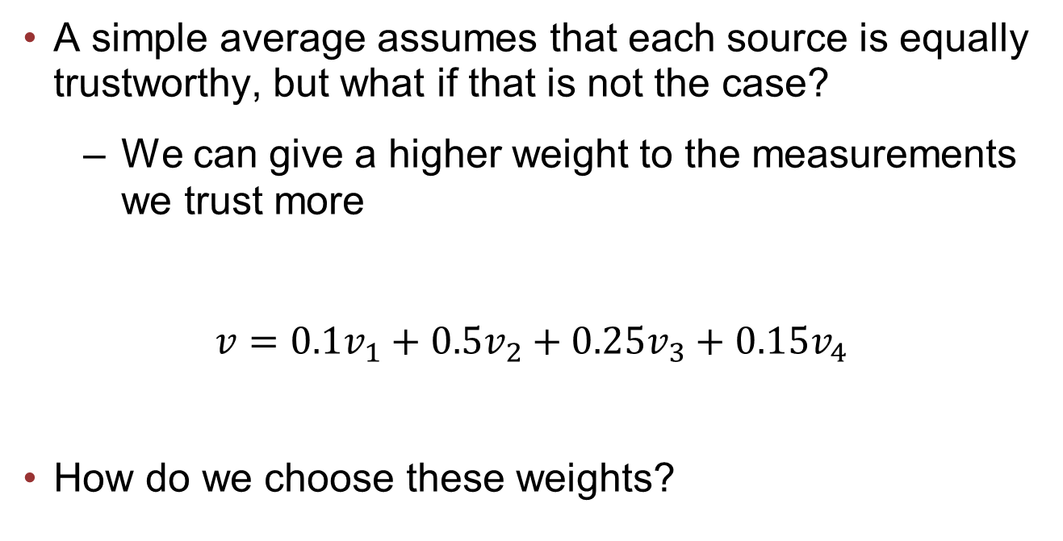
Weighted Average
A simple average assumes that each source is equally trustworthy, but what if that is not the case?
We can give a higher weight to the measurements we trust more
$$v=0.1v_{1}+0.5v_{2}+0.25v_{3}+0.15v_{4}$$
How do we choose these weights?

Slide 9
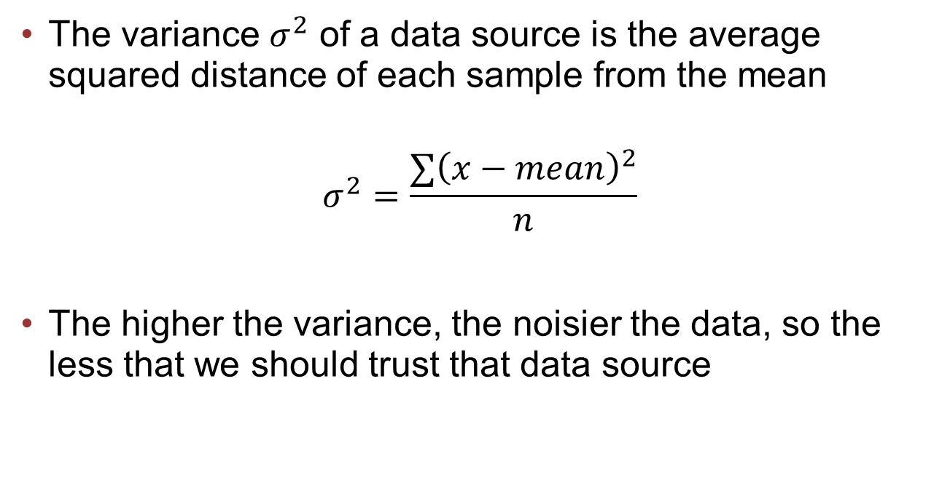
Variance
The variance $σ^{2}$ of a data source is the average squared distance of each sample from the mean
$$σ^{2}=\frac{∑{\left(x−mean\right)}^{2}}{n}$$
The higher the variance, the noisier the data, so the less that we should trust that data source

Slide 10
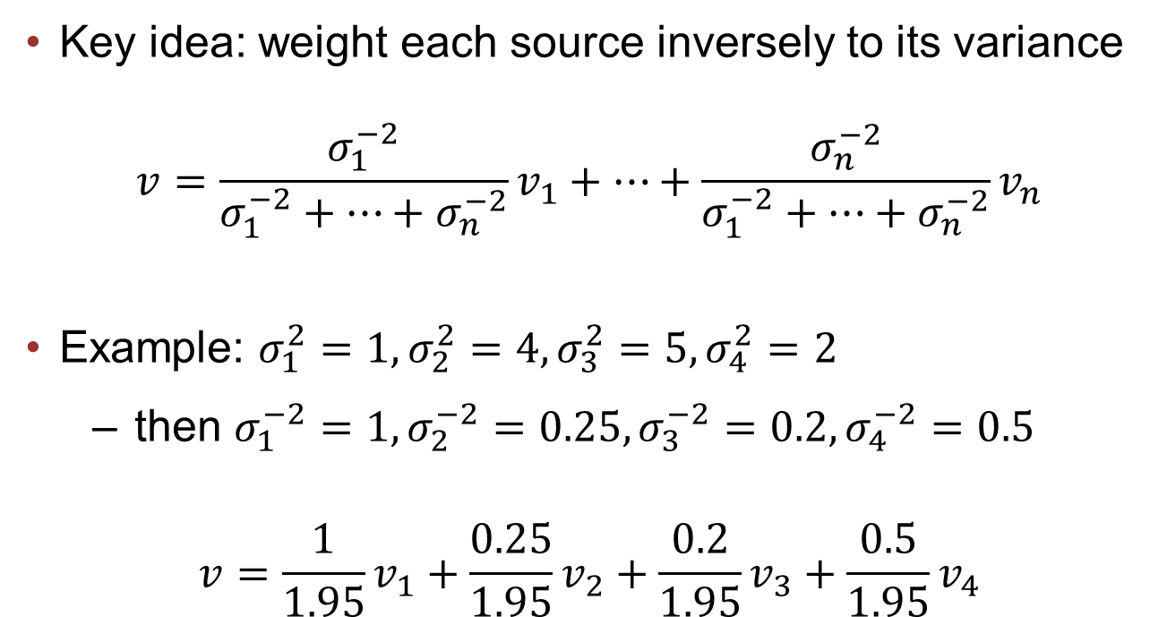
Variance
Key idea: weight each source inversely to its variance
$$v=\frac{σ_{1}^{−2}}{σ_{1}^{−2}+…+σ_{n}^{−2}}v_{1}+…+\frac{σ_{n}^{−2}}{σ_{1}^{−2}+…+σ_{n}^{−2}}v_{n}$$
Example: $σ_{1}^{2}=1, σ_{2}^{2}=4, σ_{3}^{2}=5, σ_{4}^{2}=2$
then $σ_{1}^{−2}=1, σ_{2}^{−2}=0.25, σ_{3}^{−2}=0.2, σ_{4}^{−2}=0.5$
$$v=\frac{1}{1.95}v_{1}+\frac{0.25}{1.95}v_{2}+\frac{0.2}{1.95}v_{3}+\frac{0.5}{1.95}v_{4}$$

Slide 11
Further Considerations
Ignore an input if the measurement must be a mistake
ex: no data, velocity > 5 m/s, etc.
Adjust weights depending on environment
ex: trust depth/LIDAR data less if we are turning
ex: trust depth camera less in the dark
Calculate variance on the fly

Slide 12
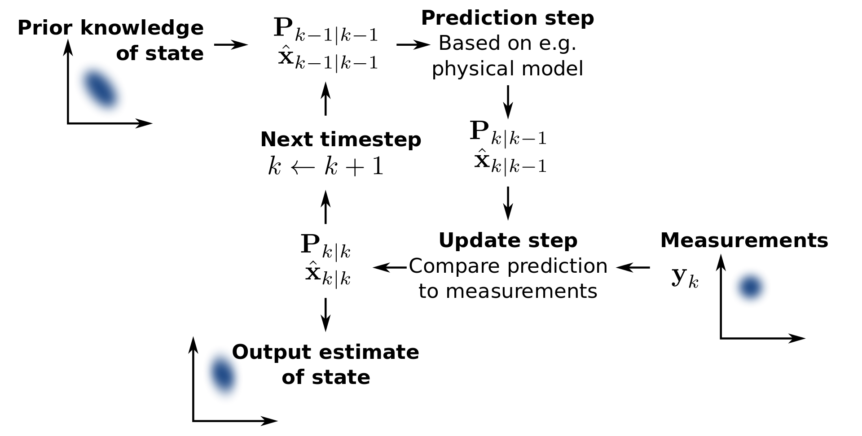
Further reading
Kalman filtering provides a more sophisticated approach which is beyond the scope of this lecture
Notes:
Further reading: https://www.kalmanfilter.net/default.aspx

Slide 13
Lab 6 Objectives
Lab 6: Sensor fusion of velocity
Develop several methods to calculate velocity
Fuse these sources into a single velocity estimate
Complete a course while limiting the car's velocity below 0.5 m/s

