Slide 1


Lab 1 – Driving in Shapes
MIT Beaver Works Racecar Curriculum
https://matthewcalligaro.github.io/RacecarWebsite/

Slide 2
Lab Objectives
Main objective: Program the car to respond to controller input and drive in predefined shapes
Learning objectives
Use the start-update paradigm to create a program which can run on the car
Use the drive module to move the car
Use the controller module to respond to input from the Xbox controller in real time

Slide 3
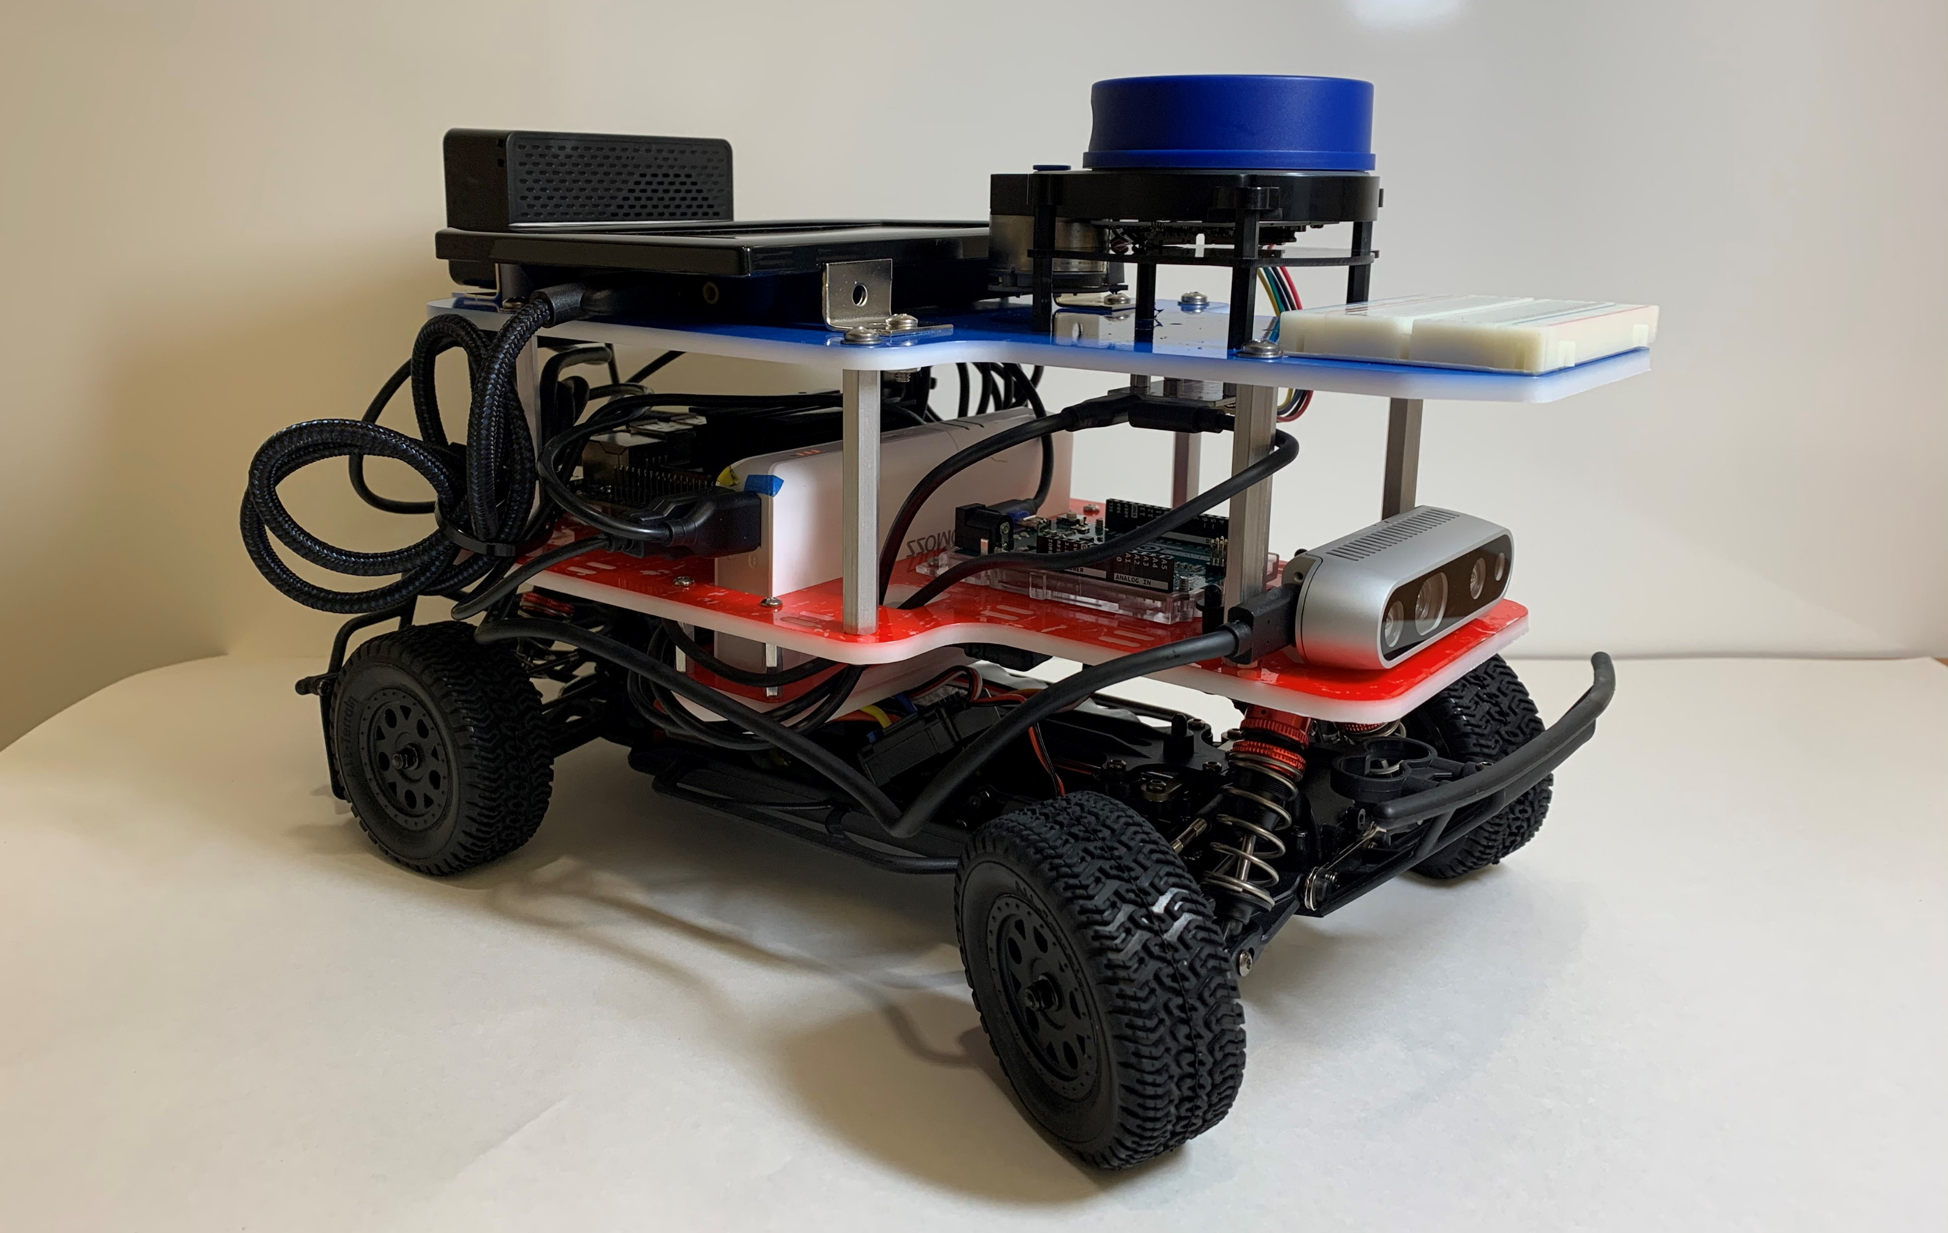
Finished Car

Slide 4
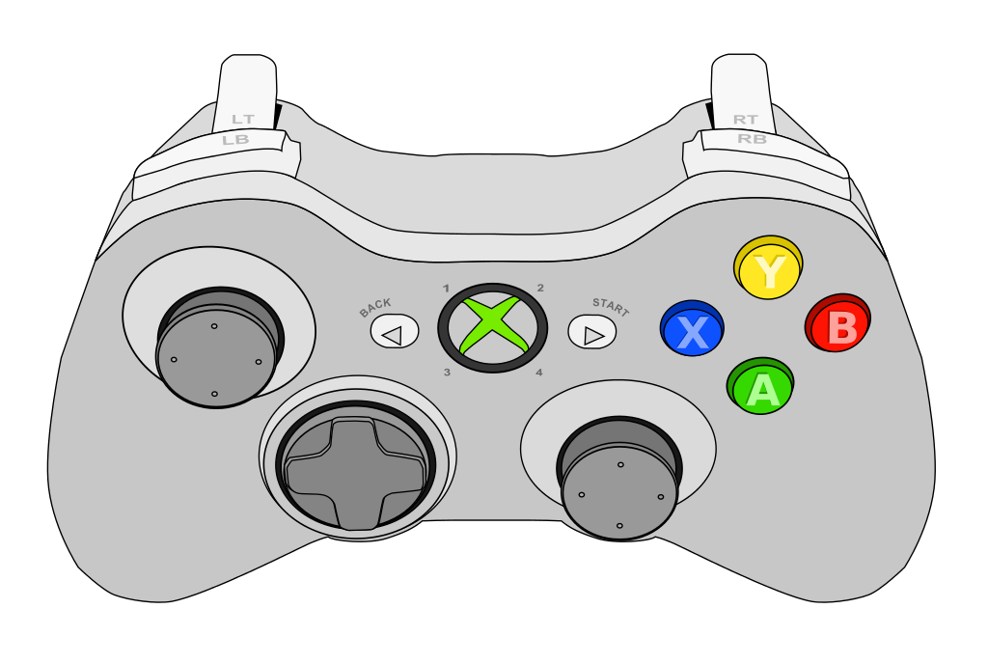
Car Modes – Default Drive
When you launch a RACECAR program, the car starts in default drive mode so you can easily drive around
Accelerate backward
Start user program
Accelerate forward
Steer
Print message

Slide 5

Car Modes – User Program
You can then tell the car to execute your Python program, which consists of a start and update function
Start: run once when you enter user program mode
Update: run 60 times per second in user program mode
Button |  | Effect
Start |  | Enter user program mode
Back |  | Enter default drive mode
Start + Back |  | Exit the program

Slide 6
Car Modes – Starter Code
For each lab, you will be provided with a Python skeleton consisting of a blank start and update function
You will complete each lab by filling the start and update function
You may wish to add additional helper functions and global variables
################################################################################
# Imports
################################################################################
import sys
sys.path.insert(0, '../../library')
from racecar_core import *
rospy.init_node('racecar')
################################################################################
# Global variables
################################################################################
rc = Racecar()
################################################################################
# Functions
################################################################################
def start():
"""
This function is run once every time the start button is pressed
"""
pass
def update():
"""
After start() is run, this function is run every frame until the back button
is pressed
"""
pass
################################################################################
# Do not modify any code beyond this point
################################################################################
if __name__ == "__main__":
rc.set_start_update(start, update)
rc.go()
Example starter code

Slide 7


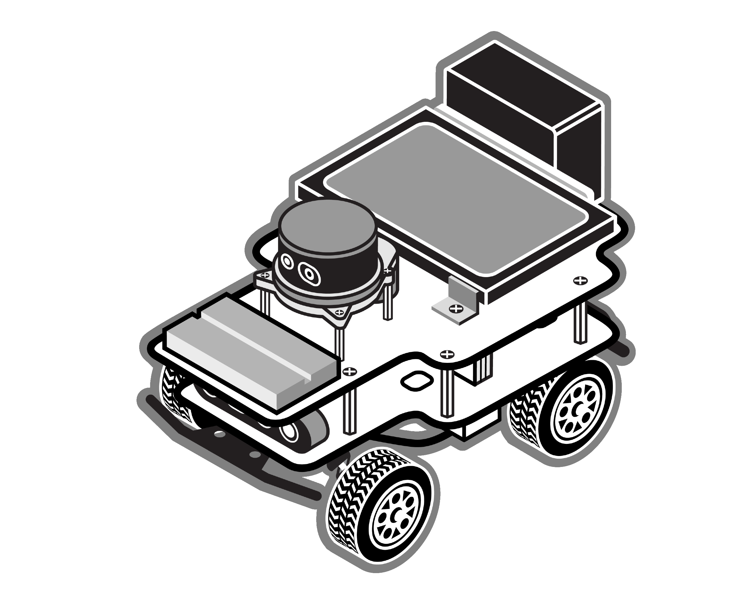


Lab Logistics
1. The RACECAR files live on GitHub
git clone/pull
ssh/scp

Slide 8
Lab Logistics
1. The RACECAR files live on GitHub
2. Clone the RACECAR files to your computer
git clone/pull
ssh/scp

Slide 9
Lab Logistics
1. The RACECAR files live on GitHub
2. Clone the RACECAR files to your computer
git clone/pull
ssh/scp
3. Edit the starter code on your computer

Slide 10
Lab Logistics
1. The RACECAR files live on GitHub
2. Clone the RACECAR files to your computer
git clone/pull
ssh/scp
4. Copy the files to you RACECAR
3. Edit the starter code on your computer

Slide 11
Lab Logistics
1. The RACECAR files live on GitHub
5. Run the program on the RACECAR
2. Clone the RACECAR files to your computer
git clone/pull
ssh/scp
4. Copy the files to you RACECAR
3. Edit the starter code on your computer

Slide 12
Key Modules – Drive
The Drive module allows us to move the car by setting its speed and the angle of the front wheels
Public interface
set_speed_angle(speed, angle)
stop()

Slide 13
Key Modules – Drive Example
This update function will cause the car to drive forward for 1 second, drive to the left for 1 second, and then stop
def update():
global counter
if counter < 1:
# Drive forward at full speed
rc.drive.set_speed_angle(1, 0)
elif counter < 2:
# Drive to the left at full speed
rc.drive.set_speed_angle(1, -0.5)
else:
rc.drive.stop()
counter += rc.get_delta_time()

Slide 14
Key Modules – Controller
The Controller module allows us to detect input from the Xbox controller
Public interface
is_down(Button)
was_pressed(Button)
was_released(Button)
get_trigger(Trigger)
get_joystick(Joystick)
Trigger.Left
Trigger.Right
Button.LB
Button.X
Button.RB
Button.Y
Button.B
Button.A
Joystick.Left
Joystick.Right

Slide 15
Key Modules – Controller Example
This update function uses input from the controller to decide how to move and when to print a message to the command line
def update():
# Enter this if block if RB is currently pressed
if rc.controller.is_down(rc.controller.Button.RB):
# Read the value of the right trigger to determine speed
speed = rc.controller.get_trigger(rc.controller.Trigger.RIGHT)
rc.drive.set_speed_angle(speed, 0)
# Print a message every time B is pressed
if rc.controller.was_pressed(rc.controller.Button.B):
print("The B button was pressed")

Slide 16
Good luck and have fun!
Let us know if you need any help during the lab

