Slide 1

Lab 7
AR Markers
This lecture is part of the RACECAR-MN introductory robotics course. You can visit the course webpage at mitll-racecar-mn.readthedocs.io.

Slide 2
Objectives
Main Objective: Combine your previous lab solutions to complete the time trial racecourse
Learning Objectives
Identify the location, orientation, and id of AR markers in a color image
Make decisions based on information provided by AR markers

Slide 3
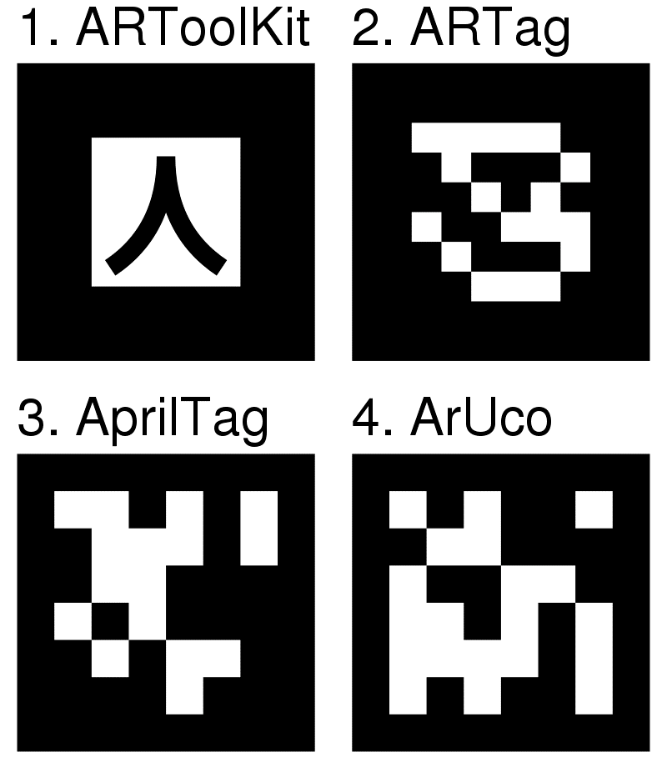
AR Markers
Fiducial markers used for augmented reality
Common characteristics:
high contrast
bi-tonal
square
bordered

Slide 4

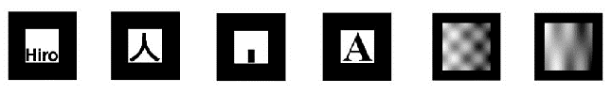
AR Markers - Outliers
ReacTIVision
ARToolKit

Slide 5

ArUco OpenCV
Border of black with a binary encoding in the center
Checks orientation
Marker id is not determined by binary coding in the marker but the index in a defined dictionary

Slide 6
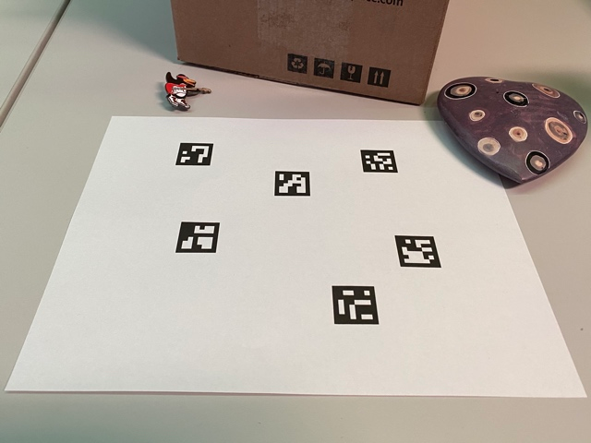
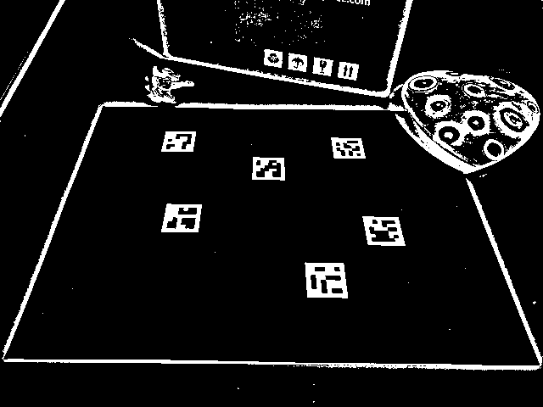
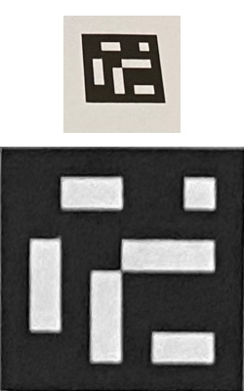

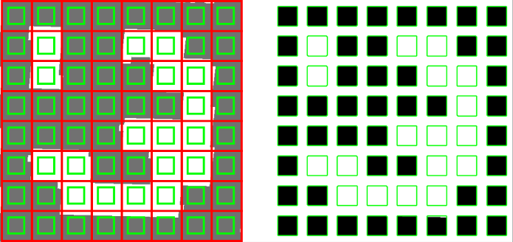

ArUco OpenCV
Original image
Image with threshold
Marker candidate
Removed perspective
Applied grid
Cell margin
Final sampling margin
Dictionary lookup

Slide 7
ArUco OpenCV
Original image
Image with threshold
Marker candidate
Removed perspective

Slide 8
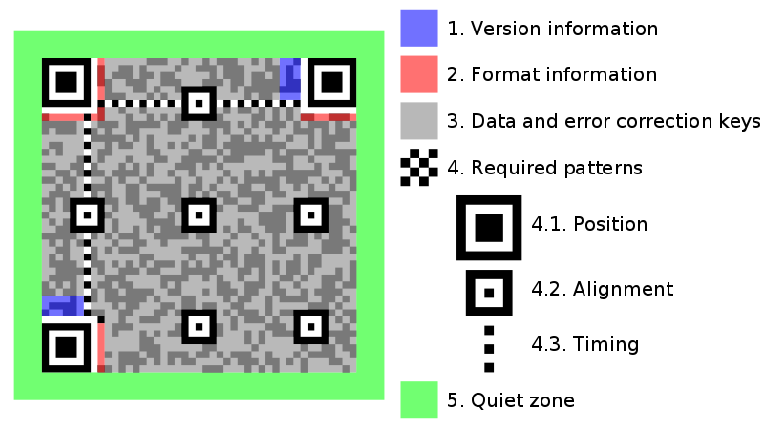
Information Gained
ArUco Markers encode
Corner location
Marker id (dictionary index)
QR Codes encode
Binary data

Slide 9


QR vs AR
Group activity
QR codes have all the common characteristics of AR markers but are commonly used to direct to a URL
What major differences are there between QR codes and AR markers like ArUco markers?
Why would a QR code be a bad AR marker?

