Slide 1

Lab 1
Driving and Controller
This lecture is part of the RACECAR-MN introductory robotics course. You can visit the course webpage at mitll-racecar-mn.readthedocs.io.

Slide 2
Objectives
Main Objective: Program the car to respond to controller input and drive in predefined shapes
Learning Objectives
Use the start-update paradigm to create a program which can run on the car
Use the drive module to move the car
Use the controller module to respond to input from the Xbox controller in real time

Slide 3
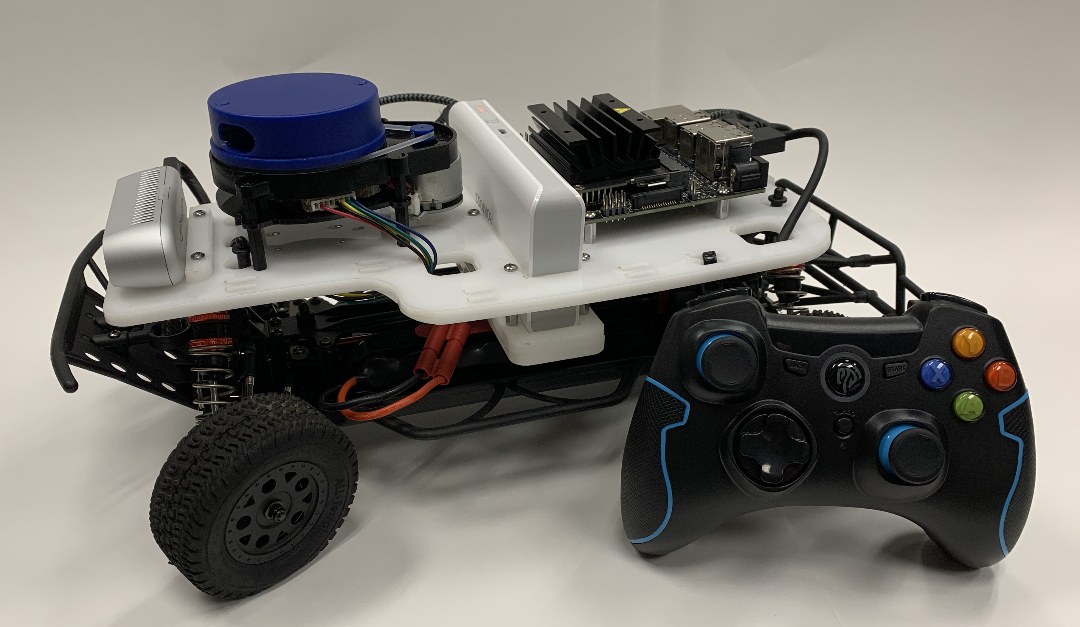
About the RACECAR-MN

Slide 4

About the RACECAR-MN
Environment
Python
Program

Slide 5
About the RACECAR-MN
Inputs
Controller
Color image
Depth image
LIDAR
IMU
Environment
Python
Program

Slide 6
About the RACECAR-MN
Inputs
Controller
Color image
Depth image
LIDAR
IMU
Environment
Outputs
Wheel speed
Wheel angle
Python
Program

Slide 7
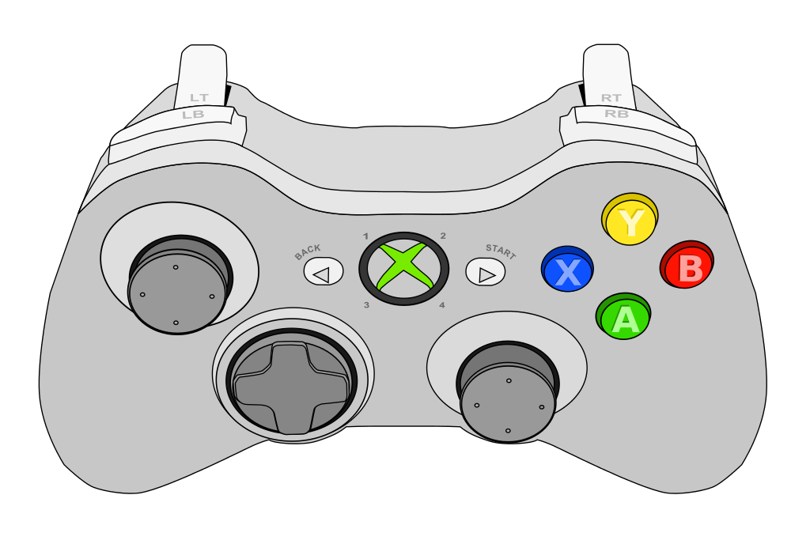
Car Modes – Default Drive
When you launch a RACECAR program, the car starts in default drive mode so you can easily drive around
Accelerate backward
Start user program
Accelerate forward
Steer
Print message

Slide 8

Car Modes – User Program
In user program mode, the car is controlled by a Python script using the start-update paradigm
Start: Run once when the program begins
Update: Run 60 times per second
Button |  | Effect
Start |  | Enter user program mode
Back |  | Enter default drive mode
Start + Back |  | Exit the program

Slide 9
Start-Update Paradigm
Example: Demo.py

Slide 10
racecar_core Library
Exposes easy access to the car's hardware
Under the hood: ROS
Documentation
Implementation
Main
Drive
Physics
Camera
LIDAR
Controller
Display

Slide 11
racecar_utils Library
Helper functions to process inputs/outputs of racecar_core
You will write everything in racecar_utils during the Jupyter notebook activates throughout the course
Documentation
Implementation

Slide 12
Drive Module
Controls the car's speed and wheel angle
Public Interface
set_speed_angle(speed, angle)
stop()
set_max_speed(max_speed)
Notes:
https://mitll-racecar.readthedocs.io/en/latest/drive.html

Slide 13
Drive Module - Example
def update():
global counter
if counter < 1:
rc.drive.set_speed_angle(1, 0)
elif counter < 2:
rc.drive.set_speed_angle(1, -0.5)
else:
rc.drive.stop()
counter += rc.get_delta_time()

Slide 14
Controller Module
Measures input from the Xbox controller
Public Interface
Button, Joystick, and Trigger enums
is_down(button)
was_pressed(button)
was_released(button)
get_trigger(trigger)
get_joystick(joystick)
Notes:
https://mitll-racecar.readthedocs.io/en/latest/controller.html

Slide 15
Controller Module - Example
def update():
if rc.controller.is_down(rc.controller.Button.RB):
speed = rc.controller.get_trigger(rc.controller.Trigger.RIGHT)
rc.drive.set_speed_angle(speed, 0)
if rc.controller.was_pressed(rc.controller.Button.B):
print("Kachow!")

Slide 16
Lab 1 – Driving in Shapes
Objectives
Implement default-drive style controls
A button = drive in a circle
B button = drive in a square
X button = drive in a figure eight
Y button = drive in a shape of your choice
lab1.py

