Slide 1

Lab 3
Lab 2B and 3A Solutions
This lecture is part of the RACECAR-MN introductory robotics course. You can visit the course webpage at mitll-racecar-mn.readthedocs.io.

Slide 2
Lab 2B State Machine
Park
Approach cone slowly
Aligned with cone
Aligned with cone
Forward
Align while driving forward
area > REVERSE_AREA
Reverse
Align while driving back
area < FORWARD_AREA

Slide 3

Running Averages
Simple average of 5 numbers
$$\frac{a+b+c+d+e}{5}$$

Slide 4
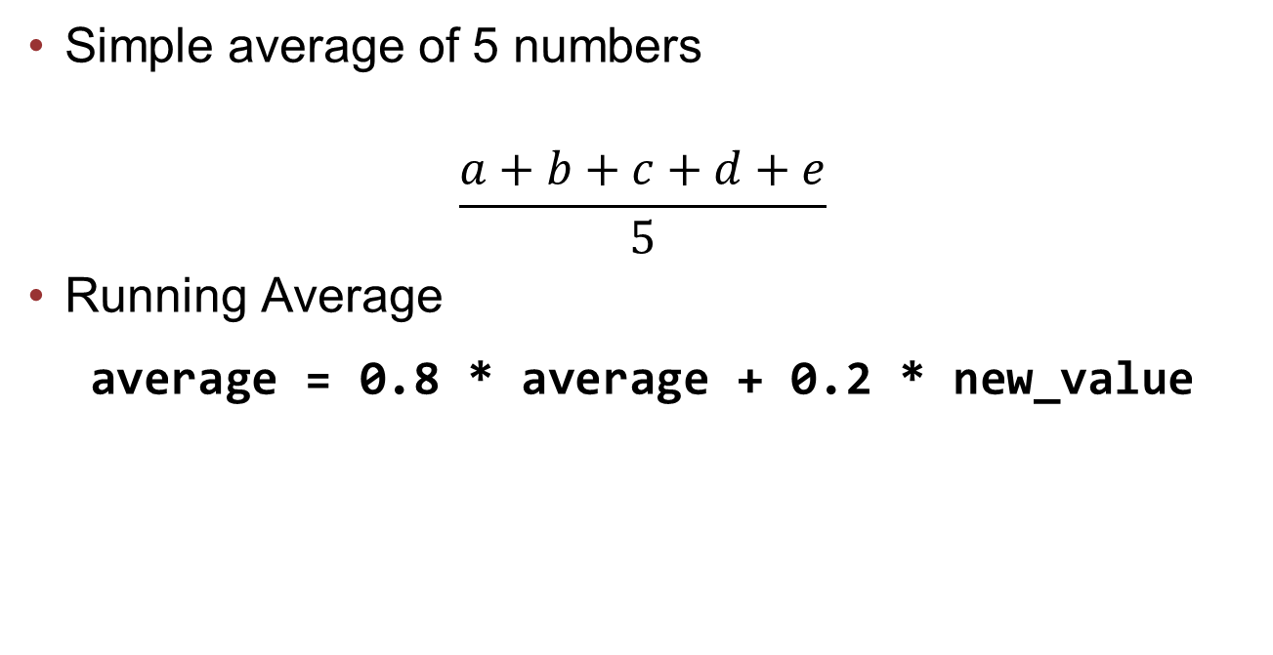
Running Averages
Simple average of 5 numbers
$$\frac{a+b+c+d+e}{5}$$
Running Average
average = 0.8 * average + 0.2 * new_value

Slide 5
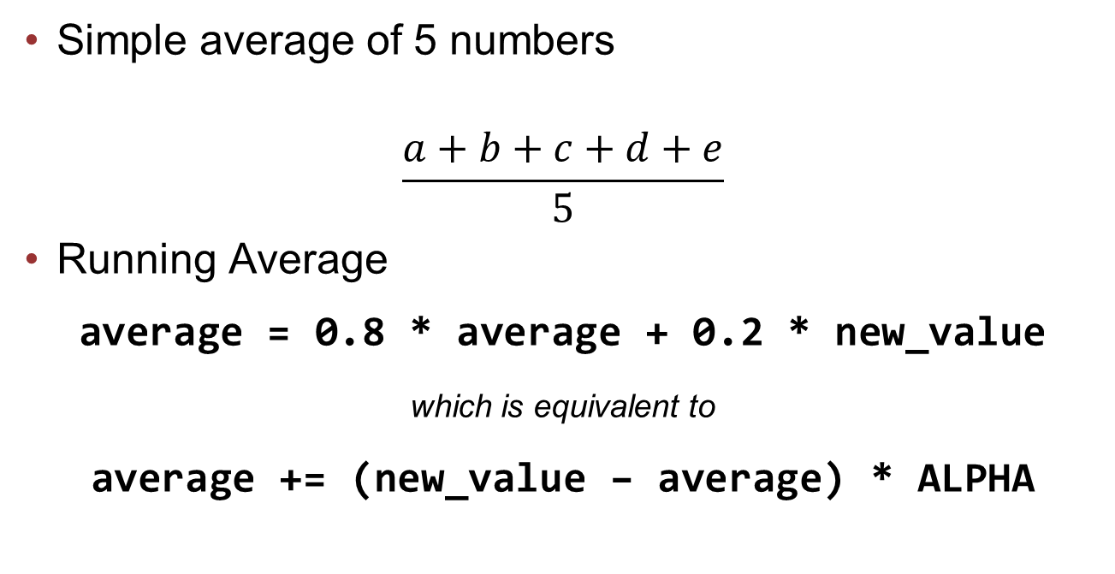
Running Averages
Simple average of 5 numbers
$$\frac{a+b+c+d+e}{5}$$
Running Average
average = 0.8 * average + 0.2 * new_value
which is equivalent to
average += (new_value – average) * ALPHA

