Slide 1


SMART INDIA HACKATHON 2024
TITLE PAGE
Problem Statement ID – 1629
Problem Statement Title- Freelancing Platform
Theme- Smart Education
PS Category- Software
Team ID - 17443
Team Name - Shramik

Slide 2
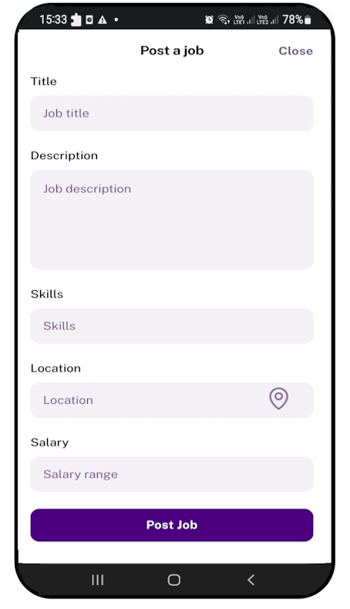
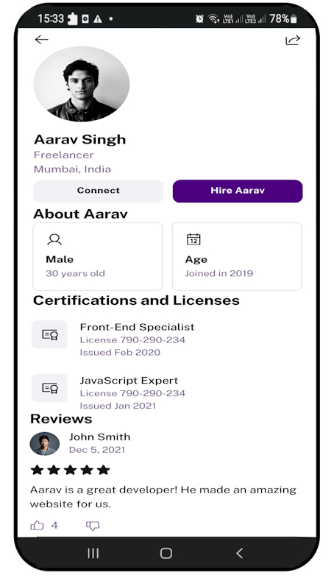
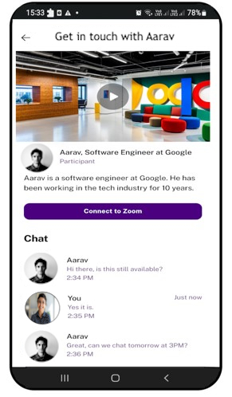
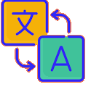
Proposed Solution – Shramik app
Shramik
User Interface designed at current stage of development
Posting Job details including its location in several regional languages
Freelancer profile showing verified certification and past reviews
Chat or Video Conference feature for connecting workers and employers

Slide 3
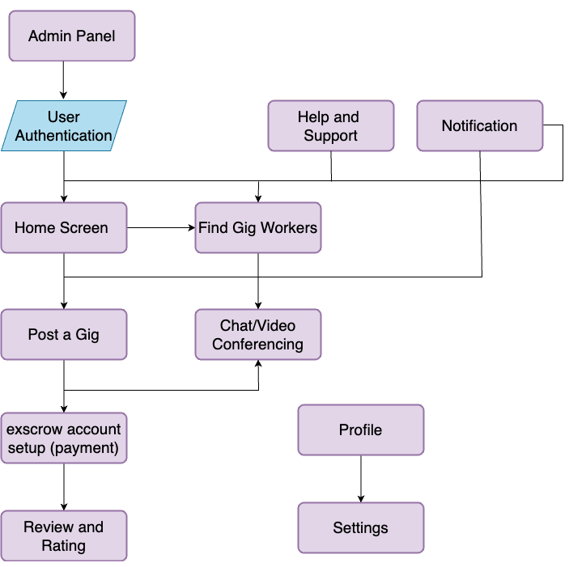
TECHNICAL APPROACH
Shramik
Technologies to be Used:
Frontend - XML (using material 3 Design) in Android Studio platform
Backend – Kotlin
Database - Firebase (real-time DB, fire-store DB, JWT O2auth)
Document Verification - TensorFlow Coordinating with Govt. and Corporate databases
Payment gateway - Strip gateway integration, future scope for blockchain payments for cryptocurrencies and CBDC.
Location Detection – Using Google Maps API
Video Conferencing – Zoom or other Live Meeting API
Operational methodology :

Slide 4
FEASIBILITY AND VIABILITY
Shramik
Feasibility of the Idea:
Technical Feasibility: The platform leverages technologies such as AI-based recommendations, escrow systems, and video conferencing,
Market Feasibility: A Growing demand in our "GIG Economy” fueled by over 9 million gig workers
Scalability: The platform can be scaled from local regions to nationwide, incorporating multilingual support and location-specific job postings.
Implement - ation of all features
Preprocess the doc/img being sent to Tessarct model
Market Saturation
Geographic Limitations
Trust and Security
Differentiation from current market players with USP features
verified user registration and secure payment with escrow account
Gradual scaling to fine tune as per feedback
Challenges(in) and Strategies(out) to overcome them

Slide 5
IMPACT AND BENEFITS
Shramik
Provides access to more job opportunities, especially in remote areas.
Helps freelancers earn a steady income by connecting them with employers.
Allows freelancers and employers to meet via video conferencing before finalizing a job, improving trust.
Specialized AI-Algorithm suggesting freelancers prevailing trends in market for their career growth

Slide 6
RESEARCH AND REFERENCES
Shramik
https://firebase.google.com/docs
(Firebase Documentation for the Backend development)
https://firebase.google.com/docs/cloud-messaging
(FCM documentation)
https://docs.stripe.com/api
(strip doc’s for payment gate way)
https://m3.material.io/
(material design for UI/UX development)

