Slide 1


HACKATHON 2.0
Problem Statement No. - 07
Problem Statement - Health Insurance Assistant (InsureSmart)
PS Category - Software
Team Name – NOVA

Slide 2
NOVA
PROPOSED SOLUTION
Assessing User’s Health Condition:
“Health Score”
Recommend Insurance Plans:
Detect Pre-existing diseases.
Identify health risk by assessing user medical test report
Input of lifestyle factors like Smoking, Drinking, Exercise etc. taken as ordinal categorical values.
Weighted average method used to calculate score (0-5) defined by registered insurance cos.
Rank available insurance plans by assessing user’s needs and health.
Advise on value of Sum Assured to apply for.
Provide users with insurer’s contact and purchase option
2

Slide 3
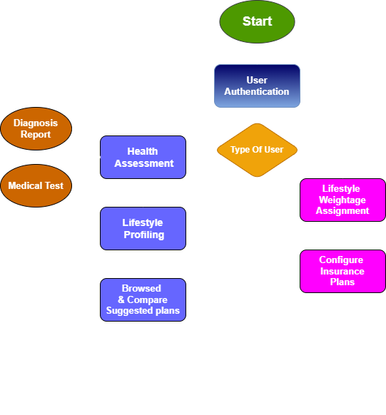
NOVA
TECHNICAL APPROACH
Technologies to be Used:
Frontend = Next JS
Backend = Next.js API Routes
Database System = MySQL
Document Parsing = Tesseract OCR, pdf2image, PIL.
ML Model = Random Forest or Multi-level Perceptron deployed as .pkl file
Payment gateway = Razorpay API integration.
Location display = Google Maps API
verified user registration and secure payment with escrow account
Process Flowchart
3

Slide 4
NOVA
FEASIBILITY AND VIABILITY
Authenticity of uploaded reports
Collaborate with hospital databases for fraud prevention
User Trust and Adoption
Feasibility of the Idea:
AI-Driven Insurance Matching : analyzes user’s medical history, lifestyle & predicts health risks for tailored insurance recommendations.
Monetization model : Affiliation with insurers, API licensing for B2B partners, and premium AI insights for users.
Expansion Scope – Can be extended to global insurance providers
Multi-criteria decision-making approach based on weightage
Complex Insurance plan matching
Scalability and Deployment
Optimize database queries and cloud service deployment
Transparency in how recommendation are generated
Challenges(in) and Strategies(out) to overcome them
3

Slide 5
NOVA
IMPACT AND BENEFITS
Simplified Health Insurance Selection
Data driven Insights
Reduced dependence on Agents
Market expansion for Insurers
5

Slide 6




Diagnostic Pathology Test Results
NOVA
RESEARCH AND REFERENCES
Dataset named Diagnostic Pathology Test Results -
https://www.kaggle.com/datasets/pareshbadnore/diagnostic-pathology-test-results?utm_medium=social&utm_campaign=kaggle-dataset-share
RazorPay API (For payment gateway) - https://razorpay.com/docs/api/
Tesseract OCR (For text extraction) – https://tesseract-ocr.github.io/
Google Maps API – https://developers.google.com/maps/documentation
6

