Slide 1
Barnes Hut Simulation for N-body simulations
Samyak Jain & Nihar Dwivedi

Slide 2
What is N-body simulation?
An N-body simulation approximates the motion of particles, often specifically particles that interact with one another through some type of physical forces (like gravity, atomic forces, etc. )
In a basic N-body simulation every body exerts force on every other body in the system. This means that in every step of the simulation a net force from all the other bodies has to be computed for each of the bodies
The complexity of this is O(n^2) where n is the number of particles. This means that this is not practically possible for simulations with large number of particles
Different methods used:
Barnes-Hut algorithm
Fast multipole method
parallel tree multipole algorithm

Slide 3
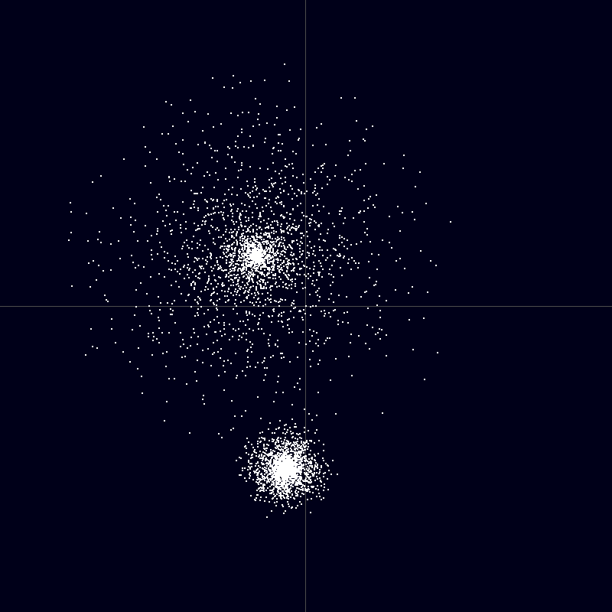
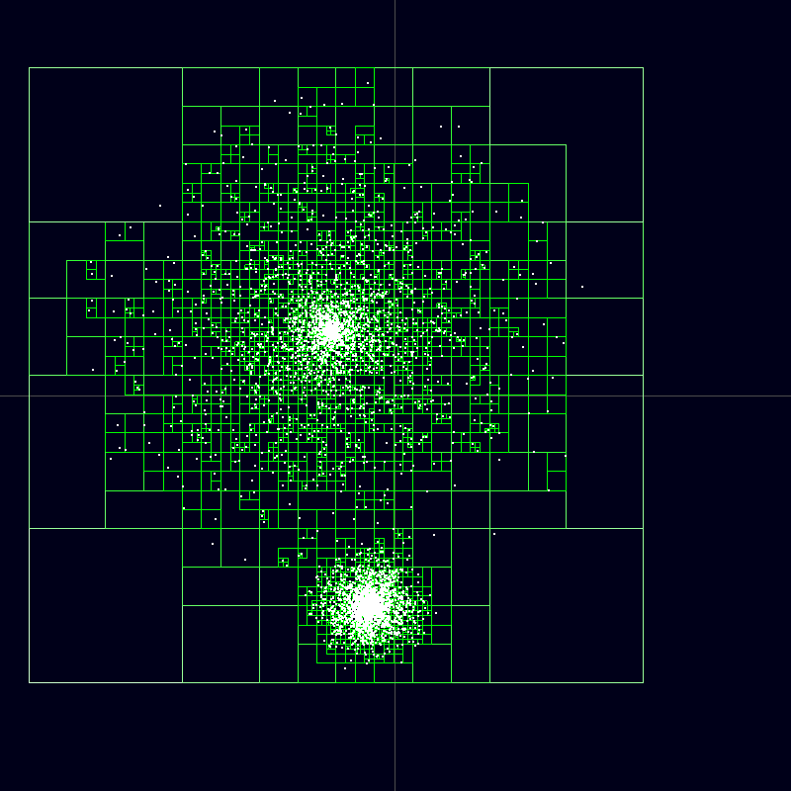
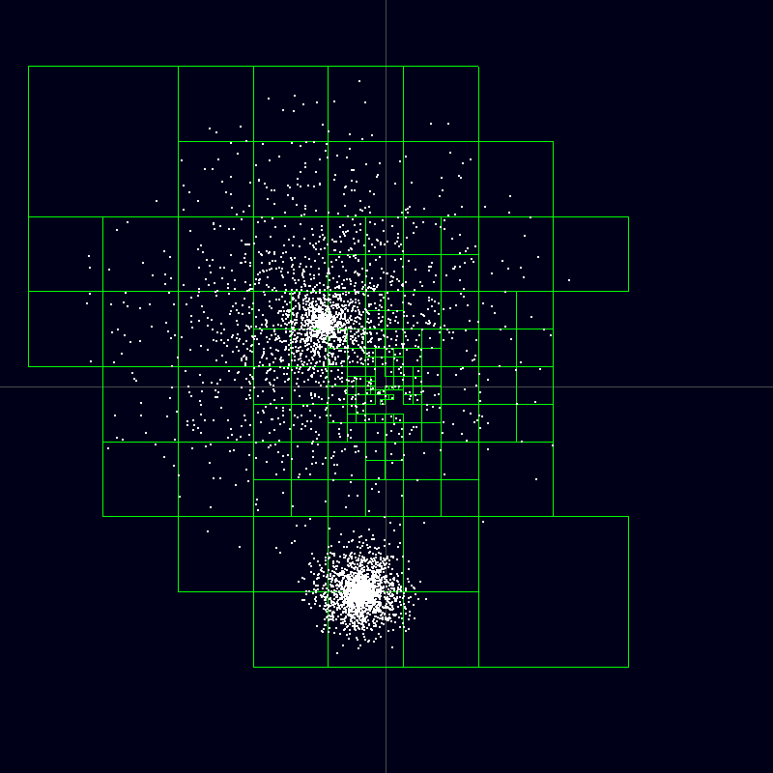
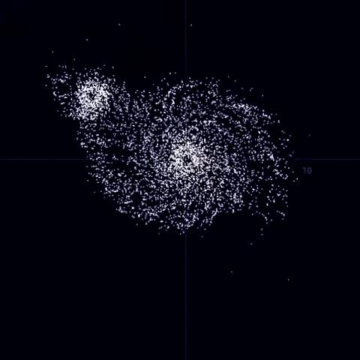
Sample Calculation
Particle distribution resembling two neighboring galaxies.
Complete Barnes–Hut tree. (Nodes that do not contain particles are not drawn)
Nodes of the Barnes–Hut tree used for calculating the force acting on a particle at the point of origin.
n-Body simulation based on the Barnes–Hut algorithm.
Ref: Wikipedia

Slide 4
Barnes Hut Simulation
In a three-dimensional n-body simulation, the Barnes–Hut algorithm recursively divides the n bodies into groups by storing them in an octree (or a quad-tree in a 2D simulation)
Hence, for n-body simulation, this uses a spatial data-structure called a quadtree to determine the relative proximity of the particles and then approximate the impact of many particles that are far apart as if they were a single particle
The force on each particle can be given by the general equation:
force = external_force + nearest_neighbor_force + far_field_force
In a lot of n-body simulations, the external forces on each particle/body can be computed for each particle independently, in an embarrassingly parallel way
This reduces the complexity to O(n*logn)

Slide 5
Our Work
To avoid complexity, we will work with 2D simulations.
We are very new to this topic and are doing more research into it. But this is what we have thought so far
We are looking towards parallelizing each of the quadtree in our 2D simulation and then we will further look towards parallelizing the interactions between each group
We can parallelize the process of creation of the quadtree and the distribution of particles among the nodes of that tree

Slide 6
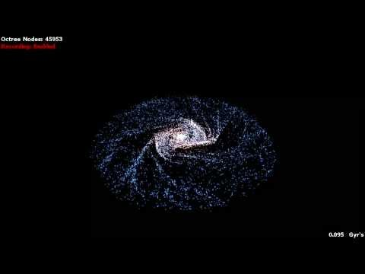
Cooler Video!

Slide 7
References
http://physics.princeton.edu/~fpretori/Nbody/intro.htm
http://www.cs.cmu.edu/~guyb/real-world/nbody/index.html
http://arborjs.org/docs/barnes-hut

