Slide 1
secure data hiding in images using steganography
CAPSTONE PROJECT
Presented By:
Student Name : Samyek Pradip Meshram
College Name & Department : Yeshwantrao Chavan College of Engineering, Wanadongari, Nagpur- 441110, Electronics Engineering
Branch: Industrial Internet Of Things (IIOT)

Slide 2
OUTLINE
Problem Statement
Technology used
Wow factor
End users
Result
Conclusion
Git-hub Link
Future scope

Slide 3
Problem Statement
With the rise in cyber threats, securing sensitive data from hackers is crucial. Traditional encryption methods attract attention, making data vulnerable to attacks. Steganography offers a convert way to hide information within images, ensuring confidentiality. This project aims to develop a secure data-hiding technique the enhances privacy and prevents unauthorized access.

Slide 4
Technology used
Library & Platform Used : cv2, string library, Python IDLE 3.13, Open Stego
Hardware Requirements:Processor: Intel Core i5/i7 or AMD Ryzen 5/7 (or higher) for efficient encryption and decryption.RAM: Minimum 8GB (16GB recommended) for handling large image files and encryption processes.Storage: At least 256GB SSD (512GB recommended) for faster read/write operations.GPU (Optional): Dedicated GPU (NVIDIA/AMD) for AI-based steganography enhancements.Display: Full HD (1920x1080) or higher resolution for accurate image processing.Peripherals: High-resolution camera/scanner (if real-world images are used) and a secure USB drive for data transfer.

Slide 5
Wow factors
Unique Features: This project integrates advanced steganography with encryption for dual-layer security. It ensures high imperceptibility, making hidden data undetectable. The technique resists steganalysis attacks, enhancing protection against hackers. A user-friendly interface enables seamless encryption and decryption. Optimized for minimal distortion, it maintains image quality while securing data.

Slide 6
End users
*End Users:*
- Cybersecurity professionals securing confidential data.
- Government and military agencies for covert communication.
- Journalists and whistleblowers protecting sensitive information.
- Businesses safeguarding trade secrets and intellectual property.
- General users ensuring personal data privacy in digital communications.

Slide 7
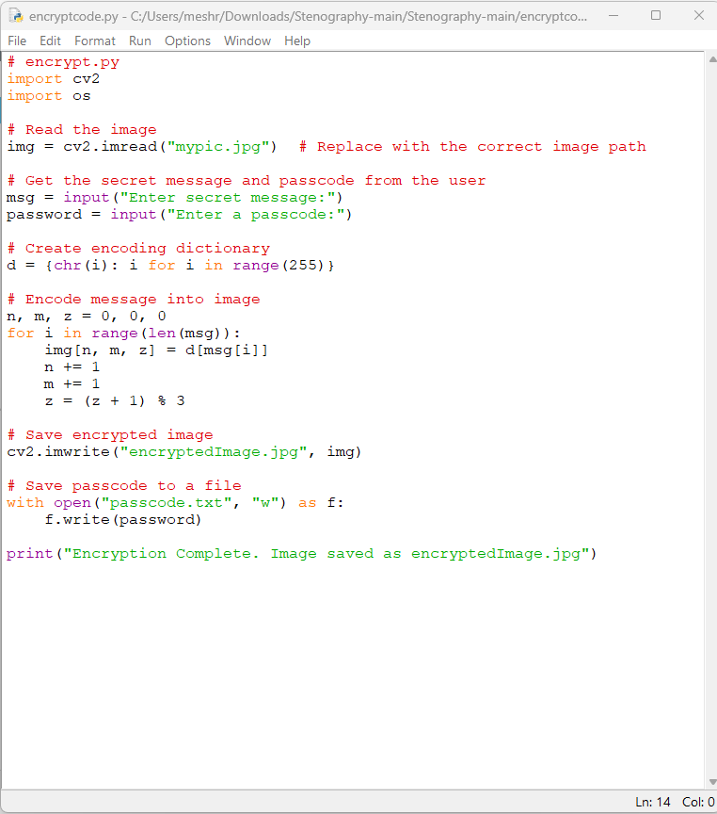
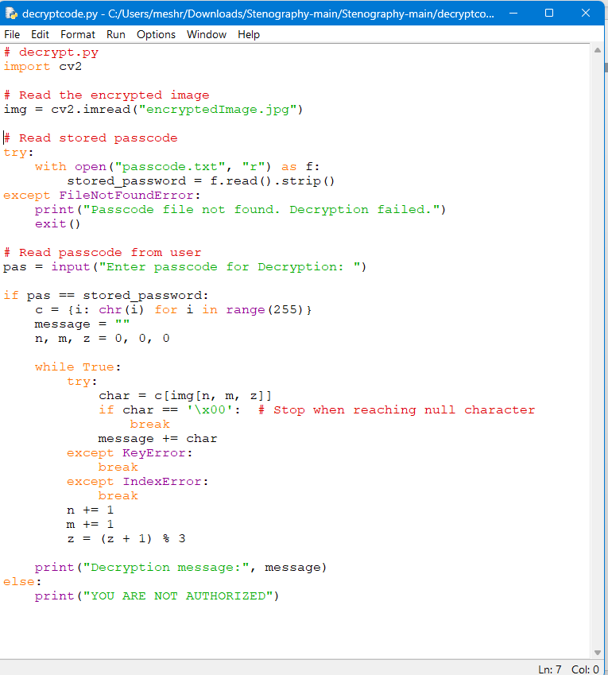
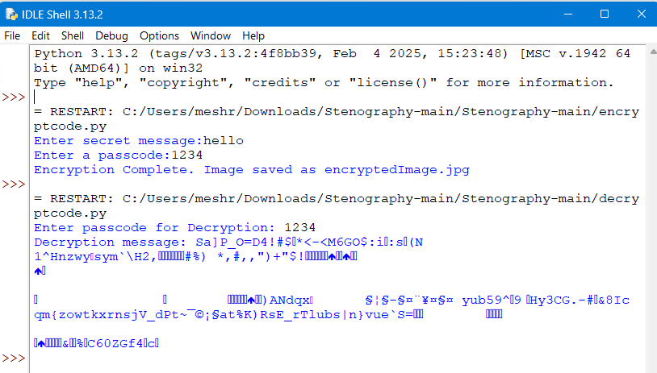
Results

Slide 8

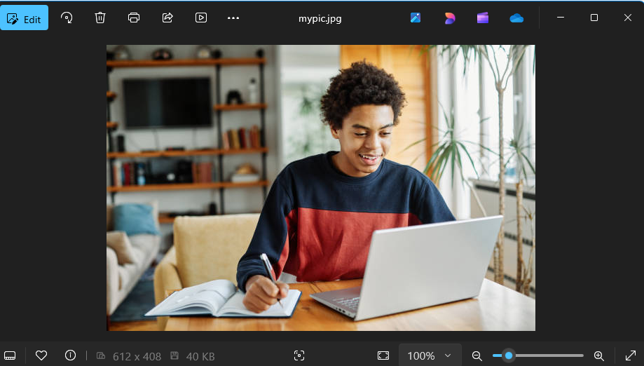


Slide 9
Conclusion
This project provides a robust and covert method for secure data transmission using steganography. By embedding encrypted data within images, it ensures confidentiality while maintaining image integrity. The dual-layer security approach enhances resistance against cyber threats and unauthorized access. With potential applications in cybersecurity, government, and private sectors, this solution paves the way for future advancements in secure communication and data protection.

Slide 10
GitHub Link
https://github.com/Samyek-dev/myproject_aice.git
https://github.com/Samyek-dev/GUI_AICTE.git

Slide 11
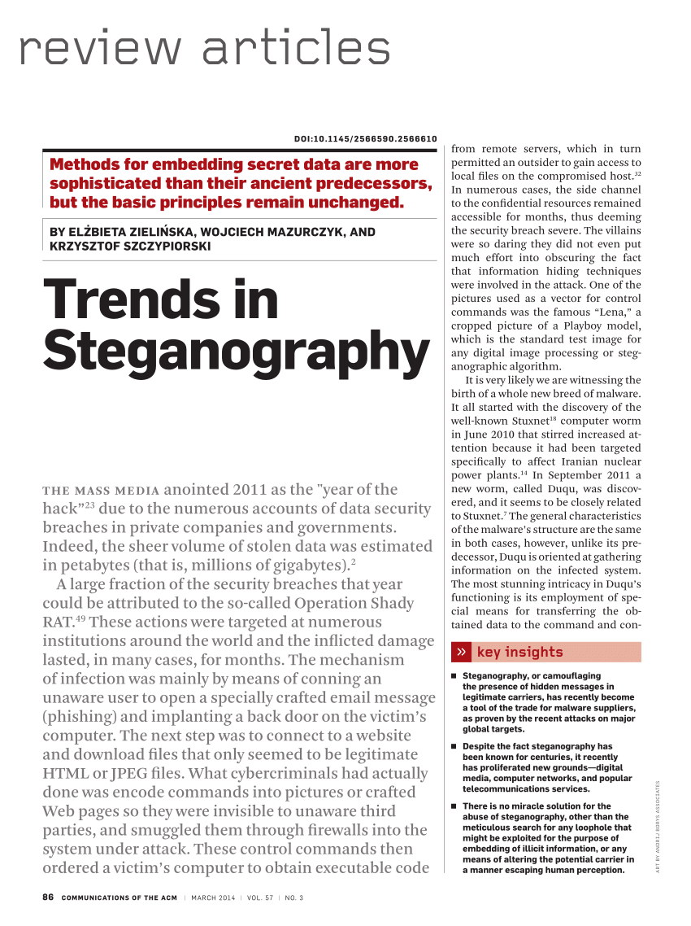
Future scope(optional)
Integration with AI for adaptive steganography to enhance security.
Development of mobile and web-based applications for wider accessibility.
Application in secure cloud storage and blockchain for tamper-proof data hiding.
Enhancement with quantum cryptography for next-gen cybersecurity.
Expansion to video and audio steganography for multi-media data protection.

Slide 12
THANK YOU

