Slide 1

Sameer Khan
Batch: MIP-DA-04
HOTEL RESERVATION
The hotel industry relies on data analysis to understand guest preferences and optimize the guest experience. This project utilizes SQL to analyze a hotel reservation dataset, uncovering insights into booking patterns, guest demographics, and key factors that impact hotel operations. The findings of this analysis have the potential to inform data-driven decision-making within the hotel, ultimately leading to improved guest experiences.
Sameer Khan Batch: MIP-DA-04
MentorNess

Slide 2


Problem Statement
What is the total number of reservations in the dataset?
Which meal plan is the most popular among guests?
What is the average price per room for reservations involving children?
How many reservations were made for the year 20XX (replace XX with the desired year)?
What is the most commonly booked room type?
How many reservations fall on a weekend (no_of_weekend_nights > 0)?
What is the highest and lowest lead time for reservations?
What is the most common market segment type for reservations?
How many reservations have a booking status of "Confirmed"?
What is the total number of adults and children across all reservations?
What is the average number of weekend nights for reservations involving children?
How many reservations were made in each month of the year?
What is the average number of nights (both weekend and weekday) spent by guests for each room type?
For reservations involving children, what is the most common room type, and what is the average price for that room type?
Find the market segment type that generates the highest average price per room.

Slide 3



HOTEL RESERVATION
What is the total number of reservations in the dataset?
Which meal plan is the most popular among guests?
SQL QUERY
SQL QUERY
SELECT COUNT(booking_id)
AS Total_Number_Of_Res
FROM hotel_reservation
SELECT type_of_meal_plan, COUNT(*) AS Most_liked_by_GUESTS
FROM hotel_reservation GRUP BY type_of_meal_plan;
Result
Result

Slide 4


HOTEL RESERVATION
What is the average price per room for reservations involving children?
How many reservations were made in the year 2018?
SQL QUERY
SQL QUERY
SELECT AVG (avg_price_per_room) FROM hotel_reservation WHERE no_of_children >0;
SELECT COUNT(booking_id) AS booking_count_of_2018 FROM hotel_reservation WHERE YEAR(arrival_date) = 2018;
Result
Result

Slide 5


HOTEL RESERVATION
What is the most commonly booked room type?
How many reservations fall on a weekend
SQL QUERY
SQL QUERY
SELECT room_type_reserved, COUNT(*) AS Booking_COUNT FROM hotel_reservation GROUP BY room_type_reserved ORDER BY booking_count DESC LIMIT 1;
SELECT COUNT(*) AS weekend_reservations FROM hotel_reservation WHERE no_of_weekend_nights > 0;
Result
Result

Slide 6


HOTEL RESERVATION
What is the highest and lowest lead time for reservations?
What is the most common market segment type for reservations?
SQL QUERY
SQL QUERY
SELECT MAX(lead_time) AS highest_lead_time, MIN(lead_time) AS lowest_lead_time FROM hotel_reservation;
SELECT market_segment_type, COUNT(*) AS Common_Mar_Seg FROM hotel_reservation GROUP BY market_segment_type ORDER BY common_mar_Seg DESC LIMIT 1;
Result
Result

Slide 7


HOTEL RESERVATION
How many reservations have a booking status as "Confirmed"?
What is the total number of adults and children across all reservations?
SQL QUERY
SQL QUERY
SELECT COUNT(booking_status) AS Confirmed_Booking FROM hotel_reservation WHERE booking_status = ‘Not_Canceled’
SELECT
SUM(no_of_adults) AS total_adults, SUM(no_of_children) AS total_children FROM hotel_reservation;
Result
Result

Slide 8
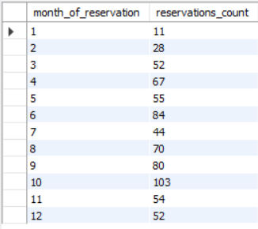

How many reservations were made in each month of the year?
HOTEL RESERVATION
SQL QUERY
What is the average number of weekend nights for reservations involving children?
SELECT MONTH(STR_TO_DATE(arrival_date, '%d-%m-%Y’)) AS month_of_reservation, COUNT(*) AS reservations_count FROM hotel_reservation GROUP BY month_of_reservation ORDER BY month_of_reservation
SQL QUERY
SELECT AVG(no_of_weekend_nights) FROM hotel_reservation WHERE no_of_children > 0;
Result
Result

Slide 9
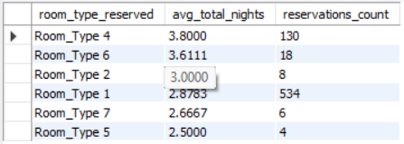
HOTEL RESERVATION
What is the average number of nights (both weekend & weekday) spent by guests for each room type?
For reservations involving children, what is the most common room type, and what is the average price for that room type?
SQL QUERY
SQL QUERY
SELECT MAX(room_type_reserved) AS most_common_room_type_with_children, AVG(avg_price_per_room) AS average_price, COUNT(*) AS number_of_reservations FROM hotel_reservation WHERE no_of_children > 0;
SELECT room_type_reserved, AVG(no_of_weekend_nights + no_of_week_nights) AS avg_total_nights, COUNT(*) AS reservations_count FROM hotel_reservation GROUP BY room_type_reserved ORDER BY avg_total_nights DESC;
Result
Result

Slide 10

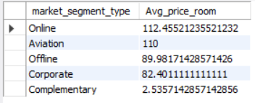
HOTEL RESERVATION
Find the market segment type that generates the highest average price per room
SQL QUERY
This query will show the Highest AVG price per room by market segment in Descnding Order.
We can always use the LIMIT function to show 1 or more than 1 values like below:
SELECT market_segment_type, AVG(avg_price_per_room) AS avg_price_room FROM hotel_reservation GROUP BY Market_segment_type ORDER BY avg_price_room DESC;
Result

Slide 11
THANK YOU

