Slide 1


Evil Mentor
The AI That Hacks You So Hackers Can't
Team: Code Blooded
Problem Statement: PS2: AI Agent for the Real World
Colleges: IIITDM Kurnool & Jaypee Institute of Information Technology

Slide 2
Problem + Existing Gap
What is the problem?
Current Solutions & Key Gaps
Developers learn security after a breach, not before
Security training is boring, theoretical, and forgettable
Real vulnerabilities require real mistakes but mistakes in production are disastrous
CTF Platforms
Artificial, not integrated into daily work fake flags, not real threats
Who is affected?
Junior developers 90% have unknowingly introduced a security bug
Startups with no dedicated security team
Engineering managers who can't afford breaches or boring training
Security Linters
Only detect issues they don't teach developers how to find or fix them
Compliance Videos
Annual, static, and completely forgotten no adaptive difficulty or audit trail
Gap
Existing Solutions
Evil Mentor
Realistic threats
❌ Fake CTF flags
✅ Real code injections
Daily workflow
❌ Separate platform
✅ Inside dev environment
Adaptive difficulty
❌ Static challenges
✅ LLM-generated variations
Safety guarantee
❌ Could break things
✅ ArmorIQ policy-gated

Slide 3



Proposed Solution
An AI agent that intentionally injects fake but safe security issues into your development environment then challenges you to find them using ArmorClaw. It's an escape room inside your codebase.
How it solves the problem
"Learn by hunting: Developers remember what they actively find."
Zero production risk: Injections are harmless & tagged as fake
"Measurable growth: AI grades performance and adapts difficulty."
Integrated into real workflow: No separate training platform
Feature
CTF Platforms
Sec. Linters
Evil Mentor
In real codebase
❌
✅
✅
Teaches how to find bugs
❌
❌
✅
Adaptive to skill level
❌
❌
✅
Audit trail for managers
❌
❌
✅ (ArmorIQ)
Safe by policy
❌
✅
✅ (ArmorIQ)

Slide 4

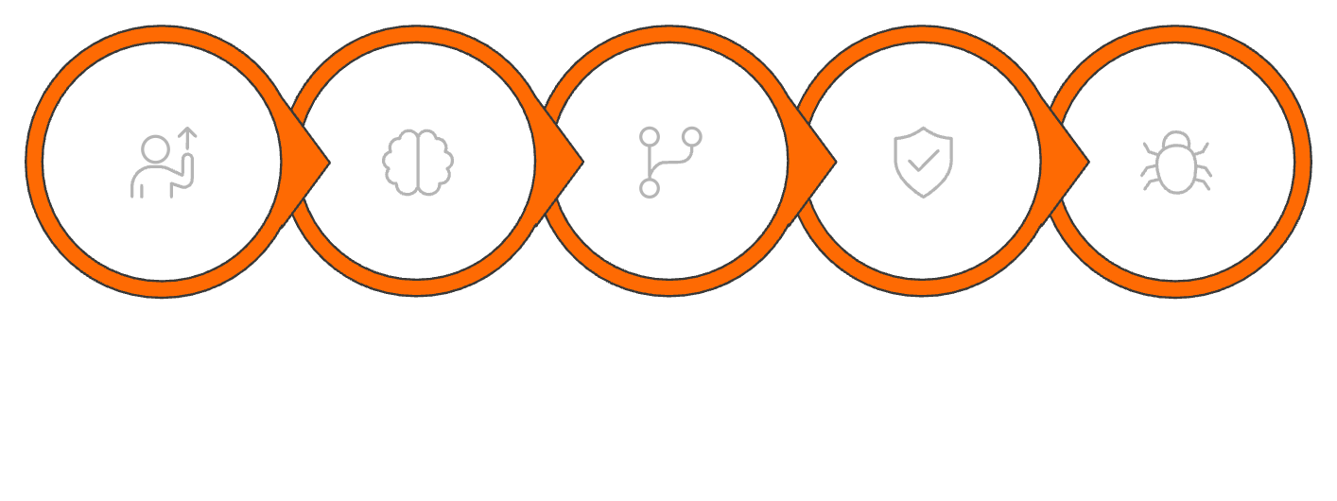
Architecture + Tech Stack
A full-cycle AI pipeline from code analysis to graded feedback, governed at every step by ArmorIQ safety policies.
Open PR
Mentor AI
Generate Variants
Policy Check
Inject Vuln
Components
Tech Stack
Component
Technology
Role
Layer
Technology
AI Agent
Python + GPT-4 / Llama
Generates fake vulns
Backend
Python FastAPI
Injection Engine
Python AST Parser
Safely inserts mock bugs
AI / LLM
OpenAI API or Local Llama
Security Scan
ArmorClaw SDK
Scanner
ArmorClaw SDK
Detects injected issues
Policy Enforcement
ArmorIQ SDK (Python)
Frontend
React + Tailwind
Policy & Logs
ArmorIQ Platform
Approvals, audit trail
Database
PostgreSQL
Dashboard
React + FastAPI
Progress, leaderboard

Slide 5

Key Features
1
LLM-Powered Vuln Generation
AI reads your actual code and generates contextually relevant fake bugs. Example: adds a missing SSL bypass if you use requests.get(). Never repeats — adaptive difficulty.
2
ArmorClaw Detection Training
Developer runs ArmorClaw to find injected issues. ArmorClaw can't tell fake from real that's the point. Learn to use real enterprise security tools.
3
ArmorIQ Safety Gates
Policy: Agent only injects during training hours (9 AM – 6 PM). Delegation: Production branches require manager approval. Audit: Every injection logged forever.
4
Auto-Grading & Leaderboard
Time to detect → Score. Missed vulnerabilities → Negative score. Weekly team leaderboard = gamified security learning.
5
"Safe Secret" Technology
Injected secrets are prefixed with EVIL_MENTOR_FAKE_. ArmorIQ policy prevents them from ever reaching production. Zero real security risk.

Slide 6

Impact + Feasibility
Who Benefits
Stakeholder
Benefit
Junior developers
Learn security by doing, at their own pace
Engineering managers
Measurable security skills growth for team
Startups
Security training without hiring a specialist
Open source maintainers
Train contributors before they merge
Cost
LLM API ~$0.10 per injection; ArmorClaw free
Safety
ArmorIQ policy prevents all production runs
Deployment
Docker container + ArmorIQ API key; 30 min to first injection
Scalability
One instance serves hundreds of developers; ArmorIQ policies scale across teams

