Slide 1
Warehouse Inventory

Slide 2
Team Members
Suresh Gopi Tulam
Pooja Kunta
Samyuktha Potla
Chaitanya Krishna Hanumantharao Chundiwar
Sravani Nalla

Slide 3
outline
What is Warehouse ?
Types of Warehouses
Responsibilities in a warehouse
ER Diagram
Order life cycle
User Interface
Summary

Slide 4
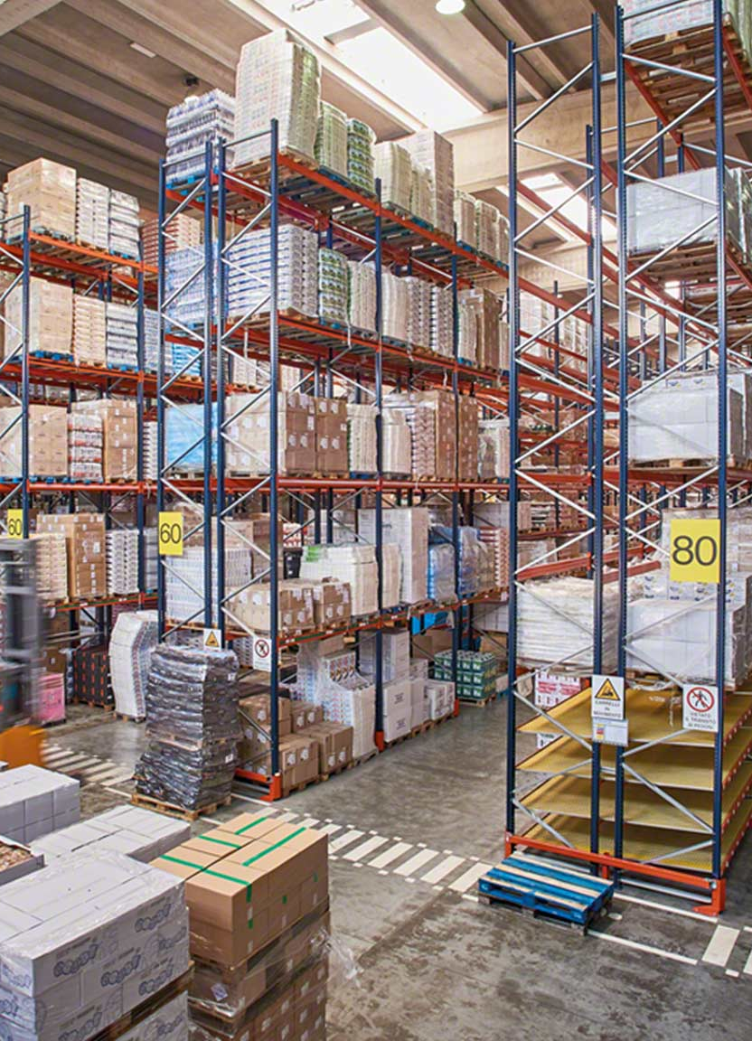
What is warehouse ?
Place used for the storage or accumulation of goods the function of storage can be carried out successful with the help of warehouses used for storing the goods.

Slide 5
Types of Warehouses
Private Warehouses
Owned and operated by big manufacturers and merchants who fulfill their own storage needs
Public Warehouses
operated by an individual or cooperative society
Bonded Warehouses
These are licensed by the government to accept imported goods for storage until the payment of customs duty

Slide 6
Responsibilities in a warehouse
Sorting merchandise
Taking inventory
Prepare documentation
Store merchandise
Fill orders
Dispatch orders

Slide 7
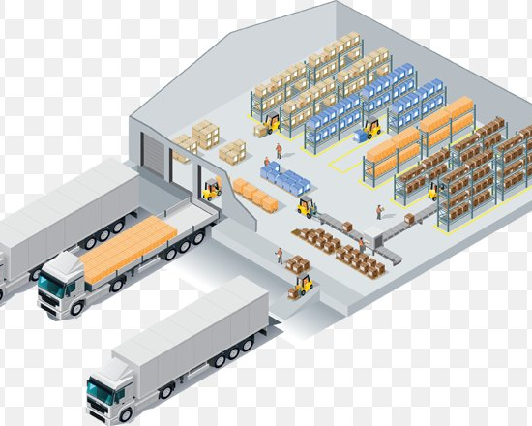
Sorting merchandise
Sorting is a system of properly categorizing a warehoused item by its characteristics and assigning an appropriate storage location based on those characteristics

Slide 8

Taking inventory
Taking inventory allows a business to know exactly what stock and assets it has and to quickly locate those stock and asset items.

Slide 9
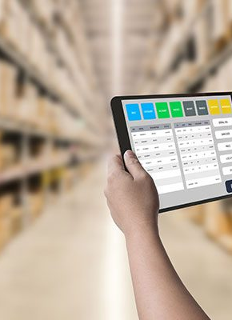
Prepare documentation
Warehouse documents are used for recording events at the warehouse and registering full history of changing stock levels for items.

Slide 10
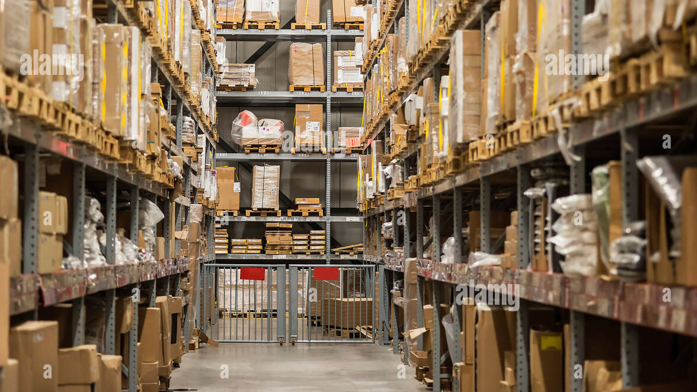
Store merchandise
Merchandising refers to the marketing and sales of products.
Marketing strategies, display design, and competitive pricing, including discounting, are all part of store merchandise.

Slide 11

Fill orders
Order filling refers to the tasks that an order filler performs, such as receiving and storing inventory, picking and packing boxes in a warehouse.

Slide 12
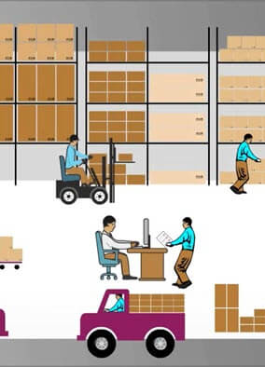
Dispatch orders
Order dispatch is nothing, but order is prepared for shipping.

Slide 13
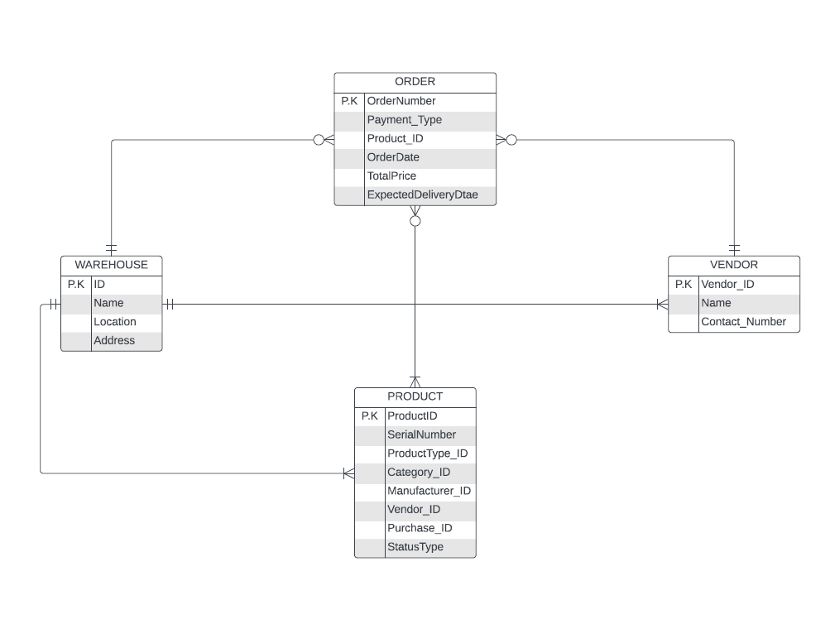
ER diagram

Slide 14
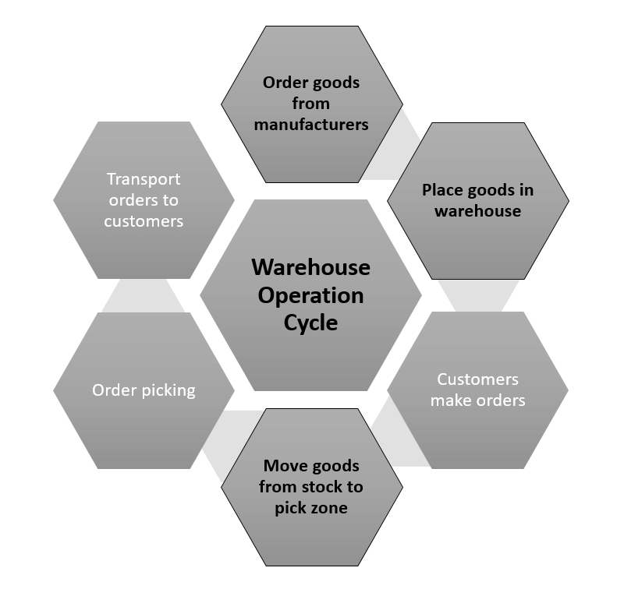
Life cycle

Slide 15
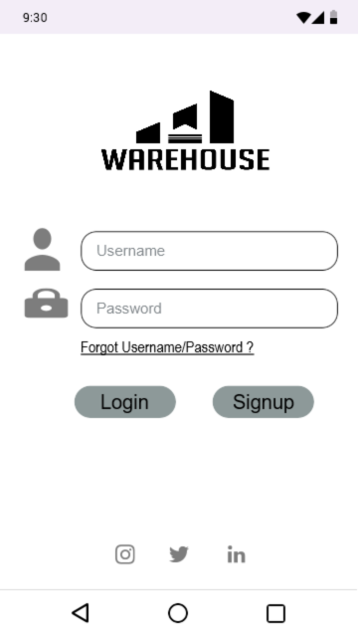
LOGIN SCREEN
Login functionality is same for both the
vendor and warehouse administrator.
Internal functionalities differ after they
successfully logged into the system.

Slide 16
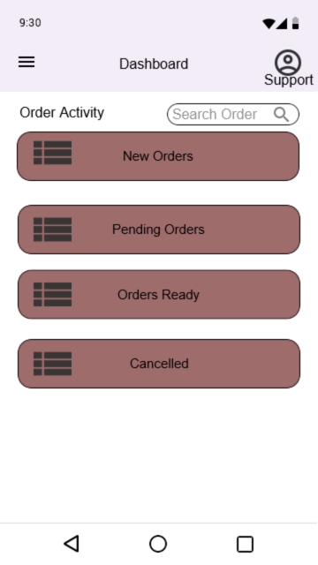
Vendor User interface
Dashboard of the vendor with all types of order
activates along with a search order privilege.

Slide 17
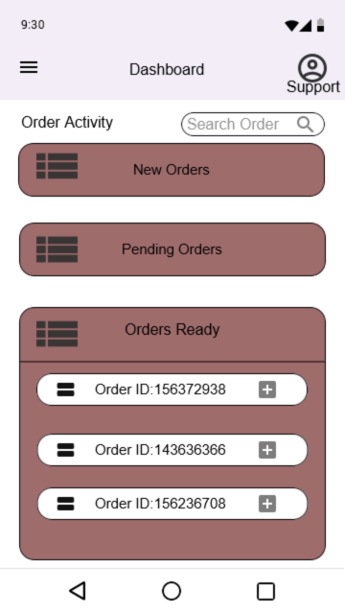
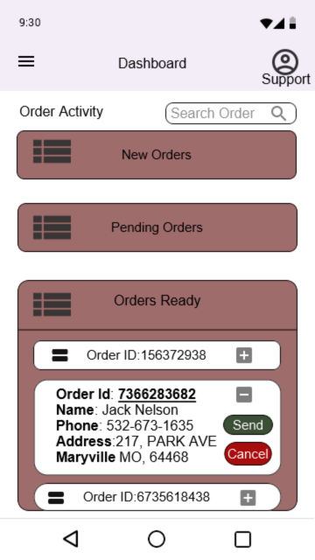
Vendor operations

Slide 18
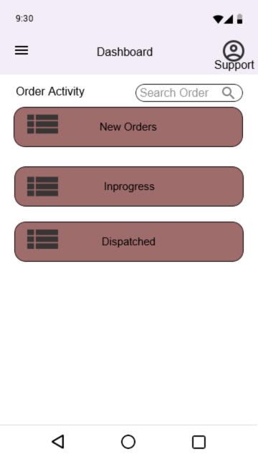
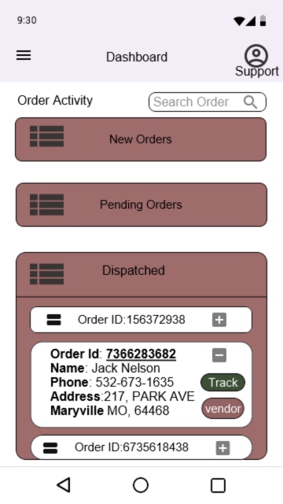
Warehouse ADMIN UI
Similar UI for both vendor and Warehouse Admin
With few additional functions.
Additional functionalities include Track order and
Vendor details.

Slide 19
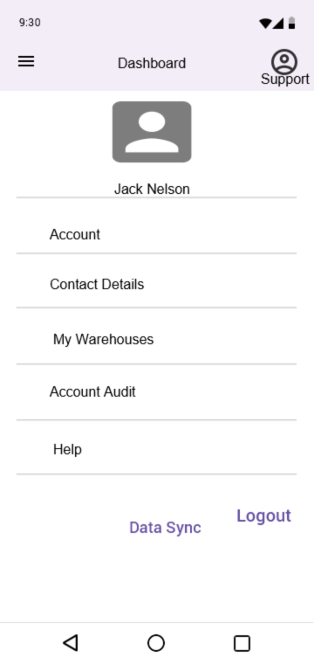
User profile
User profiles section which contains the account
information of the user, be it vendor or the warehouse admin.
Data sync is an exclusive functionality to sync the application data with the
database in case of any abnormalities or update failure

Slide 20
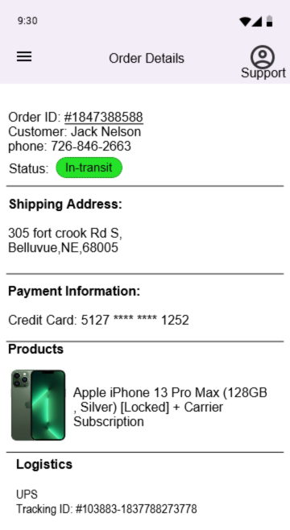
tracking
Whenever user search for the order using order number, it lands them on
the order details page which contains all the details for an order.
Status of the order is constantly updated in regular intervals.
Also contains the logistics information with tracking number.

Slide 21
summary
Warehouse inventory system involves in receiving, storing, and tracking inventory in a warehouse; managing warehouse staff; and optimizing storage space and costs; all of which directly impacts fulfillment, shipping, and the customer experience.

Slide 22

Thank you
Any Questions?

Slide 23
Team Members
Suresh Gopi Tulam
Pooja Kunta
Samyuktha Potla
Chaitanya Krishna Hanumantharao Chundiwar
Sravani Nalla

