Slide 1
Regularization Techniques in Logistic Regression L1 vs L2 vs No Regularization
Name: Samyuktha Battula
Student ID: 23072740
GitHub Repo: https://github.com/Samyuktha-DS/Machine-learning.git

Slide 2
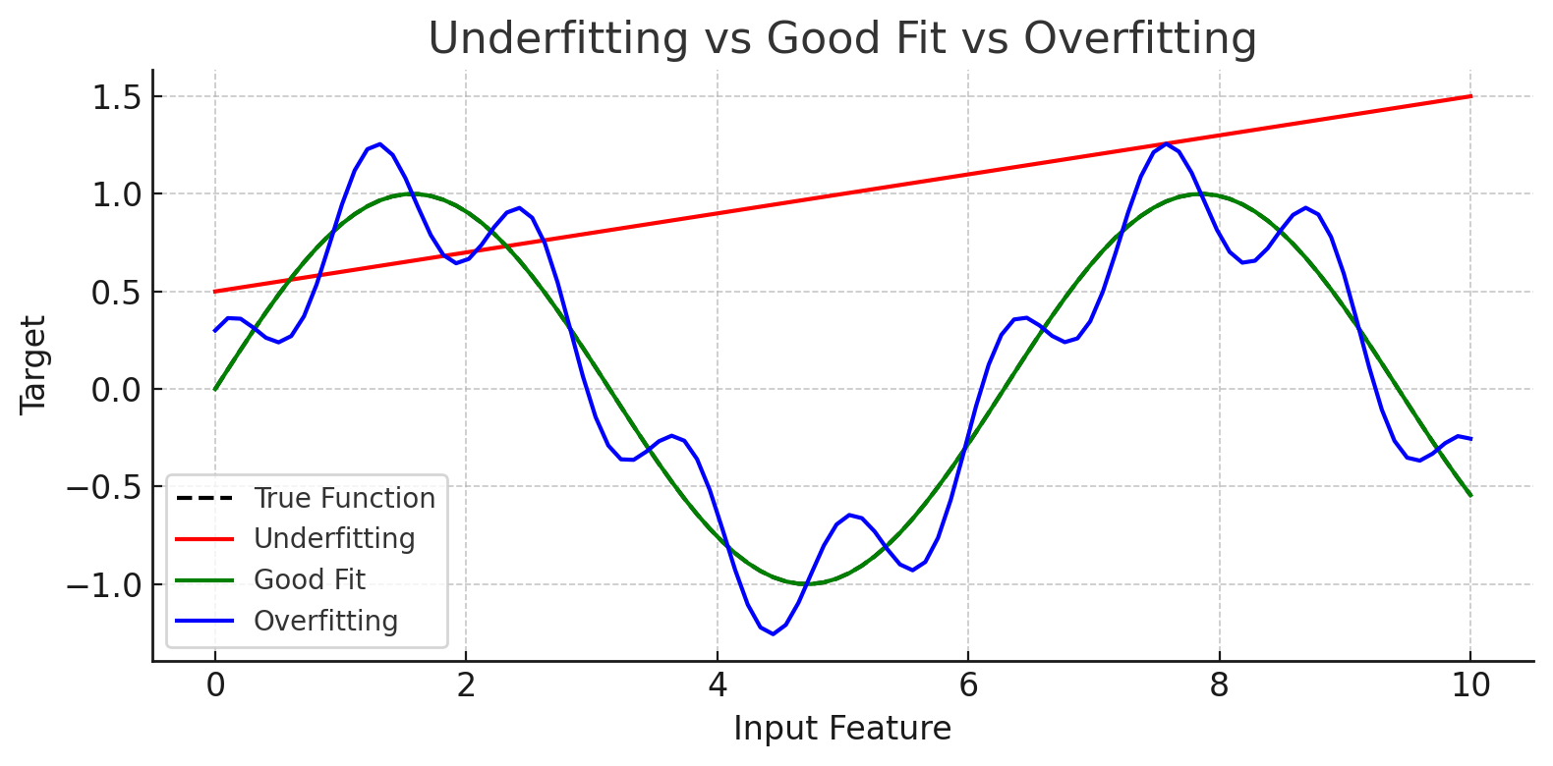
The Problem of Overfitting
Why Do We Need Regularization?
In supervised learning, we want models to perform well not just on the training data, but also on unseen data.
Overfitting happens when a model captures noise instead of the actual signal.
It performs very well on training data, but poorly on validation/test sets.
This is common in models with too many parameters or not enough training data.

Slide 3
What is Regularization?
Controlling Model Complexity with Penalties
Regularization is a technique used to reduce model complexity and prevent overfitting.
It works by adding a penalty term to the loss function that discourages large coefficient values.
In logistic regression:
Original loss: log loss / cross-entropy
Regularized loss: Loss + λ * Regularization Term
In scikit-learn, C = 1 / λ → Lower C = stronger regularization

Slide 4
L1 vs L2 Regularization
Controlling Model Complexity with Penalties
Feature | L1 (Lasso) | L2 (Ridge)
Penalty Term | Sum of absolute weights: `λ * | w
Behavior | Drives some weights to zero | Shrinks all weights smoothly
Feature Selection | Performs automatic feature selection | Keeps all features
Model Interpretability | Easy to interpret due to sparse weights | Harder to interpret
Best Used When | You suspect some features are irrelevant | All features are relevant, want general shrinkage

Slide 5
Experiment Setup
How We Tested Regularization Effects
Synthetic Dataset: Created using make_classification()
Samples: 500 rows (observations)
Features: 10 features (5 informative, 5 redundant)
Label Noise: 10% of labels were flipped to simulate noise
Model: Logistic Regression
Comparisons:
L1 Regularization (Lasso)
L2 Regularization (Ridge)
No Regularization
Regularization Strength: C = 0.1
Scaler Used: StandardScaler to normalize input data

Slide 6
Experiment Setup
Generate Dataset
(500 Samples)
Standardize Features
Train Logistic Regression (L1, L2, No Reg)
Compare Coefficients
Evaluate Accuracy
Train vs Test

Slide 7
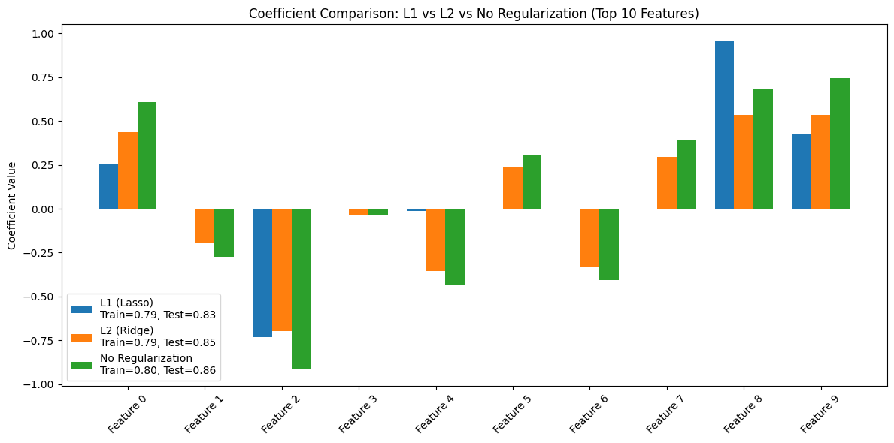
Coefficient Comparison
How Regularization Affects Feature Weights
L1 Regularization (Lasso):
Many features (like Feature 3, 4, 6) have coefficients close to zero or exactly zero.
Confirms that L1 encourages sparsity and automatic feature selection.
L2 Regularization (Ridge):
All features retain non-zero coefficients, though shrunk in magnitude.
This shows L2’s tendency to distribute weights more evenly.

Slide 8
Coefficient Comparison
How Regularization Affects Feature Weights
No Regularization:
Coefficients have higher magnitude overall, including some quite large (e.g., Feature 8).
Indicates a model that might overfit, relying heavily on certain features.
Takeaway: Regularization simplifies the model by reducing unnecessary influence of less important features.

Slide 9
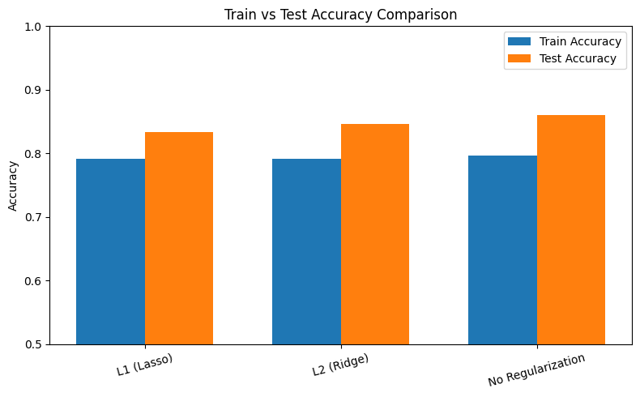
Train vs Test Accuracy
Generalization Performance
L1 Regularization:
Train Accuracy: 0.79
Test Accuracy: 0.83
Indicates good generalization with simpler model.

Slide 10
Train vs Test Accuracy
Generalization Performance
L2 Regularization:
Train Accuracy: 0.79
Test Accuracy: 0.85
Very balanced performance, strong generalization
No Regularization:
Train Accuracy: 0.80
Test Accuracy: 0.86
Slightly better accuracy, but higher risk of overfitting due to larger coefficients and model complexity.
Regularization slightly reduces training accuracy but improves model stability and generalization.

Slide 11
Key Takeaways
What Did We Learn?
Regularization is effective in preventing overfitting.
L1 Regularization (Lasso):
Shrinks irrelevant features to zero.
Helps with model interpretability.
L2 Regularization (Ridge):
Keeps all features, controls overfitting smoothly.
Great for scenarios where all features contribute somewhat.
No Regularization:
Highest test accuracy in this case, but more risk in real-world noisy data.
Might not scale well to complex, high-dimensional problems.
Best Practice: Use cross-validation to choose the right C (strength of regularization).

Slide 12
References
scikit-learn: Logistic Regression (with L1/L2) - https://scikit-learn.org/stable/modules/linear_model.html#logistic-regression
Towards Data Science – “Regularization in Machine Learning” https://towardsdatascience.com/regularization-in-machine-learning-6fbc4417b1e5/
Analytics Vidhya – “Regularization in Machine Learning” https://www.analyticsvidhya.com/blog/2022/08/regularization-in-machine-learning/#:~:text=Regularization%20is%20a%20technique%20used,generalize%20well%20to%20unseen%20data.
“The Elements of Statistical Learning” by Hastie, Tibshirani, and Friedman https://web.stanford.edu/~hastie/ElemStatLearn/

Slide 13
Thank You!

