Slide 1
Samyuktha.B
Final Project
3/21/2024 Annual Review

Slide 2

SciFiGen: Generating Science Fiction Concepts with AI
3/21/2024 Annual Review

Slide 3


AGENDA
Problem Statement
Project Overview
End Users
Value Proposition
Solution
Modelling
3/21/2024 Annual Review

Slide 4

PROBLEM STATEMENT
The challenge lies in generating original and captivating science fiction concepts efficiently. Existing methods often yield generic or disjointed ideas. SciFiGen addresses this by leveraging AI to provide diverse and cohesive prompts, inspiring writers and designers to explore new realms of imagination and create compelling narratives effortlessly.
3/21/2024 Annual Review

Slide 5

PROJECT OVERVIEW
This project utilizes LSTM neural networks to generate novel science fiction concepts. It preprocesses text data, trains the model, and then randomly combines existing concepts to create new ones. By leveraging AI, it fosters creativity and exploration in the realm of sci-fi, inspiring imaginative storytelling and world-building.
3/21/2024 Annual Review

Slide 6

WHO ARE THE END USERS?
Writers seeking inspiration for science fiction stories or novels.
Game designers looking for new concepts for sci-fi games or virtual worlds.
Filmmakers interested in developing science fiction movies or series.
Enthusiasts and fans of the science fiction genre seeking new ideas and concepts for personal enjoyment or discussion.
Creative professionals in fields such as art, graphic design, or animation, who may draw inspiration from the generated concepts for their projects.
3/21/2024 Annual Review

Slide 7

YOUR SOLUTION AND ITS VALUE PROPOSITION
Harnessing LSTM neural networks, the solution generates fresh science fiction concepts, sparking creativity and innovation. By seamlessly combining existing ideas, it offers writers and enthusiasts an efficient tool to explore the vast possibilities of the genre.This solution offers several key value propositions:
Efficient concept generation
Inspires creativity
Expands imagination
Enhances productivity
Fosters collaboration
3/21/2024 Annual Review

Slide 8

THE WOW IN YOUR SOLUTION
The wow factor in this solution lies in its ability to seamlessly blend existing science fiction concepts using LSTM neural networks, resulting in the creation of entirely new and captivating ideas. By leveraging AI technology, it offers an endless stream of imaginative concepts, inspiring writers and designers to explore uncharted territories within the genre with ease and efficiency.
3/21/2024 Annual Review
‹#›

Slide 9
MODELLING
Neural Network Architecture:
Incorporates LSTM (Long Short-Term Memory) network design.
Utilizes TensorFlow's Keras API for implementation.
Data Preprocessing:
Prepares text data for model training.
Extracts patterns and sequences from existing sci-fi concepts.
Training Methodology:
Implements LSTM layers and softmax activation for prediction.
Trains the model to generate coherent and imaginative sci-fi concepts.
3/21/2024 Annual Review
‹#›

Slide 10
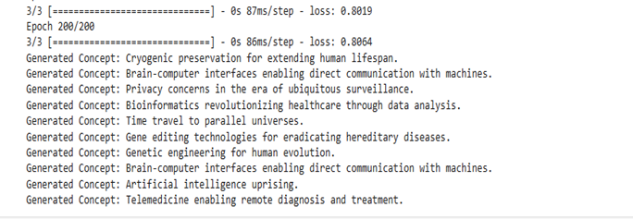
RESULTS
The model generates novel science fiction concepts by combining existing ideas. Leveraging LSTM neural networks, it seamlessly blends themes, inspiring creativity and offering a continuous stream of imaginative possibilities within the genre.
https://github.com/Samyuktha412/Naan-Mudhalvan.git
3/21/2024 Annual Review
‹#›

