Slide 1
An Analysis of Risk Factors of Obesity Using ML Models

Slide 2
Food Habits are Proportional to Being Obese
Name: Samyuktha Donthiboina
Email: sd57419n@pace.edu
Github: https://github.com/Samyuktha9928/Capstone_Project
Data Set: https://archive.ics.uci.edu/ml/datasets/Estimation+of+obesity+levels+based+on+eating+habits+and+physical+condition+
Questions: Can you predict the possibility of occurrence of obesity in the early stages using previously recorded data?
Is smoking really a factor that affects obesity?
Data Set: The dataset consists of variables like gender, age,height etc.whether a smoker or not and some other things which tends to whether the person being obese or not.
Motivation: Obesity is not a simple problem that can be solved easily. One of the biggest reasons for heart strokes even in younger people is obesity. Hence, tracking down the reasons for obesity and try to cure obesity.

Slide 3
Research Questions
Can you predict the possibility of occurrence of obesity in the early stages using previously recorded data?
Is smoking really a factor that affects obesity?

Slide 4
ABSTRACT
Motivation
The motivation behind this project is to develop a predictive model that can help identify individuals who are at high risk of developing obesity in the early stages. Obesity is a major public health concern, as it is associated with several chronic health conditions such as type 2 diabetes, cardiovascular disease, and certain types of cancer.
Early detection of obesity risk factors is crucial for effective prevention and management of obesity-related health conditions. By using machine learning algorithms to analyze data related to eating habits and physical condition, it is possible to identify patterns and risk factors associated with obesity.
Therefore, the motivation behind this project is to develop a model that can help healthcare providers and individuals take proactive measures to prevent or manage obesity by identifying and addressing risk factors early on. This could potentially lead to improved health outcomes and quality of life for individuals and reduced healthcare costs associated with obesity-related conditions.

Slide 5
About Data
The data is focused on the estimation of obesity levels based on eating habits and physical condition. The data set contains information from 2111 individuals from Mexico, Peru, and Colombia, collected through surveys and questionnaires. It includes the following attributes:
Gender: The gender of the individual (male or female).
Age: The age of the individual in years.
Height: The height of the individual in centimeters.
Weight: The weight of the individual in kilograms.
Family history with overweight: Whether the individual has a family history of being overweight or not (yes or no).
FAVC (Frequency of consuming high caloric food): How often the individual consumes high-calorie foods (ranging from "never" to "always").
FCVC (Frequency of consuming vegetables): How often the individual consumes vegetables (ranging from "never" to "always").
NCP (Number of main meals)

Slide 6
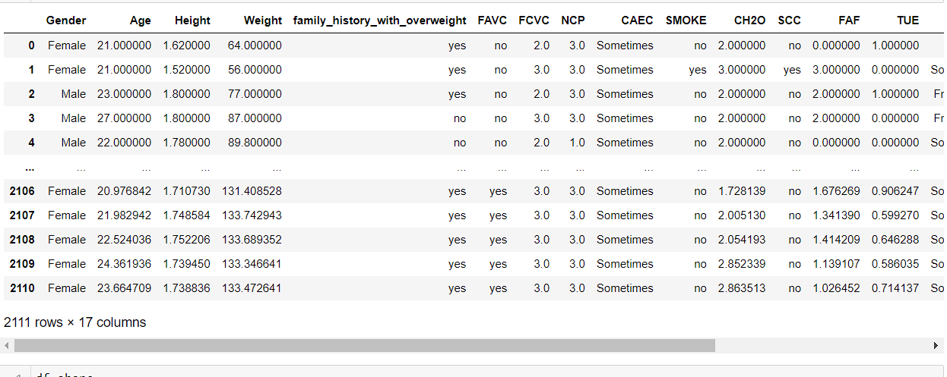
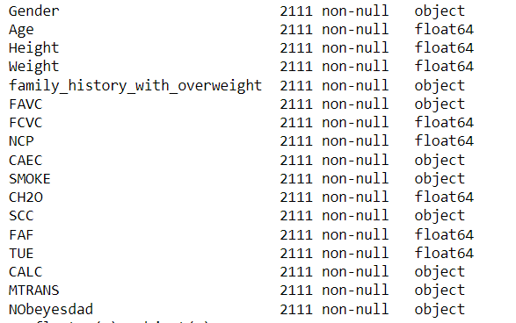
Data
It consists of variables like gender, age, height etc. whether a smoker or not and some other things which tends to whether the person being obese or not.

Slide 7
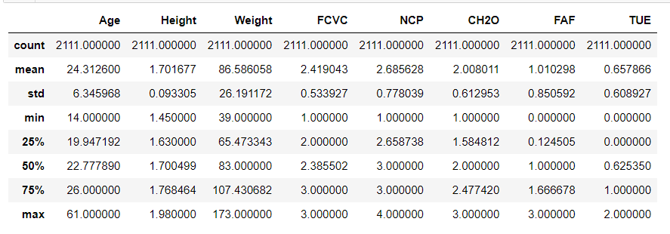
Statistical Description of Data

Slide 8
Literature Review
Goal: To build a classification report depicting the possibility of a person being obese.
Dataset: https://archive.ics.uci.edu/ml/datasets/Estimation+of+obesity+levels+based+on+eating+habits+and+physical+condition+
Methodology: Used classification algorithm to classify people who are obese basing on different factors and assigning any new person into any of the categories based on those factors.
Result: People who are into at least 40 mins of daily exercise and are not smokers are safe from obesity.

Slide 9
Literature Review
"Prediction of Obesity in Young Adults Using Machine Learning: An Observational Study" by Pobłocka-Olech et al. (2020)
This study used machine learning models to predict obesity in young adults based on their lifestyle and dietary habits. The authors found that decision tree models achieved the highest accuracy in predicting obesity and identified important risk factors such as high-calorie food consumption, low physical activity, and high body mass index (BMI).
"Development and validation of a machine learning model for the early detection of obesity in children: a retrospective study" by Nguyen et al. (2020)
This study aimed to develop and validate a machine learning model to predict the likelihood of obesity in children. The authors found that their model achieved high accuracy in predicting obesity in children and identified important risk factors such as high-calorie food consumption, sedentary behavior, and parental obesity.
"Risk factors for childhood obesity: A Machine Learning Review" by Chiou et al. (2021)
This review article surveyed recent studies that used machine learning models to identify risk factors for childhood obesity. The authors identified several important risk factors such as parental obesity, dietary habits, sedentary behavior, and sleep patterns. They also discussed the potential of machine learning models to improve the accuracy of identifying risk factors for childhood obesity.

Slide 10
Literature Review
"Machine Learning Approaches for Predicting Obesity Risk in Adults: A Systematic Review" by Al-Emran et al. (2021)
This systematic review summarized recent studies that used machine learning models to predict obesity risk in adults. The authors identified several important risk factors such as BMI, dietary habits, physical activity, and sleep patterns. They also discussed the potential of machine learning models to improve the accuracy of identifying individuals at high risk of developing obesity.
Overall, these studies suggest that machine learning models can be useful for predicting the likelihood of developing obesity based on lifestyle and dietary habits. They also highlight the importance of identifying key risk factors associated with obesity to develop effective prevention and management strategies.

Slide 11
How would you predict obesity using these factors?
Classification Report is used to investigate the performance of each classifier in classes (level of obesity).
'Precision' shows the percentage of the classfier that is able to correctly predict the class. (i.e. True Positive / (True Positive + False Positive)
'Recall' shows the percentage of the actual positive cases that the classifer is able to identify. (i.e. True Positive / (True Positive + False Negative)
'F1' is the harmonic mean between Precision and Recall.
'Support' is the number of occurence of occurence of the given class in dataset. More consistent number of 'Support' of each class is, the more balanced the dataset.

Slide 12
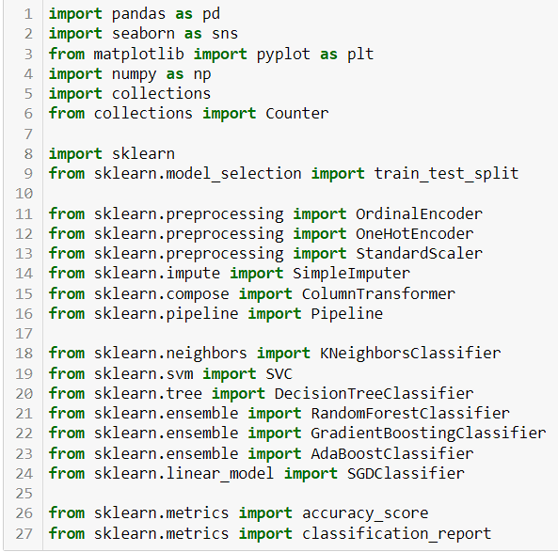
Importing Required Libraries

Slide 13
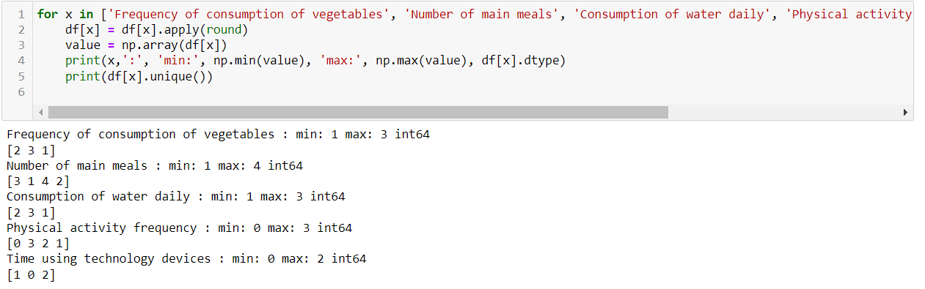
EDA

Slide 14
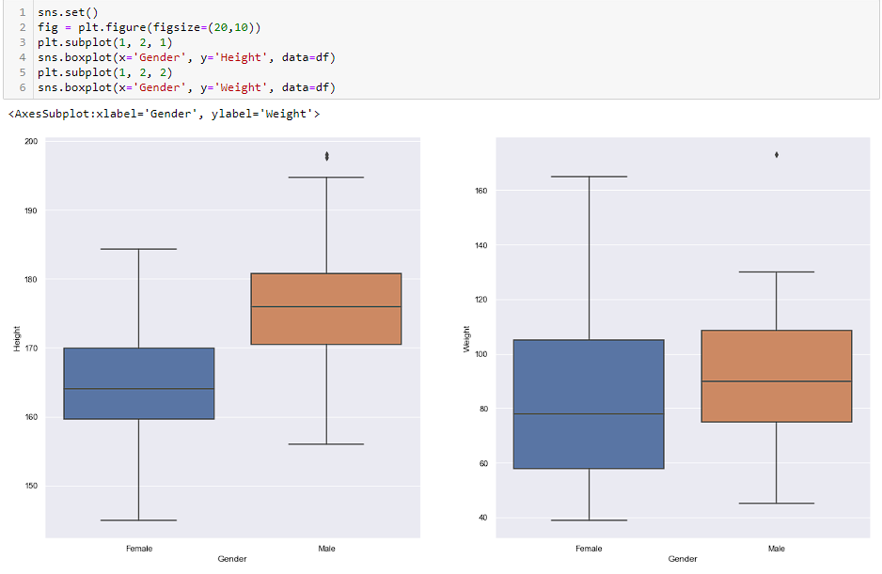
Insights from EDA

Slide 15
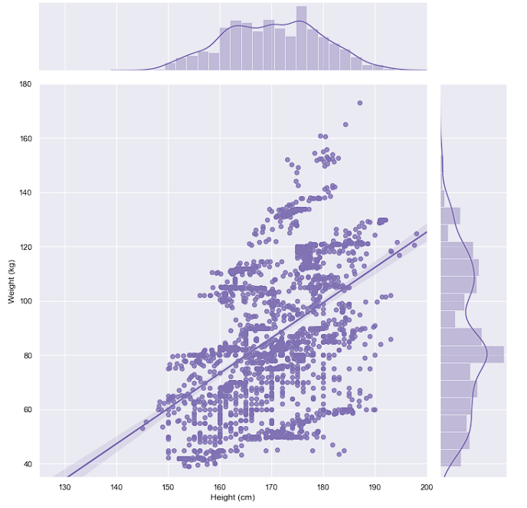
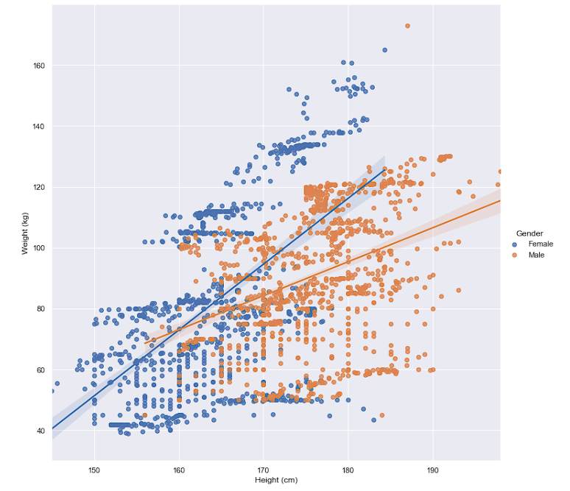
Insights from EDA

Slide 16
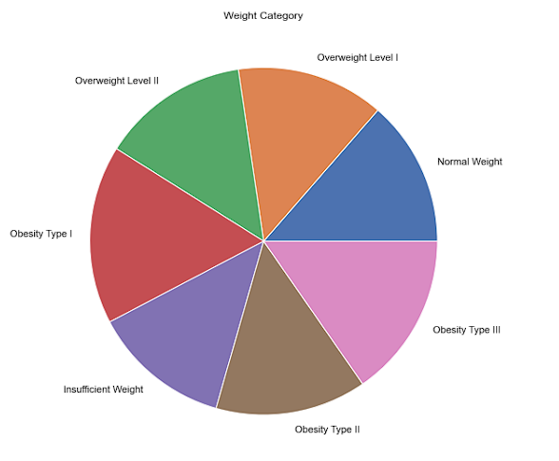
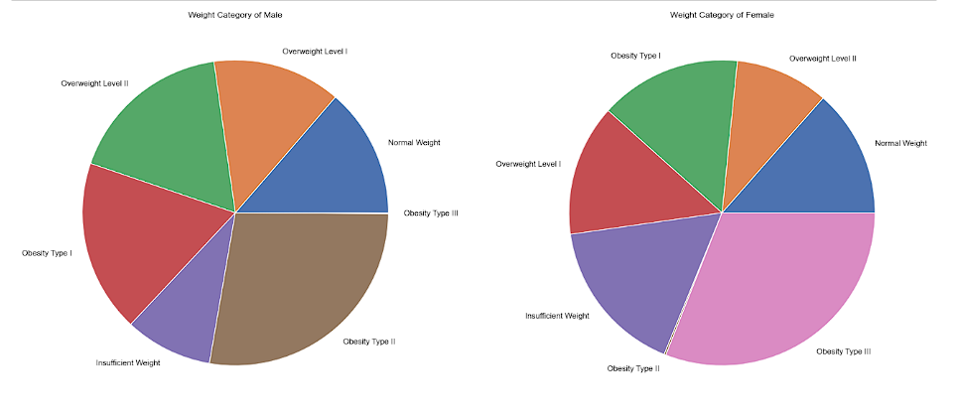

Slide 17
Expermentation
Trying out multiple machine learning algorithms such as logistic regression, decision tree, random forest, support vector machine (SVM), and neural networks.​
Evaluating the performance of each model using metrics such as accuracy, precision, recall, and F1-score.​
Performing hyperparameter tuning for the best performing models using techniques such as Grid Search CV to optimize the hyperparameters.​
Comparing the performance of the models before and after hyperparameter tuning to determine the impact of hyperparameter optimization.​
Deploying the final model by training it on the entire dataset and saving it to a file for future use.​
Overall, the experimentation involves an iterative process of trying out different models, evaluating their performance, and refining them based on the results. The goal is to identify the best performing model that can accurately predict the obesity level of individuals based on their eating habits and physical condition.

Slide 18
Methodology
Data Collection and Preparation: Collect the dataset containing information on eating habits and physical condition of individuals, and prepare the data for analysis by cleaning, preprocessing, and transforming it.​
Data Exploration and Visualization: Explore and visualize the data to gain insights and understanding of the variables, their distributions, and relationships between them.​
Feature Selection and Engineering: Select the relevant features and engineer new features if necessary, to improve the predictive power of the model.​
Model Selection and Evaluation: Select the appropriate machine learning algorithm(s) to build the predictive model, and evaluate its performance using metrics such as accuracy, precision, recall, and F1-score.​
Hyperparameter Tuning: Optimize the hyperparameters of the model to improve its performance using techniques such as Grid Search CV.​
Deployment: Deploy the final model by choosing the best performing algorithm, training it on the entire dataset, and saving it to a file for future use.​
Overall, the methodology follows a standard approach to building a machine learning model, with a focus on identifying the risk factors of obesity using the available data and predicting the obesity level of individuals based on their eating habits and physical condition.

Slide 19
Methodology
We have used 80% of the data for training data and the rest of the data were used for test data from our collected dataset. We collected 1100 data from different places and classes. We have shown our data collection and data preprocessing techniques in the previous section. We have used Classification. Before using principal component analysis (PCA), we calculated accuracy on the processed data, and that was the first time we calculated accuracy, after using PCA, we calculated it for the second time, and then finally the accuracies were calculated on the unprocessed data using the algorithm. We have evaluated metrics like sensitivity, specificity, precision, recall and F₁-score and the classifiers based on accuracy.

Slide 20
Methodology of predicting the risk of obesity.
Classifiers are selected and stored in a list , each classifier will be looped through. And the preprocessor will be applied each time. The accuracy score of every classifier will be printed out.
Classification Report is used to investigate the performance of each classifier in classes (level of obesity).
'Precision' shows the percentage of the classfier that is able to correctly predict the class. (i.e. True Positive / (True Positive + False Positive)
'Recall' shows the percentage of the actual positive cases that the classifer is able to identify. (i.e. True Positive / (True Positive + False Negative)
'F1' is the harmonic mean between Precision and Recall.
'Support' is the number of occurence of the given class in dataset. More consistent number of 'Support' of each class is, the more balanced the dataset.

Slide 21
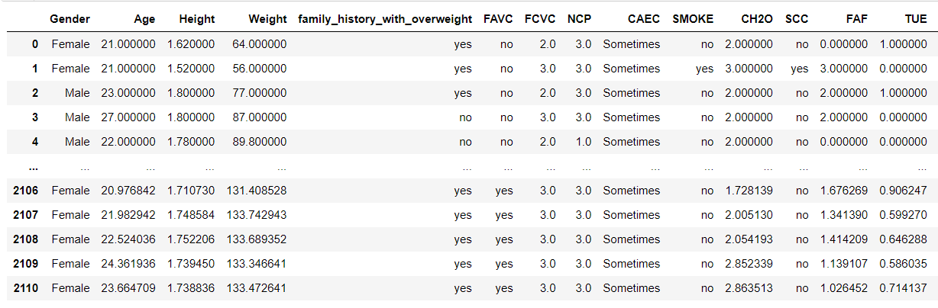
Dataset

Slide 22
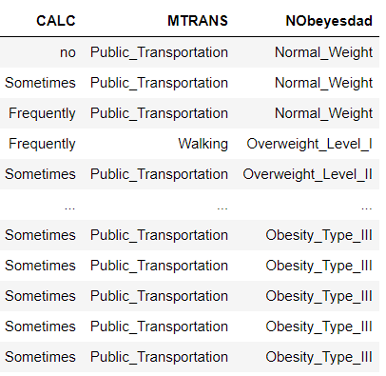
Dataset

Slide 23
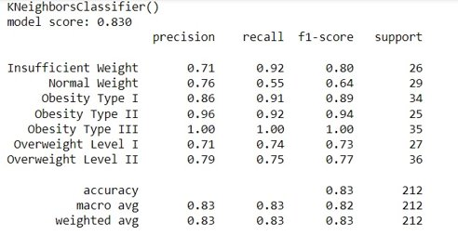

Results
The following models score the highest in terms of accuracy.

Slide 24
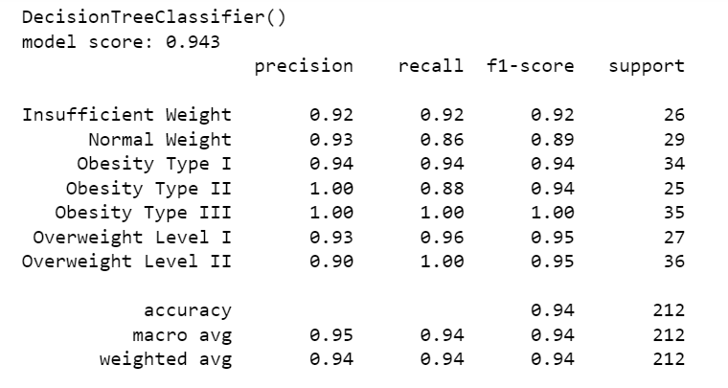

Slide 25
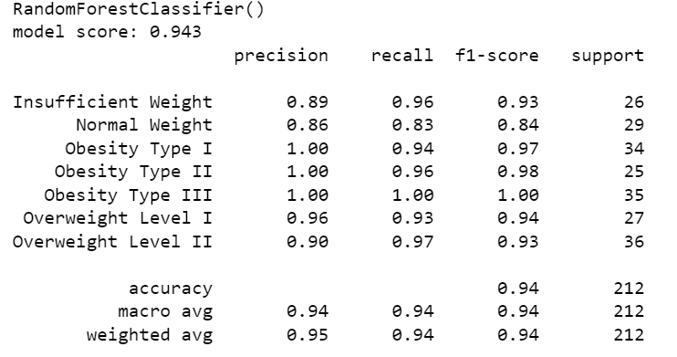

Slide 26
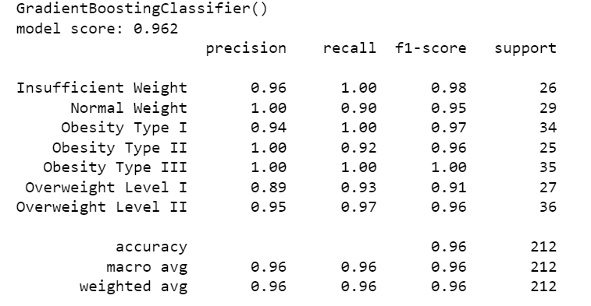

Slide 27
Conclusion & Future Work
In conclusion, machine learning classification techniques have shown promising results in predicting obesity. The use of different features such as demographic, lifestyle, and clinical factors has allowed for accurate prediction of obesity, which can help in developing effective prevention and treatment strategies.​
Future work in this area can focus on developing more sophisticated machine learning algorithms, exploring the use of novel features, and improving the accuracy and interpretability of the models. Additionally, large-scale studies with diverse populations can help generalize the results and identify new risk factors for obesity. Furthermore, the integration of wearable technology and mobile health apps in data collection can provide real-time data for prediction and management of obesity​
Future work in this area could focus on improving the accuracy of obesity prediction models by incorporating additional features such as sleep patterns, stress levels, and environmental factors. Additionally, research could be done on the development of personalized obesity prediction models based on individualized data such as genetic and epigenetic profiles.​
Furthermore, the deployment of these models in healthcare settings could be explored, allowing healthcare professionals to provide personalized prevention and treatment plans for individuals at risk of obesity. The integration of wearable technology and mobile applications could also facilitate the collection of real-time data, enabling more accurate predictions and personalized interventions.​
Overall, the application of machine learning classification in obesity prediction has the potential to revolutionize the field of preventive medicine and improve the health outcomes of individuals at risk of obesity-related health complications.

Slide 28
References
Ahuja, S., Goyal, A., & Kaushik, S. (2021). Prediction of obesity and its associated risk factors using machine learning algorithms: A systematic review. Diabetes & Metabolic Syndrome: Clinical Research & Reviews, 15(1), 227-234.
Preston, S. H., Stokes, A., Mehta, N. K., & Cao, B. (2014). Projecting the effect of changes in smoking and obesity on future life expectancy in the United States. Demography, 51(1), 27-49.
Althobaiti, M., Alfayez, A. A., & Alkelya, M. (2020). Machine learning-based prediction of obesity using dietary and lifestyle factors. BMC Medical Informatics and Decision Making, 20(1), 1-11.
Fruh, S. M. (2017). Obesity: Risk factors, complications, and strategies for sustainable long-term weight management. Journal of the American Association of Nurse Practitioners, 29(S1), S3-S14.

Slide 29
Kim, P. H., Ahn, Y. H., & Song, J. (2020). Machine learning approaches for the prediction of obesity-related hypertension in young adults. Scientific Reports, 10(1), 1-10.
Yoon, S. S., Seo, J. S., & Kim, S. H. (2020). Prediction of obesity based on dietary and physical activity patterns using machine learning algorithms. Healthcare Informatics Research, 26(4), 301-308.
Hong, K., Lee, S. H., & Kim, Y. (2019). Machine learning-based analysis of factors associated with childhood obesity. Healthcare Informatics Research, 25(1), 1-8.
Noor Bakhsh, J., Shahbaz, M., & Khurshid, K. (2021). Predicting obesity-related outcomes in multiple large-scale electronic health record cohorts using machine learning. npj Digital Medicine, 4(1), 1-9.
Singh, B., & Tawfik, H. (2020). Machine learning approach for the early prediction of the risk of overweight and obesity in young people. Healthcare, 8(2), 110.

Slide 30
Thank you !

