Slide 1
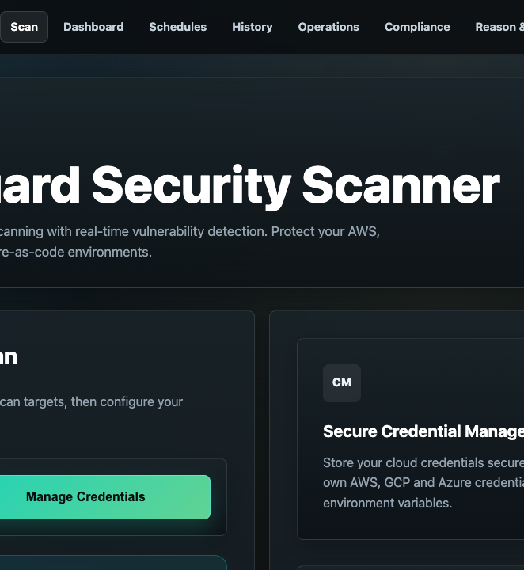
LIVE SECURITY WORKSHOP
CloudGuard
Live Workshop
Four scanners. One evidence trail.
One verified closure story.
AWS • GCP • Kubernetes • IaC
2.5-hour facilitator deck
Notes:
Timing: 3 minutes.
Welcome participants and state that every demonstration is authorized and isolated.
Set the promise: the session will not stop at finding vulnerabilities; it will show evidence, ownership, and closure.
[Sources]
- /Users/anjali/Cloud_Vulnerabilities/output/playwright/cloudguard-portal.png
- /Users/anjali/Cloud_Vulnerabilities/README.md
[/Sources]

Slide 2
WORKSHOP OUTCOME
A finding matters only when it changes a decision
Discover the weakness.
Prove the risk.
Govern the fix.
By the end, participants can:
Recognize what each of the four scanners proves
Explain why isolated labs are safer than vulnerable production-like accounts
Follow one finding into evidence, priority, control mapping, and remediation
Define the rescan or cleanup proof that closes the issue
CloudGuard live workshop
02
Notes:
Timing: 5 minutes.
Invite a quick show of hands: who works mainly in cloud, platform, development, or governance?
Use the answers to choose terminology depth during the four demos.
[Sources]
- /Users/anjali/Cloud_Vulnerabilities/docs/vendor-neutral-reason-act-architecture.md
[/Sources]

Slide 3
RUN OF SHOW
The 150-minute workshop keeps every demo moving
01
00:00–00:20
Purpose, platform, and authorization rules
02
00:20–00:40
AWS scanner demo
03
00:40–01:00
GCP scanner demo
04
01:00–01:20
Kubernetes scanner demo
05
01:20–01:35
IaC scanner demo
06
01:35–02:05
Buffer, comparison, and prioritization
07
02:05–02:30
Evidence, GRC, Reason & Act, and cleanup
CloudGuard live workshop
03
Notes:
Timing: 3 minutes.
Tell participants that cloud scan duration is variable; the warm-live method prevents waiting from consuming the session.
Keep questions short during demos and collect deeper questions for the comparison block.
[Sources]
- /Users/anjali/Cloud_Vulnerabilities/docs/sandbox-lab-workflow.md
[/Sources]

Slide 4

PLATFORM MAP
Portal coordination; scanner workers execute
CloudGuard separates the participant experience from long-running scan jobs. Workers collect findings, evidence is normalized, and governance remains available even when scanners run elsewhere.
Portal: target, credential reference, and job status
Workers: provider-specific discovery and analysis
Evidence: source, asset, proof, checksum, and control
GRC: priority, owner, action, and audit trail
CloudGuard live workshop
04
Notes:
Timing: 7 minutes.
Explain the queue before opening any provider-specific screen.
Emphasize that the portal can be hosted independently of AWS or GCP while still scanning them through stored credentials and workers.
[Sources]
- /Users/anjali/Cloud_Vulnerabilities/handoff/grc-compliance-governance/setup-dokploy-cloudguard-stack.png
- /Users/anjali/Cloud_Vulnerabilities/README.md
[/Sources]

Slide 5
SAFE LAB DESIGN
Host vulnerable resources in isolated sandboxes
Pre-create isolated environments, then give every temporary resource an owner, expiry, and kill switch.
Never use production credentials or real data.
CREATE
SCAN
DESTROY
Isolated targets
Bounded exposure
Closure proof
AWS sandbox account
GCP sandbox project
Kubernetes lab
IaC file pack
Empty data stores
No production trust
Short TTL
Budget alerts
Delete resources
Check stale tags
Store cleanup event
Confirm zero leftovers
CloudGuard live workshop
05
Notes:
Timing: 8 minutes.
Use pre-created AWS and GCP sandboxes. Do not attempt live account creation or closure.
IaC is the zero-cost fallback. Kubernetes can use kind, k3s, or a temporary namespace in a dedicated cluster.
Before proceeding, state the authorization boundary and demonstrate the cleanup command or button.
[Sources]
- /Users/anjali/Cloud_Vulnerabilities/docs/sandbox-lab-workflow.md
- /Users/anjali/Cloud_Vulnerabilities/db/init/12_migration_sandbox_labs.sql
[/Sources]

Slide 6
DEMO RELIABILITY
A warm-live run keeps cloud latency out of the agenda
01
02
03
Before participants arrive
During each demo
Before closing
Provision targets, run one successful scan per provider, and retain the completed results as the safety net.
Trigger a fresh scan, show queued/running state, then explain the last completed result while the new job runs.
Return to fresh jobs, show evidence, destroy resources, and verify that the cleanup event was recorded.
Keep screenshots and raw outputs ready, but always show at least the live launch and live queue state.
CloudGuard live workshop
06
Notes:
Timing: 4 minutes.
Explain the warm-live method to the demo operator and lab assistant before the session.
Use a visible run sheet: target ready, credential validated, baseline result ready, fresh job started, cleanup confirmed.
[Sources]
- /Users/anjali/Cloud_Vulnerabilities/README.md
- /Users/anjali/Cloud_Vulnerabilities/docs/sandbox-lab-workflow.md
[/Sources]

Slide 7
AWS SCANNER DEMO
AWS connects identity, storage, and network risk
SHOW THE FULL CHAIN
AWS
Show the sandbox account and temporary resource tags
TEMPORARY TARGETS
Launch the AWS scan and show queued/running state
01
Empty S3 bucket with risky public-access configuration
Open two findings: one exposure, one identity risk
02
Unattached security group with broad admin ingress
Choose one finding for evidence and closure
03
Test IAM role with an overly broad policy
Takeaway: severity becomes meaningful when the resource, exposure path, and identity impact are visible.
CloudGuard live workshop
07
Notes:
Timing: 20 minutes.
Do not store data in the test bucket. Keep the security group unattached and the IAM role unusable outside the lab.
Show resource prefix and expiry before showing findings.
Return to the live job after explaining the completed baseline result.
[Sources]
- /Users/anjali/Cloud_Vulnerabilities/docs/sandbox-lab-workflow.md
- /Users/anjali/Cloud_Vulnerabilities/README.md
[/Sources]

Slide 8
GCP SCANNER DEMO
GCP reveals the same risks through different controls
SHOW THE FULL CHAIN
GCP
Show project boundary, labels, and expiry
Launch the GCP scan and show the job lifecycle
TEMPORARY TARGETS
01
Empty Cloud Storage bucket with risky IAM binding
Compare storage, firewall, and IAM findings with AWS
02
Broad firewall rule without a production workload
Map one result to the same business risk story
03
Test service account with excessive permissions
Takeaway: normalize the evidence so cross-cloud teams can compare equivalent risks.
CloudGuard live workshop
08
Notes:
Timing: 20 minutes.
Keep the storage bucket empty, do not create a service-account key, and do not attach the firewall rule to production workloads.
Ask participants which AWS finding is most similar to each GCP result.
[Sources]
- /Users/anjali/Cloud_Vulnerabilities/docs/sandbox-lab-workflow.md
- /Users/anjali/Cloud_Vulnerabilities/README.md
[/Sources]

Slide 9
KUBERNETES SCANNER DEMO
Kubernetes risk spans workload, identity, and network
Use a disposable kind/k3s cluster or a temporary namespace. Keep the workload benign even when its configuration is intentionally unsafe.
WORKLOAD
IDENTITY
NETWORK
Privileged pod
Broad RBAC
Exposed service
Benign image
No real secret
No host data
Dummy service account
Short-lived binding
Isolated scope
NodePort or missing policy
No production traffic
Cleanup verified
Launch → inspect RBAC/workload/service findings → compare manifest with live state → delete the namespace or cluster
CloudGuard live workshop
09
Notes:
Timing: 20 minutes.
Start with the namespace or cluster boundary, then show the three risk surfaces in this order: workload, identity, network.
Do not use a harmful image, real secret, or hostPath containing host data.
End by deleting the temporary namespace or disposable cluster and showing the cleanup event.
[Sources]
- /Users/anjali/Cloud_Vulnerabilities/docs/sandbox-lab-workflow.md
- /Users/anjali/Cloud_Vulnerabilities/README.md
[/Sources]

Slide 10
IAC SCANNER DEMO
IaC finds the weakness before cloud resources exist
vulnerable-lab.tf
Predict before you scan
resource "cloud_storage" "demo" {
public_access = true
encryption = false
}
resource "firewall" "admin" {
source = "0.0.0.0/0"
port = 22
}
# workshop fixture — no real secret
Ask participants to name the expected findings
Upload Terraform, CloudFormation, or Kubernetes YAML
Run the local zero-cost scanner
Compare predicted findings with file and line evidence
Correct the template and rescan
Best workshop fallback: fast, deterministic, and no cloud bill.
CloudGuard live workshop
10
Notes:
Timing: 15 minutes.
Use the IaC demo as the participation moment: ask the room to predict public storage, broad ingress, encryption, privileged Kubernetes, and dummy-secret findings.
This is the zero-cost fallback if any live provider scan fails.
[Sources]
- /Users/anjali/Cloud_Vulnerabilities/docs/sandbox-lab-workflow.md
- /Users/anjali/Cloud_Vulnerabilities/README.md
[/Sources]

Slide 11
CROSS-SCANNER DEBRIEF
Compare risk stories—not provider vocabulary
TARGET
EXAMPLE FINDING
PROOF
LIKELY OWNER
CLOSURE
AWS
Public storage
Bucket policy
Cloud team
Policy + rescan
GCP
Public IAM binding
IAM policy
Cloud team
Binding removed
Kubernetes
Privileged workload
Pod spec
Platform team
Manifest + rescan
IaC
Broad ingress
File + line
DevOps
Corrected code
Audience prompt: Which finding should be fixed first—and what extra context would change your answer?
CloudGuard live workshop
11
Notes:
Timing: 20 minutes, including a short buffer for scans.
Ask teams to pick one finding and justify priority using exposure, identity impact, data sensitivity, and business criticality.
Do not present the example table as measured workshop output; it is a discussion scaffold.
[Sources]
- /Users/anjali/Cloud_Vulnerabilities/docs/vendor-neutral-reason-act-architecture.md
- /Users/anjali/Cloud_Vulnerabilities/db/init/11_migration_reason_act_workflow.sql
[/Sources]

Slide 12

EVIDENCE PIPELINE
Normalized evidence unifies all four scanners
Every useful artifact answers five questions
Where did it come from?
Which asset does it describe?
What proof was retained?
Which control or risk does it affect?
Who must act next?
CloudGuard live workshop
12
Notes:
Timing: 8 minutes.
Open one evidence item and point out source system, scanner type, asset reference, checksum, metadata, and control mapping.
Explain that external scanners can use the same evidence contract without being embedded in the portal.
[Sources]
- /Users/anjali/Cloud_Vulnerabilities/handoff/grc-compliance-governance/architecture-grc-evidence-flow.png
- /Users/anjali/Cloud_Vulnerabilities/db/init/09_migration_scan_jobs_evidence.sql
- /Users/anjali/Cloud_Vulnerabilities/docs/grc-platform-merge.md
[/Sources]

Slide 13
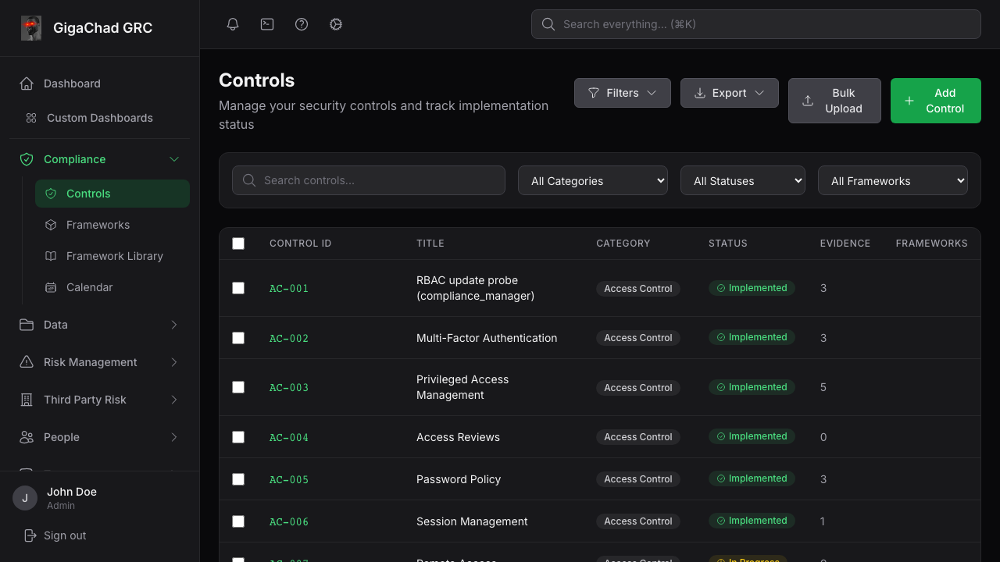
GOVERNANCE VIEW
GRC turns proof into control status and ownership
Show the selected finding beside its control, evidence count, status, and remediation owner. The governance view should answer what failed, who owns it, and what proves closure.
Control and framework mapping
Evidence review and audit history
Risk and remediation tracking
Leadership and auditor visibility
CloudGuard live workshop
13
Notes:
Timing: 7 minutes.
Show how a scanner artifact becomes evidence for a control rather than merely a line in a vulnerability report.
Call out evidence count, status, framework association, and the expected remediation owner.
[Sources]
- /Users/anjali/Cloud_Vulnerabilities/grc-platform/frontend/e2e/__snapshots__/visual.spec.ts/controls-list.png
- /Users/anjali/Cloud_Vulnerabilities/docs/grc-platform-merge.md
- /Users/anjali/Cloud_Vulnerabilities/grc-platform/README.md
[/Sources]

Slide 14

CLOSURE WORKFLOW
Reason & Act moves findings toward approval
1
Discover
2
Prioritize
3
Validate
4
Approve
5
Govern
Production-changing automation should remain approval-gated until rollback and guardrails are reviewed.
CloudGuard live workshop
14
Notes:
Timing: 8 minutes.
Open the Reason & Act page and connect each phase to the finding selected during the comparison exercise.
Demonstrate learn or approve mode; do not execute production-changing automation in the workshop.
[Sources]
- /Users/anjali/Cloud_Vulnerabilities/output/playwright/cloudguard-reason-act.png
- /Users/anjali/Cloud_Vulnerabilities/docs/vendor-neutral-reason-act-architecture.md
- /Users/anjali/Cloud_Vulnerabilities/db/init/11_migration_reason_act_workflow.sql
[/Sources]

Slide 15
WORKSHOP COMPLETE
You are done when
the proof is complete
THE STORY
Weakness
→ finding
→ evidence
→ owner
→ fix
→ closure
Before anyone leaves, confirm four things:
✓
All four scan jobs have a result or documented fallback
✓
One finding is mapped to evidence, control, owner, and action
✓
AWS, GCP, and Kubernetes lab resources are destroyed
✓
Cleanup events and the final rescan or validation proof are retained
A dashboard reports risk. A workshop teaches people how to close it.
Notes:
Timing: 5 minutes.
Run the cleanup checklist in front of participants.
Confirm that no temporary resource remains, then invite final questions and collect feedback.
Share the deck, lab guide, and approved sample outputs after the session.
[Sources]
- /Users/anjali/Cloud_Vulnerabilities/docs/sandbox-lab-workflow.md
- /Users/anjali/Cloud_Vulnerabilities/docs/vendor-neutral-reason-act-architecture.md
[/Sources]

