Slide 1

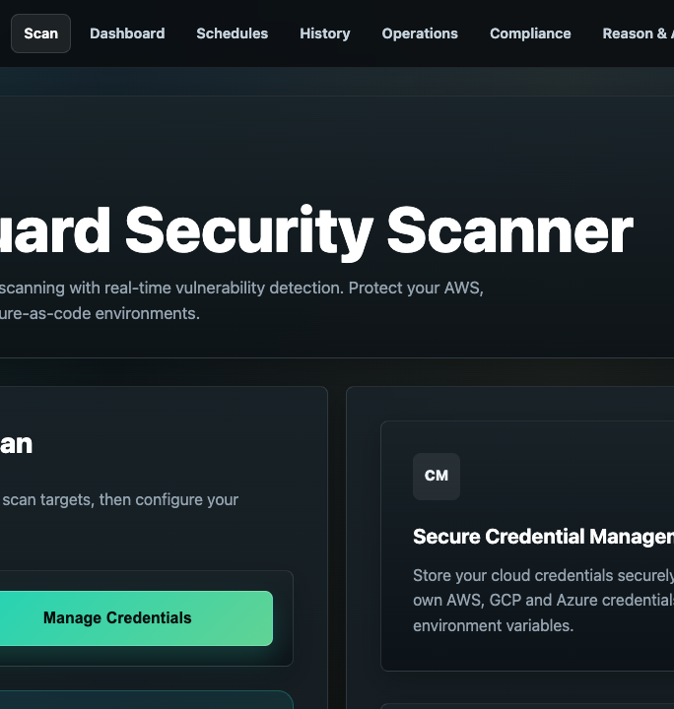
DeepTrustxAI
CloudGuard
Security Workshop
Four scanner demonstrations with separate practical labs
AWS GCP Kubernetes Infrastructure as Code
Facilitator deck | 150 minutes
Notes:
Timing: 2 minutes
Welcome participants, confirm that all activity stays inside approved lab environments, and introduce the four scanner streams.
[Sources]
- /Users/anjali/Cloud_Vulnerabilities/workshop/marp-demo/images/deeptrustxai-logo.png
- /Users/anjali/Cloud_Vulnerabilities/output/playwright/cloudguard-portal.png
- /Users/anjali/Cloud_Vulnerabilities/README.md
[/Sources]

Slide 2
WORKSHOP OPENING
DeepTrustxAI
Learning outcomes
Participants finish with a complete finding story, not only a scan report.
Participants will be able to
Workshop output
Explain what each scanner checks
Identify unsafe identity, storage, network, workload, and IaC settings
Collect evidence without exposing real credentials or data
One finding mapped to an asset and control
A named remediation owner
A cleanup event or rescan that proves closure
CloudGuard workshop
02
Notes:
Timing: 5 minutes
Set the success criteria before discussing tools. Ask participants to keep one finding throughout the session and use it in the final evidence workflow.
[Sources]
- /Users/anjali/Cloud_Vulnerabilities/workshop/deeptrustxai-cloud-security-module-wise-syllabus.md
[/Sources]

Slide 3
WORKSHOP OPENING
DeepTrustxAI
150-minute agenda
Block | Time | Focus
Opening | 10 min | Outcomes, scope, and lab rules
Module 1 | 20 min | Foundations and safe lab design
Module 2 | 55 min | Live demonstrations of all four scanners
Module 3 | 45 min | Separate practical lab exercises
Module 4 | 15 min | Evidence, GRC, and approval workflow
Closing | 5 min | Cleanup proof, questions, and next steps
CloudGuard workshop
03
Notes:
Timing: 3 minutes
Explain the pace and the warm-live approach. The workshop remains within two and a half hours if each exercise stops at its stated completion check.
[Sources]
- /Users/anjali/Cloud_Vulnerabilities/workshop/deeptrustxai-cloud-security-module-wise-syllabus.md
[/Sources]

Slide 4
DeepTrustxAI
MODULE 1
Foundations and
safe lab design
Understand the platform, the authorization boundary, and the facilitator setup before any scan begins.
20 minutes
DeepTrustxAI CloudGuard workshop
04
Notes:
Timing: 1 minute
Introduce the first module and state that the workshop uses vulnerable resources inside isolated environments.
[Sources]
- /Users/anjali/Cloud_Vulnerabilities/grc-platform/cloudguard-test-labs/README.md
[/Sources]

Slide 5

MODULE 1
DeepTrustxAI
CloudGuard platform architecture
The portal records scope and scan status. Separate workers collect provider-specific findings, and the evidence layer keeps the governance view available.
Portal for targets, credential references, and job state
Workers for AWS, GCP, Kubernetes, and IaC analysis
Evidence records with source, asset, proof, and checksum
GRC records with owner, action, and audit history
CloudGuard workshop
05
Notes:
Timing: 5 minutes
Trace one scan from the portal to a worker, then to evidence storage and the GRC view. Avoid discussing deployment internals that do not affect the workshop.
[Sources]
- /Users/anjali/Cloud_Vulnerabilities/handoff/grc-compliance-governance/setup-dokploy-cloudguard-stack.png
- /Users/anjali/Cloud_Vulnerabilities/docs/sandbox-lab-workflow.md
[/Sources]

Slide 6
MODULE 1
DeepTrustxAI
Authorized lab boundaries
Use vulnerable resources inside approved sandboxes. Do not weaken production accounts.
Allowed scope
Required controls
Disposable AWS account
Disposable GCP project
Disposable cluster or namespace
Local IaC fixture that will never be applied
Dummy data and dummy secrets only
cloudguard-test tag or label
Budget alert, expiry, and named cleanup owner
Destroy command tested before the workshop
CloudGuard workshop
06
Notes:
Timing: 7 minutes
Confirm written authorization, stop conditions, and who owns cleanup. Make it explicit that the lab creates insecure resources, not insecure production accounts.
[Sources]
- /Users/anjali/Cloud_Vulnerabilities/grc-platform/cloudguard-test-labs/README.md
[/Sources]

Slide 7
MODULE 1
DeepTrustxAI
Facilitator readiness checklist
Before participants arrive | During every demo | Before the session ends
Confirm portal login and tenants | Show a fresh job entering the queue | Destroy AWS and GCP resources
Run one successful scan per provider | Use the completed result if the live job waits | Delete Kubernetes resources
Capture fallback screenshots and raw output | Keep raw evidence redacted | Retain cleanup events and final proof
Verify budget alerts and destroy commands | Record the selected finding ID | Revoke temporary access
Keep live launch and queue state visible, with a completed scan ready as the fallback.
CloudGuard workshop
07
Notes:
Timing: 7 minutes
Assign one assistant to watch scan jobs and one person to track cleanup. Open all required pages in separate tabs before the workshop begins.
[Sources]
- /Users/anjali/Cloud_Vulnerabilities/docs/sandbox-lab-workflow.md
- /Users/anjali/Cloud_Vulnerabilities/output/playwright/cloudguard-portal.png
[/Sources]

Slide 8
DeepTrustxAI
MODULE 2
Four scanner
demonstrations
Show the full path from authorized target to finding, evidence, and the next action.
55 minutes
DeepTrustxAI CloudGuard workshop
08
Notes:
Timing: 1 minute
Tell participants that each demonstration follows the same sequence so they can compare scanner behavior.
[Sources]
- /Users/anjali/Cloud_Vulnerabilities/grc-platform/cloudguard-test-labs/README.md
[/Sources]

Slide 9
MODULE 2
DeepTrustxAI
Warm-live demonstration method
01
02
03
04
Prepare
Launch
Explain
Return
Provision targets and retain one completed scan for each provider.
Start a fresh scan and show the queued or running state.
Use the completed result while the new job runs.
Revisit the live job, capture evidence, and show cleanup.
Cloud latency should never consume the lab exercise time.
CloudGuard workshop
09
Notes:
Timing: 5 minutes
Explain the fallback policy. The audience should still see a live launch even when the completed result supplies the detailed walkthrough.
[Sources]
- /Users/anjali/Cloud_Vulnerabilities/docs/sandbox-lab-workflow.md
[/Sources]

Slide 10
MODULE 2
DeepTrustxAI
AWS scanner walkthrough
Demonstration sequence
AWS
01
Confirm the sandbox account and cloudguard-test tags
Prepared targets
02
Launch the AWS scan and show job status
Public S3 bucket with dummy content
Internet-facing SSH and RDP rules
IAM user with wildcard permissions
03
Open one storage finding and one identity finding
04
Select one finding for the evidence workflow
Explain severity with the affected asset, exposure, and identity impact.
CloudGuard workshop
10
Notes:
Timing: 12 minutes
Use the pre-provisioned AWS lab. Show the account boundary before launching the scan, then select one finding that can later be mapped to GRC.
[Sources]
- /Users/anjali/Cloud_Vulnerabilities/grc-platform/cloudguard-test-labs/aws/main.tf
- /Users/anjali/Cloud_Vulnerabilities/grc-platform/cloudguard-test-labs/README.md
[/Sources]

Slide 11
MODULE 2
DeepTrustxAI
GCP scanner walkthrough
Demonstration sequence
GCP
01
Confirm the project, region, and cloudguard-test labels
Prepared targets
02
Launch the GCP scan and show the job lifecycle
Public Cloud Storage bucket
Firewall rules open to the internet
Public VM with weak hardening
03
Compare storage, network, and identity results with AWS
04
Map one result to the same business risk category
Normalize equivalent risks so teams can compare cloud environments.
CloudGuard workshop
11
Notes:
Timing: 10 minutes
If the optional test principal is configured, show the broad editor binding. Otherwise focus on storage, firewall, and VM posture.
[Sources]
- /Users/anjali/Cloud_Vulnerabilities/grc-platform/cloudguard-test-labs/gcp/main.tf
- /Users/anjali/Cloud_Vulnerabilities/grc-platform/cloudguard-test-labs/README.md
[/Sources]

Slide 12
MODULE 2
DeepTrustxAI
Kubernetes scanner walkthrough
Demonstration sequence
Kubernetes
01
Confirm the disposable cluster and cloudguard-test namespace
Prepared targets
02
Launch the Kubernetes scan with the assigned kubeconfig
Cluster-admin service account binding
Privileged workload with host access
NodePort, LoadBalancer, and broad ingress
03
Inspect workload, RBAC, service, and network findings
04
Compare the manifest with the live cluster state
Prioritize the finding that creates the largest cluster blast radius.
CloudGuard workshop
12
Notes:
Timing: 12 minutes
Keep the workload benign even though its configuration is unsafe. Do not place real secrets or data inside the namespace.
[Sources]
- /Users/anjali/Cloud_Vulnerabilities/grc-platform/cloudguard-test-labs/kubernetes/vulnerable-k8s.yaml
- /Users/anjali/Cloud_Vulnerabilities/grc-platform/cloudguard-test-labs/README.md
[/Sources]

Slide 13
MODULE 2
DeepTrustxAI
Infrastructure as Code scanner walkthrough
vulnerable-aws.tf
Predict before scanning
public bucket
open ingress from 0.0.0.0/0
public unencrypted database
wildcard IAM policy
Workshop rule:
scan the files, never apply them
Upload the Terraform, CloudFormation, and Kubernetes fixtures
Record the findings participants expect
Run the local IaC scan
Compare file and line evidence with the predictions
Correct one setting and rescan
This scanner is the fastest live fallback because it has no cloud dependency.
CloudGuard workshop
13
Notes:
Timing: 10 minutes
Do not apply the IaC fixtures. Show the original file, the scanner finding with line evidence, one corrected setting, and the clean or reduced rescan result.
[Sources]
- /Users/anjali/Cloud_Vulnerabilities/grc-platform/cloudguard-test-labs/iac/terraform/vulnerable-aws.tf
- /Users/anjali/Cloud_Vulnerabilities/grc-platform/cloudguard-test-labs/README.md
[/Sources]

Slide 14
MODULE 2
DeepTrustxAI
Cross-scanner comparison
Scanner | Example finding | Primary proof | Likely owner | Closure
AWS | Public storage | Bucket policy | Cloud team | Policy change and rescan
GCP | Public IAM binding | IAM policy | Cloud team | Binding removed
Kubernetes | Privileged workload | Pod and RBAC spec | Platform team | Manifest change and rescan
IaC | Broad ingress | File and line | DevOps | Corrected code
Discussion: Which finding should be fixed first, and what context would change the answer?
CloudGuard workshop
14
Notes:
Timing: 5 minutes
Ask the audience to prioritize one finding. Require them to state the asset value, exposure path, identity impact, and available closure proof.
[Sources]
- /Users/anjali/Cloud_Vulnerabilities/workshop/deeptrustxai-cloud-security-module-wise-syllabus.md
[/Sources]

Slide 15
DeepTrustxAI
MODULE 3
Practical lab
exercises
Participants use the four scanners in separate exercises and submit evidence from each one.
45 minutes
DeepTrustxAI CloudGuard workshop
15
Notes:
Timing: 1 minute
Split participants into pairs if access is limited. State the completion check for each exercise before the timer starts.
[Sources]
- /Users/anjali/Cloud_Vulnerabilities/grc-platform/cloudguard-test-labs/README.md
[/Sources]

Slide 16
MODULE 3
DeepTrustxAI
Lab 1: AWS scanner
Starting point
LAB 1
Use the assigned AWS sandbox with the pre-created CloudGuard test resources.
AWS
Participant tasks
Submit
Confirm the account ID and tagged lab resources
Run the AWS scan from the portal
Identify one storage and one IAM or network finding
Choose the higher-risk finding and explain why
Scan job ID
Finding ID
One evidence screenshot
Participant time
11 minutes
Completion check: the chosen finding includes an asset, proof, severity, and owner
CloudGuard workshop
16
Notes:
Timing: 11 minutes
The facilitator should pre-provision the AWS lab. Participants scan and analyze it; they should not create new accounts or make destructive changes.
[Sources]
- /Users/anjali/Cloud_Vulnerabilities/grc-platform/cloudguard-test-labs/aws/main.tf
[/Sources]

Slide 17
MODULE 3
DeepTrustxAI
Lab 2: GCP scanner
Starting point
LAB 2
Use the assigned disposable project and the pre-created CloudGuard test resources.
GCP
Participant tasks
Submit
Confirm the project ID and resource labels
Run the GCP scan from the portal
Find the public bucket and one network weakness
Compare the result with the equivalent AWS risk
Scan job ID
Finding ID
Cross-cloud comparison note
Participant time
11 minutes
Completion check: the finding maps to a provider-neutral risk category
CloudGuard workshop
17
Notes:
Timing: 11 minutes
Use only the instructor-provided project. If cloud quota or latency blocks the live job, use the completed scan while keeping the fresh job visible.
[Sources]
- /Users/anjali/Cloud_Vulnerabilities/grc-platform/cloudguard-test-labs/gcp/main.tf
[/Sources]

Slide 18
MODULE 3
DeepTrustxAI
Lab 3: Kubernetes scanner
Starting point
LAB 3
Use a disposable kind, k3s, minikube, or instructor-provided cluster.
Kubernetes
Participant tasks
Submit
Apply vulnerable-k8s.yaml to the cloudguard-test namespace
Run the Kubernetes scan with the assigned kubeconfig
Identify the cluster-admin binding and privileged workload
Delete the manifest after evidence collection
Finding ID
RBAC or workload proof
kubectl delete result
Participant time
12 minutes
Completion check: the namespace is deleted and the cleanup event is retained
CloudGuard workshop
18
Notes:
Timing: 12 minutes
Apply only to a disposable cluster. Keep the payload benign, verify the namespace name before deletion, and capture cleanup output.
[Sources]
- /Users/anjali/Cloud_Vulnerabilities/grc-platform/cloudguard-test-labs/kubernetes/vulnerable-k8s.yaml
- /Users/anjali/Cloud_Vulnerabilities/grc-platform/cloudguard-test-labs/README.md
[/Sources]

Slide 19
MODULE 3
DeepTrustxAI
Lab 4: Infrastructure as Code scanner
Starting point
LAB 4
Use the local grc-platform/cloudguard-test-labs/iac folder. Do not apply any file.
IaC
Participant tasks
Submit
Predict three findings before the scan
Upload or select the IaC fixture folder
Run the scanner and compare results with the prediction
Correct one setting and run the scan again
Original finding
File and line evidence
Corrected scan result
Participant time
8 minutes
Completion check: one unsafe setting has a documented before and after result
CloudGuard workshop
19
Notes:
Timing: 8 minutes
This exercise does not need cloud credentials. If time is short, use it as the mandatory participant exercise and treat the live cloud labs as guided demonstrations.
[Sources]
- /Users/anjali/Cloud_Vulnerabilities/grc-platform/cloudguard-test-labs/iac
- /Users/anjali/Cloud_Vulnerabilities/grc-platform/cloudguard-test-labs/README.md
[/Sources]

Slide 20
MODULE 3
DeepTrustxAI
Lab report-out
Each group records one complete finding. Use provider-specific detail only in the evidence field.
Field | What the group should record
Risk category | Identity, storage, network, workload, or IaC
Affected asset | Exact resource or file reference
Evidence | Policy, configuration, screenshot, file and line, or cleanup output
Owner | Team responsible for the change
Closure proof | Rescan result, corrected code, or deletion event
CloudGuard workshop
20
Notes:
Timing: 2 minutes
Collect one record from each group. Use the selected records in Module 4 to demonstrate GRC mapping and closure.
[Sources]
- /Users/anjali/Cloud_Vulnerabilities/workshop/deeptrustxai-cloud-security-module-wise-syllabus.md
[/Sources]

Slide 21
DeepTrustxAI
MODULE 4
Evidence, GRC,
and closure
Convert scanner output into proof, ownership, and an approval-based remediation workflow.
15 minutes
DeepTrustxAI CloudGuard workshop
21
Notes:
Timing: 1 minute
Use the lab report-out as the input for the governance walkthrough.
[Sources]
- /Users/anjali/Cloud_Vulnerabilities/docs/grc-platform-merge.md
[/Sources]

Slide 22

MODULE 4
DeepTrustxAI
Evidence pipeline
Every evidence record should answer
Where did it come from?
Which asset does it describe?
What proof was retained?
Which control does it affect?
Who must act next?
CloudGuard workshop
22
Notes:
Timing: 4 minutes
Take one lab finding and identify its source, asset, proof, control mapping, and owner. Emphasize checksum and lineage when evidence moves through a connector.
[Sources]
- /Users/anjali/Cloud_Vulnerabilities/handoff/grc-compliance-governance/architecture-grc-evidence-flow.png
- /Users/anjali/Cloud_Vulnerabilities/docs/grc-platform-merge.md
[/Sources]

Slide 23
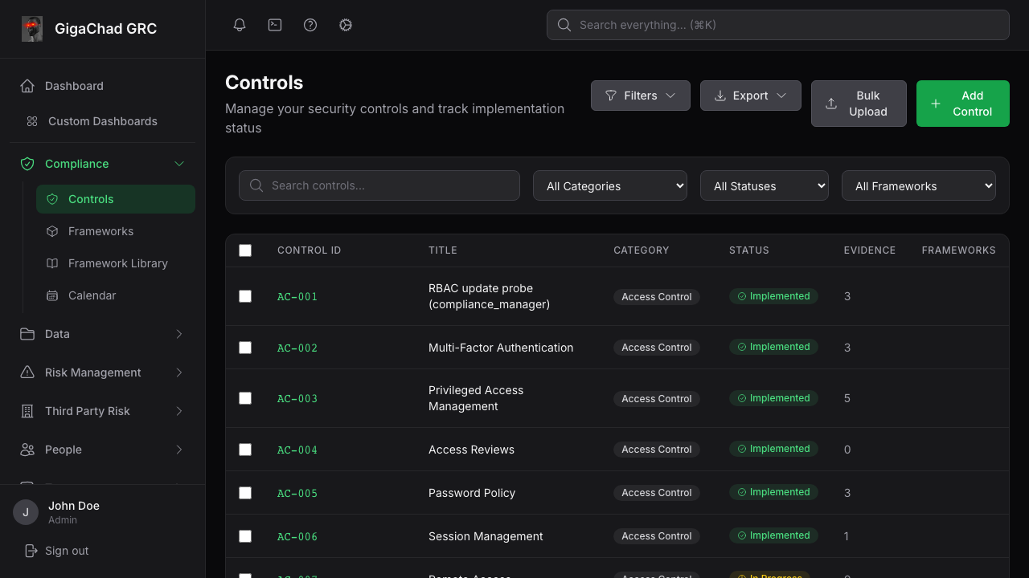
MODULE 4
DeepTrustxAI
GRC control mapping
The governance view should show what failed, who owns the response, and what will prove closure.
Control and framework mapping
Evidence review and audit history
Risk and remediation tracking
Leadership and auditor visibility
CloudGuard workshop
23
Notes:
Timing: 5 minutes
Map the selected lab finding to a control. Assign the owner and identify the evidence or rescan needed to change the control status.
[Sources]
- /Users/anjali/Cloud_Vulnerabilities/grc-platform/frontend/e2e/__snapshots__/visual.spec.ts/controls-list.png
- /Users/anjali/Cloud_Vulnerabilities/docs/grc-platform-merge.md
- /Users/anjali/Cloud_Vulnerabilities/grc-platform/README.md
[/Sources]

Slide 24

MODULE 4
DeepTrustxAI
Reason and Act workflow
1
Discover
2
Prioritize
3
Validate
4
Approve
5
Govern
Production changes remain approval-gated until rollback and guardrails have been reviewed.
CloudGuard workshop
24
Notes:
Timing: 5 minutes
Demonstrate validation and approval. Do not execute production-changing automation during the workshop.
[Sources]
- /Users/anjali/Cloud_Vulnerabilities/output/playwright/cloudguard-reason-act.png
- /Users/anjali/Cloud_Vulnerabilities/docs/vendor-neutral-reason-act-architecture.md
[/Sources]

Slide 25
Cleanup and
workshop close
DeepTrustxAI
Before anyone leaves, confirm these conditions.
All four scanner streams produced a result or documented fallback
One finding has evidence, a control, an owner, and a closure action
AWS, GCP, and Kubernetes lab resources have been destroyed
Temporary credentials and access have been revoked
Cleanup events and the final rescan or validation result have been retained
WORKSHOP RESULT
A finding with
proof, ownership,
and a verified fix
Questions and next steps
Notes:
Timing: 5 minutes
Verify cleanup before questions. Assign any unresolved cleanup action to a named owner and keep the session open until the owner confirms completion.
[Sources]
- /Users/anjali/Cloud_Vulnerabilities/grc-platform/cloudguard-test-labs/README.md
[/Sources]

