Slide 1
CloudGuard: Multi-Cloud Vulnerability Scanner
Review-2 Presentation (12–15 minutes)
Student Name: __________ | Roll No: __________ | Guide: __________
MANDATORY: Insert screenshot of Guide Approval Email here
(Replace this box with the screenshot before final submission)
CloudGuard | Review-2
Notes:
15-20 seconds: Introduce yourself and point to the guide approval screenshot.

Slide 2
1. Introduction (Slide 1/2)
Cloud organizations manage AWS/GCP resources at scale, increasing security exposure.
Threats include misconfigured IAM, exposed storage, vulnerable dependencies, and secret leakage.
Security teams often use multiple disconnected tools and manual checks.
Our project goal: one unified platform for cloud posture + vulnerability visibility.
CloudGuard | Review-2
Notes:
~1 minute: Explain why cloud security needs integrated scanning, not isolated tools.

Slide 3
1. Introduction (Slide 2/2) + Literature Review
Existing approaches reviewed:
Prowler/ScoutSuite: strong cloud checks but limited integrated workflow.
Trivy/Safety/Gitleaks/Nuclei: excellent specialization but fragmented outputs.
Native dashboards (CSP tools): provider-specific, weaker cross-cloud correlation.
Observation: Most solutions require manual aggregation for complete risk assessment.
Need identified in literature: unified, extensible, and automation-friendly architecture.
CloudGuard | Review-2
Notes:
~1 minute: Mention at least 3 prior tools/systems and what each misses.

Slide 4
2. Problem Statement + Research Gap
Problem Statement:
Current cloud vulnerability assessment is fragmented across tools, clouds, and output formats.
Teams lack a single workflow for scan, compare, prioritize, and report findings.
Research Gap:
Limited student-level implementations combine multi-cloud scanning, offensive checks, and AI-assisted analysis in one system.
Few systems enforce user-scoped credential security with integrated dashboard reporting.
CloudGuard | Review-2
Notes:
~1 minute: Keep problem and gap explicit; this directly maps to review marks.

Slide 5
3. Research Objectives
Design and implement a unified cloud vulnerability scanner (AWS + GCP).
Integrate scanners (Trivy, Safety, Gitleaks, Nuclei, CloudFox) into one workflow.
Provide secure user authentication and credential isolation for scan operations.
Build a dashboard for findings, history, reports, and scheduled scans.
Deliver actionable output: severity-based prioritization and recommendations.
CloudGuard | Review-2
Notes:
~45 seconds: Present measurable objectives and mention what success looks like.

Slide 6
4. Proposed System Overview
User logs in -> provides/selects cloud credentials -> starts scan from dashboard.
FastAPI backend orchestrates scan plugins and vulnerability engines via MCP architecture.
Results are normalized and stored in PostgreSQL for analytics and reporting.
Scheduler + Redis support recurring scans and automated execution.
Frontend presents live status, findings, severity trends, and downloadable reports.
CloudGuard | Review-2
Notes:
~1 minute: Explain data flow end-to-end in plain sequence.

Slide 7
5. System Diagram
User
Frontend (HTML/JS)
Backend API (FastAPI)
OAuth + Session Auth
MCP Orchestrator
Scanner Engines (Trivy/Nuclei/Gitleaks/Safety/CloudFox)
PostgreSQL
AWS / GCP
Redis + Scheduler
CloudGuard | Review-2
Notes:
~1 minute: Walk left-to-right flow, then top-to-bottom processing and storage.

Slide 8
6. Modules (1/4): Authentication & Credential Management
Google OAuth login and session-based access control for protected APIs.
Credential APIs for AWS/GCP/OpenAI/Azure with user-scoped ownership.
Secure storage pipeline and validation support in backend credential manager.
Outcome: only authenticated users can run scans and access their own credentials.
CloudGuard | Review-2
Notes:
~1 minute: Emphasize security boundary and per-user isolation.

Slide 9
6. Modules (2/4): Scan Orchestration Engine
MCP-based plugin registry initializes provider-specific scan servers.
Supports direct scans, multi-cloud scans, offensive scans, and scheduled scans.
Error-handling persists failed scan context for dashboard visibility.
Scheduler worker + Redis enables recurring execution.
CloudGuard | Review-2
Notes:
~1 minute: Explain why orchestrator design improves extensibility and reliability.

Slide 10
6. Modules (3/4): Vulnerability & Analysis Module
Combines multiple scanners: Trivy, Nuclei, Safety, Gitleaks, CloudFox.
Normalizes heterogeneous findings into a common result model.
AI components generate explanation and prioritization support.
Includes enhanced scan modes for deeper analysis and comparison.
CloudGuard | Review-2
Notes:
~1 minute: Mention strength of combining config + dependency + secret + offensive checks.

Slide 11
6. Modules (4/4): Dashboard, Reports & APIs
Frontend pages: Home, Dashboard, History, Scheduled Scans, System Status.
REST APIs: health, scan history, findings, reports (including PDF export).
System status endpoint provides component and operational checks.
Outcome: actionable visibility for review, triage, and reporting.
CloudGuard | Review-2
Notes:
~1 minute: Show how users consume results and produce reports.

Slide 12
Analysis & Requirements
Functional Requirements
User authentication and session management
Credential CRUD and validation
Single and multi-cloud scan execution
Scheduled scans and status tracking
Dashboard visualization and report generation
Non-Functional Requirements
Security: protected APIs, credential isolation
Scalability: modular scan plugin architecture
Reliability: error persistence and health checks
Usability: dashboard-driven workflow
Deployability: dockerized environment
CloudGuard | Review-2
Notes:
~1 minute: Keep this structured; this slide maps to 10-mark analysis criterion.

Slide 13
Project Plan (Review-2 Status)
1. Phase 1: Requirement Analysis -> Completed
2. Phase 2: Architecture & DB Schema -> Completed
3. Phase 3: Core Module Implementation -> ~45% Completed
4. Phase 4: Integration Testing -> In Progress
5. Phase 5: Final Validation + Documentation -> Pending
Target for next review: complete remaining integration, testing, and evaluation.
CloudGuard | Review-2
Notes:
~45 seconds: Show planned phases and current completion percentage.

Slide 14
7. 40–50% Implementation Results (Slide 1/2)
Current implementation progress: approximately 45%.
Completed so far:
Core FastAPI backend with scan, report, and health APIs
Credential and scheduling modules with DB integration
OAuth-based authentication routes and protected endpoints
Frontend dashboard pages integrated with backend APIs
Initial dockerized deployment validated in dev profile.
CloudGuard | Review-2
Notes:
~1 minute: State clearly what is already working today.

Slide 15
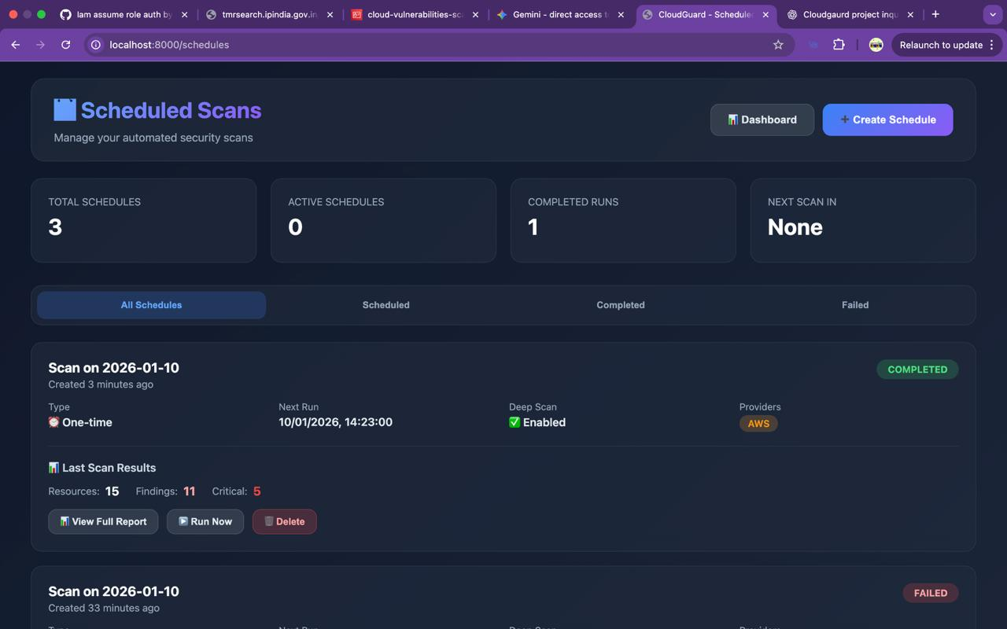
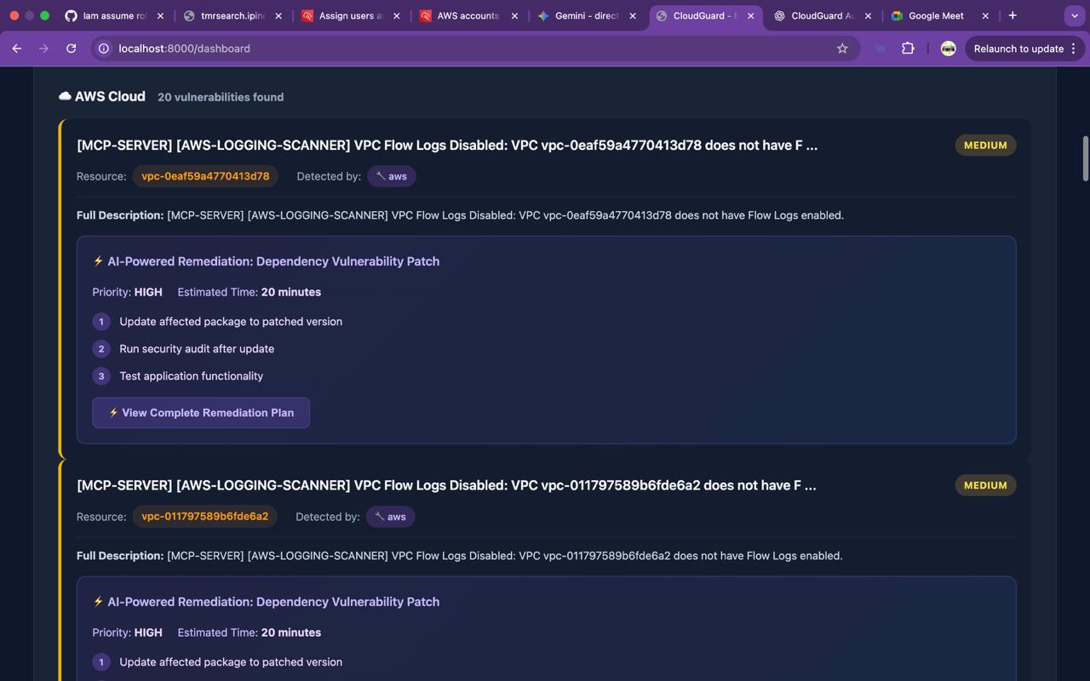
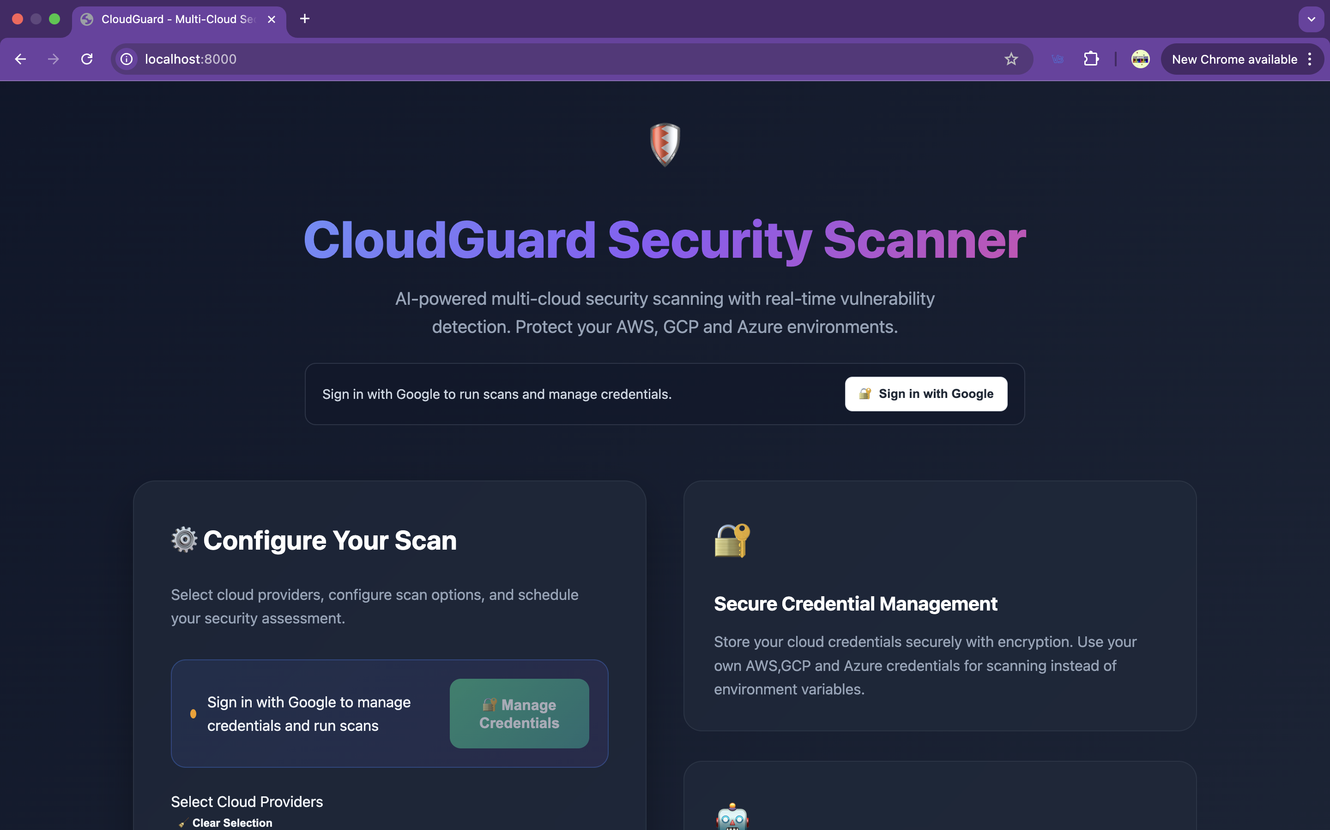
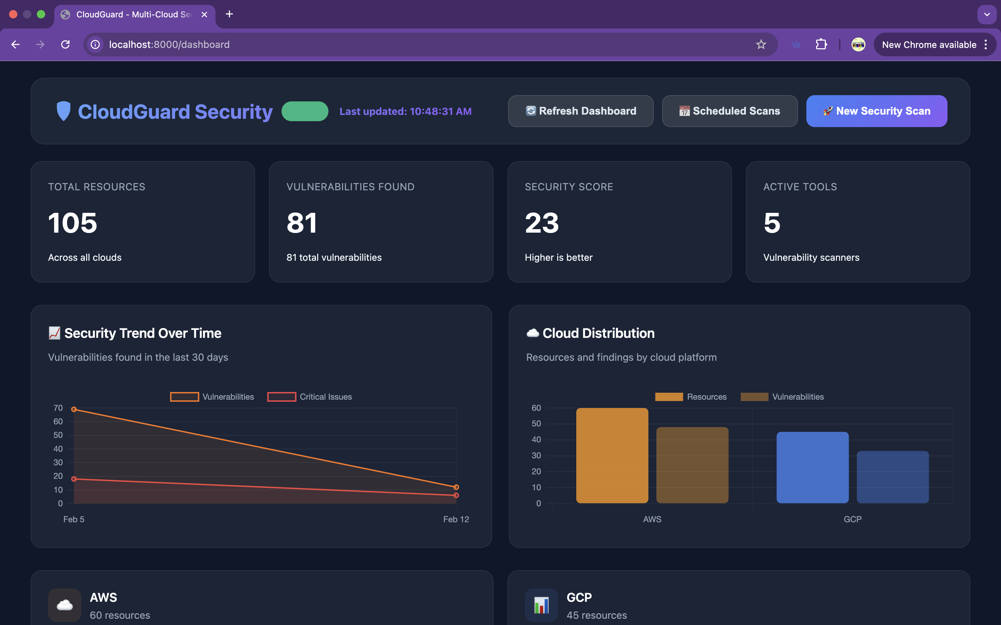
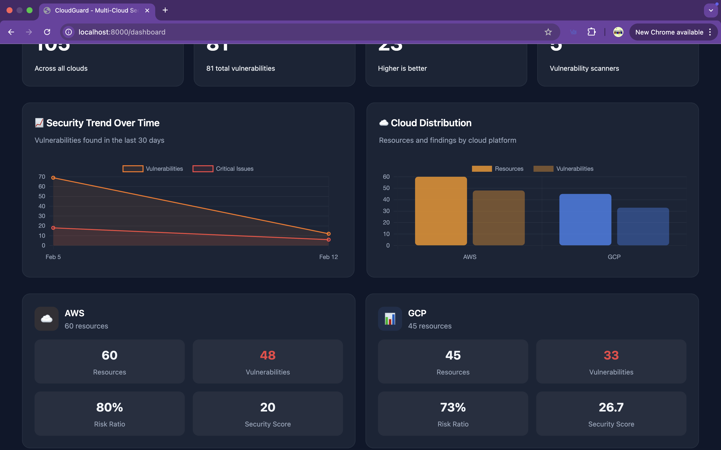
7. 40–50% Implementation Results (Slide 2/2): Evidence Screenshots
Scheduled Scan Module
Detailed Finding + AI Remediation
Home/Login (OAuth) Screen
Main Dashboard Overview
Cloud Metrics + Trend Section
CloudGuard | Review-2 | Real implementation evidence from running system
Notes:
Use these screenshots to demonstrate implemented modules and current working status (~45%).

