Slide 1
Heart Disease Prediction Using-Machine Learning
Final Project
Samyukthan.A 2021506083 Madras Institute of Technology, AU

Slide 2
PROJECT TITLE
Heart Disease Prediction using Machine Learning
Good data-driven systems for predicting heart diseases can improve the entire research and prevention process, making sure that more people can live healthy lives. This is where Machine Learning comes into play. Machine Learning helps in predicting the Heart diseases, and the predictions made are quite accurate.
The project involved analysis of the heart disease patient dataset with proper data processing. Then, different models were trained and and predictions are made with different algorithms KNN, Decision Tree, Random Forest,SVM,Logistic Regression etc. Dataset I've used for my Kaggle kernel 'Binary Classification with Sklearn and Keras'

Slide 3


AGENDA
PROBLEM STATEMENT
PROJECT OVERVIEW
END USERS
SOLUTION
MODELLING
RESULTS
3/21/2024 Annual Review

Slide 4

PROBLEM STATEMENT
Heart disease is a leading cause of mortality worldwide, and early detection plays a crucial role in its management and prevention. The goal of this project is to develop a machine learning model that can accurately predict the likelihood of an individual having heart disease based on various medical and demographic factors.
The objective is to build a robust predictive model that can assist healthcare professionals in identifying individuals at high risk of heart disease, enabling timely intervention and personalized treatment strategies

Slide 5

PROJECT OVERVIEW
Dataset Analysis and Processing:
Conducted thorough analysis of the heart disease patient dataset, including data exploration and understanding of features.
Model Selection and Training:
Utilized various machine learning algorithms
Comparative Analysis:
Conducted a comprehensive comparative analysis of the different machine learning algorithms to determine their effectiveness in predicting heart disease.
Model Deployment and Future Considerations:
Deployed the selected models into a production environment for real-time predictions, potentially enhancing early detection and prevention of heart disease.

Slide 6

WHO ARE THE END USERS?
Healthcare Professionals
Medical Researchers
Public Health Authorities
Individuals Concerned About Heart Health

Slide 7

YOUR SOLUTION AND ITS VALUE PROPOSITION
Our solution combines diverse machine learning algorithms to accurately predict heart disease presence, ensuring robust diagnostic accuracy.
We offer healthcare professionals and individuals a versatile toolkit for risk assessment, empowering personalized treatment plans and proactive health management.
By integrating advanced machine learning with clinical data analysis, our system enhances patient outcomes and advances preventative care initiatives.

Slide 8

THE WOW IN YOUR SOLUTION
The WOW in our solution is the seamless integration of advanced machine learning techniques with clinical data analysis, enabling personalized and proactive healthcare management.
By harnessing the power of diverse algorithms, we provide a comprehensive approach to predicting heart disease, ultimately leading to improved patient outcomes and enhanced preventative care initiatives.
3/21/2024 Annual Review

Slide 9
MODELLING
Data Collection
Preprocessing
Algorithm Selection
Training Strategy
Evaluation Metrics
Fine-tuning and Hyperparameter Tuning
Inference
Deployment and Integration

Slide 10
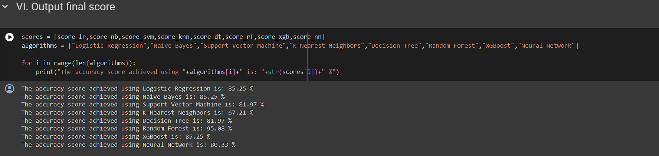
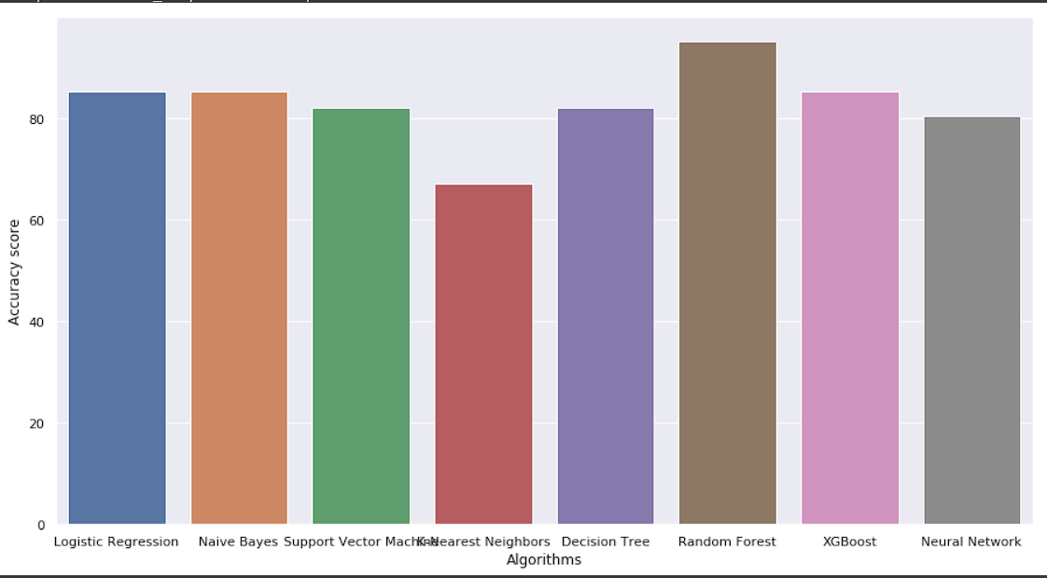
RESULTS
Through our project, we successfully developed a predictive model for heart disease detection utilizing a variety of machine learning algorithms. By meticulously preprocessing the dataset and training diverse models including Logistic Regression, Naive Bayes, Support Vector Machine, K-Nearest Neighbours, Decision Tree, Random Forest, XGBoost, and Artificial Neural Network, we achieved comprehensive coverage of predictive techniques
Demo Link

