Slide 1


PRODUCT DEMAND PREDICTION WITH MACHINE LEARNING

Slide 2
DATA COLLECTION
Gather historical sales data , which typically includes information such as date, product ID, quantity sold, price, and other relevant features.
You may also need external factors like economic indicators, seasonality, and marketing efforts data.

Slide 3
DATA PREPROCESSING
Loading Data:
Load your historical sales data and external factors data into data structures like Pandas DataFrames in Python.
Data Integration:
Merge or join the historical sales data and external factors data, aligning them by the date or another common key.
Handling Missing Values:
Check for missing values in both datasets. You can impute missing values using methods like mean, median, or interpolation, or drop rows with missing data if appropriate.

Slide 4
DATASET
Dataset Link: https://www.kaggle.com/datasets/chakradharmattapalli/product-demand-prediction-with-machine-learning

Slide 5
PREPROCESSED DATASET
CODING:
import pandas as pd
import numpy as np
import plotly.express as px
import seaborn as sns
I mport matplotlib.pyplot as plt
from sklearn.model_selection import train_test_split
from sklearn.tree import DecisionTreeRegressor
data = pd.read_csv(“productdemand.csv")
data.head()

Slide 6
OUTPUT
ID | STORE ID | TOTAL PRICE | BASE PRICE | UNIT SOLD
1 | 8091 | 99.0375 | 111.8625 | 20
2 | 8091 | 99.0375 | 99.0375 | 28
3 | 8091 | 133.9500 | 133.95 | 19
4 | 8091 | 133.9500 | 133.95 | 44
5 | 8091 | 141.0750 | 141.075 | 52

Slide 7
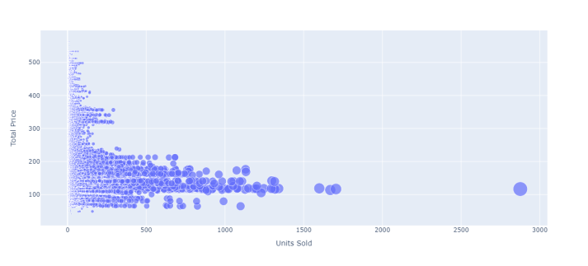
ANALYZE THE PRICE AND DEMAND PRODUCT
fig = px.scatter(data, x="Units Sold", y="Total Price",size='Units Sold') fig.show()
Fig: Scatter Plot

Slide 8
EXPLORATORY DATA ANALYSIS
Analyze the data to identify pattern, trends and correlations.
EDA can help you make informed decision about feature selection and model choice.
CODING:
missing_values = data.isnull().sum()
# Summary statistics
summary_stats = data.describe()
# Data visualization (e.g., histograms, scatter plots)
import matplotlib.pyplot as plt
import seaborn as sns
# perform EDA here

Slide 9
ANALYZE THE CORRELATION
CODING:
print(data.corr())
correlations = data.corr(method='pearson’)
plt.figure(figsize=(15, 12))
sns.heatmap(correlations, cmap="coolwarm", annot=True)
plt.show()

Slide 10
OUTPUT OF THE CORRELATION
 | ID | STORE ID | TOTAL PRICE | BASE PRICE | UNITS SOLD
ID | 1.000000 | 0.007464 | 0.008473 | 0.018932 | -0.010616
STORE ID | 0.007464 | 1.000000 | -0.038315 | -0.038848 | -0.007432
TOTAL PRICE | 0.008473 | -0.038315 | 1.000000 | 0.958885 | -0.235625
BASE PRICE | 0.018932 | -0.038848 | 0.958885 | 1.000000 | -0.140032
UNITS SOLD | -0.010616 | -0.004372 | -0.235625 | -0.140032 | 1.000000

Slide 11
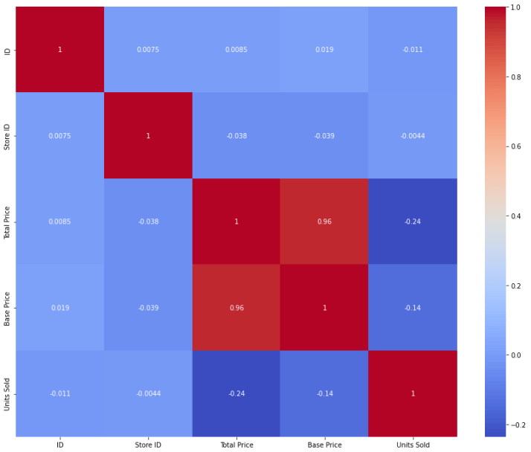
Correlations=data.corr(method=‘pearson’) plt.figure(figsize=(15,12)) sns.heatmap(correlations,cmap=“coolwarm”,annot=true) plt.show()
Fig: Heatmap

Slide 12
CONCLUSION
Product demand prediction with machine learning were classified and various processing were done using the given dataset.

