Slide 1
Energy Data Science
Time Series Analysis of Electric Load-Profile
Submitted By:
Hassan Mirza

Slide 2
Project Goals
Exploratory Data Analysis
Build & Compare Prophet and NeuralProphet Models

Slide 3
LIBRARIES
Plotting Libraries EDA Tools
Matplotlib missingno
Seaborn Panadas_profiling
pivottablejs
Wrangling Libraries ML Libraries
Numpy sklearn
Pandas scipy
statsmodels
prophet
System Packages
Os
Sys
warnings

Slide 4
Exploratory Data Analyis
Exploratory data analysis consists of following major tasks
Wrangle data
Assess quality of data
Profile data
Explore Features using graphs
Explore data across many dimensions

Slide 5
The Dataset
Dataset has electric load profiles of 20 industrial plants in Germany
It holds load profiles of small and mid-size enterprises for the year 2016
The load is shown in kW as an average over 15 minutes
Approximately 35,000 data points

Slide 6
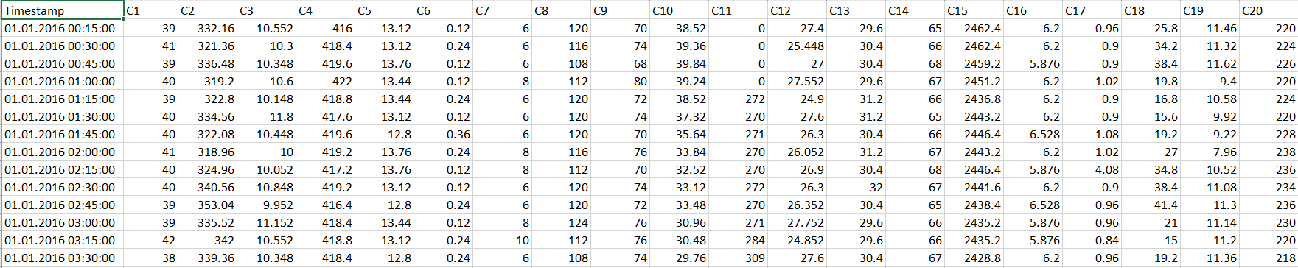
The Dataset

Slide 7
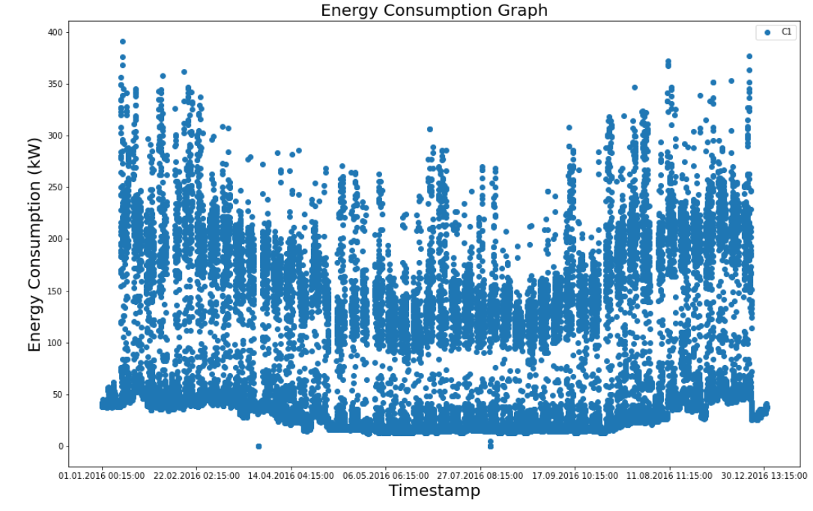
Energy Load Profile

Slide 8
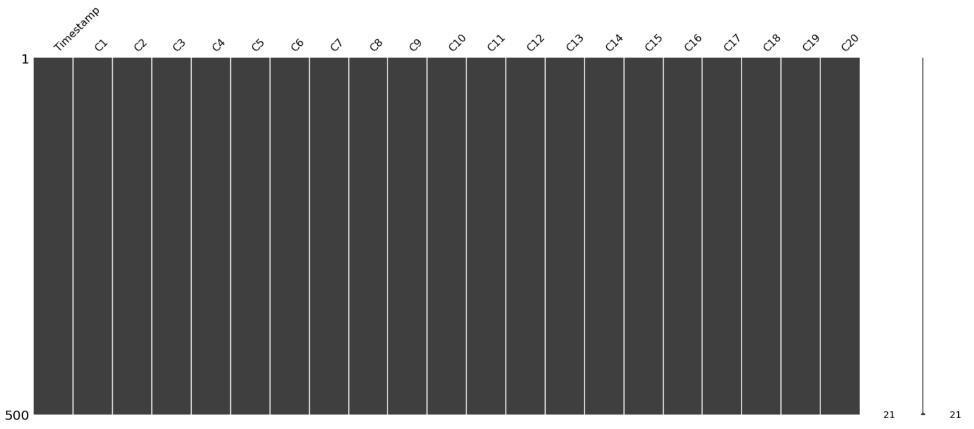
Evaluating Missingness
1. Identify systemic reasons for missing data
2. Identify fields that are always missing at the same time
3. Find what data is missing

Slide 9
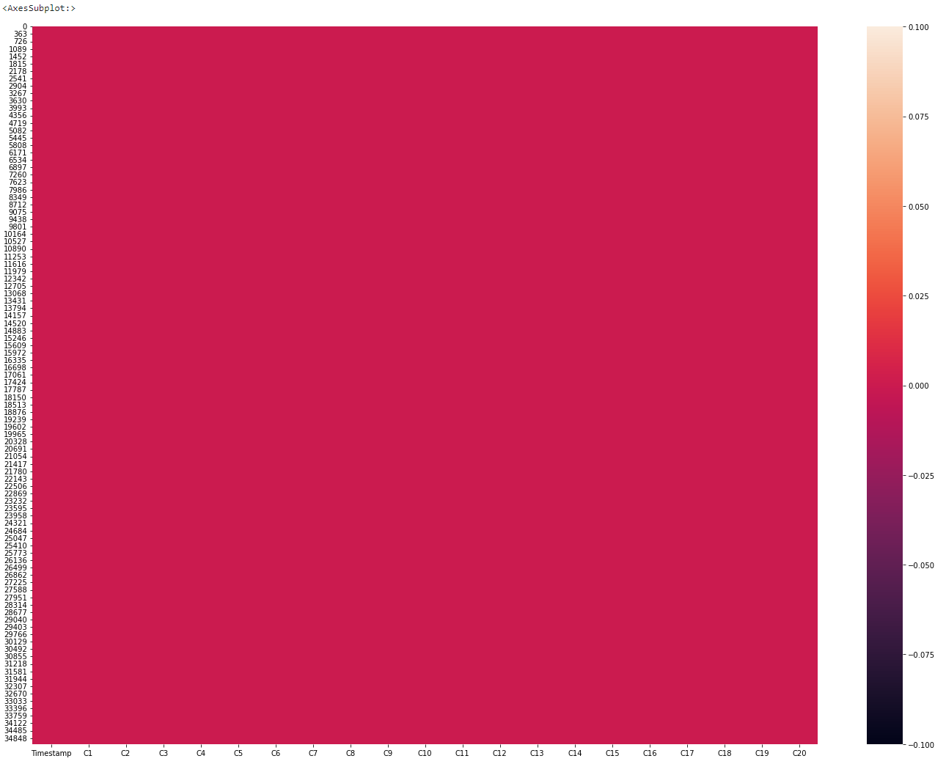
Evaluating Missingness
From above plots we concluded that there is no missing data.

Slide 10
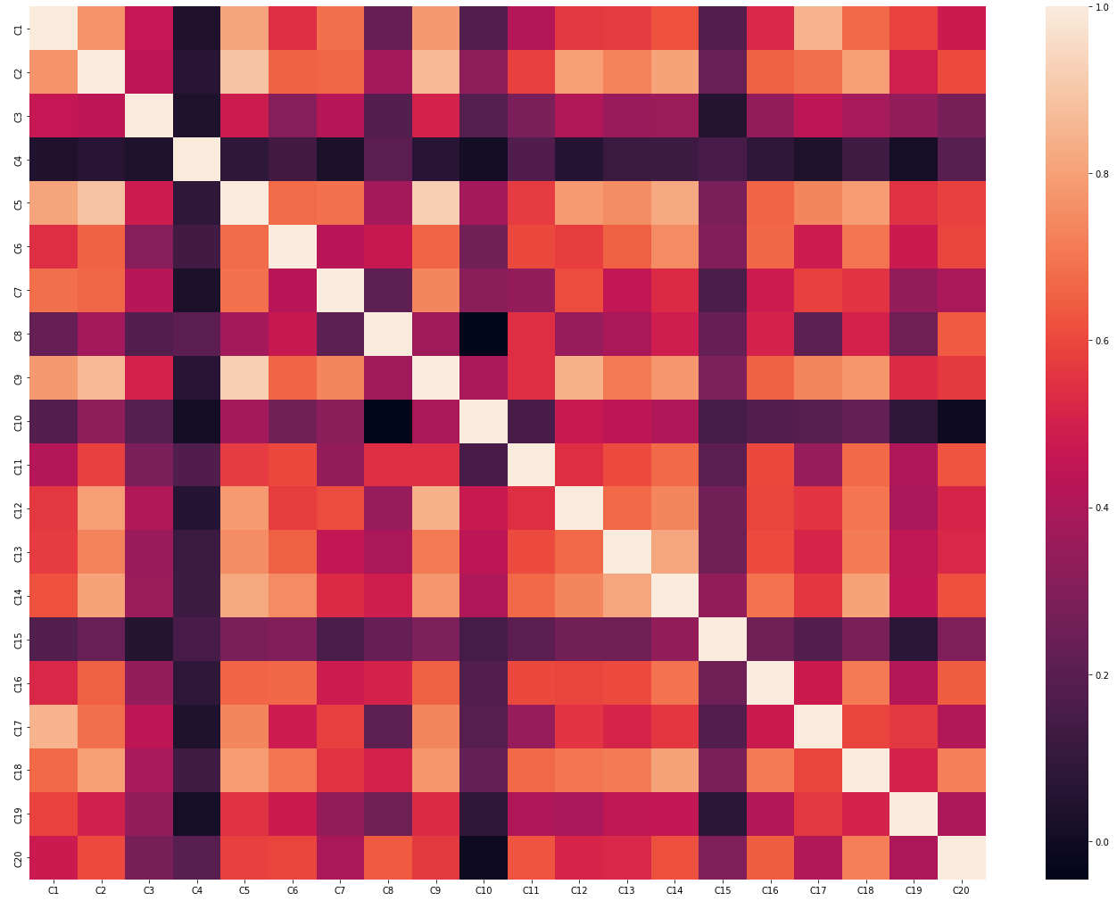
Correlation Heat Map

Slide 11
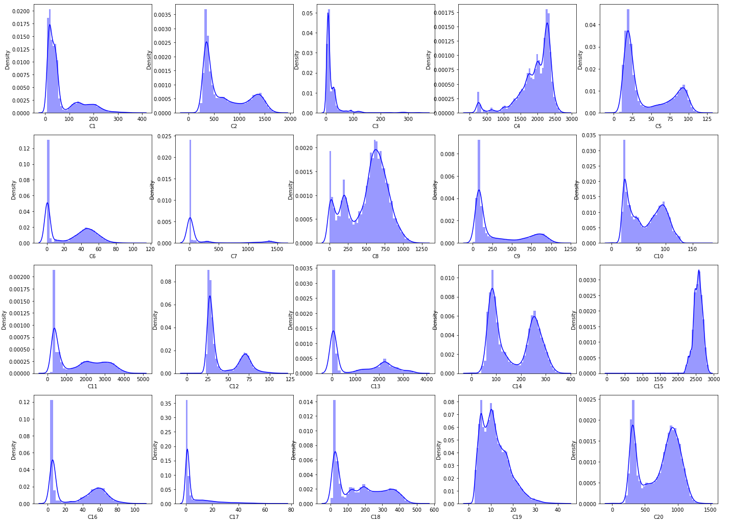
Density Plots

Slide 12
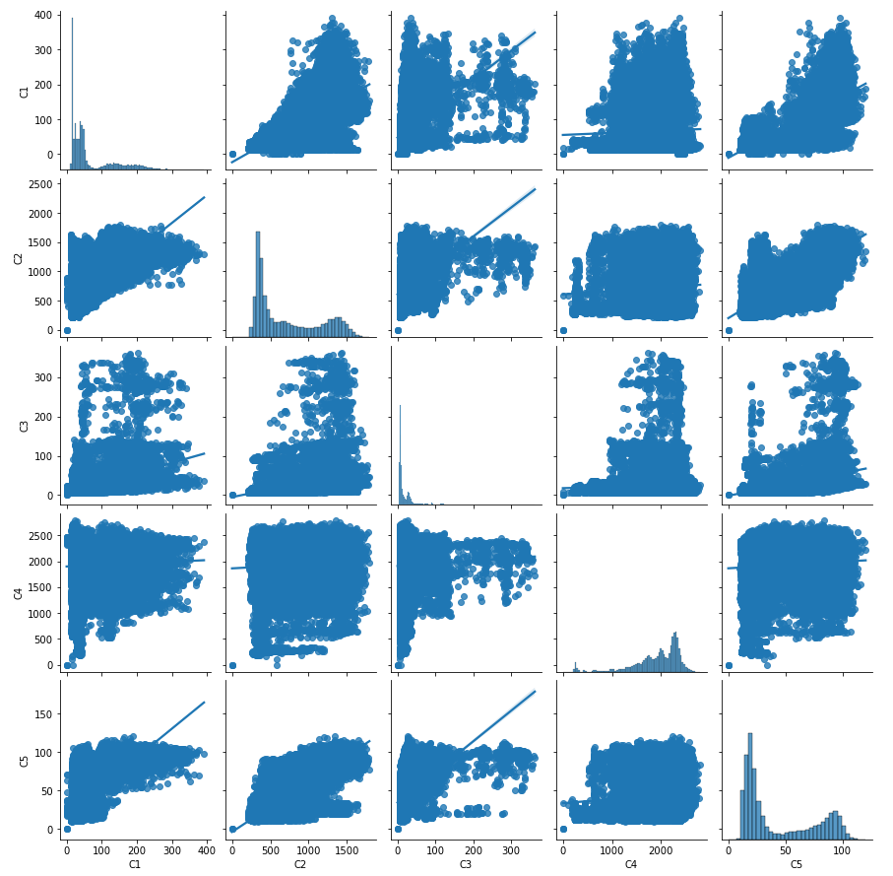
Pairplot of C1, C2, C3, C4 and C5

Slide 13
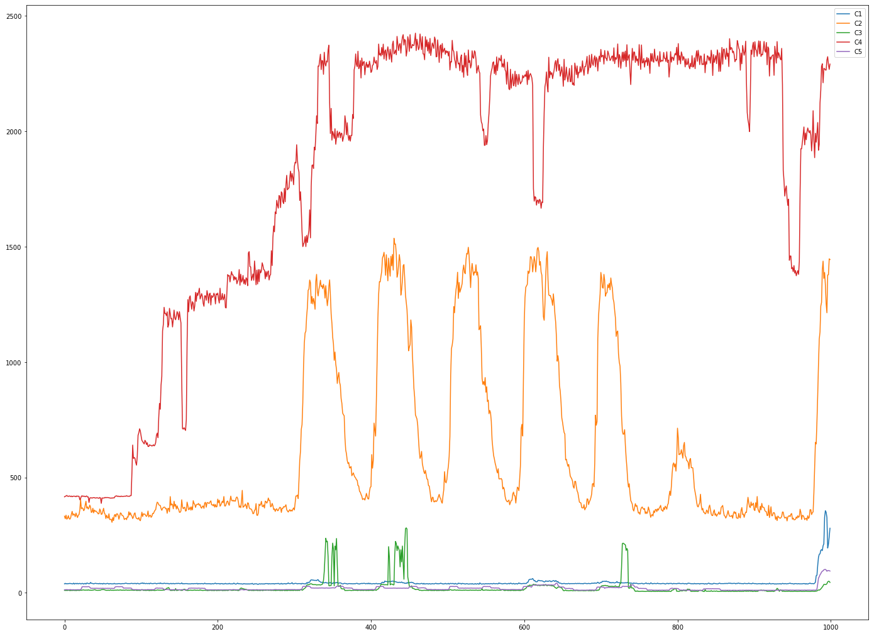
Rolling Mean Average of C1, C2, C3, C4, C5

Slide 14
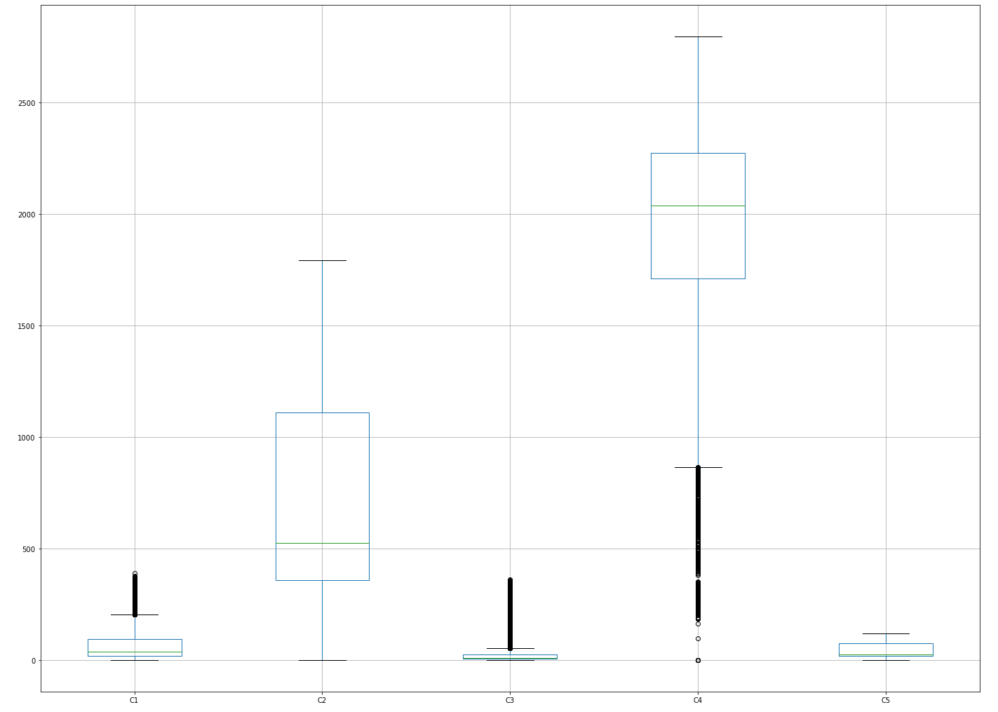
Box Plot for C1, C2,C3, C4, C5

Slide 15
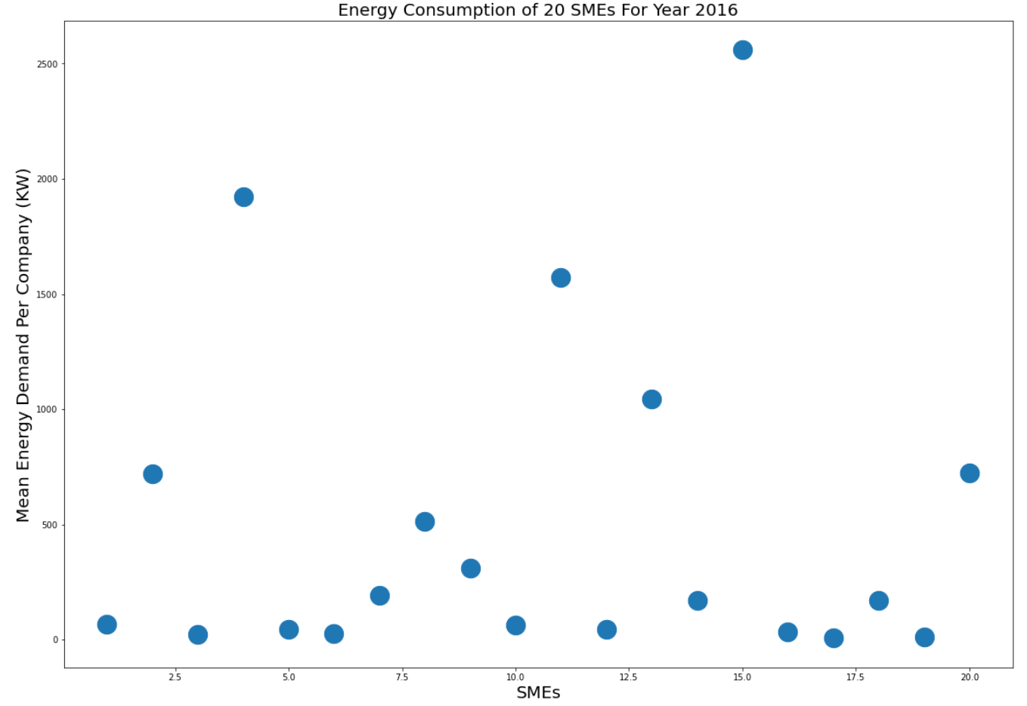
Identifying Small and Medium Companies
There are 6 out of 20 SMEs which have mean energy demand greater than 500 KW for year 2016. So, probably out of these 20 companies only 6 companies might be considered medium sized enterprises. Rest of are small sized companies.

Slide 16
Build & Compare Prophet and NeuralProphet
Prophet is an open-source library developed by Facebook (2017)
It is a type of generalized additive model (GAM)
NeuralProphet is the second iteration of Prophet, but not from Facebook (2020)
It incorporates autoregressive deep learning in addition to GAM
The input to both Prophet and Neural Prophet is a data frame with two columns: ds and y

Slide 17
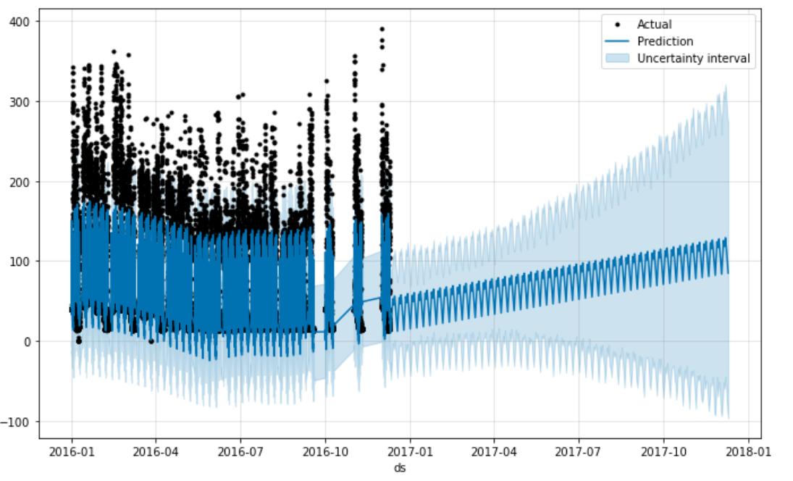
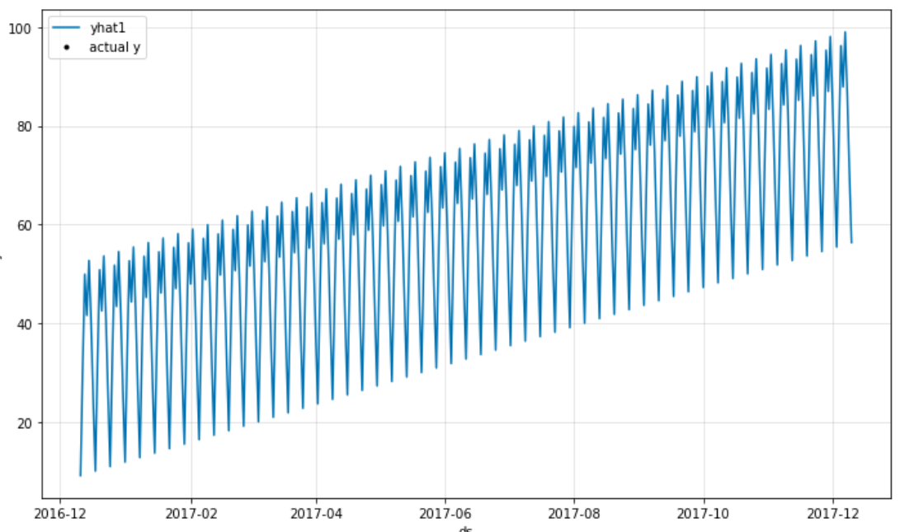
Predictions
Prophet NeuralProphet

Slide 18
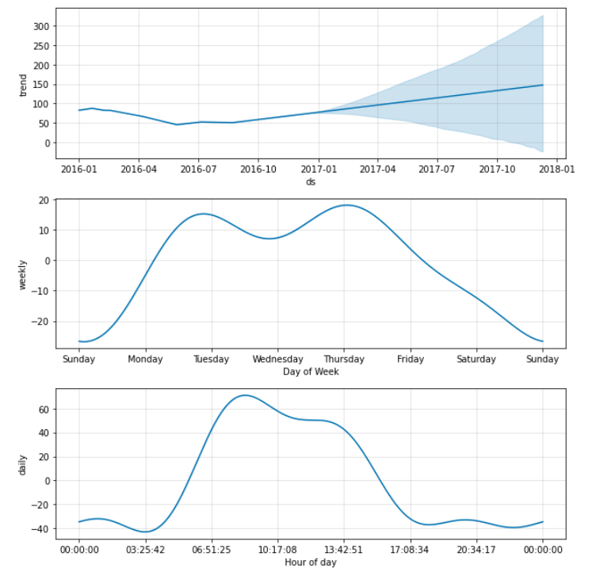
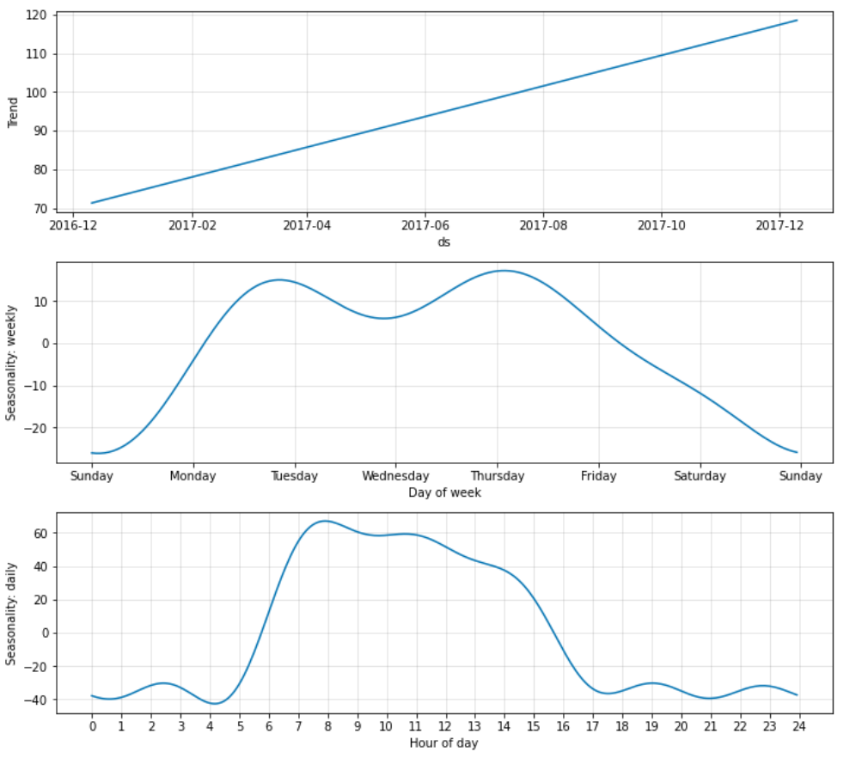
Components
Prophet NeuralProphet

Slide 19
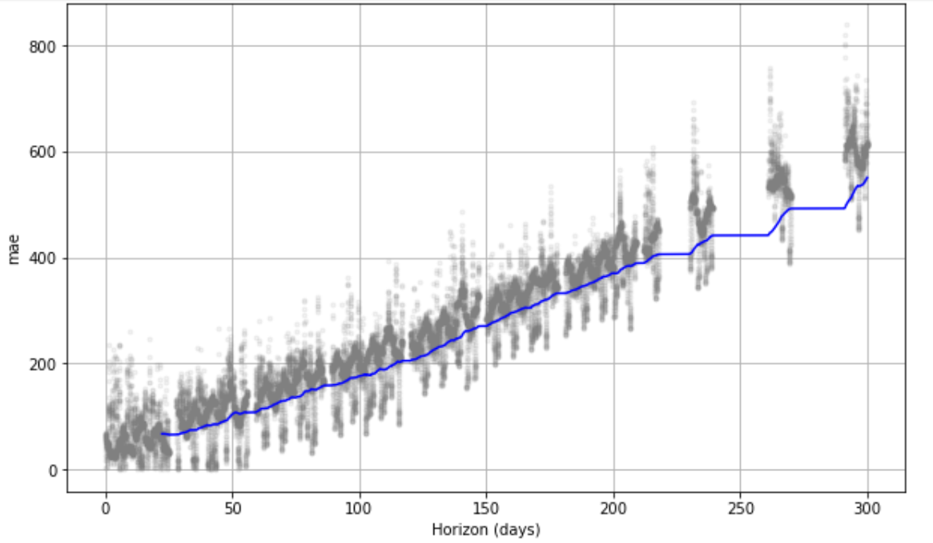
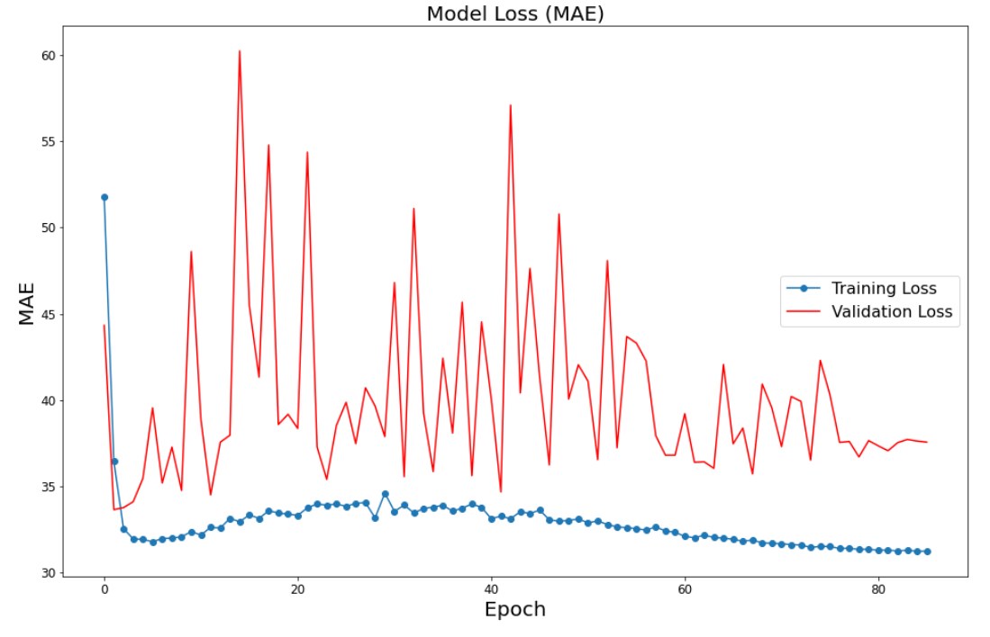
Model Loss (MAE)
Prophet NeuralProphet

Slide 20
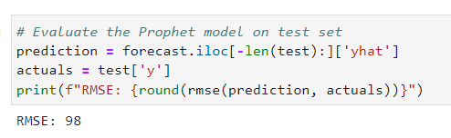
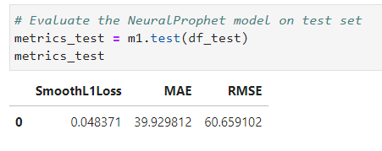
RMSE Prophet NeuralProphet
It appears that NeuralProphet has lower RMSE value than Prophet, so it is probably
more accurate for C1 dataset.

Slide 21
THANK YOU

