Slide 1

HR ANALYTICS
-Sangeetha s

Slide 2
PROJECT DESCRIPTION :
This project aims to help organization understand and manage their workforce effectively. By leveraging data analytics the system will provide valuable insights into employee retention factors and predict attrition rates.
Tools Used :
Excel
SQL
Power BI

Slide 3
Introduction
HR analytics, also known as Human Resources analytics or talent analytics, is the systematic application of data analysis and statistical methods to human resources data. It involves gathering and analyzing data related to an organization’s workforce to make informed decisions and drive improvements in HR processes, policies, and strategies. The primary goal of HR analytics is to optimize the performance, engagement, and overall effectiveness of an organization’s workforce.

Slide 4
Here's a detailed analysis of the HR Analytics Dashboard, incorporating key insights and visualizations:
This dashboard shows data for a company with 50,000 employees. It looks like 25,105 of those employees are currently active, which means the company has an attrition rate of 50%.
Key Metrics Overview:
• Total Employees: 50,000
• Active Employees: 24,895
• Attrition Count: 25,105
• Attrition Rate: 50.21%
• Average Age: 39
1.Avg Attrition Rate for all Departments :
It shows Average Attrition Rate for all Departments
Research and development is having Highest Attrition rate of 51.21%
Hardware is having Lowest Attrition rate of 49.44%
2.Attriton By Gender :
Male has slight higher Attrition Rate 50.25%
Female attrition rate is 49.75%

Slide 5
3.Attrition By Business Travel
Non-travel count is 16919
Travel frequently count is 16593
Travel Rarely count is 16488
4.Attrition By Last Promotion
In this Demographic it show Attrition Rate Among The Employees Since their Last Promotion
5.Avg Working Years For All Departments:
The average Working Years for all Departments Is Approximately 20 years
Employees recently promoted within the last year have a higher attrition rate (20.65%).
6.Monthly Income Vs Attrition Rate :
A slight positive correlation exists between income and attrition rate, warranting further exploration
7.Job Role Vs WorkLifeBalance :
Healthcare Representative is having highest Worklifebalance of 12646
Laboratory Technician is having lowest worklifebalance of 12233

Slide 6
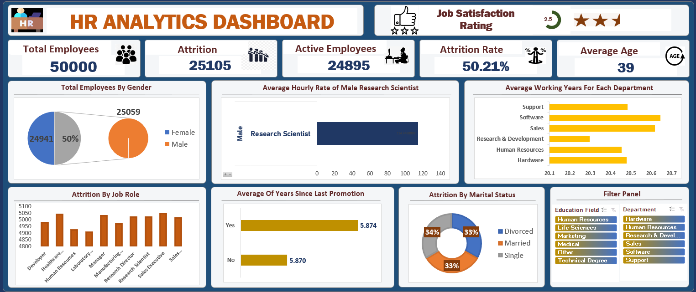
Excel Dashboard

Slide 7
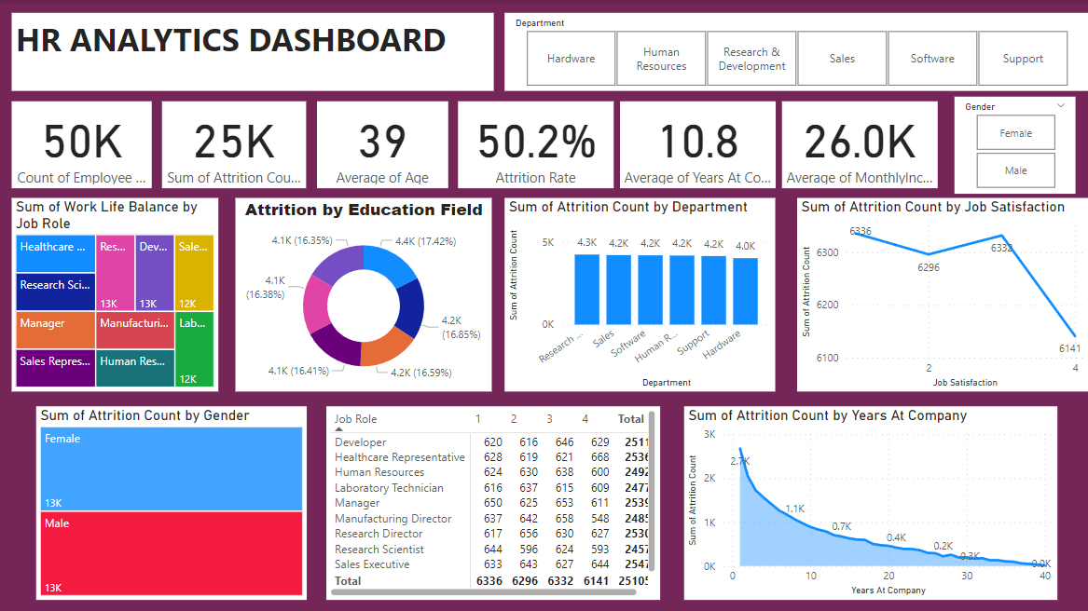
Power BI Dashboard

Slide 8
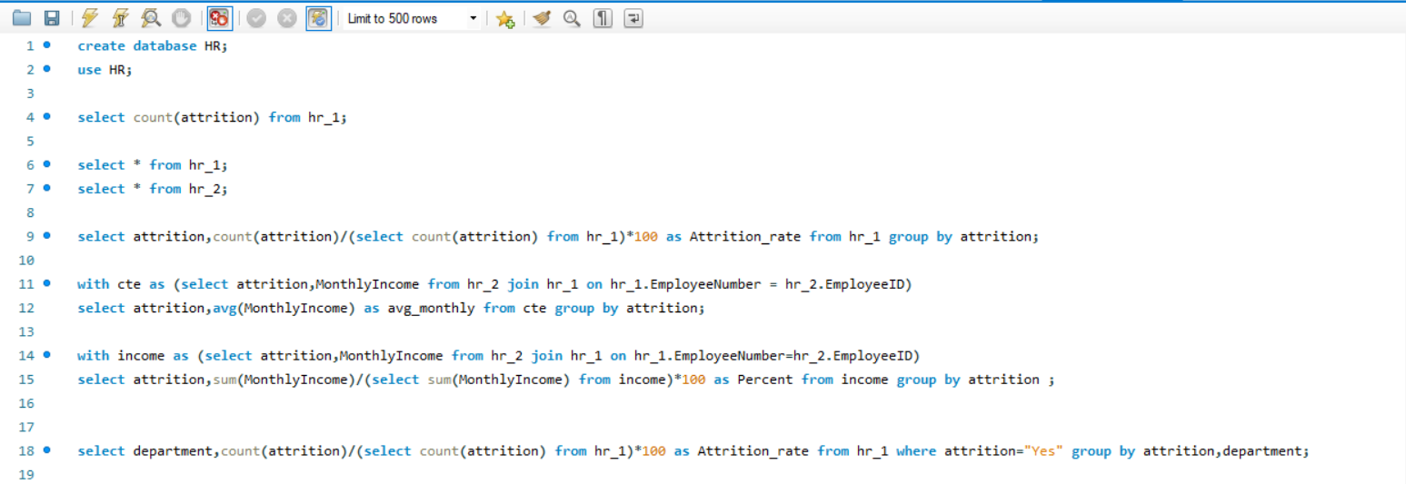
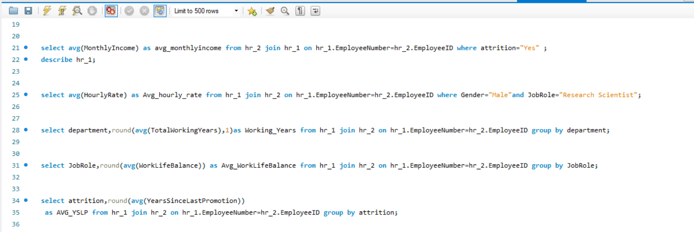
SQL Queries

Slide 9
Data Modelling Challenges
Choosing the right data model
Ensuring data quality
Balancing normalization and DE normalization
Handling data changes and evolution
Communicating and collaborating with stakeholders

Slide 10
Conclusion
The provided recommendations aim to enhance organizational effectiveness, employee engagement, and overall satisfaction. By focusing on training and development, gender diversity, financial incentives, communication, departmental optimization, and community integration, the organization can strive for a more harmonious and productive workplace.
In essence, the symphony of the
organization, composed of its people, passions, and progress,
should resonate harmoniously, striving for a future where every
individual is empowered, valued, and contributes meaningfully to
the collective success and aspirations of the organization.

Slide 11
THANK YOU

