Slide 1

Banker's Algorithm For Deadlock Detection And Avoidance
SRM INSTITUTE OF SCIENCE AND TECHNOLOGY
COLLEGE OF ENGINEERING AND TECHNOLOGY
DEPARTMENT OF NETWORKING AND COMMUNICATIONS
21CSC202J-Operating Systems , Mini-Project Presentation
Sanyog Dani (RA2211031010087)
Arush Sirotiya (RA2211031010092)
Nikhil Kumar (RA2211031010097)
V1 Section
Under the guidance of
Dr. Saranya G
Assistant Professor , Department of Networking and Communications

Slide 2
Table of contents
Objective
Problem Statement
Architecture/ Flow chart
Hardware/Software requirements
Implementation- Code snippet
Results- Screen Shots of Output
Conclusion

Slide 3
Objective
Main Goal and Objective of this Operating System Mini Project is :-
To acquire knowledge of deadlock & algorithms used to detect and avoid deadlock and how they are implemented in system and there calculations to detect and avoid deadlock with help of examples.
Banker’s Algorithm is used majorly in the banking system to avoid deadlock. It helps you to identify whether a loan will be given or not.
This algorithm is used to test for safely simulating the allocation for determining the maximum amount available for all resources. It also checks for all the possible activities before determining whether allocation should be continued or not.

Slide 4
Problem Statement
Assume there are ‘n’ account holders in a certain bank, and the total amount of their money is ‘x’.
Now, if a person applies for a loan (say, to buy a house), the loan amount reduced from the total amount available in the bank gives us the residual amount, which must be more than ‘x’ in order for the loan to be sanctioned by the bank.
It is done with the worst-case scenario in mind, in which all account holders arrive at the bank at the same moment to withdraw their money.
So to solve this issue use We use Bankers Algorithm for Deadlock Avoidance.

Slide 5
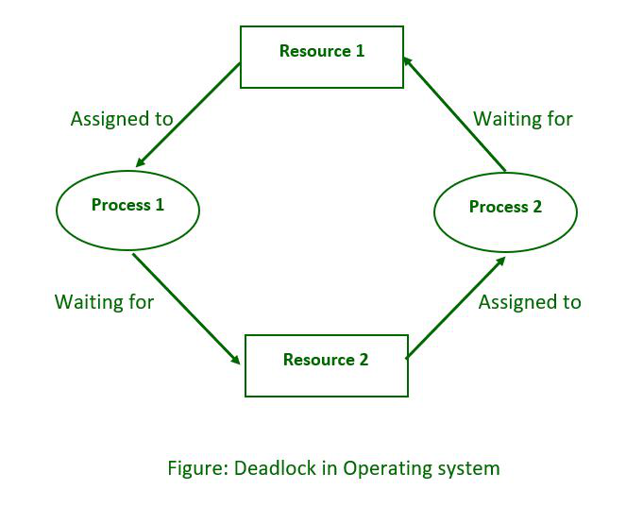
Architecture/ Flow chart

Slide 6
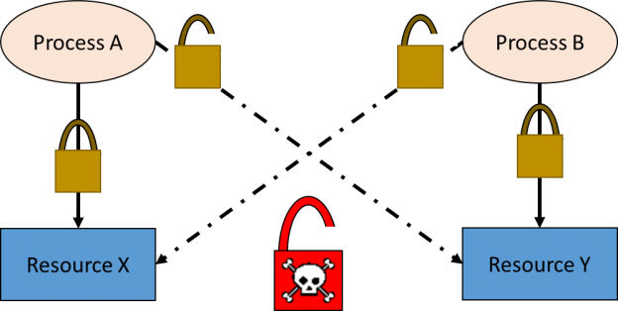
Architecture/ Flow chart

Slide 7
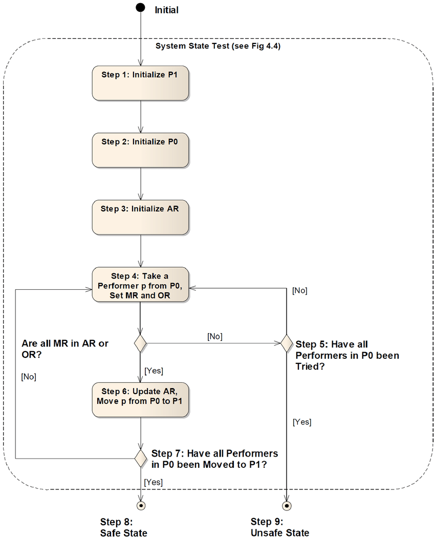
Architecture/ Flow chart

Slide 8
Hardware/Software requirements
The following data structures are needed to implement the Bankers Algorithm in OS:
Available Resources Array: An array that stores the current number of available resources of each type.
Maximum Need Matrix: A matrix that stores the maximum number of resources of each type required by each process.
Allocation Matrix: A matrix that stores the number of resources of each type currently allocated to each process.
Need Matrix: A matrix that stores the remaining resources of each type required by each process (calculated as the difference between the Maximum Need and Allocation matrices).
Completed Processes Set: A set that stores the IDs of processes that have completed and released their resources.

Slide 9
Implementation- Code snippet
Algorithm :
Step 1: When a process requests for a resource, the OS allocates it on a trial basis.
Step 2: After trial allocation, the OS updates all the matrices and vectors. This updating can be done by the OS in a separate work area in the memory.
Step 3: It compares F vector with each row of matrix B on a vector to vector basis.
Step 4: If F is smaller than each of the row in Matrix B i.e. even if all free resources are allocated to any process in Matrix B and not a single process can completes its task then OS concludes that the system is in unstable state.
Step 5: If F is greater than any row for a process in Matrix B the OS allocates all required resources for that process on a trial basis. It assumes that after completion of process, it will release all the recourses allocated to it. These resources can be added to the free vector.
Step 6: After execution of a process, it removes the row indicating executed process from both matrices.
Step 7: This algorithm will repeat the procedure step 3 for each process from the matrices and finds that all processes can complete execution without entering unsafe state.
For each request for any resource by a process OS goes through all these trials of imaginary allocation and updation. After this if the system remains in the safe state, and then changes can be made in actual matrices.

Slide 10
Conclusion
We studied about that how to apply Banker’s Algorithm to avoid deadlock and allocate resources safely to each process in the computer system.
Through this algorithm we learnt how it is used in real world such as majorly in the banking system to avoid deadlock.
It helps you to identify whether a loan will be given or not.
This algorithm is used to test for safely simulating the allocation for determining the maximum amount available for all resources.
The application of this mini project in real world is that
Banker’s algorithm is named so because it is used in banking system to check whether loan can be sanctioned to a person or not.
The banker algorithm is applied to the college scheduling system, which mainly allows the system to judge whether the existing classroom resources can meet the needs of the students in class, and find a reasonable solution, which is not a security sequence, and does not fall into a deadlock.

Slide 11
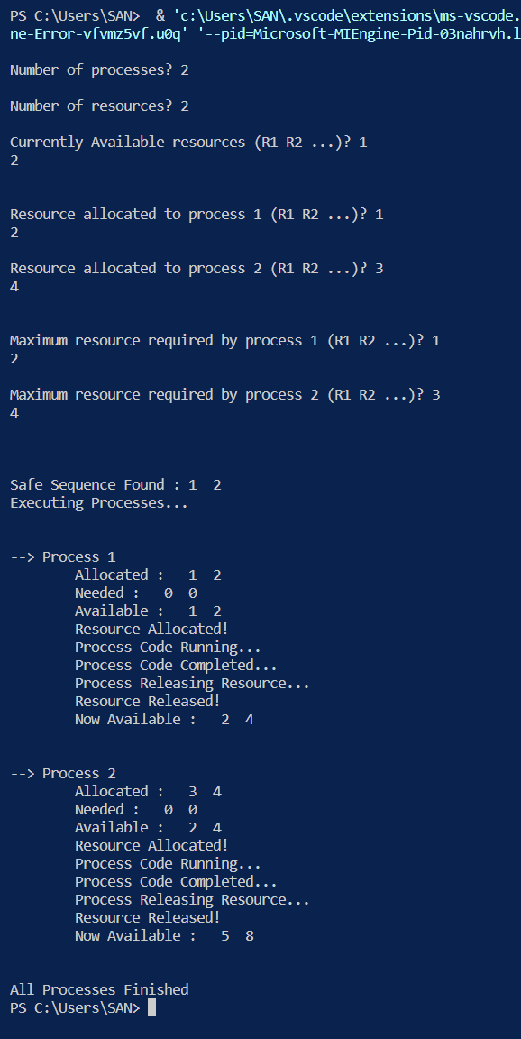
Results- Screen Shots of Output

Slide 12
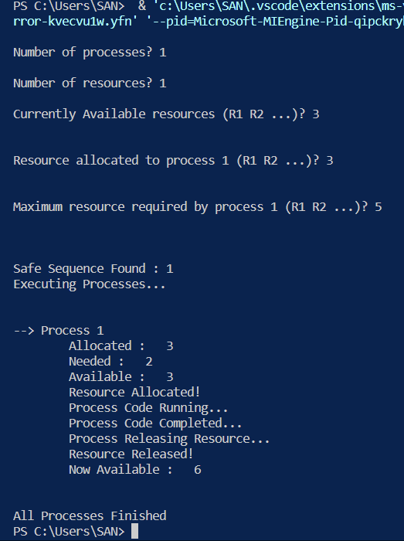
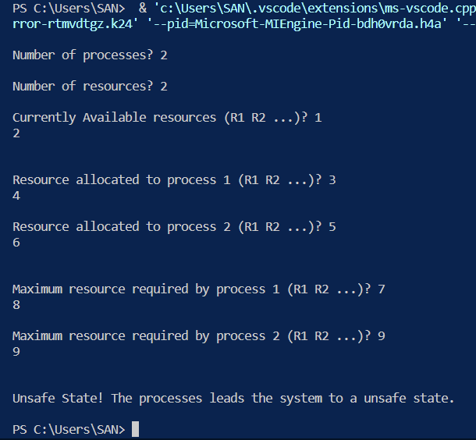
Results- Screen Shots of Output

Slide 13
Thanks

