Slide 1
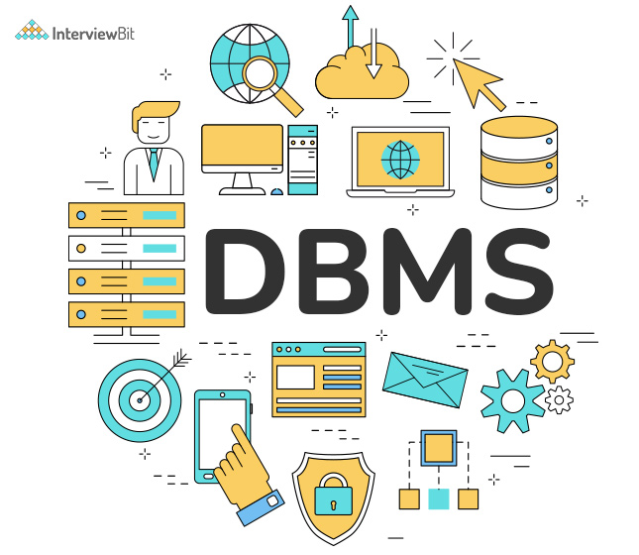
DATABASE MANAGEMENT SYSTEM COURSE 2(C)
Sanyog dani
Ra221103110087
V1 section​

Slide 2
Topics
INTRODUCTION
ER MODELS AND DIAGRAMS
RELATIONAL ALGEBRA AND CALCULUS
SQL
FUNCTIONAL DEPENDENCIES AND NORMALIZATION

Slide 3
INTRODUCTION
A Database Management System (DBMS) is software that allows users to create, manage, and manipulate databases. It provides an interface for users to interact with databases, storing and retrieving data efficiently. DBMS ensures data integrity, security, and facilitates data organization through various structures like tables, schemas, and indexes.
It allows concurrent access to data by multiple users and supports transactions for maintaining consistency. Overall, DBMS simplifies data management tasks and enhances data reliability and accessibility.
Tables and Keys: Table are intersection of rows and columns, which have different types of keys in it, some of them are primary key, foreign key, candidate key etc.
Constraints: These are conditions which applied on the columns to enforce date integrity, some of the constraints are NOT NULL, Check, Unique etc

Slide 4
ER MODELS AND DIAGRAMS
Cardinalities: These refers to relationship between two tables. There are 4 types of cardinalities 1) One to One
2) One to Many
3) Many to One
4) Many to Many
Construction of ER diagrams: They are made using special structures to showcase different relationships.
Weak, Strong and Self Referential Entities: Entities which are dependent on other attributes are weak entities. Strong Entities are independent tables which have one primary key. Entities which have relationship with itself they are Self Referential Entities

Slide 5
RELATIONAL ALGEBRA AND CALCULUS
Relational algebra and calculus are core query languages in database management systems (DBMS). Relational algebra offers a procedural framework, defining operations like selection, projection, and join to manipulate relations. On the other hand, relational calculus adopts a declarative approach, specifying desired results without specifying the sequence of operations. While algebra is more complete, calculus is more expressive, allowing for complex queries. Understanding both is crucial for optimizing SQL queries, as algebra focuses on operations while calculus deals with logical expressions. Together, they form the theoretical foundation for querying relational databases and are essential for database professionals and developers alike.
Relational Algebra and Operators: It is query language which use certain operators to manipulate data in relational tables. Operators used in this are Selection, Projection, Union, Intersection, Set Difference, Join.

Slide 6
SQL
Introduction to SQL: Structured Query Language used in querying data, manipulating data, defining schema, and managing access control.
Commands used in SQL: There are large no of commands used in SQL. Like Order by, Aggregate Commands, etc.
SQL Joins: Joins are used in SQL to show combination of table attributes. Some of them are Inner Join, Left Join, Right Join, Full Join
Advanced Queries: Subqueries, also known as nested queries or inner queries, are queries nested within another SQL query. They allow you to retrieve data from one or more tables based on the results of another query.
DML,DDL,TCL: Certain basic statements are under Data Manipulation Language (Update, Select, Insert, Delete), under Data Definition Language (Create, Drop, Alter) and Transaction Control Language contain( Commit, Rollback, Save point)

Slide 7
FUNCTIONAL DEPENDENCIES AND NORMALIZATION
Types of Functional Dependencies:
1) Fully Dependency
2) Partially Dependency
3) Trivial Dependency
4) Non-Trivial Dependency
5) Transitivity Dependency
6) Multi-Valued Dependency

Slide 8
FUNCTIONAL DEPENDENCIES AND NORMALIZATION
Introduction to Normalization: Normalization is a process used in database design to organize tables and their relationships in such a way that data redundancy and dependency are reduced. This ensures data integrity and improves the efficiency of the database.
1NF,2NF,3NF,4NF and BCNF: The goal of normalization is to reduce data redundancy and anomalies such as insertion, update, and deletion anomalies, thereby improving data integrity and making the database structure more flexible and efficient

Slide 9

Thank you

