Slide 1
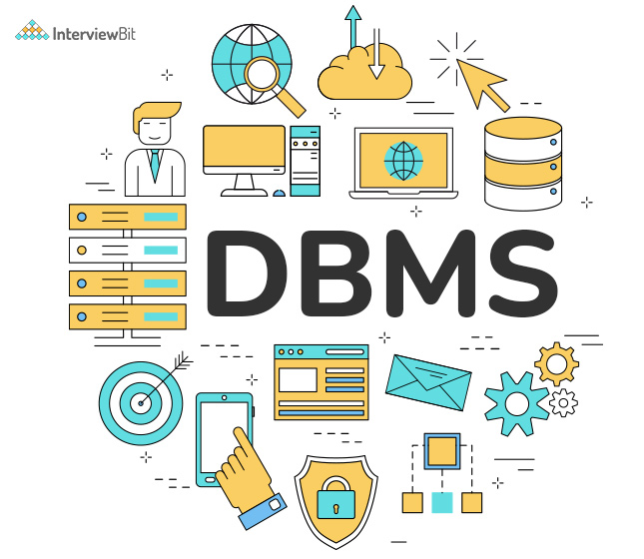
DATABASE MANAGEMENT SYSTEM COURSE 3(C)
Sanyog dani
Ra221103110087
V1 section​

Slide 2
Topics
CONSTRAINTS
SET OPERATIONS
JOINS
VIEWS
TRIGGERS
CURSORS

Slide 3
CONSTRAINTS
SQL constraints are used to specify rules for the data in a table. Constraints are used to limit the type of data that can go into a table. This ensures the accuracy and reliability of the data in the table. If there is any violation between the constraint and the data action, the action is aborted.
There are a total of 6 constraints in SQL:
Primary key
Foreign key
Unique key
Not Null
Check
Default key

Slide 4
CONSTRAINTS
Primary Key is a field which uniquely identifies each row in the table. A combination of a NOT NULL and UNIQUE. Uniquely identifies each row in a table.
The FOREIGN KEY constraint is used to prevent actions that would destroy links between tables.
A unique key in SQL is the set of fields or columns of a table that helps us uniquely identify records. The unique key guarantees the uniqueness of the columns in the database. A primary key constraint automatically defines a unique key constraint. More than one unique key can exist in a table, unlike the primary key, which can exist only once.
A NOT NULL constraint in SQL is used to prevent inserting NULL values into the specified column, considering it as a not accepted value for that column. This means that we should provide a valid SQL NOT NULL value to that column in the INSERT or UPDATE statements, as the column will always contain data.
The Check constraint is used to impose conditions on what type of data to be inserted into our table. It helps in maintaining the accuracy and consistency of the data. It helps in avoiding the entry of data that does not follow our specified conditions.
The MySQL DEFAULT constraint returns the default value for a table column. The DEFAULT value of a column is a value used in the case, when there is no value specified by the user.

Slide 5
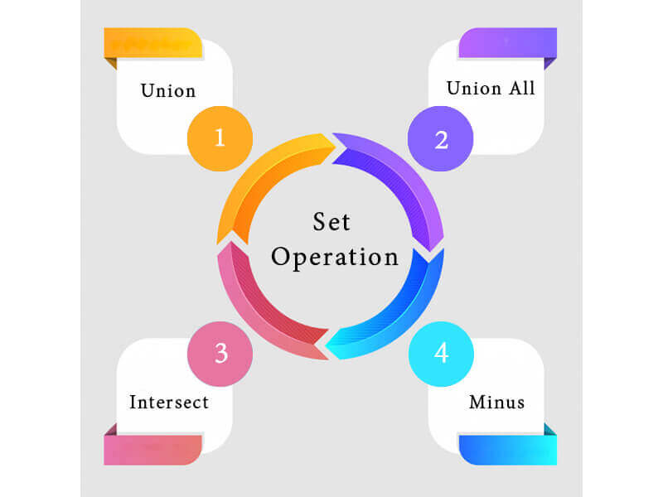
Set Operations
The SQL Set operation is used to combine the two or more SQL SELECT statements.
There are 4 types of set operations available in MYSQL:
Union
Union All
Intersect
Minus

Slide 6
Set Operations
Union Operation:
UNION is used to combine the results of two or more SELECT statements.
The main advantage of UNION operation is that it will eliminate duplicate rows from its result set.
In case of union, number of columns and datatype must be same in both the tables, on which UNION operation is being applied.
Union All operation:
The UNION ALL operator combines two or more results from multiple SELECT queries and returns all records into a single result set. It does not remove the duplicate rows from the output of the SELECT statements.
It has no feature to eliminate the duplicate rows from the output.
Its performance is fast because it does not eliminate the duplicate rows

Slide 7
Set Operations
Intersect Operator :
The INTERSECT is an operator in Structured Query Language that combines the rows of two SELECT statements and returns only those rows from the first SELECT statement, which are the same as the rows of the second SELECT statement.
In simple words, we can say that this operator shows common rows from both the SELECT statement.
Minus Operator :
The Minus is an operator in Structured Query Language, which is used with two SELECT queries.
This operator returns only unique records of the first table, not the common records of both tables.

Slide 8
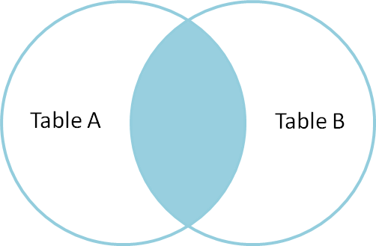
Joins
Inner Join
The INNER JOIN keyword selects all rows from both the tables as long as the condition is satisfied. This keyword will create the result-set by combining all rows from both the tables where the condition satisfies i.e value of the common field will be the same.
Types of Joins:
INNER JOIN
LEFT JOIN
RIGHT JOIN
FULL JOIN
CROSS JOIN

Slide 9
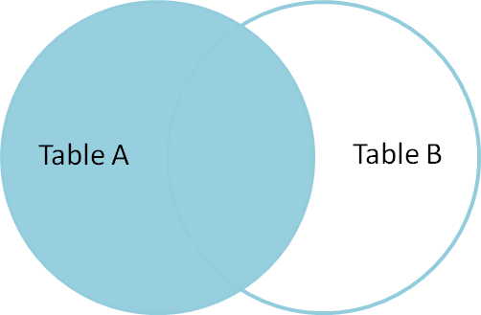
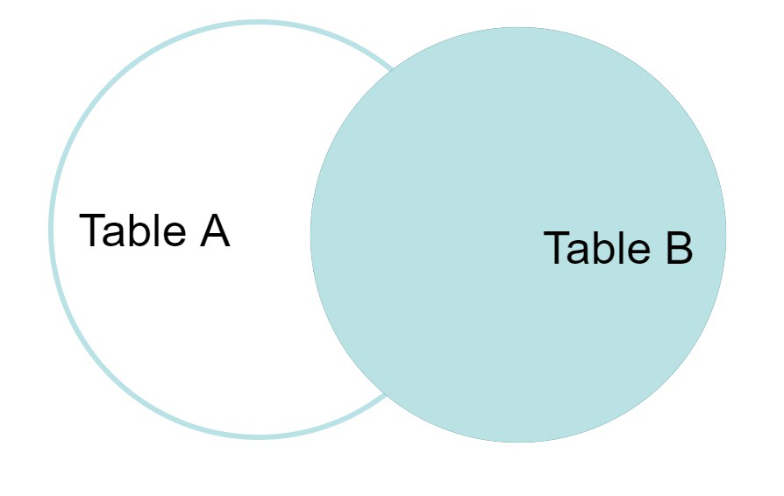
JoinS
Right or Right Outer Join
RIGHT JOIN is similar to LEFT JOIN. This join returns all the rows of the table on the right side of the join and matching rows for the table on the left side of the join. For the rows for which there is no matching row on the left side, the result-set will contain null. RIGHT JOIN is also known as RIGHT OUTER JOIN.
Left or Left Outer Join
This join returns all the rows of the table on the left side of the join and matches rows for the table on the right side of the join. For the rows for which there is no matching row on the right side, the result-set will contain null. LEFT JOIN is also known as LEFT OUTER JOIN.

Slide 10
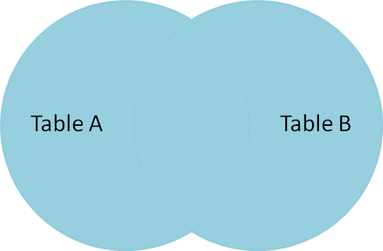
JoinS
Cross or Cartesian Join
The CARTESIAN JOIN is also known as CROSS JOIN. In a CARTESIAN JOIN there is a join for each row of one table to every row of another table. This usually happens when the matching column or WHERE condition is not specified.
Full Join
FULL JOIN creates the result-set by combining results of both LEFT JOIN and RIGHT JOIN. The result-set will contain all the rows from both tables. For the rows for which there is no matching, the result-set will contain NULL values.

Slide 11
Views
Views in SQL are kind of virtual tables.
A view also has rows and columns as they are in a real table in the database.
We can create a view by selecting fields from one or more tables present in the database.
A View can either have all the rows of a table or specific rows based on certain condition.
Syntax:
CREATE VIEW view_name AS SELECT column1, column2..... FROM table_name WHERE condition;
view_name: Name for the View
table_name: Name of the table
condition: Condition to select rows

Slide 12
Triggers
A trigger is a stored procedure in database which automatically invokes whenever a special event in the database occurs. For example, a trigger can be invoked when a row is inserted into a specified table or when certain table columns are being updated.
Triggers are composed to be executed in light of any of the accompanying occasions.
A database control (DML) statement (DELETE, INSERT, or UPDATE).
A database definition (DDL) statement (CREATE, ALTER, or DROP).
A database operation (SERVERERROR, LOGON, LOGOFF, STARTUP, or SHUTDOWN).

Slide 13
Cursors
A cursor is a pointer to this context area. PL/SQL controls the context area through a cursor. A cursor holds the rows (one or more) returned by a SQL statement. The set of rows the cursor holds is referred to as the active set.
There are two types of cursors:
Implicit cursors: Implicit cursors are automatically created by Oracle whenever an SQL statement is executed, when there is no explicit cursor for the statement.
Explicit cursors: Explicit cursors are programmer-defined cursors for gaining more control over the context area. An explicit cursor should be defined in the declaration section of the PL/SQL Block. It is created on a SELECT Statement which returns more than one row.

Slide 14

Thank you

