Slide 1
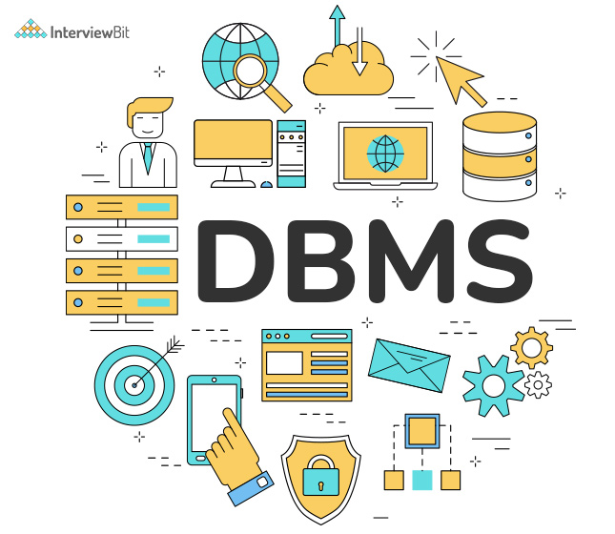
DATABASE MANAGEMENT SYSTEM COURSE 5(C)
Sanyog dani
Ra221103110087
V1 section​

Slide 2
Topics
TRANSACTION AND ITS STATES
CONCURRENCY CONTROL
NoSQL
RAID

Slide 3
Transaction
A transaction is a logical unit of work that consists of one or more database operations (such as read, write, update, or delete), treated as a single entity.
ACID Properties: Transactions should adhere to ACID properties:
Atomicity: All operations within a transaction must succeed or fail as a whole.
Consistency: Transactions must leave the database in a consistent state, preserving all integrity constraints.
Isolation: Concurrent transactions should not interfere with each other's execution.
Durability: Once a transaction is committed, its changes should persist even in the event of system failure.

Slide 4
Transaction States
Transactions typically go through states such as Active, Partially Committed, Committed, or Aborted.
Active:
The initial state of a transaction, in this state, the transaction is executing its operations, such as reading or modifying data.
Partially Committed:
After the transaction has executed all its operations successfully, the changes made by the transaction are recorded in a temporary location, but not yet made permanent in the database.
Committed:
Once the transaction has been successfully completed and all its changes have been permanently saved to the database , at this stage, the changes are made durable and visible to other transactions.
Aborted:
If the transaction encounters an error or is explicitly rolled back due to failure or cancellation.
In this state, any changes made by the transaction are undone, and the database is restored to its state before the transaction began.

Slide 5
CONCURRENCY CONTROL
Concurrency control ensures that multiple transactions can execute concurrently without compromising the consistency and integrity of the database.
Concurrency Problems: Concurrency can lead to various problems,
Lost Updates: Overwriting changes made by other transactions.
Dirty Reads: Reading uncommitted changes made by other transactions.
Non-Repeatable Reads: Inconsistent reads due to changes made by other transactions.
Phantom Reads: Inconsistent reads due to concurrent insertions or deletions by other transactions.
Concurrency Control Techniques:
Locking: Transactions acquire locks on data items to prevent concurrent access.
Optimistic Concurrency Control: Transactions proceed assuming no conflicts and check for conflicts only at commit time.
Timestamp Ordering: Assigning timestamps to transactions and using them to order conflicting operations.
Serializability: Ensuring that the execution of concurrent transactions is equivalent to some serial order of those transactions.
Deadlock Handling: Deadlocks occur when transactions are waiting indefinitely for resources held by each other. Techniques like deadlock detection and deadlock prevention are used to handle them.

Slide 6
N0SQL
NoSQL (Not Only SQL) is a term used to describe a wide range of non-relational dbms that provide alternative approaches to storing and retrieving data compared to traditional relational databases.
Features of NoSQL databases:
Schema-less or Dynamic Schema:
NoSQL databases typically do not enforce a rigid schema like traditional relational databases, they allow for flexible data models, making it easier to store and retrieve semi-structured or unstructured data.
Horizontal Scalability:
Many NoSQL databases are designed to scale horizontally across multiple servers or clusters, they can handle large volumes of data and high levels of traffic by distributing data across multiple nodes.
High Performance:
NoSQL databases are often optimized for specific use cases, such as high throughput or low latency, they can provide better performance for certain types of queries or workloads compared to relational databases.
Flexible Data Models:
NoSQL databases support various data models, including key-value pairs, document stores, column-family stores, and graph databases, each data model is suited for different types of applications and data structures.
Eventual Consistency:
Some NoSQL databases prioritize availability and partition tolerance over strict consistency , they may provide eventual consistency, where all updates are eventually propagated to all replicas, but not necessarily immediately.

Slide 7
RAID
RAID (Redundant Array of Independent Disks) is a storage technology commonly used in computer systems, including database servers, to improve data availability, reliability, and performance. However, RAID is not directly related to SQL, which is a language used for managing relational databases. Instead, RAID is a hardware or software-based technology implemented at the storage level, while SQL is used to interact with databases at the application level.
That said, while SQL itself doesn't implement RAID, it's common to see databases (managed using SQL) deployed on RAID configurations to ensure data durability and availability. RAID offers various levels, each with its own trade-offs in terms of performance, redundancy, and cost.
Some commonly used RAID levels include:
RAID 0 , RAID 1, RAID 2, RAID 3 , RAID 4 ,RAID 5 , RAID 6

Slide 8
RAID LEVELS
RAID 0 (Striping):
Description: RAID 0 stripes data across multiple disks without parity or mirroring.
Performance: Provides improved read/write performance by distributing data across multiple disks, allowing for parallel I/O operations.
Redundancy: No redundancy is provided. A single disk failure can lead to data loss.
Minimum Disks: Requires a minimum of two disks.
RAID 1 (Mirroring):
Description: RAID 1 mirrors data across pairs of disks, providing redundancy.
Performance: Reads can be faster, especially for read-intensive workloads, as data can be read from either disk in the mirror pair.
Redundancy: Provides redundancy against disk failures. Data is duplicated across disks, so if one disk fails, data can be retrieved from the mirror disk.
Minimum Disks: Requires a minimum of two disks.
RAID 2:
Description: RAID 2 uses bit-level striping and error-correcting codes (ECC) to provide data redundancy and error correction.
Performance: Provides high data transfer rates and improved fault tolerance.
Redundancy: Offers high fault tolerance through error correction codes, but it's less efficient compared to other RAID levels.
Minimum Disks: Requires a minimum of three disks.
RAID 3:
Description: RAID 3 stripes data at the byte level across multiple disks and uses a dedicated parity disk for error checking and fault tolerance.
Performance: Offers high read and write performance, especially for large sequential I/O operations.
Redundancy: Provides redundancy through dedicated parity disks. If a data disk fails, data can be reconstructed using parity information.
Minimum Disks: Requires a minimum of three disks.

Slide 9
RAID LEVELS
RAID 4:
Description: RAID 4 is similar to RAID 3 but stripes data at the block level rather than the byte level.
Performance: Offers high read performance but lower write performance due to the single parity disk becoming a bottleneck.
Redundancy: Provides redundancy through dedicated parity disks, similar to RAID 3.
Minimum Disks: Requires a minimum of three disks.
RAID 5:
Description: RAID 5 stripes data across multiple disks and distributes parity information across all disks.
Performance: Provides a balance of performance and redundancy. Read performance is good, but write performance can be slower due to parity calculations.
Redundancy: Offers fault tolerance by distributing parity information. If a disk fails, data can be reconstructed using parity information from other disks.
Minimum Disks: Requires a minimum of three disks.
RAID 6:
Description: RAID 6 is similar to RAID 5 but with an additional parity block, providing increased fault tolerance.
Performance: Offers similar performance to RAID 5 but with higher fault tolerance. Write performance may be slightly lower due to the additional parity calculations.
Redundancy: Provides double parity, allowing the array to tolerate the failure of up to two disks simultaneously.
Minimum Disks: Requires a minimum of four disks.

Slide 10
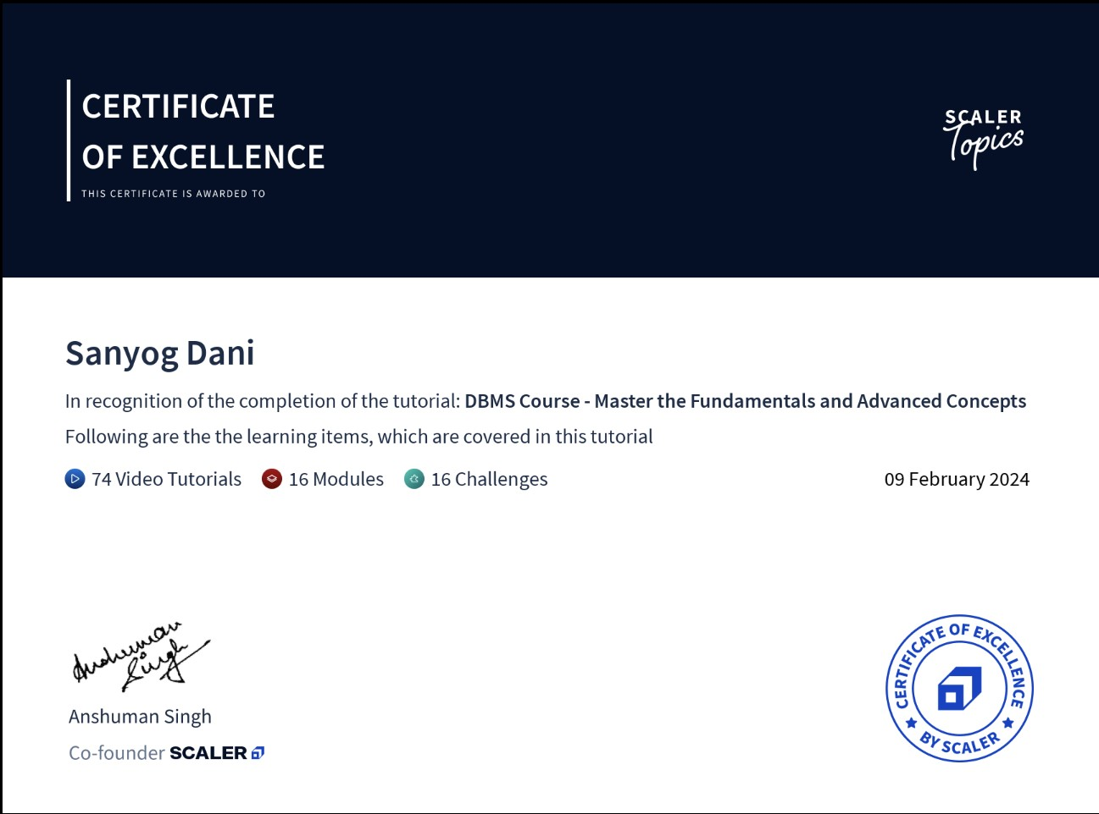

Slide 11

Thank you

