Slide 1
INVENTORY MANAGEMENT SYSTEM (IMS)
Presented BY-
SANYOG DANI (RA2211031010087)
ARUSH Sirotiya (ra2211031010092)
Nikhil kumar (ra2211031010097)

Slide 2
ABSTRACT
The Inventory Management System (IMS) serves as a comprehensive solution for organizations to efficiently track, manage, and optimize their inventory operations. With a focus on streamlining processes and maximizing productivity, IMS offers a centralized platform for inventory control, procurement, and monitoring.
Key functionalities of IMS include inventory tracking, which enables real-time visibility into stock levels, locations, and movement. Also users can swiftly record incoming and outgoing inventory transactions, minimizing errors and enhancing accuracy.
Furthermore, IMS provides robust reporting and analytics capabilities, allowing stakeholders to analyze inventory performance, identify trends, and make data-driven decisions. From inventory turnover rates to supplier performance metrics, these insights empower organizations to optimize inventory strategies and reduce carrying costs.
Overall, the Inventory Management System offers a scalable, customizable solution tailored to the unique needs of businesses across various industries. By leveraging technology to streamline inventory processes and enhance visibility, IMS equips organizations with the tools they need to drive efficiency, minimize costs, and improve customer satisfaction.

Slide 3
INTRODUCTION
Inventory management is a critical aspect of operations for businesses across diverse industries. An Inventory Management System (IMS) serves as a pivotal tool in facilitating the efficient handling, monitoring, and optimization of inventory levels within an organization.
The primary objective of an IMS is to ensure that businesses maintain optimal stock levels while minimizing costs associated with excess inventory or stockouts. By providing real-time visibility into inventory data, such as stock quantities, locations, and movement, an IMS enables businesses to make informed decisions regarding procurement, storage, and distribution.
Traditionally, inventory management involved manual processes, such as spreadsheet-based tracking or physical counts. However, the complexity and scale of modern supply chains necessitate more sophisticated solutions. An IMS automates key inventory-related tasks, streamlining operations and enhancing accuracy.

Slide 4
INTRODUCTION
Key features of an Inventory Management System typically include:
Inventory Tracking: Real-time monitoring of stock levels, allowing businesses to accurately assess inventory positions and respond to fluctuations in demand.
Warehouse Management: Efficient management of warehouse operations, including inventory receipt, storage, picking, packing, and shipping, to streamline logistics processes and minimize errors.
Reporting and Analytics: Comprehensive reporting and analytics capabilities to track key performance indicators (KPIs), analyze inventory trends, and identify opportunities for improvement.
In today's competitive business landscape, effective inventory management is essential for meeting customer demand, optimizing cash flow, and maintaining a competitive edge. An Inventory Management System plays a pivotal role in helping businesses achieve these objectives by providing visibility, control, and efficiency throughout the inventory lifecycle.
Overall, the adoption of an Inventory Management System empowers businesses to enhance operational efficiency, minimize costs, and improve customer satisfaction, ultimately driving sustainable growth and success.

Slide 5
PROBLEM STATEMENT
In today's dynamic business environment, effective inventory management is crucial for businesses to meet customer demand, minimize costs, and maintain a competitive edge. However, many organizations face challenges in efficiently tracking, managing, and optimizing their inventory operations. Manual processes, outdated systems, and lack of real-time visibility often result in inventory inaccuracies, stockouts, excess inventory, and inefficiencies in procurement and logistics.
The problem statement revolves around the need for a comprehensive Inventory Management System (IMS) that addresses the following challenges:
Inventory Tracking and Visibility
Inventory Optimization
Procurement Efficiency
Warehouse Management
Reporting and Analytics

Slide 6
RELATIONAL SCHEMA
1. Supplier (supplier_id, name, contact_info, ...)
2. Manufacturer (manufacturer_id, name, contact_info, ...)
3. Product (product_id, name, description, category_id, manufacturer_id, ...)
4. Category (category_id, name, description, ...)
5. Warehouse (warehouse_id, name, location, ...)
6. Inventory (inventory_id, product_id, warehouse_id, quantity, ...)
7. Orders (order_id, order_date, customer_id, ...)
8. Order_Item (order_item_id, order_id, product_id, quantity, ...)
9. Purchase_Order (purchase_order_id, order_date, supplier_id, ...)
10. Purchase_Order_Item (purchase_order_item_id, purchase_order_id, product_id, quantity, ...)
11. Sales_Order (sales_order_id, order_date, customer_id, ...)
12. Sales_Order_Item (sales_order_item_id, sales_order_id, product_id, quantity, ...)
13. Customer (customer_id, name, contact_info, ...)
14. Employee (employee_id, name, position, ...)
15. Location (location_id, address, city, state, ...)

Slide 7
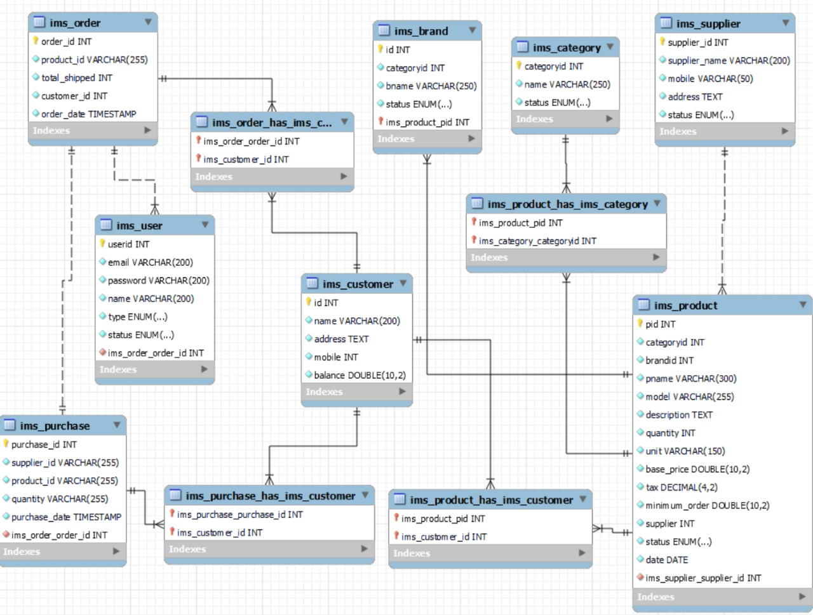
RELATIONAL SCHEMA

Slide 8
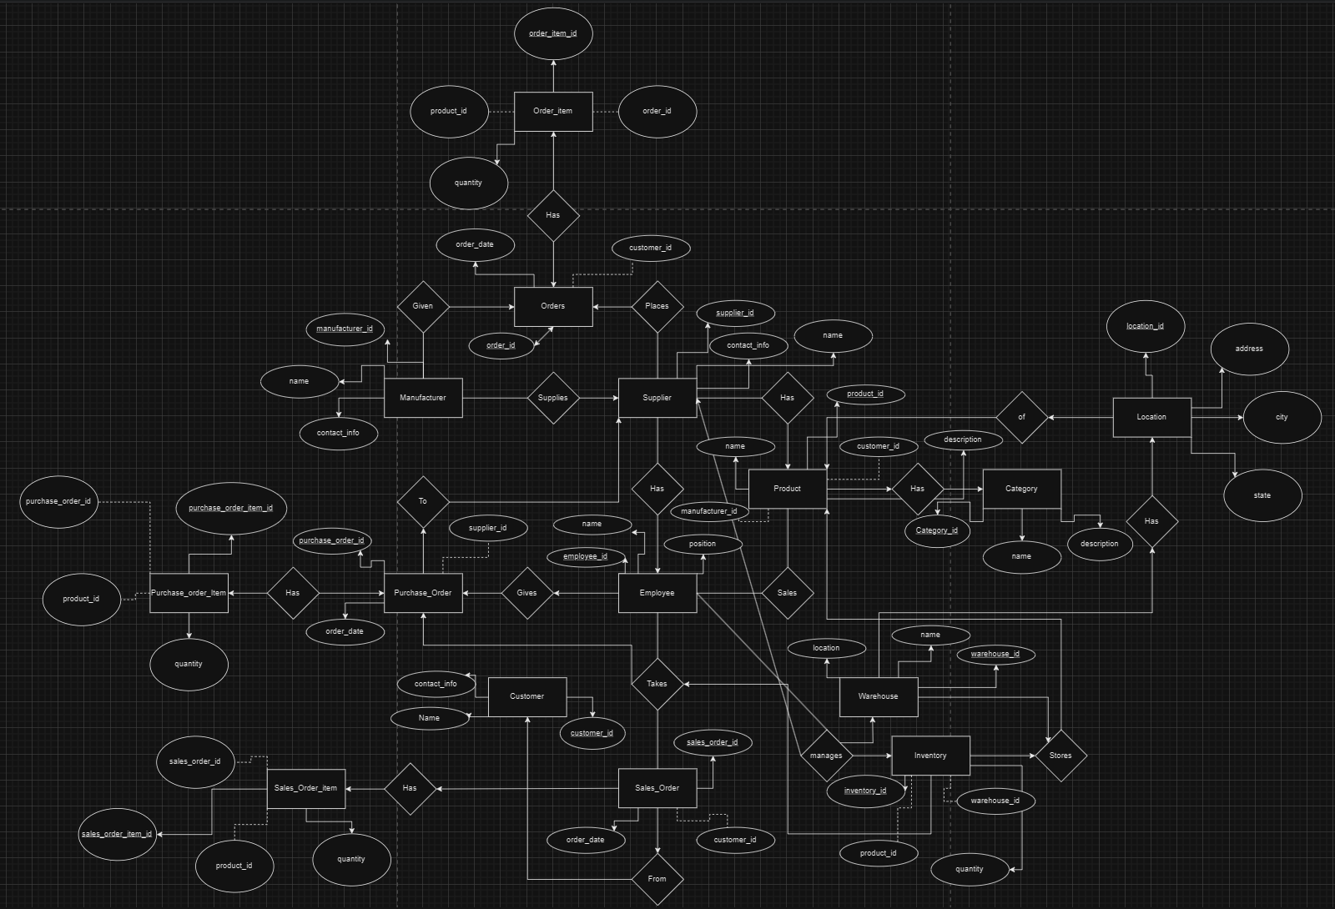
ER DIAGRAM

Slide 9
FUNCTIONAL DEPENDECIES
To analyze the database schema provided and identify any pitfalls, dependencies, and potential normalization improvements, we can follow these steps:
1. Identify Primary Keys: Ensure that each table has a primary key defined, uniquely identifying each record. Each table has a primary key defined:
category_id in the category table
customer_id in the customer table
employee_id in the employee table
inventory_id in the inventory table
location_id in the location table
manufacturer_id in the manufacturer table
order_id in the orders table
product_id in the product table
purchase_order_id in the purchase_order table
purchase_order_item_id in the purchase_order_item table
sales_order_id in the sales_order table
sales_order_item_id in the sales_order_item table
supplier_id in the supplier table
warehouse_id in the warehouse table

Slide 10
FUNCTIONAL DEPENDECIES
2. Check Foreign Key Relationships: Verify that foreign keys are properly defined to establish relationships between tables.
Foreign key relationships exist between tables, such as 'customer_id' in the 'orders' table referencing 'customer_id' in the 'customer' table, and 'product_id' in the 'order_item' table referencing 'product_id' in the 'product' table.
3. Review Data Types: Ensure that data types are appropriate for the values they store and that they are consistent across tables.
Data types seem appropriate for the values they store, with integers ('int'), variable-length strings ('varchar'), and dates ('date') used where necessary.
4. Analyze Redundancy: Look for any redundancy or duplication of data, which could lead to inconsistencies and inefficiencies.
Redundancy can be observed in the 'location' table, where the same address information appears multiple times. This could be normalized by creating a separate table for addresses and linking them to their respective entities.

Slide 11
NORMALIZATIONS
Normalize the Schema: Apply normalization techniques to minimize redundancy and dependency, aiming for higher data integrity and efficiency. To apply normalization, we can consider techniques such as:
Breaking down tables with repeating groups of attributes into separate tables.
Ensuring each table represents a single entity or relationship.
Removing transitive dependencies by creating additional tables.
First Normal Form (1NF): Ensure that each column contains atomic values, meaning no multi-valued attributes. All tables in the provided schema already satisfy the 1NF criteria.
Second Normal Form (2NF): Remove partial dependencies by ensuring that non-prime attributes depend on the whole primary key.
Third Normal Form (3NF): Eliminate transitive dependencies by ensuring that non-prime attributes do not depend on other non-prime attributes.
Fourth Normal Form (4NF): Ensure multivalued dependencies are eliminated.

Slide 12
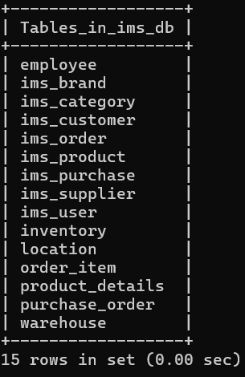
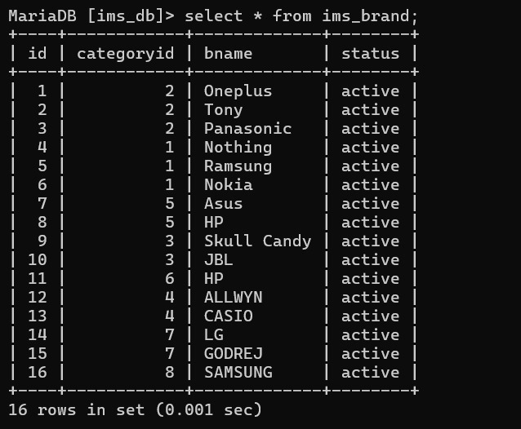
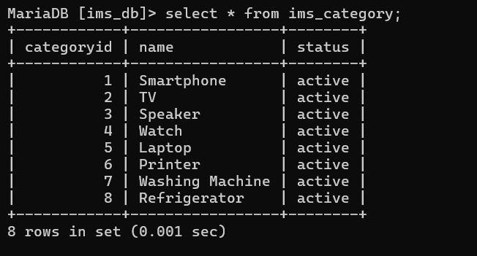
DATABASE TABLES

Slide 13
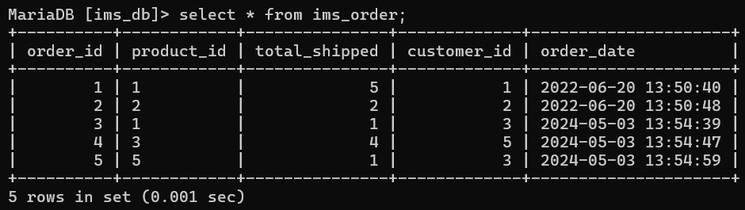
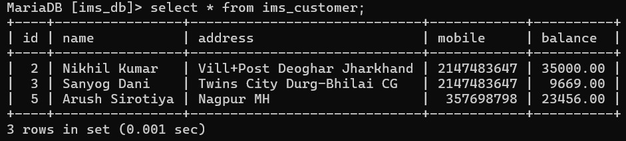
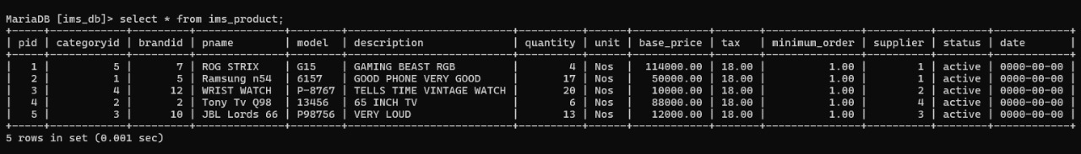
DATABASE TABLES

Slide 14
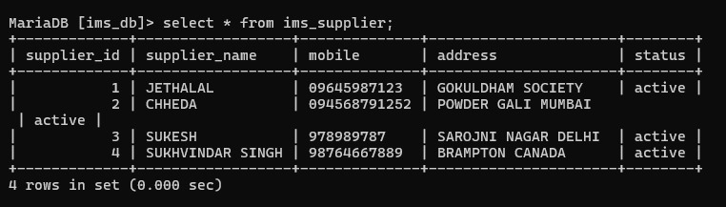
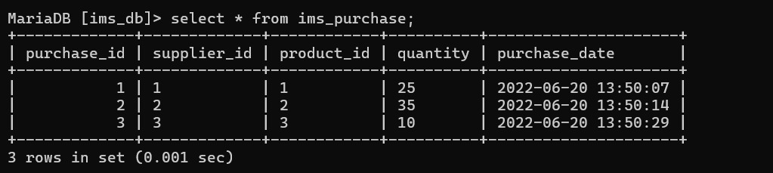
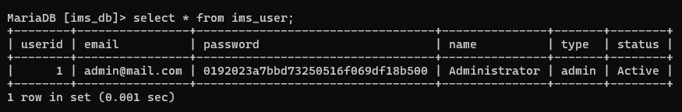
DATABASE TABLES

Slide 15
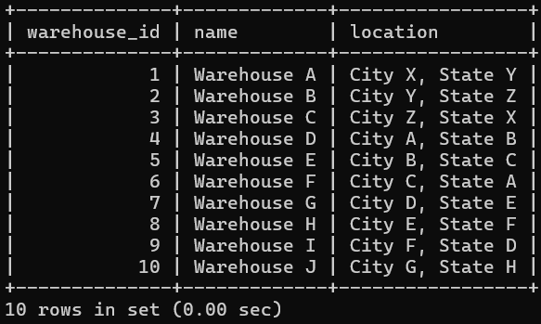
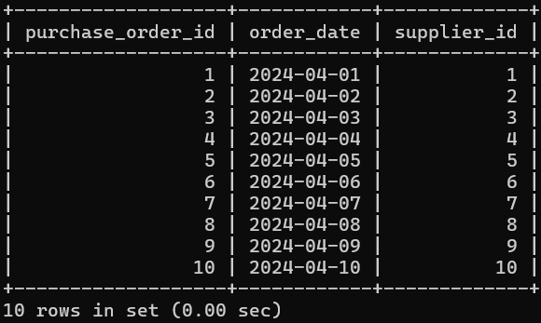
DATABASE TABLES

Slide 16
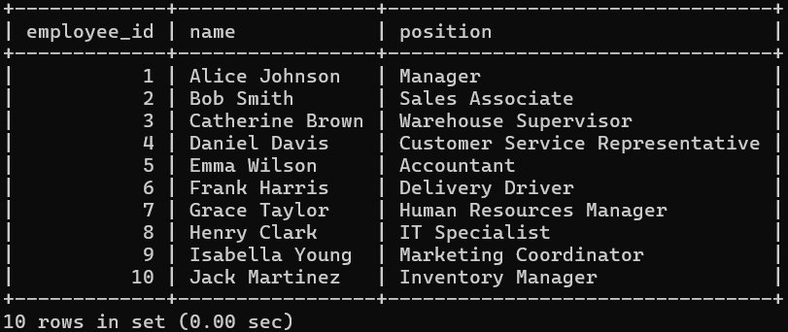
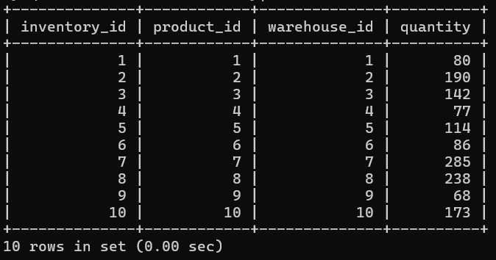
DATABASE TABLES

Slide 17
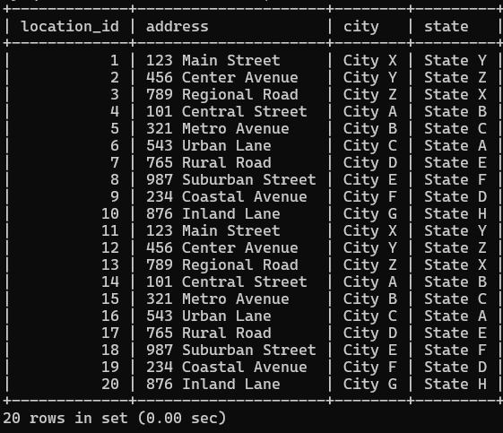
DATABASE TABLES

Slide 18
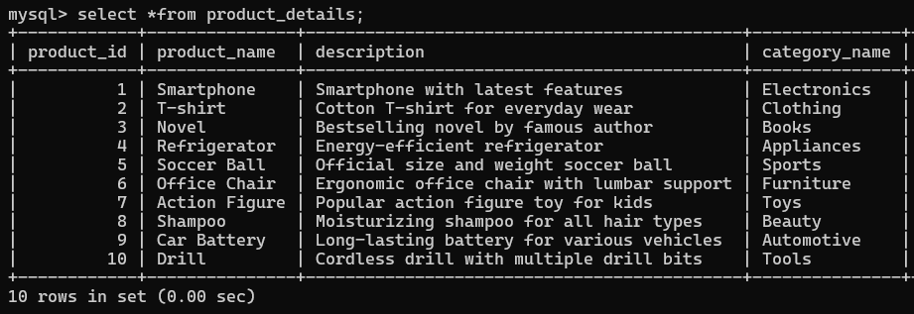
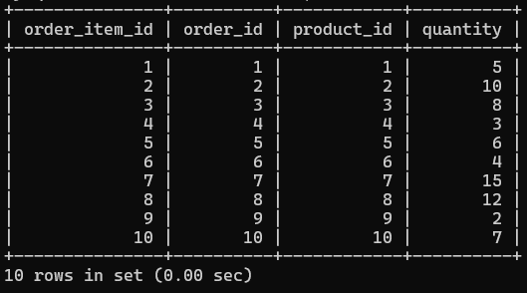
DATABASE TABLES

Slide 19
NORMALIZATIONS TABLE
Table | Functional Dependencies Identified | Normal Form Applied
category | No functional dependencies identified | Already in 1NF
customer | No functional dependencies identified | Already in 1NF
employee | No functional dependencies identified | Already in 1NF
manufacturer | No functional dependencies identified | Already in 1NF
product | No functional dependencies identified | Already in 1NF
supplier | No functional dependencies identified | Already in 1NF
warehouse | No functional dependencies identified | Already in 1NF

Slide 20
address | No functional dependencies identified | Already in 1NF
location | Location dependent on address; address determines location | 1NF, 2NF
inventory | No functional dependencies identified | Already in 1NF
orders | No functional dependencies identified | Already in 1NF
order_item | Order_item is dependent on both order and product; order and product detne order_item | 1NF, 2NF
sales_order | No functional dependencies identified | Already in 1NF
sales_order_item | Sales_order and product determine sales_order_item | 1NF, 2NF
purchase_order | No functional dependencies identified | Already in 1NF
purchase_order_item | purchase_order and product determine purchase_order_item | 1NF, 2NF

Slide 21
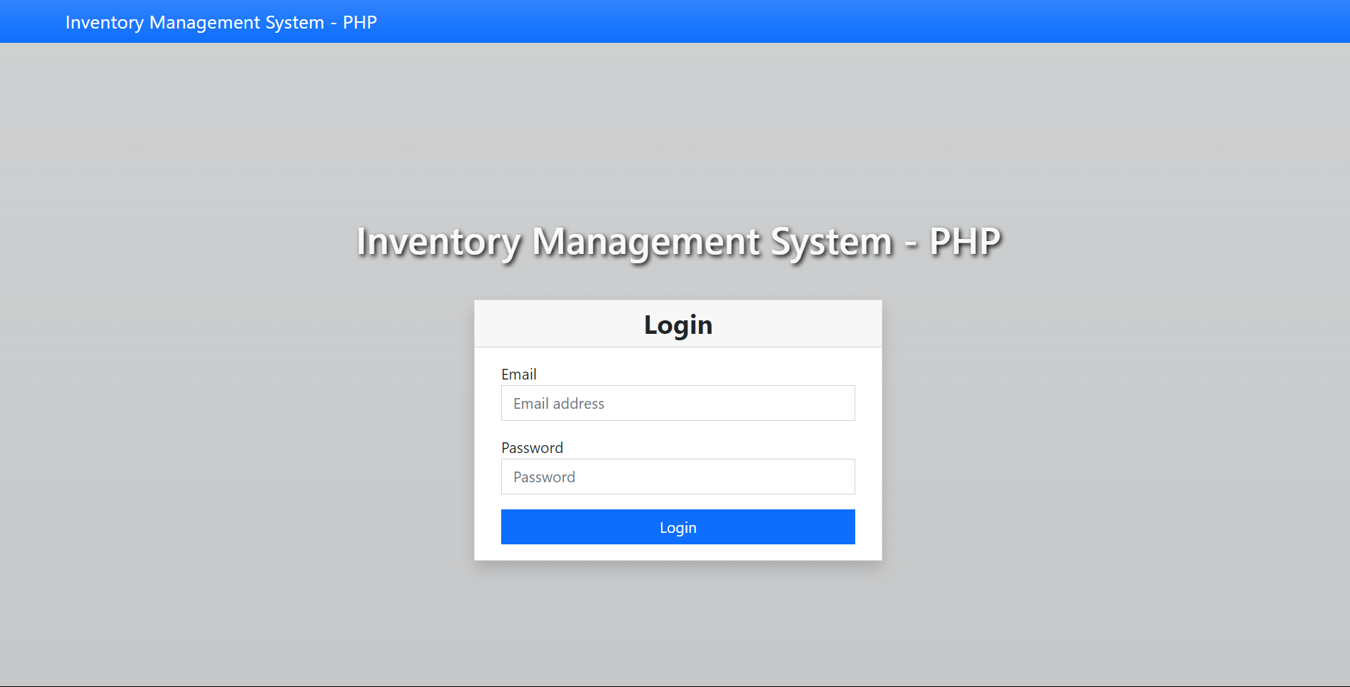
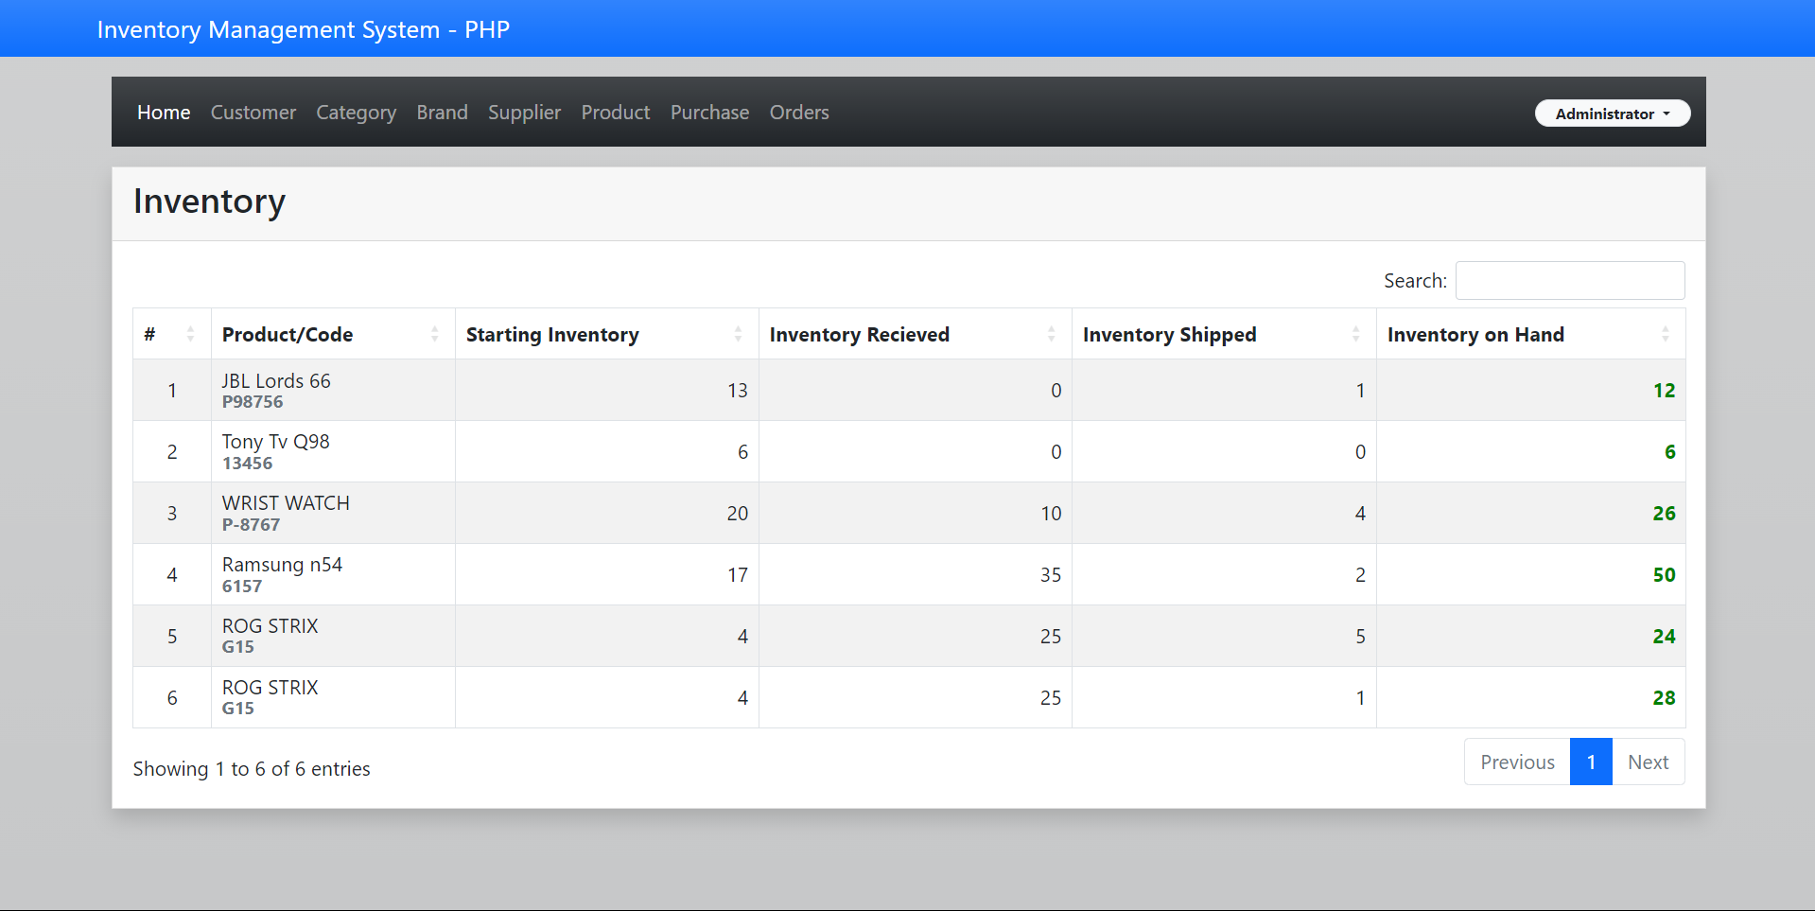
SCREENSHOTS

Slide 22
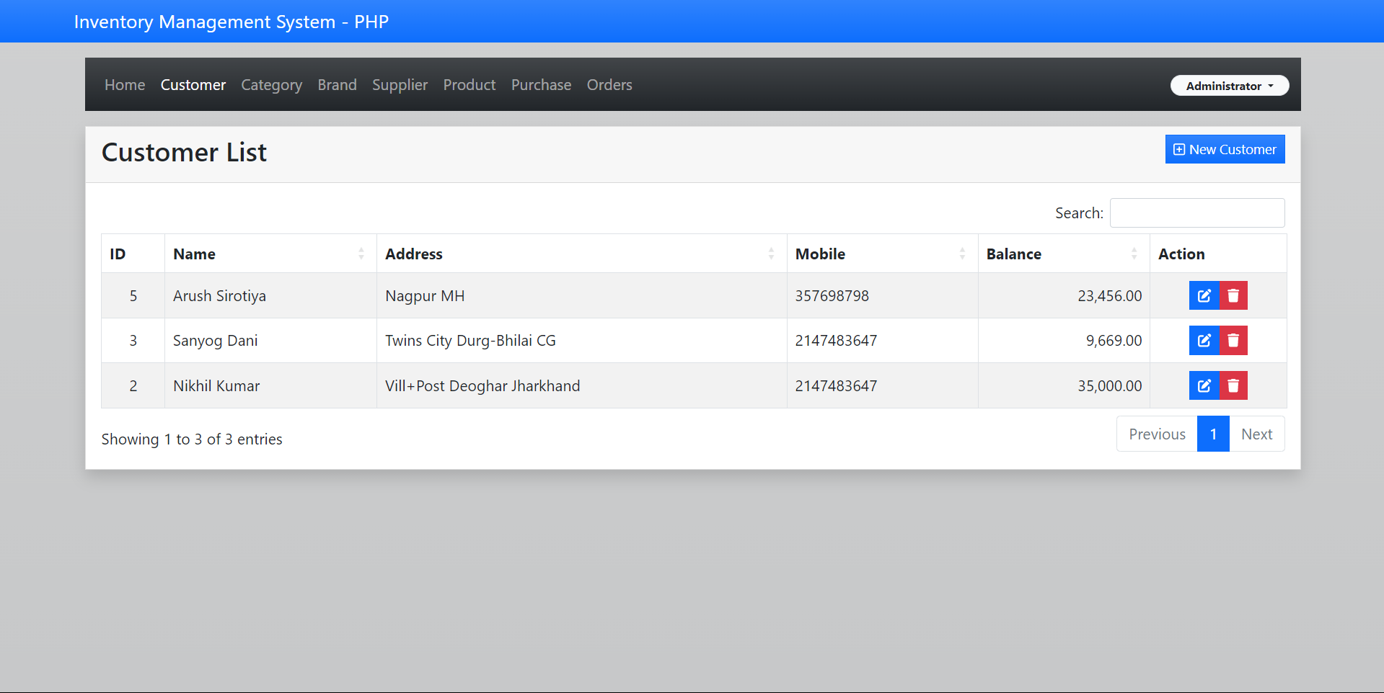
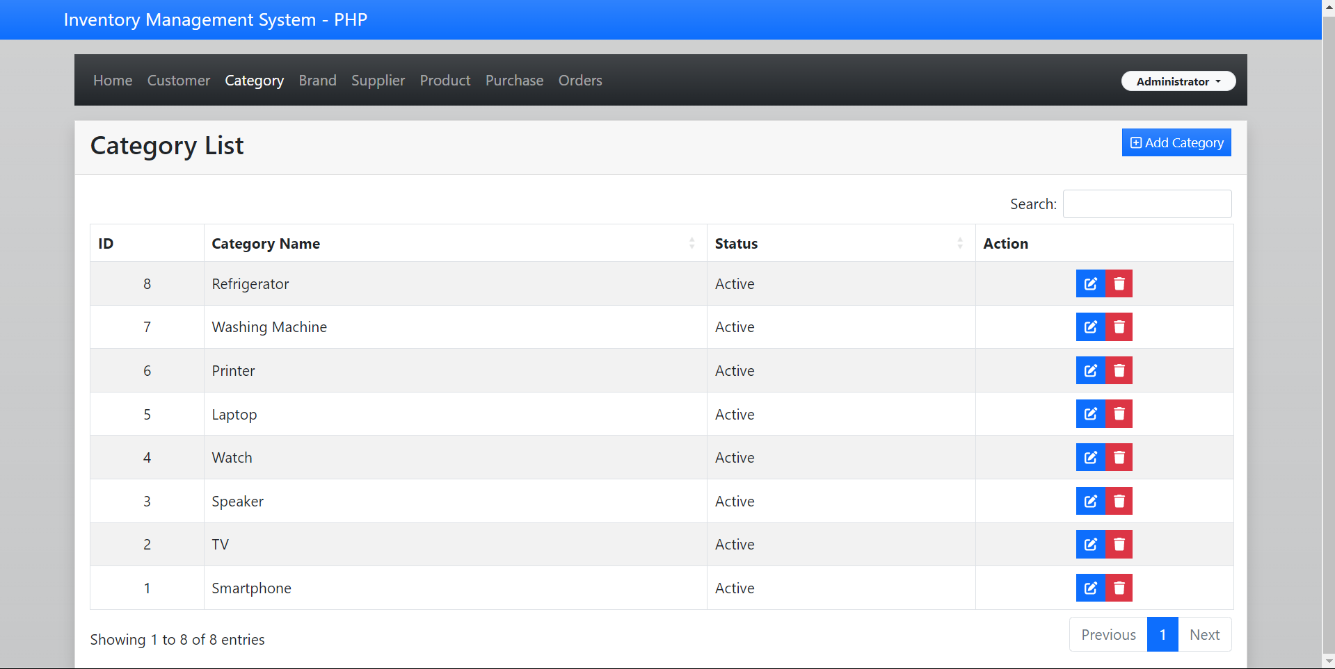
SCREENSHOTS

Slide 23
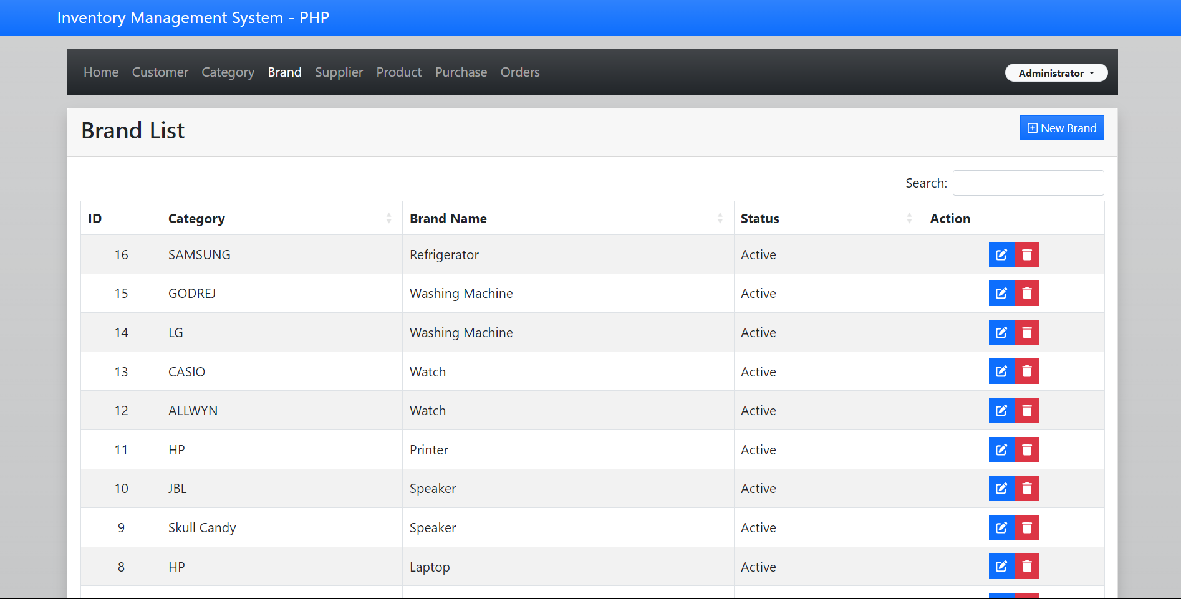
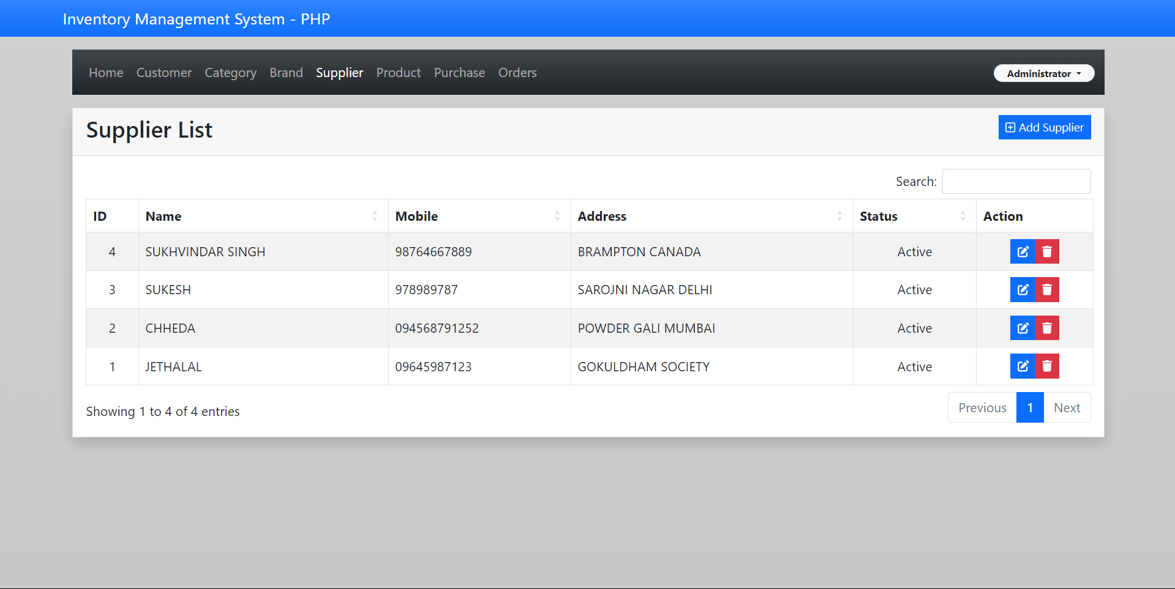
SCREENSHOTS

Slide 24
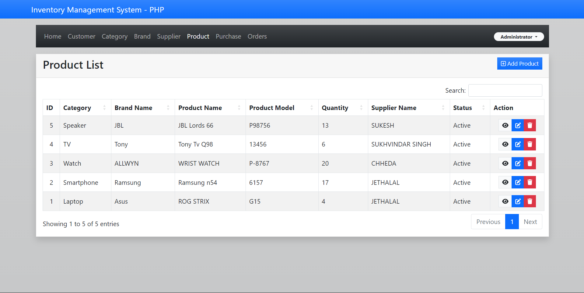
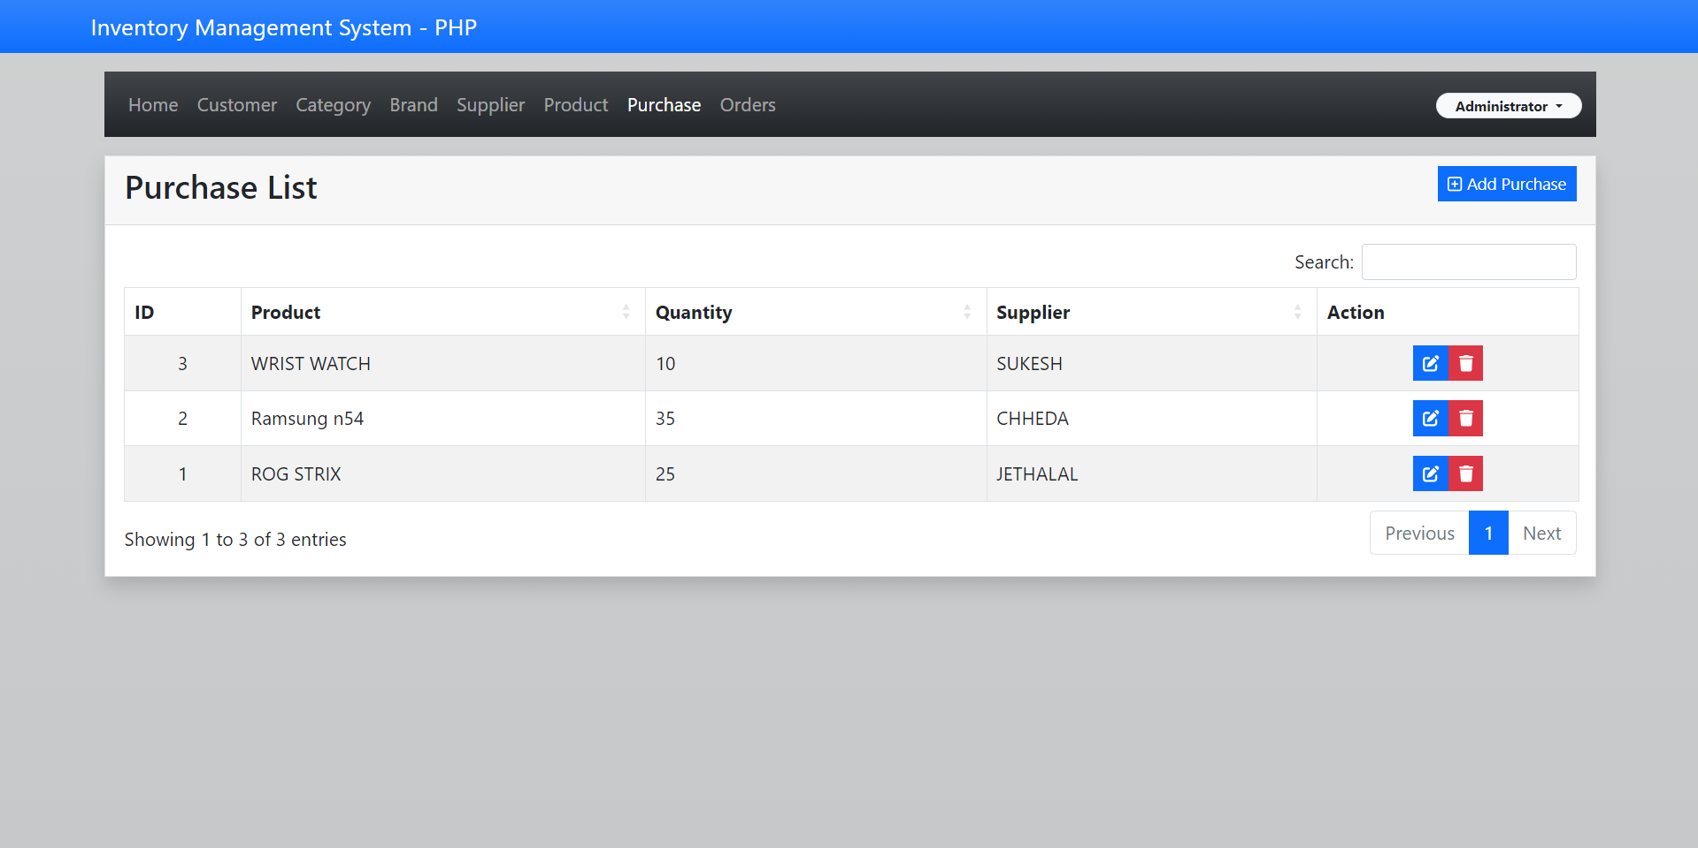
SCREENSHOTS

Slide 25
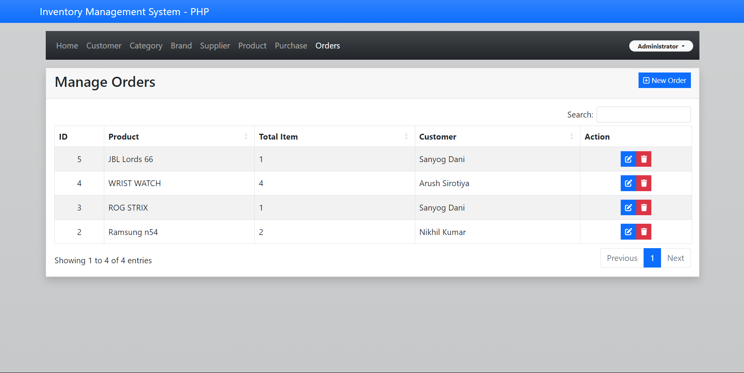
SCREENSHOTS

Slide 26
Thank You

