Slide 1

PRICE COMPARISON WEBSITE using web scraping algorithm
SRM INSTITUTE OF SCIENCE AND TECHNOLOGY
COLLEGE OF ENGINEERING AND TECHNOLOGY
DEPARTMENT OF NETWORKING AND COMMUNICATIONS
21CSC203P – ADVANCED PROGRAMMING PRACTICE
Mini-Project Presentation
Sanyog Dani (RA2211031010087)
Arush Sirotiya (RA2211031010092)
V1 Section
Under the guidance of
Dr. M Manickam
Assistant Professor , Department of Networking and Communications

Slide 2
Table of contents
Objective
Problem Statement
Architecture/ Flow chart
Hardware/Software requirements
Implementation- Code snippet
Results- Screen Shots of Output
Conclusion

Slide 3
Objective
Main Goal and Objective of this Mini Project is :-
This platform serves as a valuable tool for comparing prices across diverse E-commerce websites. It caters specifically to the needs of frequent online shoppers, offering the convenience of centralized price comparisons from a multitude of online retailers. This system efficiently aggregates pricing data from various sellers, enabling users to pinpoint the most cost-effective source for their desired products. Once the data from these websites is collected, it is presented on the platform in the form of an easily navigable price comparison.
In the realm of E-commerce, applications consist of several essential components, including a database server, a web application server, and the Payment Gateway Interface (PGI) for facilitating online transactions. The pervasive influence of the internet has fundamentally transformed the way individuals and businesses approach their operations and decision-making processes. This project embodies the fusion of technology and consumer empowerment in the ever-evolving world of online shopping.

Slide 4
Problem Statement
An individual is seeking to purchase a Titan watch, but he's encountering varying price listings on different websites. Additionally, he's frustrated by intrusive ads and the risk of stumbling upon fraudulent websites, resulting in a significant waste of 15 to 30 minutes.
Develop an open-source software tool that helps users avoid intrusive ads, identify counterfeit and fraudulent websites, and obtain up-to-date, accurate prices for authentic and high-quality products from online retailers.

Slide 5
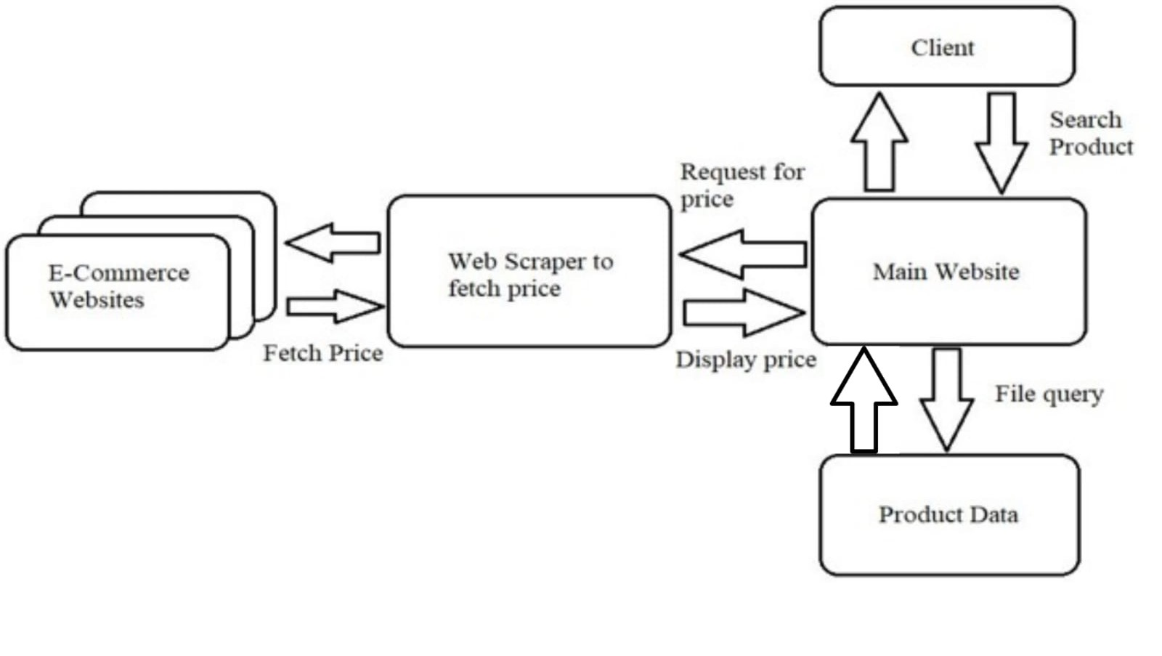
Architecture/ Flow chart

Slide 6
Hardware/Software requirements
Hardware
A server with a fast processor and at least 8GB of RAM. This is necessary to handle the load of web scraping and serving the website to users.
A large hard drive or SSD, depending on the amount of data you need to store.
A reliable internet connection.
A dedicated server from a reputable provider such as Amazon Web Services (AWS) or Google Cloud Platform (GCP).
A Linux operating system such as Ubuntu or Debian.
A reliable internet connection with at least 100 Mbps bandwidth.
Software
Python 3
Beautiful Soup: A Python library for parsing HTML and XML documents.
Requests: A Python library for making HTTP requests.
A database management system (DBMS) such as MySQL or PostgreSQL to store the links and classes of a particular attribute.
A web server such as Apache or Nginx to serve the website to users.

Slide 7
Implementation- Code snippet
Algorithm :
We start by importing necessary libraries, including requests, BeautifulSoup, and mysql.connector. It establishes a connection to a MySQL database using specified credentials. The user is then presented with a menu of product options, such as Titan Watch, Victus Laptop, Boat Airdopes, and the option to exit.
The algorithm prompts the user to input their choice, and based on the selection, a function called fetch_and_display_info is invoked. This function retrieves relevant product information from the database, makes an HTTP request to the associated website, parses the HTML content using BeautifulSoup, and displays the fetched price along with the URL.
The algorithm handles different product selections by calling the function with appropriate product IDs. After processing the user's input and displaying information, the algorithm concludes by closing the MySQL database connection.

Slide 8
Conclusion
our price comparison website project is a significant achievement, demonstrating our skills in web scraping, database management, and web development. It provides a valuable service to users by simplifying their product research and saving them time and money. As we continue to work on this project and make improvements, it has the potential to become a popular destination for online shoppers seeking the best deals. It showcases our ability to create practical, data-driven solutions and opens the door to various opportunities for expansion and monetization. Keep refining and enhancing our project to stay competitive in the dynamic e-commerce landscape.

Slide 9
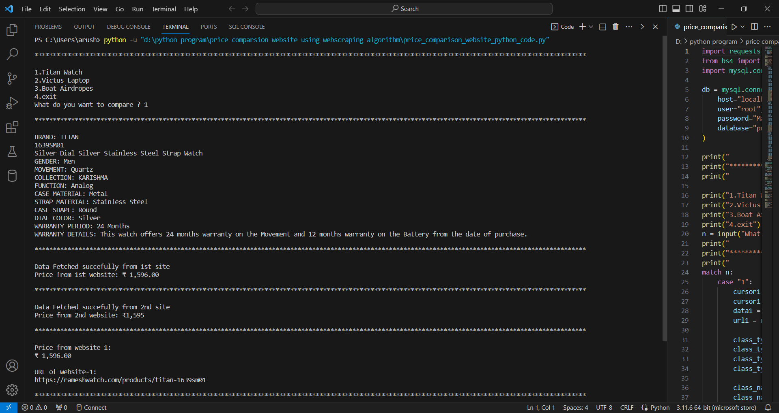
Results- Screen Shots of Output

Slide 10
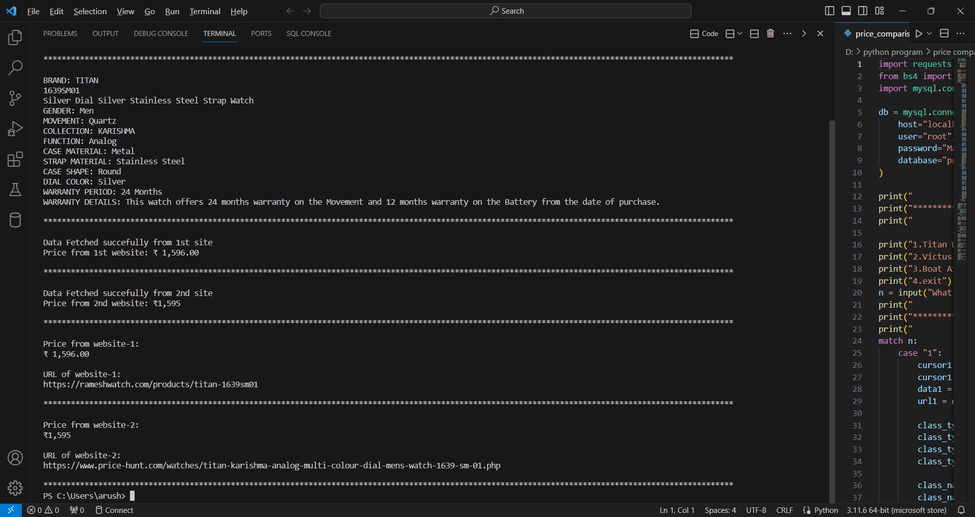
Results- Screen Shots of Output

Slide 11
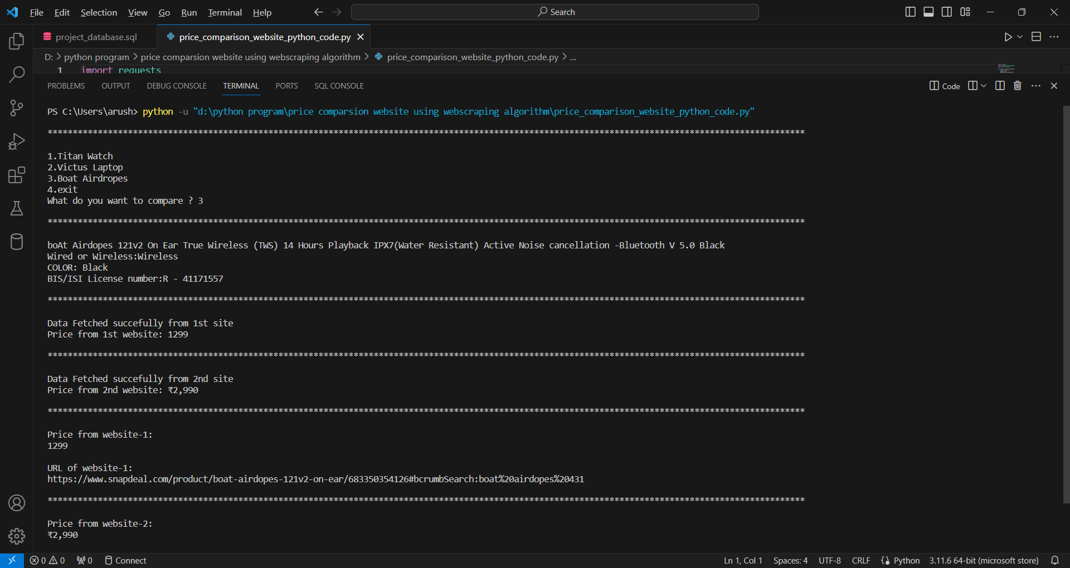
Results- Screen Shots of Output

Slide 12
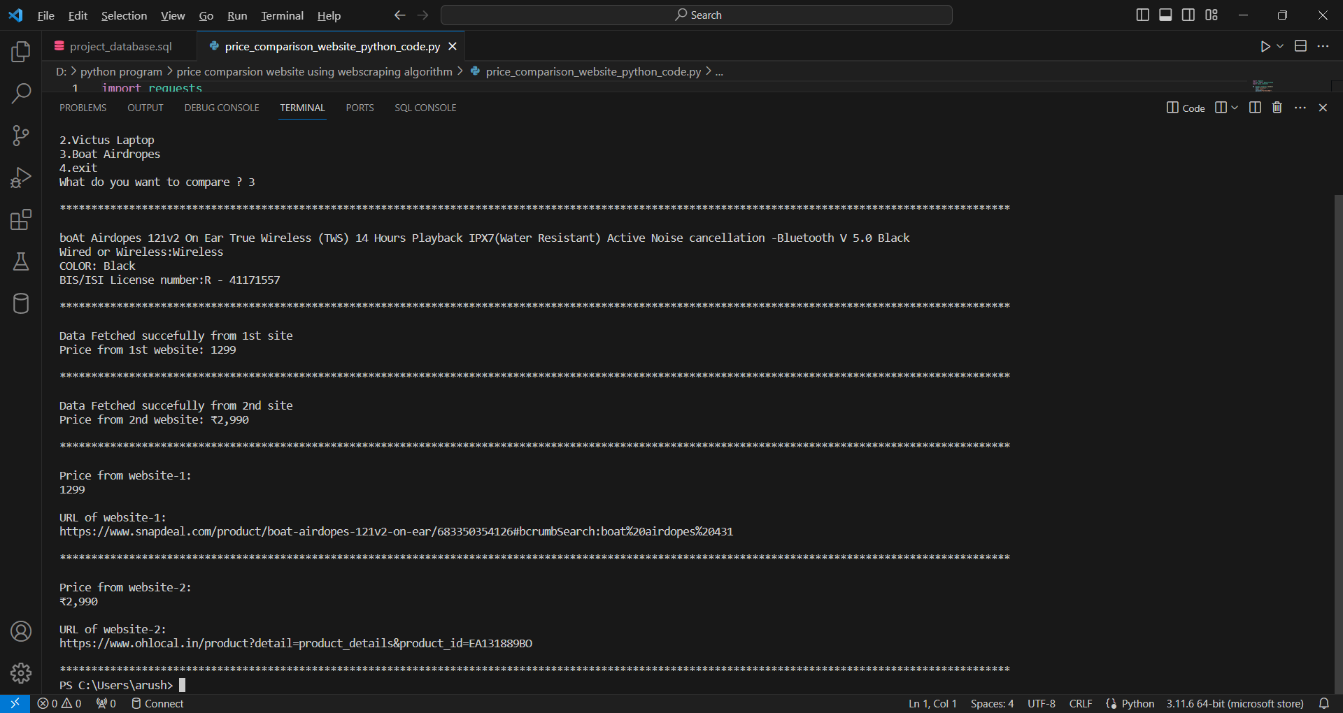
Results- Screen Shots of Output

Slide 13
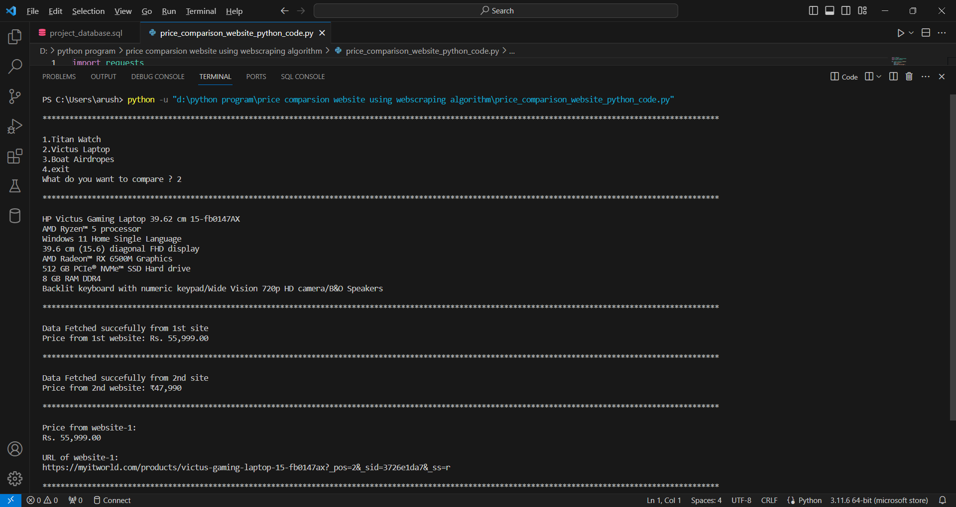
Results- Screen Shots of Output

Slide 14
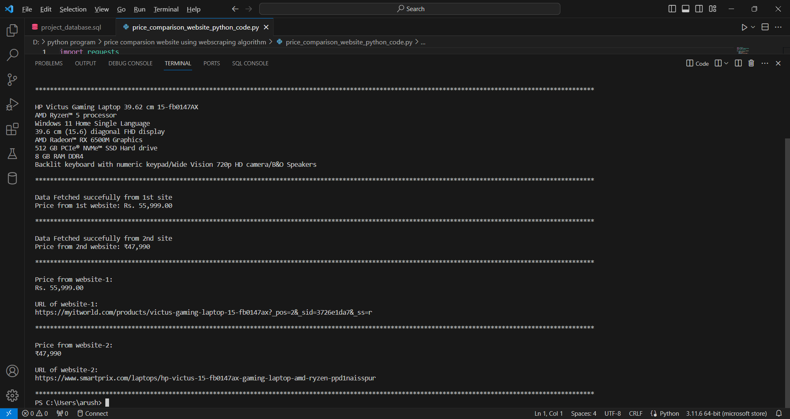
Results- Screen Shots of Output

Slide 15
Thanks

