Slide 1

Secure Chat Room Server
SRM INSTITUTE OF SCIENCE AND TECHNOLOGY
COLLEGE OF ENGINEERING AND TECHNOLOGY
DEPARTMENT OF NETWORKING AND COMMUNICATIONS
21CSC203P – ADVANCED PROGRAMMING PRACTICE
Mini-Project Presentation
Sanyog Dani (RA2211031010087)
Arush Sirotiya (RA2211031010092)
V1 Section
Under the guidance of
Dr. M Manickam
Assistant Professor , Department of Networking and Communications

Slide 2
Table of contents
Objective
Problem Statement
Architecture/ Flow chart
Hardware/Software requirements
Implementation- Code snippet
Results- Screen Shots of Output
Conclusion

Slide 3
Objective
Main Goal and Objective of this Mini Project is :-
The software offers an intuitive Graphical User Interface (GUI), making it accessible to users with minimal system operation knowledge. It is designed for cross-platform compatibility, functioning seamlessly on various operating systems, thus ensuring its usability on any system, regardless of the underlying OS. Remarkably, the messenger supports an unlimited number of concurrent users without compromising the server's performance. The primary objective of this project is to develop an instant messaging solution that facilitates seamless communication between users. Notably, the project places a strong emphasis on user-friendliness, ensuring that even those with limited technical experience can easily use the application.

Slide 4
Problem Statement
This endeavor aims to construct a chat application encompassing a server and user interfaces, facilitating interactive conversations among its users. The central objective is the development of a real-time messaging solution, designed to foster seamless communication between users, bridging gaps and enhancing collaboration. A primary focus lies in ensuring the project's accessibility, making it user-friendly to the extent that even those with minimal technical experience can navigate and employ it effortlessly. Importantly, this undertaking holds the potential to serve as a valuable asset within organizational settings, offering a means for employees to connect via Local Area Network (LAN), thus promoting efficient communication and teamwork.

Slide 5
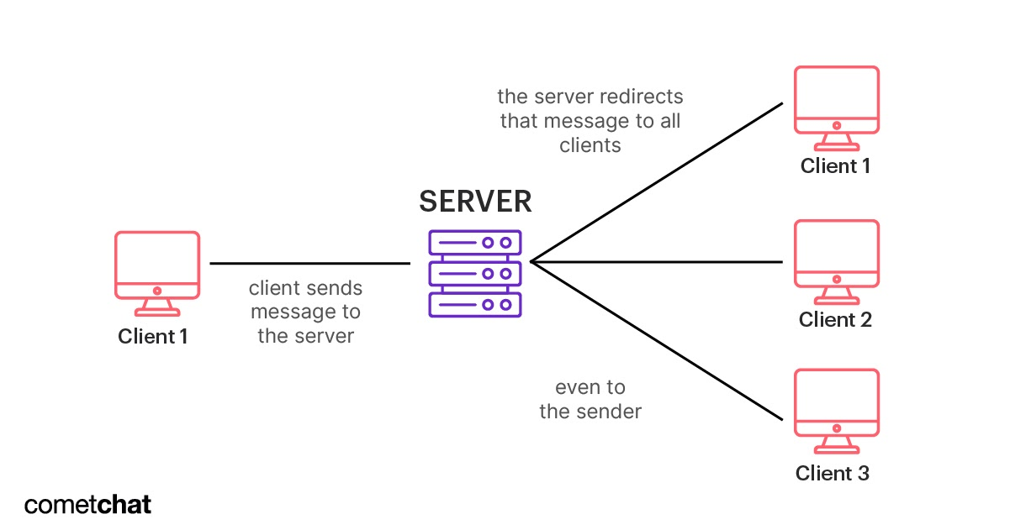
Architecture/ Flow chart

Slide 6
Hardware/Software requirements
Hardware
To support your chat application, a server with a minimum of 256 megabytes of RAM and 300 megabytes of disk storage is essential. Additionally, for managing chat messages and user data, you'll require a dedicated database server equipped with ample disk space. Ensuring a robust network connection is vital to enable users to seamlessly connect to your chat application. A high-speed network connection is indispensable for maintaining smooth and uninterrupted communication among users.
Software
We will require a programming language, options include Python, Java, JavaScript, or Go. This language will serve as the foundation for your chat application's core functionality.If you're developing a web-based chat application, you may consider using a web framework for enhanced efficiency. Choices include Django, Flask, or Express.js, which can streamline web application development and user interactions. To manage data effectively, you'll need a database system. Options include PostgreSQL, MySQL, or MongoDB, each offering unique features for storing and retrieving chat messages and user information.In terms of real-time communication, a messaging protocol is a key component. WebSocket, XMPP, or MQTT can facilitate instant message delivery and user interactions within your chat application. On the server side, a robust operating system is pivotal. Opt for a server-grade operating system, like Linux or macOS, to provide a stable environment for hosting your chat application and its associated services.

Slide 7
Implementation- Code snippet
Algorithm :
Server:
Create a TCP socket and bind it to a specific port.
Listen for incoming connections from clients.
When a client connects, accept the connection and create a new thread for handling communication with that client.
In each client thread, receive messages from the client and broadcast them to all other connected clients.
When a client disconnects, remove it from the list of connected clients and close the thread associated with that client.
Client:
Create a TCP socket and connect to the server on the specified port.
Send a message to the server with the username of the client.
Enter a loop where the client receives messages from the server and displays them to the user.
When the user enters a message, send the message to the server.

Slide 8
Conclusion
Our exploration delved into the inner workings of server-client interactions in Java. We gained insights into crafting graphical user interfaces (GUI) through Java Swing, enhancing our proficiency in the language. This project served as a valuable educational experience, deepening our understanding of Java, Java Swing, as well as the dynamics of server-client communication in a comprehensible manner. Ultimately, our efforts culminated in the development of a fully operational and secure chat room server, offering users the capability to engage in private and confidential conversations.

Slide 9
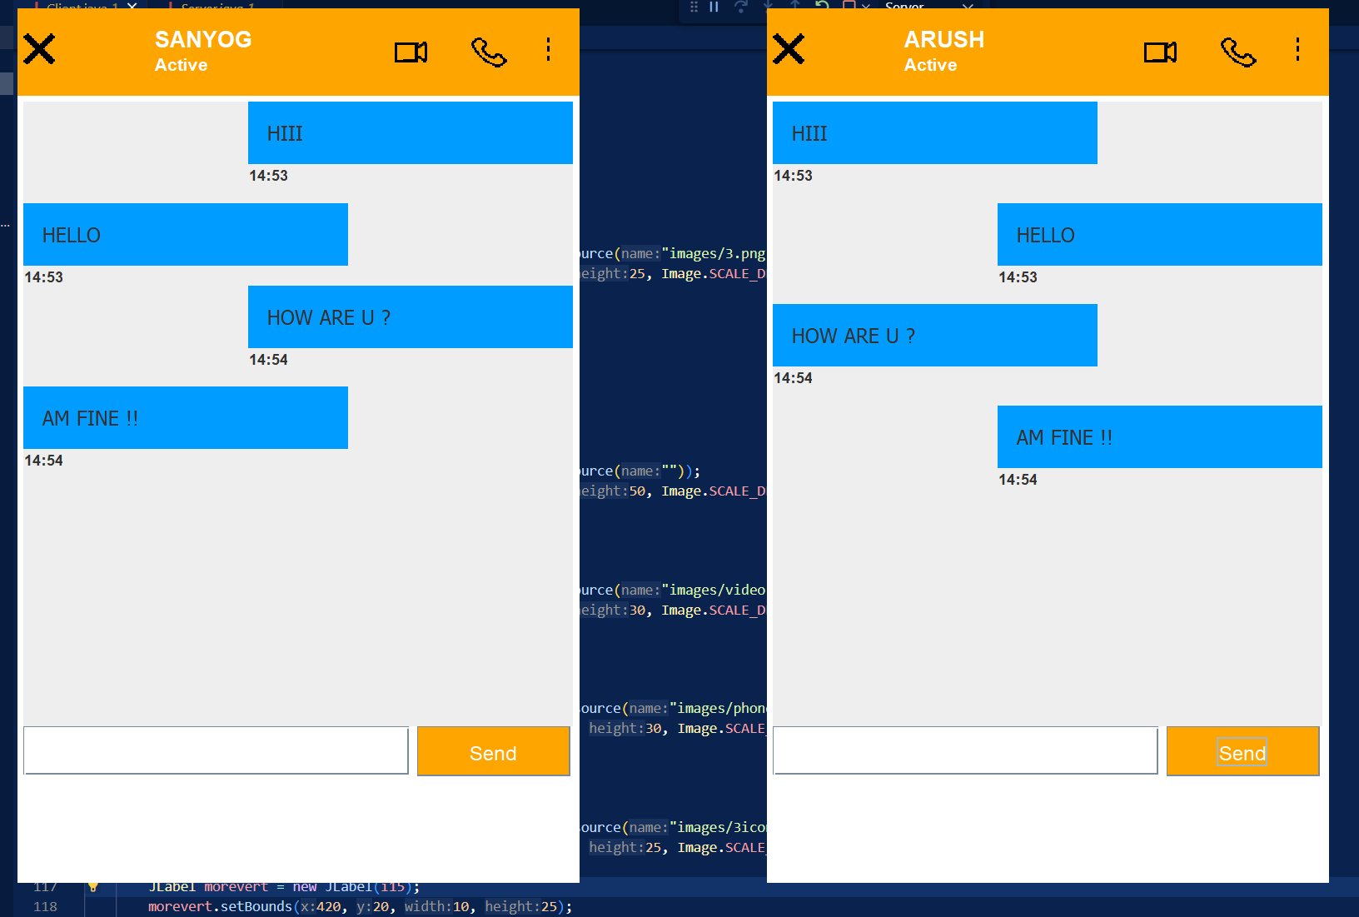
Results- Screen Shots of Output

Slide 10
Thanks

