Slide 1
Shanthosh Kumar E
Final Project
3/21/2024 Annual Review

Slide 2
Poetry Generator using LSTM
3/21/2024 Annual Review

Slide 3


AGENDA
This project revolutionizes poetry creation by leveraging advanced machine learning techniques to generate original and engaging verses.
Empowering Creativity: By providing users with a tool that streamlines the poetry writing process, we aim to empower individuals to express their creativity effortlessly.
Unlocking Poetic Potential: Our Poetry Generator offers a platform for poets of all skill levels to unlock their poetic potential and explore the art of verse creation in new ways.
3/21/2024 Annual Review

Slide 4

PROBLEM STATEMENT Traditional methods of writing poetry often rely solely on the poet's creativity and inspiration, which can pose challenges for individuals new to poetry or facing writer's block. This reliance on subjective creativity can be limiting, leading to difficulties in generating original and engaging verses. Our goal is to overcome these limitations by providing a solution that empowers users to effortlessly create poetry using advanced machine learning techniques. By leveraging LSTM networks and Markov Chains, we aim to streamline the poetry writing process, enabling users to generate coherent and stylistically consistent verses with ease.
3/21/2024 Annual Review

Slide 5

PROJECT OVERVIEW
The Poetry Generator Solution: Our solution utilizes LSTM networks and Markov Chains to generate poetry inspired by input poems while maintaining style and thematic elements.
Streamlining Poetry Writing: By automating parts of the poetry writing process, our Poetry Generator streamlines the creation of original and engaging verses.
Customization Options: We offer users customizable options to tailor the output according to their preferences, including parameters such as syllable count and rhyme scheme.
Versatility and Adaptability: The Poetry Generator is designed to be versatile and adaptable, catering to various creative needs and artistic endeavors across different genres and poetic forms.
3/21/2024 Annual Review

Slide 6

WHO ARE THE END USERS?
Poets: Experienced poets looking for inspiration or seeking to explore new poetic styles and themes.
Writers: Writers interested in experimenting with poetry as a creative outlet or supplementing their prose writing with poetic elements.
Musicians: Musicians seeking lyrical inspiration or looking to incorporate poetry into their songwriting process.
Enthusiasts: Poetry enthusiasts interested in exploring the art of poetry writing and creating original verses for personal enjoyment or artistic expression.
3/21/2024 Annual Review

Slide 7

YOUR SOLUTION AND ITS VALUE PROPOSITION
Seamless Poetry Generation: Our solution offers a seamless platform for generating poetry, empowering users to effortlessly create original and engaging verses.
Leveraging Advanced Machine Learning: By leveraging advanced machine learning techniques such as LSTM networks and Markov Chains, we provide users with a powerful tool for poetry creation.
Maintaining Style and Consistency: The Poetry Generator maintains the style and thematic elements of the source material, ensuring stylistic consistency in the generated poetry.
Customization and Control: We provide users with customizable options to tailor the output according to their preferences, giving them control over the creative process.
3/21/2024 Annual Review

Slide 8

THE WOW IN YOUR SOLUTION
Generating Verses with Rhyming Patterns: Our Poetry Generator is capable of generating verses with rhyming patterns reminiscent of hip-hop lyrics, adding charm and flair to the generated poetry.
Prioritizing Rhyme Scheme: While maintaining creativity, our Poetry Generator prioritizes rhyme scheme, resulting in engaging and stylistically consistent compositions.
Versatility Across Genres: Our solution is versatile and adaptable, catering to various artistic endeavors and genres, spanning different poetic forms and themes.
Adding Charm and Versatility: By focusing on rhyme scheme and stylistic coherence, our Poetry Generator adds charm and versatility to the generated poetry, making it suitable for a wide range of artistic expressions.
3/21/2024 Annual Review

Slide 9
MODELLING
Implementation of LSTM Networks: Our Poetry Generator implements LSTM networks to model the sequential nature of poetry and capture long-term dependencies in text data.
Utilizing Markov Chains: In addition to LSTM networks, we utilize Markov Chains to generate new sentences based on word-to-word probabilities, ensuring coherence and flow in the generated poetry.
Predicting Properties of the Next Line: LSTM networks predict properties of the next line, such as syllable count and rhyme scheme, adding depth and context to the generated verses.
3/21/2024 Annual Review

Slide 10
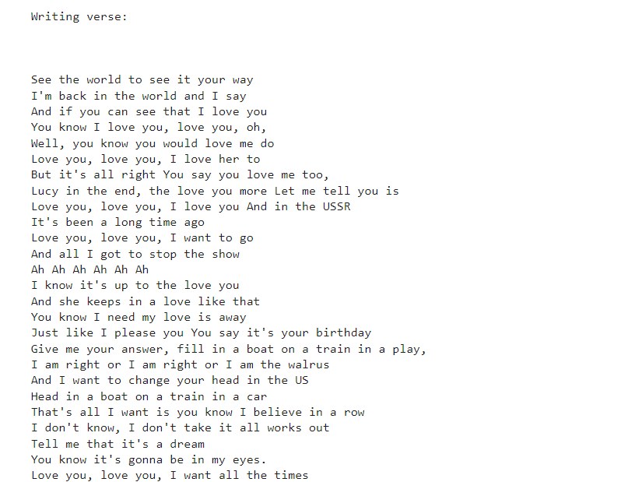
RESULTS
Demo Link
3/21/2024 Annual Review

