Slide 1
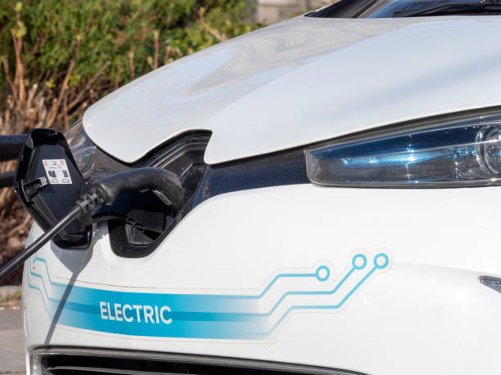
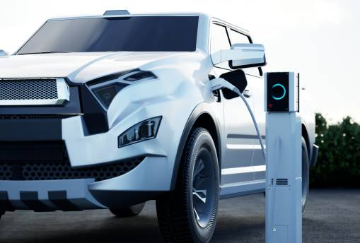
EV Population in WA
Data Analysis
An Overview of Growth and Infrastructure
Electric Vehicles in Washington State
(1990-2025)

Slide 2

Objectives
Analyze EV Growth & Infrastructure – Examine the rise in EV adoption,
regional distribution, and expansion of
charging stations in Washington State.
Assess Policies & Impact – Evaluate government incentives, environmental benefits, and economic effects of EV adoption.
Address Challenges & Future Trends – Identify barriers like infrastructure gaps and predict advancements shaping Washington’s EV future.

Slide 3

Methodology
Data Collection
Analyze EV registration trends from WSDOT, DOL, and energy reports.
Infrastructure & Policy Review
Assess charging station growth and government incentives.
Comparative Analysis
Compare Washington’s EV adoption with national trends.

Slide 4
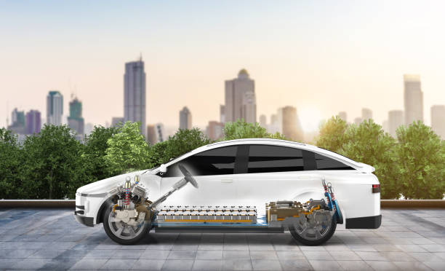
Introduction
Washington State is a leader in EV adoption, driven by strong policies, expanding charging infrastructure, and a push for sustainability. With rising EV registrations and government support, this study explores growth trends, infrastructure, challenges, and future prospects.

Slide 5
Data Exploration and Insights
Data Collection
Visualization Trends
Comparative Analysis
Data Cleaning
Key Insight
Gather EV registration and charging station data from official sources.
Remove inconsistencies and standardize regional identifiers.
Analyze EV adoption, regional spread, etc using visual data.
Compare adoption rates with national trends and policy impact.
Identify growth areas, infrastructure gaps, and future opportunities.

Slide 6
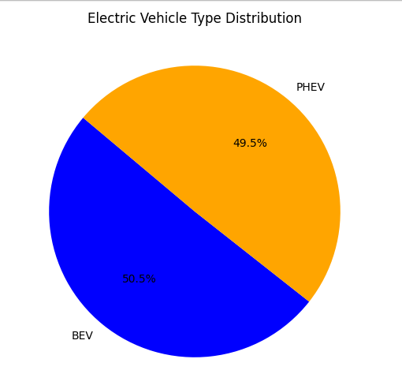
Visualizations
Electric Vehicle Type Distribution
BEVs (Battery Electric Vehicles) ⚡ – Fully electric, zero emissions.
PHEVs (Plug-in Hybrid Electric Vehicles) 🔌⛽ – Use both electricity and fuel.

Slide 7
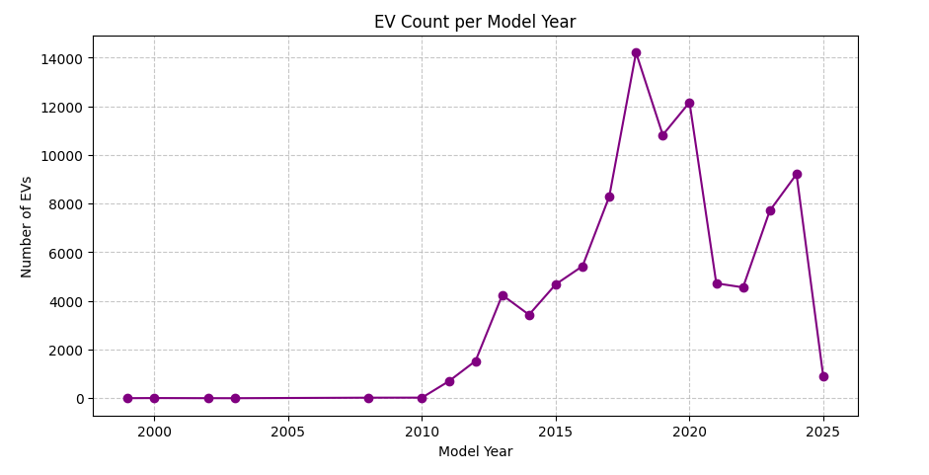
Visualizations
Electric Vehicle Count
Per Model Year
A line chart of EV count per model year visualizes adoption trends over time, highlighting peak registration years, market shifts, and the impact of policies or incentives. It helps identify growth patterns and predict future EV adoption.

Slide 8
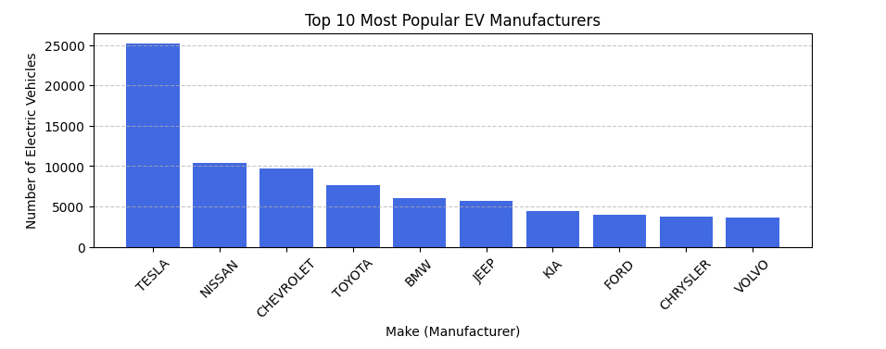
Visualizations
Top 10 Electric Vehicle Manufacturers

Slide 9
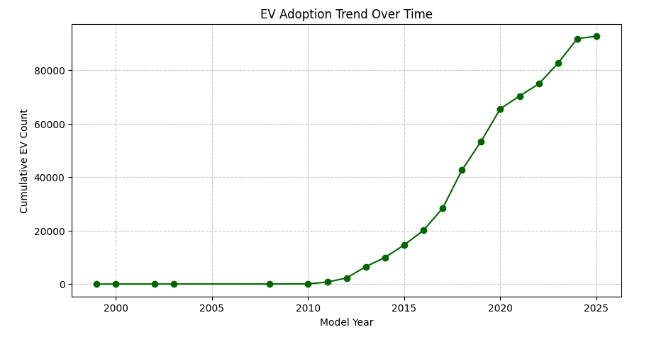
Visualizations
Electric Vehicle Adoption Trend Over Year

Slide 10
Conclusion
The growth of Electric Vehicles (EVs) in Washington State reflects a strong shift toward sustainable transportation. Rising EV adoption is driven by government incentives, expanding charging infrastructure, and increasing environmental awareness.
However, challenges like charging accessibility, affordability, and regional adoption gaps remain. Continued investment in fast-charging networks, policy support, and technological advancements will be crucial for future growth.
Washington’s commitment to clean energy positions it as a leader in EV adoption, setting an example for other states in the transition to a greener future. 🚗⚡

Slide 11
Thank You For Being
A Wonderful Audience

