Slide 1
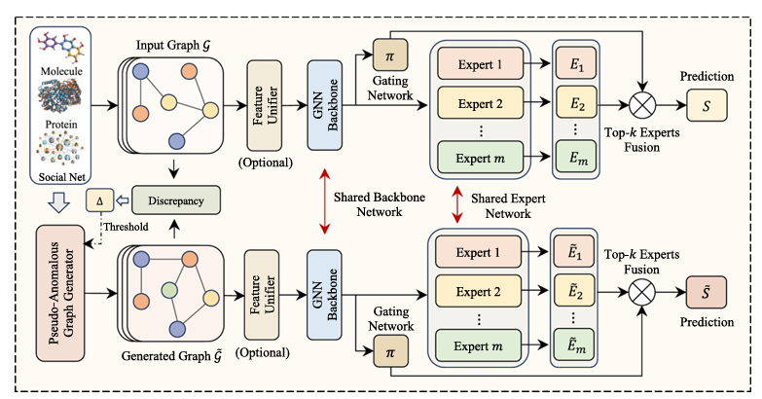
Title: MoEGAD:A Mixture-of-Experts Framework With Pseudo-Anomaly Generation for Graph-Level Anomaly Detection

