Slide 1
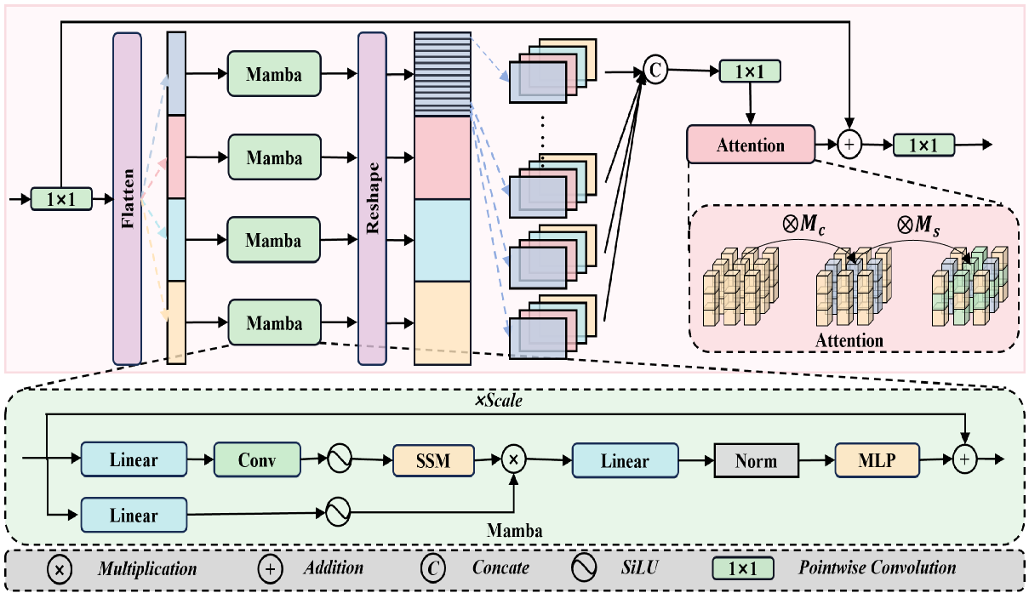
C
C
1×1
Title: SAMamba: Adaptive State Space Modeling with Hierarchical Vision for Infrared Small Target Detection

