Slide 1
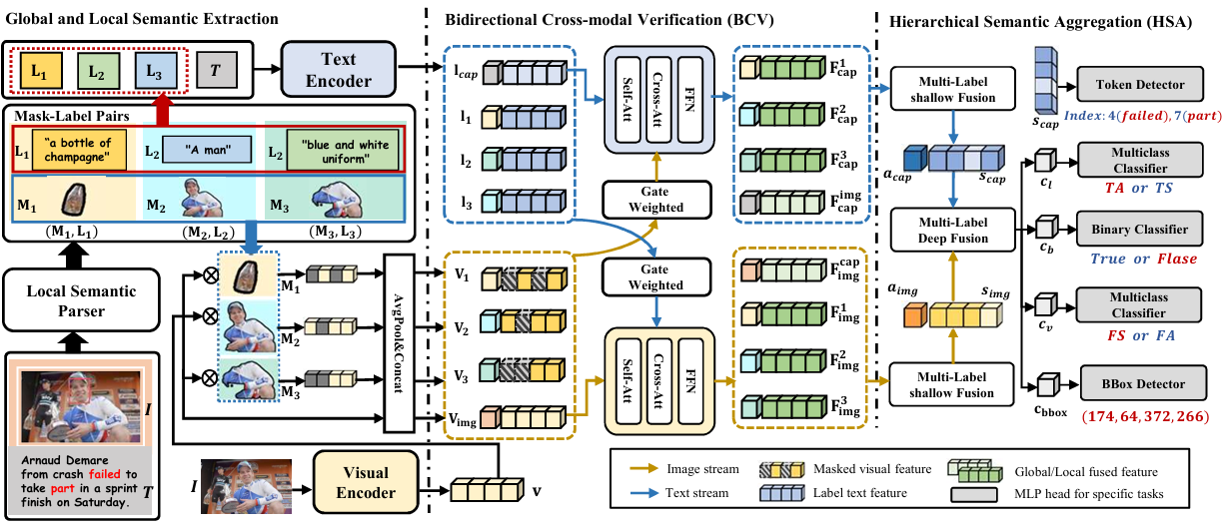
Title：Bridging Pixelsand Words: MaskAware LocalSemantic Fusionfor Multimodal MediaVerification

