Slide 1
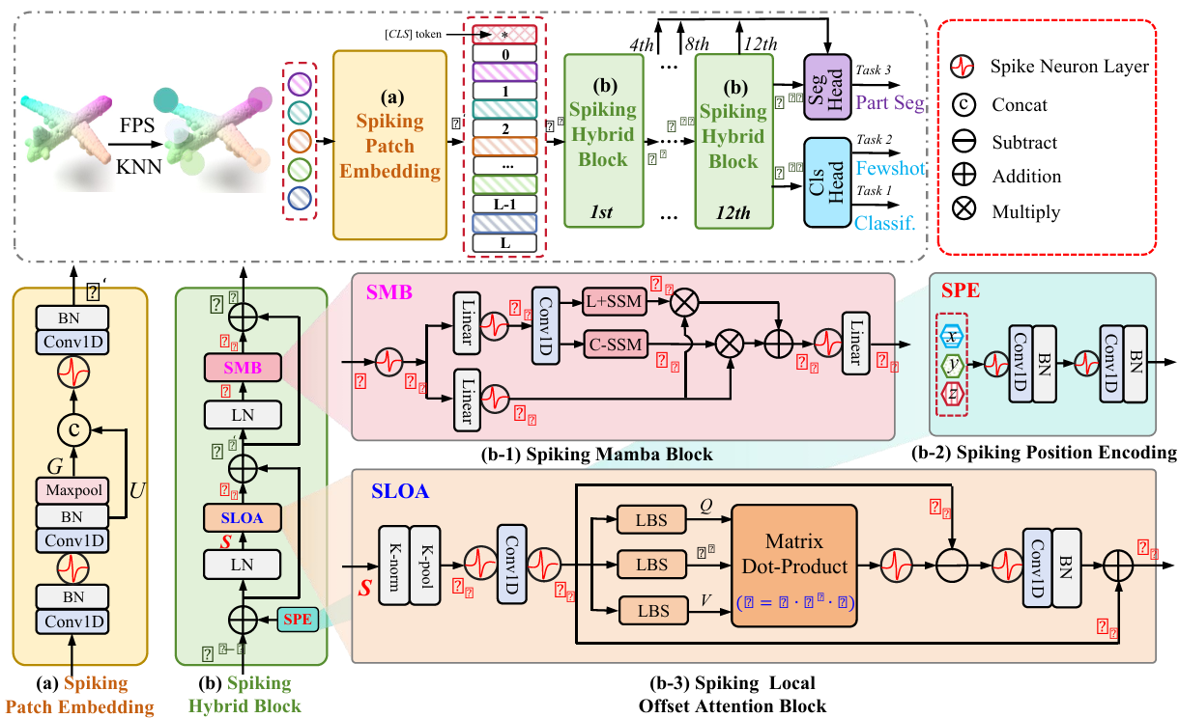
C
C
Title:3DSMT: AHYBRIDSPIKING MAMBA-TRANSFORMER FOR POINT CLOUD ANALYSIS

